Slide 1
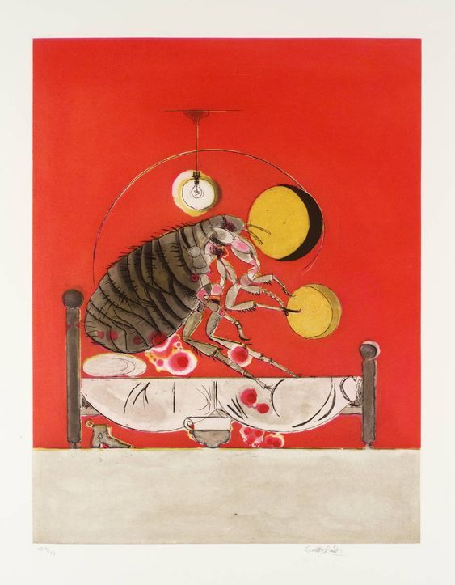
Brief bestiaries: Animal encounters in the modernist short story Seminario di anglistica e americanistica Dissl
PAOLO BUGLIANI
paolo.bugliani@unipd.it

Slide 2
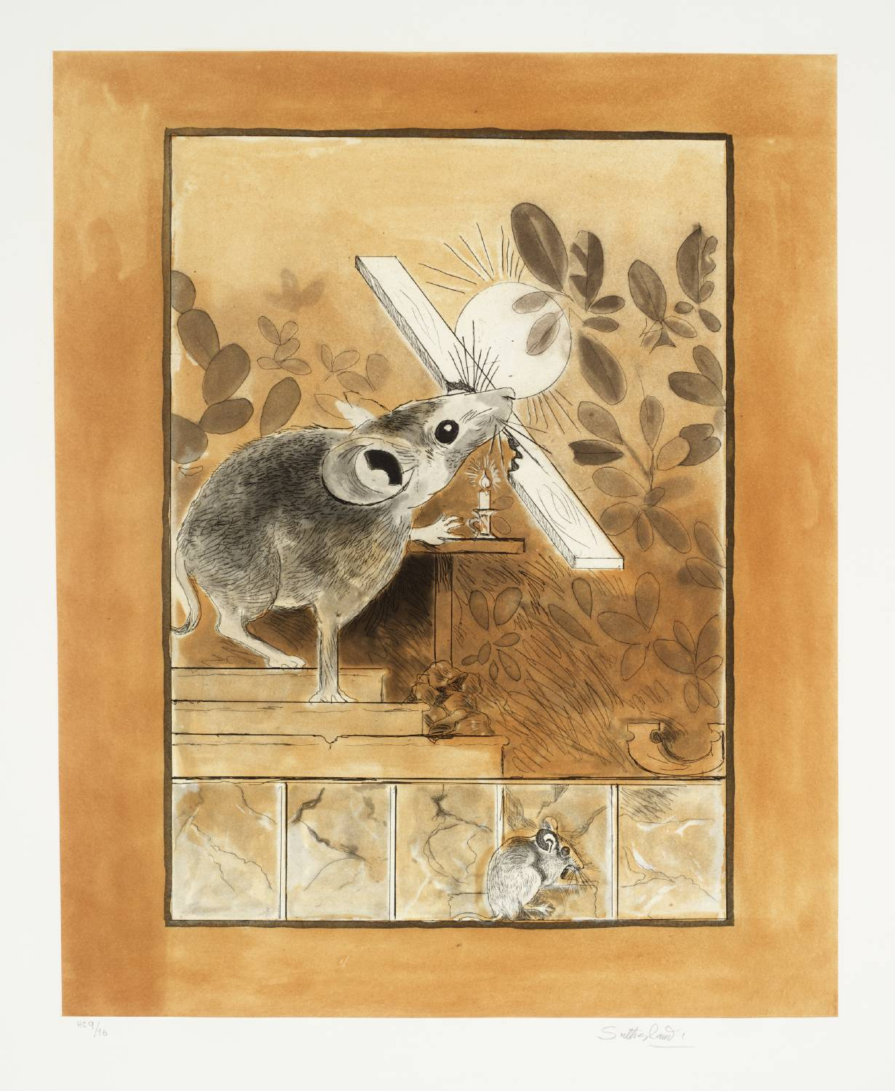
MINOR DWELLINGS: modern short stories
In discussions of the modern novel we have come to talk of it as the novel without a hero. In fact, the short story has never had a hero. What it has instead is a submerged population group—a bad phrase which I have had to use for want of a better. That submerged population changes its character from writer to writer, from generation to generation. It may be Gogol’s officials, Turgenev’s serfs, Maupassant’s prostitutes, Chekhov’s doctors and teachers, Sherwood Anderson’s provincials, always dreaming of escape.
[…] Always in the short story there is this sense of outlawed figures wandering about the fringes of society, superimposed sometimes on symbolic figures whom they caricature and echo—Christ, Socrates, Moses.
frank o’connor The Lonely Voice [1963]

Slide 3
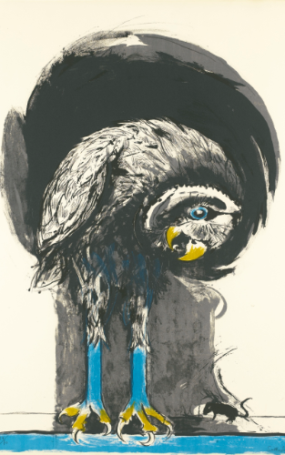
MINOR DWELLINGS: modern short stories
Animality is thus a critical ‘unknown’ in many registers. It presents, I think, a unique theoretical and ethical challenge to literary critics and to students of literature and culture. Animality should be understood as a privileged site of alterity that probes the postmodern relation to otherness beyond the easy boundaries of human fraternity. Its foreignness to the canonical treatment of humanism is […] maintained through disavowal. Humanity’s identity formation through difference from the animal, predicated as it often is upon a humanist relation to language, is arguably the most intractable of humanist dogmas. […] Indeed, the structuring of humanist identity through the abjection of animality continues to elicit defensive and reactionary dismissals of the species problem for critical theory. What this threat reveals, of course, is the deeply unquestioned marginalization of the animal in Western philosophy.
carrie rohman, Stalking the Subject: Modernism and the Animal (2008) 20

Slide 4
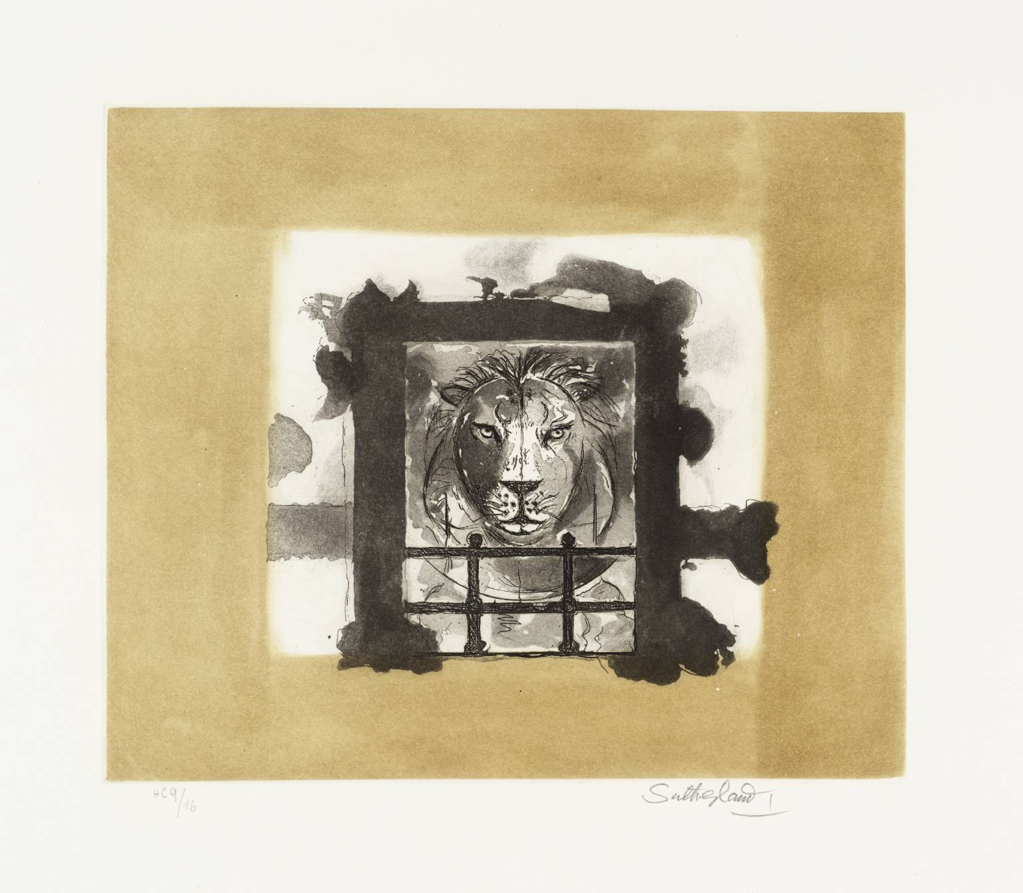
MINOR DWELLINGS: modern short stories
To become animal is to participate in movement, to stake out the path of escape in all its positivity, to cross a thresh- old, to reach a continuum of intensities that are valuable only in themselves, to find a world of pure intensities where all forms come undone, as do all the significations, signifiers, and signifieds, to the benefit of an unformed matter of de- territorialized flux, of nonsignifying signs.
G. Deleuze – F. Guattari, Kafka: Toward a Minor Literature ed. by R. Bensmaïa (1996): 13

Slide 5
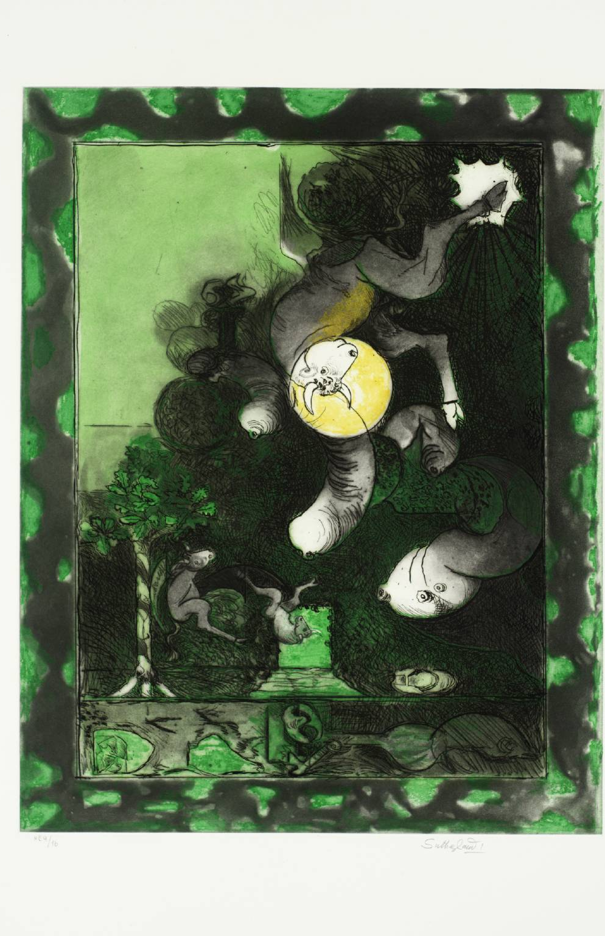
A MATTER OF THE AGE: modern animals
I took the English book out of my pocket, laid it on the counterpane in front of Kafka, and told him about my latest conversation with Bachrach. When I said that Garnett’s book [Lady Into Fox] imitated the method of The Metamorphosis, he gave a tired smile, and with a faint dissenting movement of his head said: ‘But no! He didn’t get that from me. It’s a matter of the age. We both copied from that. Animals are closer to us than human beings. That’s where our prison bars lie. We find relations with animals easier than with men
Gustav Janouch, Conversations with Franz Kafka, trans. by G. Rees (2012): 21-22 .

Slide 6
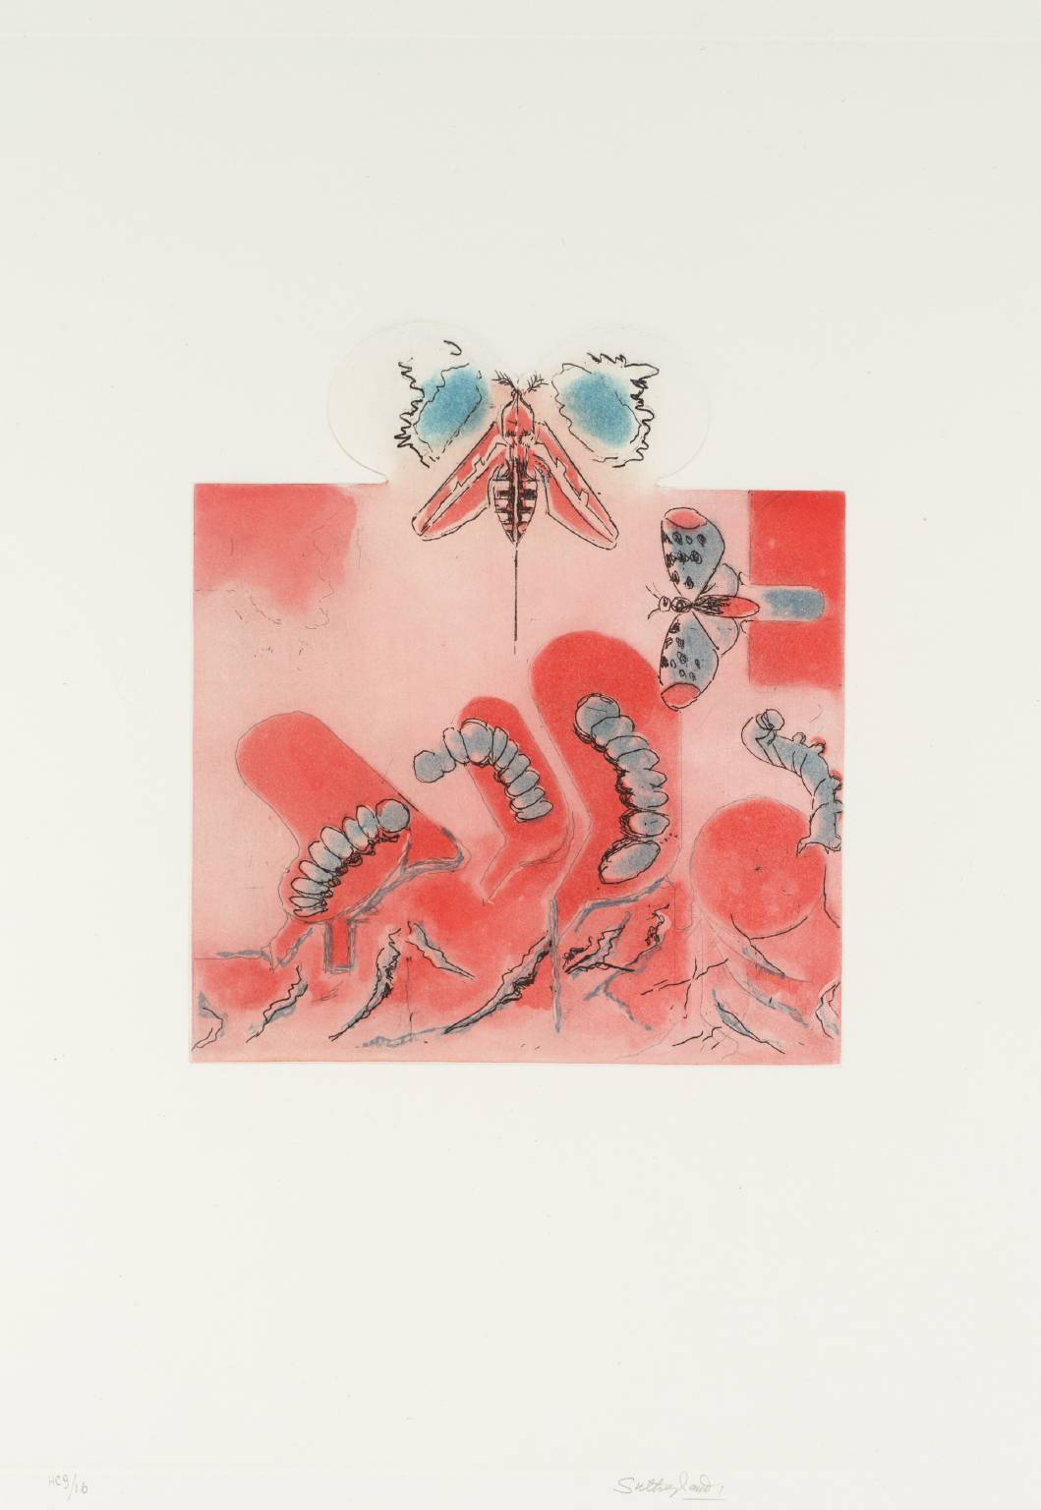
A MATTER OF THE AGE: modern animals
Modernist writers like Kafka and Garnett often draw attention to this paradoxical process of writing and reading about animals by attending to the tensions between literal and figurative language in order to unsettle the binary designation of the human creatures who write (as subjects who matter) and those animal creatures who are merely written about (as objects to explore human matters).
Derek Ryan, “Literature”, in The Edinburgh Companion to Animal Studies, ed. by L. Turner, U. Sellbach, R. Broglio (2018): Kindle edition

Slide 7
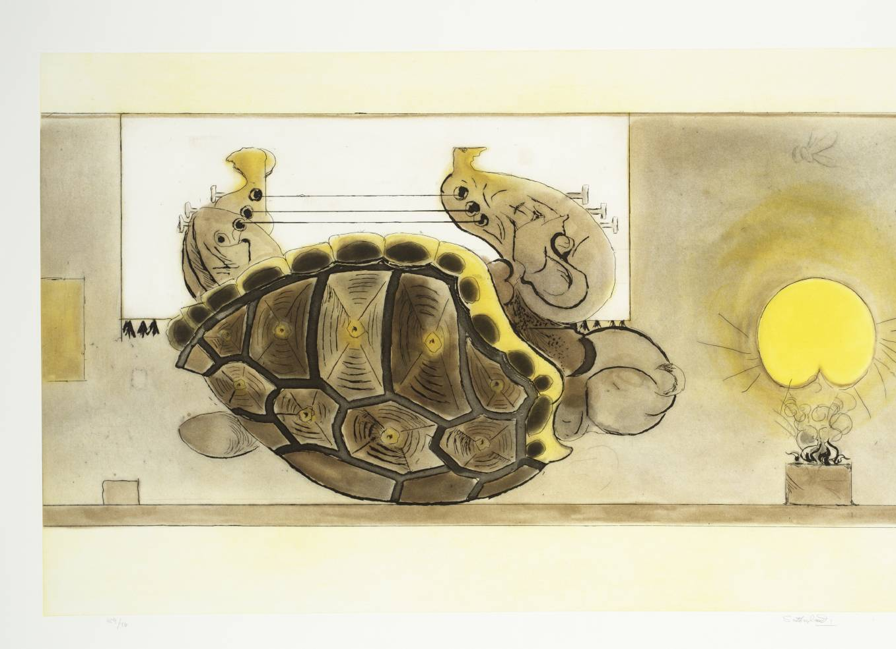
A MATTER OF THE AGE: modern animals
[animals are] figural and cultural representation which provoke powerful questions about how humans imagine themselves with and over against other animals and they are also literary entities who cannot be explained fully with traditional literary critical methods, creatures for whom literary imaginings have consequences, and who have lives that are deeply imbricated with those of humans
Catherine Parry Other Animals in Twenty-First-Century Fiction (2017): 2.

Slide 8
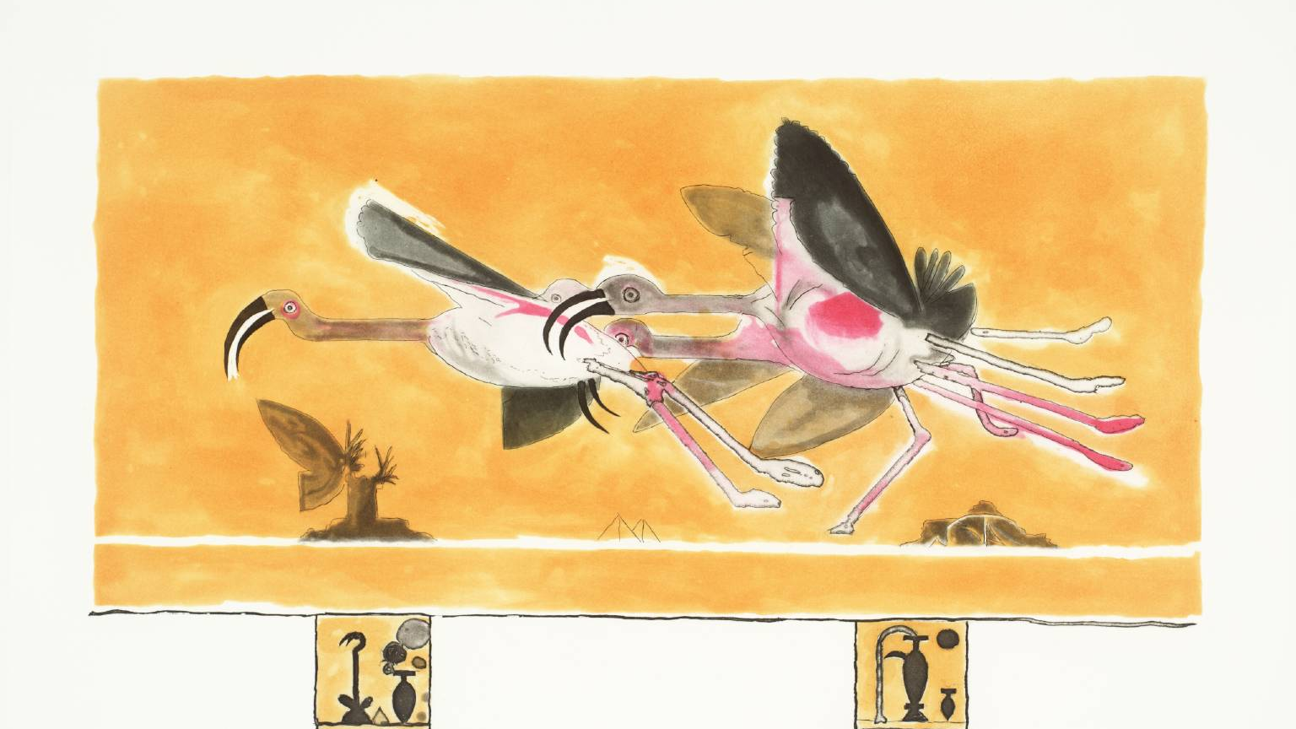
“a cage went in search of a bird”: Katherine Mansfield

Slide 9
a gradual absorption
I am becoming absorbed in animals, not to watch only but to know how to care for them & to know about them. Why does one live so far away from these things?
To Murry 19.11.1922
When I write about ducks I swear that I am a white duck with a round eye, floating in a pond fringed with yellow blobs and taking an occasional dart at the other duck with the round eye […] in fact the whole process of becoming the duck … is so thrilling that I can hardly breathe, only to think about it. For although that is as far as most people can get, it is really only the ‘prelude’. There follows moments when you are more duck, more apple or more Natasha than any of these objects could ever possibly be, and so you create them anew
To Dorothy Brett 11.10.1917

Slide 10
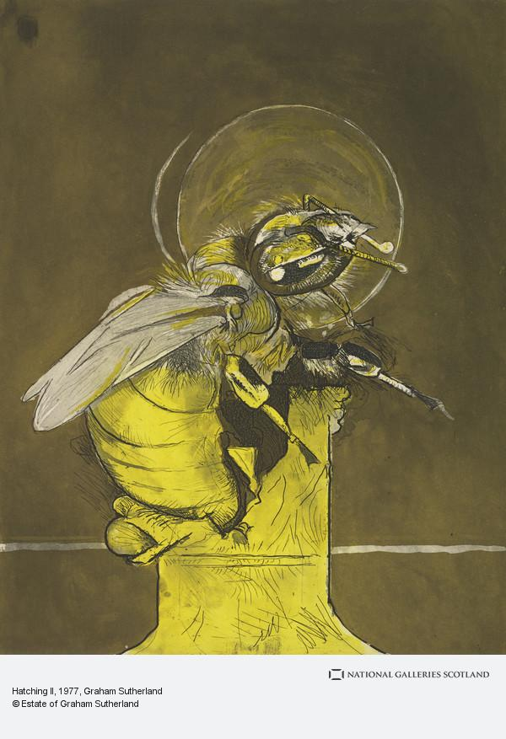
“The Fly” [1922]
But just then the boss had an idea. He plunged his pen back into the ink, leaned his thick wrist on the blotting-paper, and as the fly tried its wings down came a great heavy blot. What would it make of that! What indeed! The little beggar seemed absolutely cowed, stunned, and afraid to move because of what would happen next. […]
What about it this time? A painful moment of suspense followed. But behold, the front legs were again waving; the boss felt a rush of relief. He leaned over the fly and said to it tenderly, ‘You artful little b...’ And he actually had the brilliant notion of breathing on it to help the drying process. All the same, there was something timid and weak about its efforts now, and the boss decided that this time should be the last, as he dipped the pen deep into the inkpot.
It was. The last blot fell on the soaked blotting-paper, and the draggled fly lay in it and did not stir. The back legs were stuck to the body; the front legs were not to be seen.
‘Come on,’ said the boss. ‘Look sharp!’ And he stirred it with his pen in vain. Nothing happened or was likely to happen. The fly was dead.

Slide 11
“The Fly” [1922]
The boss lifted the corpse on the end of the paper-knife and flung it into the waste-paper basket. But such a grinding feeling of wretchedness seized him that he felt positively frightened. He started forward and pressed the bell for Macey.
‘Bring me some fresh blotting-paper,’ he said sternly, ‘and look sharp about it.’ And while the old dog padded away he fell to wondering what it was he had been thinking about before. What was it? It was... He took out his handkerchief and passed it inside his collar. For the life of him he could not remember.

Slide 12
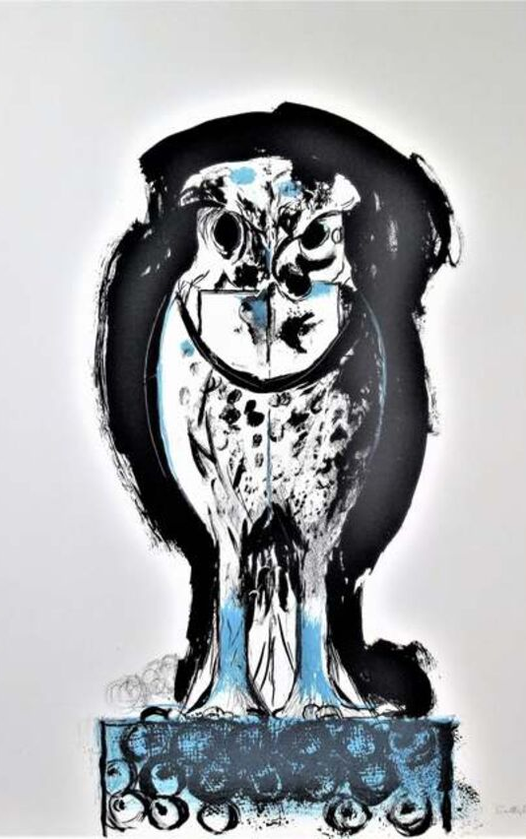
“The Canary” [1922]
Perhaps it does not matter so very much what it is one loves in this world. But love something one must. Of course there was always my little house and the garden, but for some reason they were never enough. Flowers respond wonderfully, but they don’t sympathize. Then I loved the evening star. Does that sound foolish?
My heart felt hollow, as if it was his cage. I shall get over it. Of course. I must. One can get over anything in time. And people always say I have a cheerful disposition. They are quite right. I thank my God I have.
All the same, without being morbid, and giving way to – memories and so on, I must confess that there does seem to me something sad in life. It is hard to say what it is. I don’t mean the sorrow that we all know, like illness and poverty and death. No, it is something different. It is there, deep down, deep down, part of one, like one’s breathing. However hard I work and tire myself I have only to stop to know it is there, waiting. I often wonder if everybody feels the same. One can never know. But isn’t it extraordinary that under his sweet, joyful little singing it was just this—sadness—ah, what is it?—that I heard

Slide 13
“The Canary” [1922]
… You cannot imagine how wonderfully he sang. It was not like the singing of other canaries. And this isn’t just my fancy […] I suppose it sounds absurd to you – it wouldn’t if you had heard him – but it really seemed to me that he sang whole songs with a beginning and an end to them.
I remember one night. I had had a very awful dream – dreams can be dreadfully cruel – even after I had woken up I could not get over it. […] I suppose I was still half asleep, but through the kitchen window, […] it seemed to me the dark was staring in, spying. And suddenly I felt it was unbearable that I had no one to whom I could say “I’ve had such a dreadful dream,” or – or “Hide me from the dark.” I even covered my face for a minute. And then there came a little “Sweet, Sweet!” […] ”Sweet sweet!” said the darling little fellow again, softly, as much to say, “I’m here Missus! I’m here!” That was so beautifully comforting that I nearly cried.

Slide 14
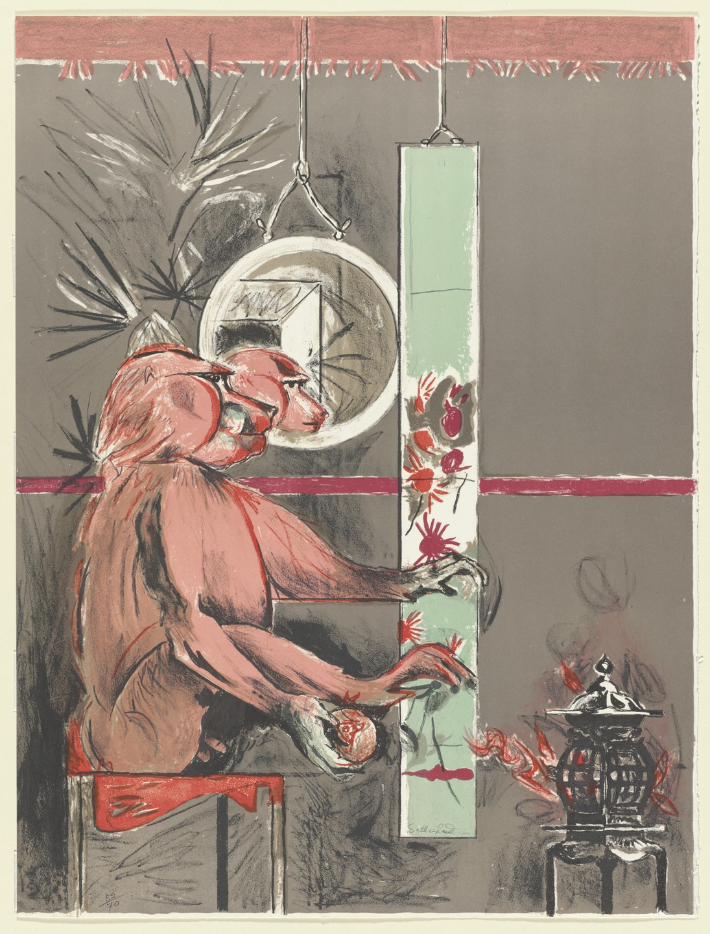
“I write stories as birds sing”: virginia woolf

Slide 15
becoming animal
[She was] fascinated by all animals but her affection was odd and remote. She wanted to know what her dog was feeling … and perhaps the dogs were no more inscrutable than most humans. Flush is not so much a book by a dog lover as a book by someone who would love to be a dog.
Quentin Bell, Virginia Woolf: A Biography (1972)
She was growing old now and so was Flush. She bent down over him for a moment. Her face with its wide mouth and its great eyes and its heavy curls was still oddly like his. Broken asunder, yet made in the same mould, each, perhaps, completed what was dormant in the other. But she was woman; he was dog. Mrs. Browning went on reading. Then she looked at Flush again. But he did not look at her. An extraordinary change had come over him. “Flush!” she cried. But he was silent. He had been alive; he was now dead. That was all. The drawing-room table, strangely enough, stood perfectly still.
Virginia Woolf, Flush: A Biography (1933)

Slide 16
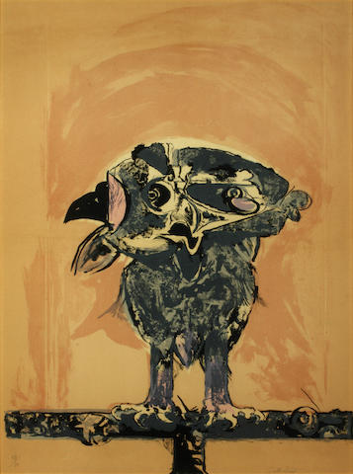
“the widow and the parrot” [1924]
Some fifty years ago Mrs Gage, an elderly widow, was sitting in her cottage in a village called Spilsby in Yorkshire. Although lame, and rather short sighted she was doing her best to mend a pair of clogs, for she had only a few shillings a week to live on. […]
The most important of these [preparations] was the care of her dog Shag during her absence, for in spite of her poverty she was devoted to animals, and often went short herself ﻿rather than stint her dog of his bone.
He [Mrs Gage’s brother] was always a cruel little boy when we were children,’ she went on. ‘He liked worrying the poor insects, and I’ve known him trim a hairy caterpillar with a pair of scissors before my very eyes. He was such a miserly varmint too. He used to hide his pocket money in a tree, and if anyone gave him a piece of iced cake for tea, he cut the sugar off and kept it for his supper.
Has anybody saved the parrot?’ she cried. ‘Be thankful you’re not inside yourself, Madam,’ said the Rev James Hawkesford, the clergyman. ‘Do not worry for the dumb creatures. I make no doubt the parrot was mercifully suffocated on his perch.’ But Mrs Gage was determined to see for herself.

Slide 17
“the widow and the parrot” [1924]
It now only remains to be said that Mrs Gage got back to Spilsby in safety; took her black box to the Bank; and lived with James the parrot and her dog Shag in great comfort and happiness to a very great age. It was not till she lay on her death bed that she told the clergyman (the son of the Rev Samuel Tallboys) the whole story, adding that she was quite sure that the house had been burnt on purpose by the parrot James, who, being aware of her danger on the river bank, flew into the scullery, and upset the oil stove which was keeping some scraps warm for her dinner. By this act, he not only saved her from drowning, but brought to light the three thousand pounds, which could have been found in no other manner. Such, she said, is the reward of kindness to animals.

Slide 18
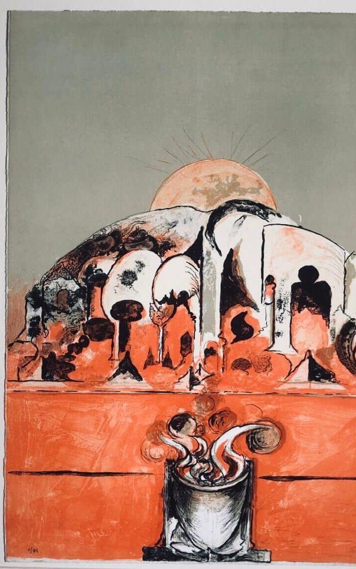
“nurse lugton’s curtain” [1924]
Nurse Lugton was asleep. She had given one great snore. She had dropped her head; thrust her spectacles up her forehead; and there she sat by the fender with her finger sticking up and a thimble on it; and her needle full of cotton hanging down; and she was snoring, snoring; and on her knees, covering the whole of her apron, was a large piece of figured blue stuff. The animals with which it was covered did not move till Nurse Lugton snored for the fifth time. One, two, three, four, five—ah, the old woman was at last asleep.
Even a little black beetle made her jump. But Nurse Lugton slept; Nurse Lugton saw nothing at all. The elephants drank; and the giraffes snipped off the leaves on the highest tulip trees; and the people who crossed the bridges threw bananas at them, and tossed pineapples up into the air, and beautiful golden rolls stuffed with quinces and rose leaves, for the monkeys loved them.

Slide 19
“nurse lugton’s curtain” [1924]
The old Queen came by in her palanquin; the general of the army passed; so did the Prime Minister; the Admiral, the Executioner; and great dignitaries on business in the town, which was a very beautiful place called Millamarchmantopolis. Nobody harmed the lovely beasts; many pitied them; for it was well known that even the smallest monkey was enchanted. For a great ogress had them in her toils, the people knew; and the great ogress was called Lugton. They could see her, from their windows, towering over them. She had a face like the side of a mountain with great precipices and avalanches, and chasms for her eyes and hair and nose and teeth. And every animal which strayed into her territories she froze alive, so that all day they stood stock still on her knee, but when she fell asleep, then they were released, and down they came in the evening to Millamarchmantopolis to drink.

