Slide 1
Project presentation: date to be decided (roughly end of January)

Slide 2
Get ready for tomorrow
delivery of assignment N°1( 2 slides with 1) group members, 2) topic and very broad research question

Slide 3
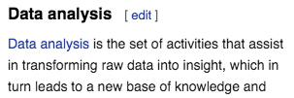
The process of a network project

Slide 4
Define Problem and Purpose
description of the problem at hand
contextualization: provide a background
an outline of your objectives and their implications

Slide 5
Contextualize Problem
Make a literature search
Identify relevant theories and evidence
->master the subject!!!
address alternative perspectives
make connections between different sources
offer new insights.
Specify
an outline of your main arguments/hypotheses

Slide 6
Theoretical grounding

Slide 7
Why this question?
Why this network?
Which previous evidence?
Which theoretical model?
Which hypotheses?

Slide 8
Provide an explicit statement of the questions and objectives being addressed with reference to their key elements (e.g., population or participants, concepts, and context) or other relevant key elements used to conceptualize the review questions and/or objectives.
What the literature is already showing?
Which methods were applied?
Which sample/data?
https://www.psychology.org/resources/online-research-guide/

Slide 9
How to do a literature search
Relevant MS
Plan your search for information by defining relevant keywords on your topic
Reliable MS
Identify the key information resources for your subject

Slide 10
Identifying the key ideas to research
What do I need to find out?
What are the key concepts or ideas in the assessment which I need to explore?
What search terms will be effective in helping me find what I need?
What types of information will I need to answer the question?

Slide 11
The literature searching cycle
Notes:
The cycle is not necessarily sequential: you will need to move back and forth between these steps as your search for information develops. However, it’s important to have a good plan in place at the beginning.

Slide 12
Search… what?
Keyword planning
It may be that you don’t come up with all the necessary keywords on your first plan, but remember that you can continue to add new words to your list as you read more about the topic.

Slide 13
Keywords tips
Think of as many synonyms as you can, i.e. words which have similar meanings, such as centrality, density, betwenness
If you are unsure of ideas for keywords, you could use a thesaurus or take a quick look at a resource like Wikipedia to get an overview of the topic
Consider whether your keywords might also have plural or alternative endings, e.g. city/cities, motivate/motivation
Consider alternative spellings, e.g. color/colour, aeroplane/airplane

Slide 14
Where to look for
Google Scholar
Psych Info
Web of Knowledge
PubMed
Etc…

Slide 15
You can use Google Scholar to search for:
books
journal articles
conference proceedings
other scholarly publications.

Slide 16
Evaluate
How to establish the credibility of the information you have found
Is there a publication date?
Is there any indication of when the information was last updated?
Does the date of publication actually reflect the date the information was produced?
Even if published very recently, has the information been superseded?
If published very recently, has it been properly peer-reviewed?

Slide 17
Evaluate
Intention
Viewpoint
Audience
Opinion
Language

Slide 18
Evaluate
Intention
Viewpoint
Audience
Opinion
Language
What is the intention? Everything is produced for a reason, be it to educate, to entertain or to make money. Understanding the motivation behind a piece of work can shed light on potential bias.

Slide 19
Evaluate
Intention
Viewpoint
Audience
Opinion
Language
What position does the author take? Reliable authors will generally make their point of view clear and seek to support it with valid evidence.

Slide 20
Evaluate
Who is the intended audience? Something designed to be read by the general public may differ greatly in detail from something aimed at academics or researchers.
Intention
Viewpoint
Audience
Opinion
Language

Slide 21
Evaluate
Intention
Viewpoint
Audience
Opinion
Language
Is opinion being presented as fact? Academic articles will often present unsubstantiated theories for debate, but this should be made clear.

Slide 22
Evaluate
Does the language seem appropriate?
Emotionally charged language is often used to persuade in the absence of evidence.
Language that is very vague can be used to gloss over flaws in an argument.
Intention
Viewpoint
Audience
Opinion
Language

Slide 23
Critical appraisal is "the process of assessing and interpreting evidence by systematically considering its validity, results, and relevance"
(Cochrane Community, 2018).

Slide 24
Evaluate content
read the MS more carefully to judge the quality of the arguments and evidence presented.
What is the main argument being presented?
What are the strengths and weaknesses of this argument? Consider whether the arguments are supported/warranted by credible evidence or are they just opinion?
Can you think what the counter arguments might be?

Slide 25
Manage content
How does the information relate to other sources on the same subject?
Which are the implications for your project?
Which questions is the literature rising?

Slide 26
Google Scholar
The easiest
Remember few tricks
Check the reliability of the journal (Impact factor of the journal-by RANK_ Webofscience/Scimago)
Check the success of the paper (n° of citations)

Slide 28
Get the reference for your reference list

Slide 29
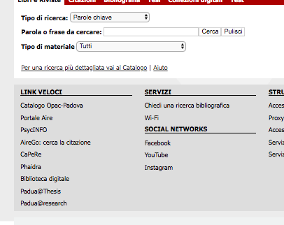
http://bibliotecapsicologia.cab.unipd.it/

Slide 30
Have a go:
Identify your question, look for relevant literature in google, select a good one, type your preliminary answer
www.wooclap.com/RPMHZB

Slide 31
Results too broad and general? | Too few results to support arguments for a paper?
Use more specific subject terms | Use broader subject terms
Search in narrow fields (e.g. Title, rather than searching anywhere) | Search in broad fields (keyword, abstract)
Use AND to combine different concepts | Use OR to combine alternative terms for a concept
Apply limits (e.g. publication date) | Use truncation (*) e.g. agricult* and wildcard (?) symbols e.g. wom?n
If possible, limit by material type, e.g. peer reviewed articles only | Check results for more alternative terms

Slide 32
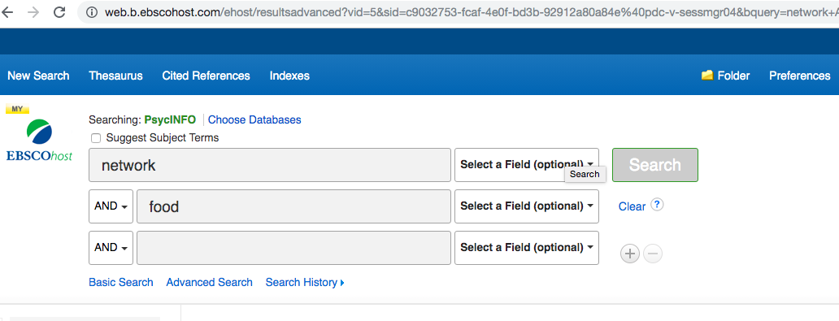
Psych Info

Slide 34
Web of Knowledge
https://apps.webofknowledge.com/

Slide 38
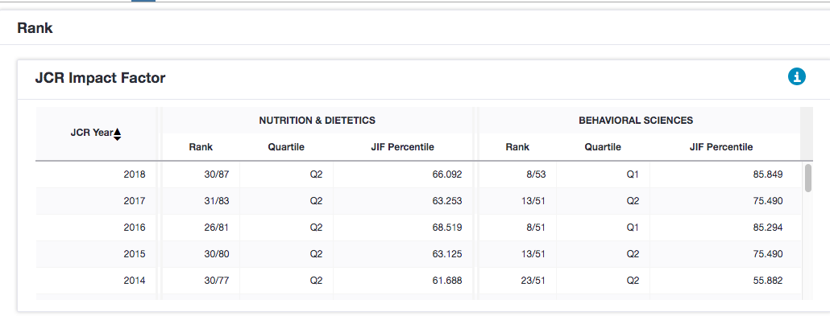

Slide 39
631242

Slide 40
Selecting the data
Definition of the social network
Definition of network boundaries
Selecting within the boundaries
Sampling within the boundaries
Pag 53-62
John Scott
Social Network Analysis
Sage Publications (see Moodle)

Slide 41
Definition of the network
Theoretical definition>operationalization
When we want to study a social network the first step is to define it.
NODES=???
LINKS=????

Slide 42
Definition of the network: e.g. networks of people
Maybe participanst are not aware of ties between their social supporters
Solution: objective measures (e.g., co-publications of supporters)
Class mates
Colleagues: belonging to same organization
Political affiliation: enroled in a party???
Collaborators: working to the same project? Co-authors?
Friends: how do you define friendship?
CRITERIA: number of interactions? Quality of the relationship? Self determination? Top 5? Top 3?

Slide 43
Identification of Network Boundaries
Formal vs. informal group
Risk: ARTIFICIAL boundaries
From theoretical definition to empirical criteria
-> transparent inclusion/exclusion criteria allow:
- replicability of the results
- generealizability of the findings

Slide 44
Selecting within the boundaries
Two main stategies:
Positional approach
Reputational approach
Notes:
p. 33 libro Scott

Slide 45
Sampling: positional approach
Premise: you have a list of the entire population
Make an ordered list of possible participants (possible nodes), namely list the entire target population
E.g.: I make the list of the athletes taking a knee for Blacklives matter
E.g.: I make the list of the political leaders
Rank the list according to a meaningful criterion
E.g.: Rank the list of athletes by N°of followers in tweeters
E.g.: Rank the leaders according to number of votes
Select cut off
E.g.: top 10, top 100

Slide 46
Sampling: positional approach
Problem: justify your cut off: a cut off implies that you have subgroups
E.g. top 10 are one group, from the 11th they belong to a different group
The better you initially define your network, the less problems you will encounter in arguing and identifying the inclusion/exclusion criteria

Slide 47
Selecting: reputational approach
Premise: you do not have a list of the entire population
The list is created starting by a group of judges (nominees), that are asked nominate the member of the target population (i.e., the nodes of the network)
knowledgeable informants
a sample of «users»

Slide 48
Selecting: reputational approach
OPTION 1: The nominees are independent from social relations under investigation (this eliminates a methodological circularity)
e.g. A group of students nominates all the athletes that comes into their mind. Those athletes are the target network
e.g. A group of athletes nominates all the sport brands that sponsor them.
e.g. A group of real estates agents nominates the most promising spots in the city. The houses for sell in that spots could be in the network, and you can build a network based on co-visits to implement marketing strategies

Slide 49
Selecting: reputational approach
OPTION 2: Snow ball: Every Judge nominates 3 further judges
In this case the shape of the outcome network will be highly contaminated by the initial selection. But this can work in specific cases (for example, the initial selection involves a very influential / important person as the starting point)

Slide 50
Statistical sampling problems
Representative samples
Snowball procedure
Identification of roles: positions or structural locations

Slide 51
Statistical sampling problems
Representative sample: reproduces the relevant characteristics of the reference population (age, gender, level of education, socio-economic, political orientation ...)
BUT a representative sample of individual respondents does not correspond to a sample representation of their relationships !!!!
At most I can get basic and self-centered info:
E.g. We could get info on the density of the Italians' network of friends by asking a representative sample how many "friends" they have, but you cannot know for example anything about reciprocity or the level of cohesion of the group of friends

Slide 52
Statistical sampling problems
Possible solution: snowballing starting from the initial sample. This allows the indirect contacts of the initial sample to be studied. Problem: when to stop? When the number of new members tends not to increase much.
Limit: the structure of the network is defined very much by the snowballing procedure
The snowball procedure could be improved by trying to have preliminary information on how the network structure is and the roles / positions assumed by the members.
E.g. To compare the interactional and national networks of potential customers, the contacts of foreign vs. national salesmen could be studied.

Slide 53
Identification of positions or structural locations
Assumption: agents in a similar structural location within the NTW share social attributes
Eg: I expect the hubs/brokers in the network (e.g., athletes taking a klnee) to be black male.
E.g. identify the hubs/brokers in the networks and then I code their socio-demographic characteristics.

Slide 54
Questions ?

Slide 55
Thank you Cardiff: https://xerte.cardiff.ac.uk/play_4095
Write your essay:
https://xerte.cardiff.ac.uk/play_4094
https://xerte.cardiff.ac.uk/play_4216

