Slide 1
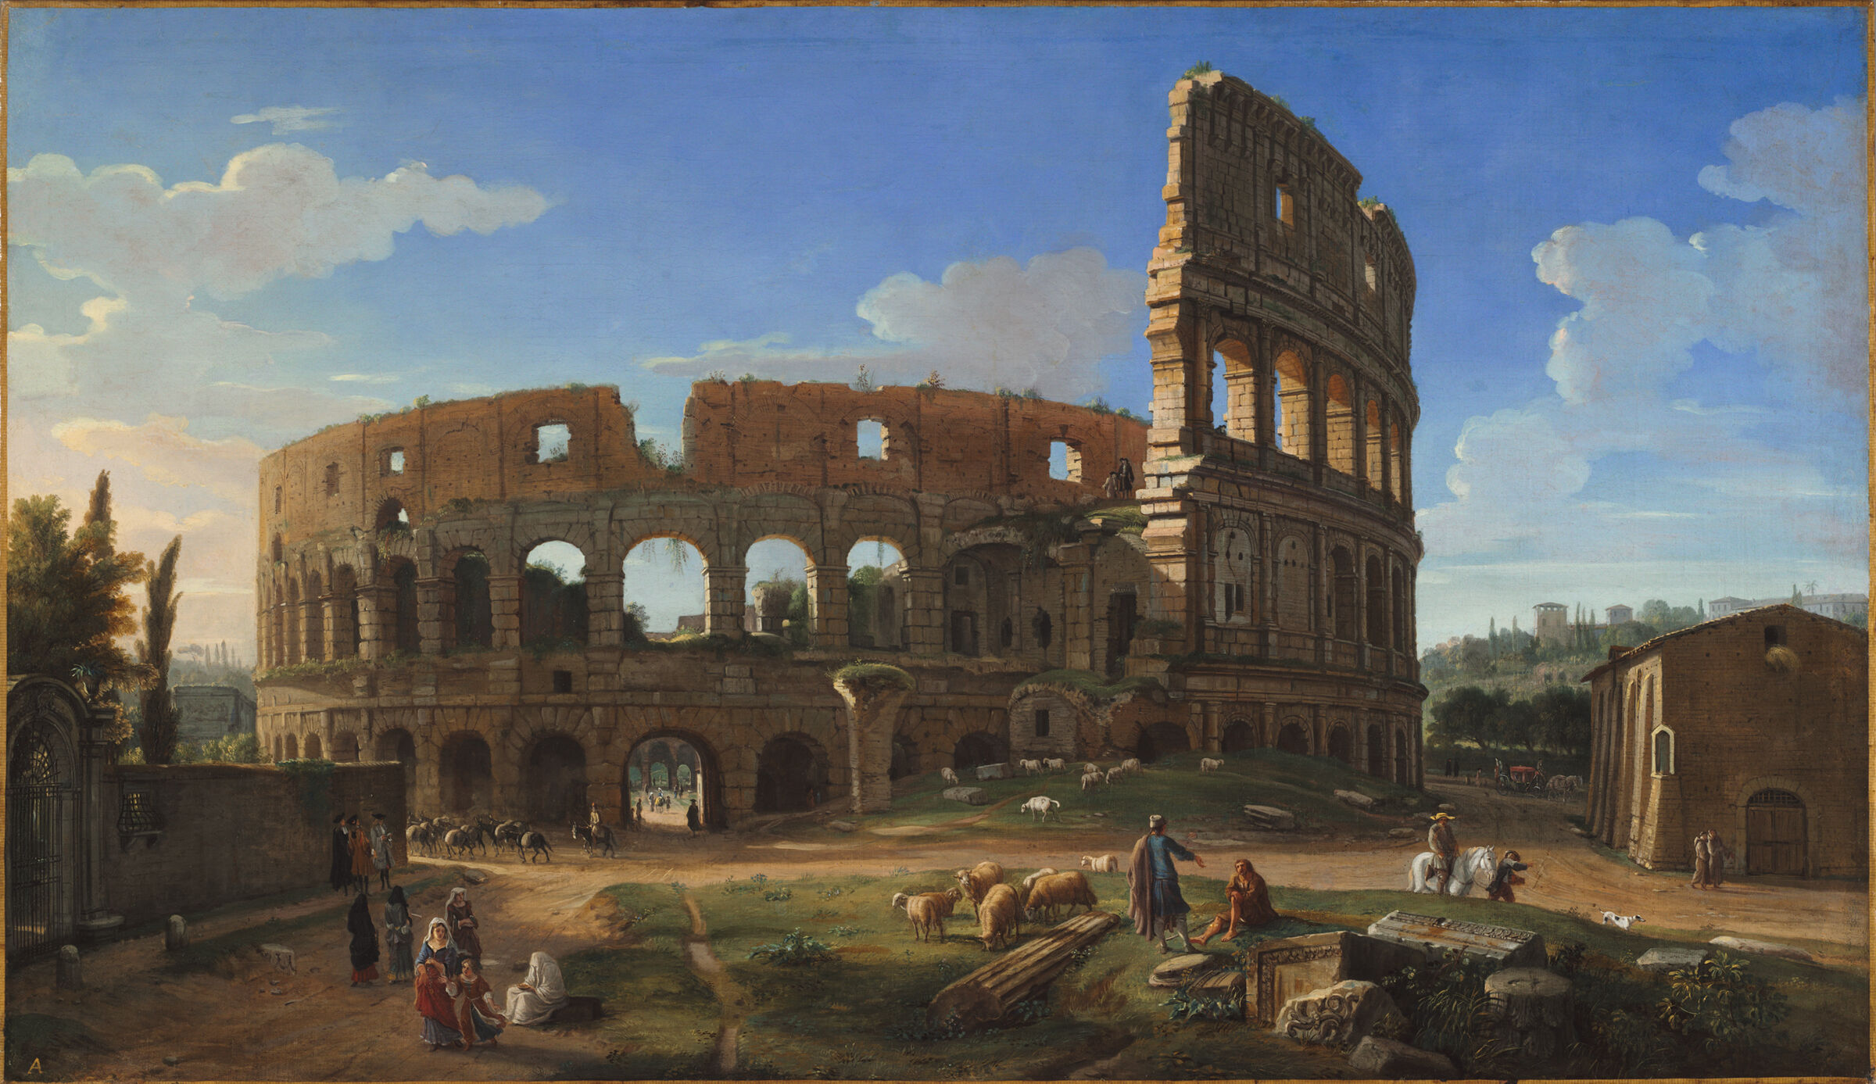
Transformation or End of Civilization?
--- Late Antiquity from Comparative Perspective
Zhang Kaiyue
(PhD student, Oxford University)

Slide 2
What is late antiquity?

Slide 3
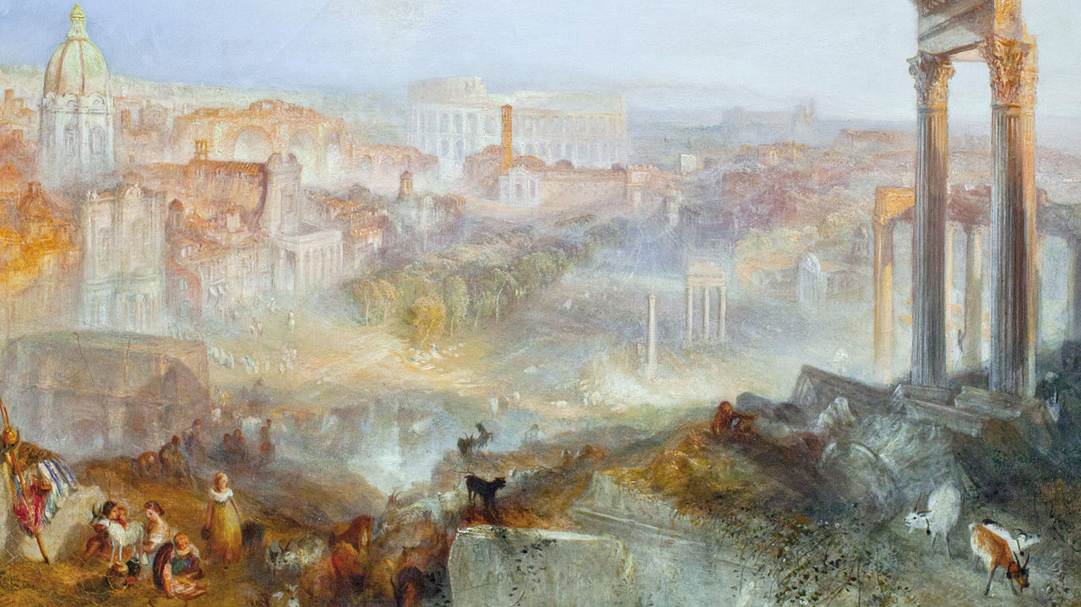
Narrative for the ‘Fall of Rome’

Slide 4
What is ‘Rome’ or ‘antiquity’?
--- state?
--- way of life?
--- socio & economic system

Slide 5
Two traditional narratives:
Triumph of Christianity
Plight and Disintegration of the Late Imperial State

Slide 6
Some important events?
313 AD Edict of Milan
325 AD First Council of Nicaea
378 AD Battle of Adrianople
380 AD Edict of Thessalonica
410 AD Sack of Rome by Visigoths

Slide 7
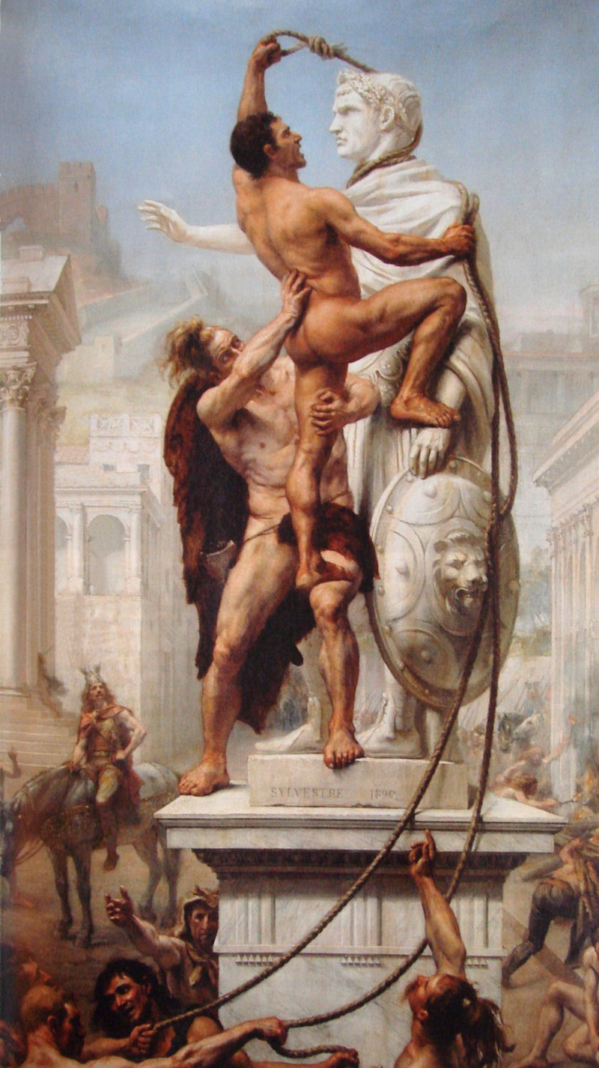

Slide 8
452 AD Attila’s March into Italy
455 AD Vandals’ sack of Rome
461 AD Death of Majorian
476 AD Deposition of Romulus Augustus

Slide 9
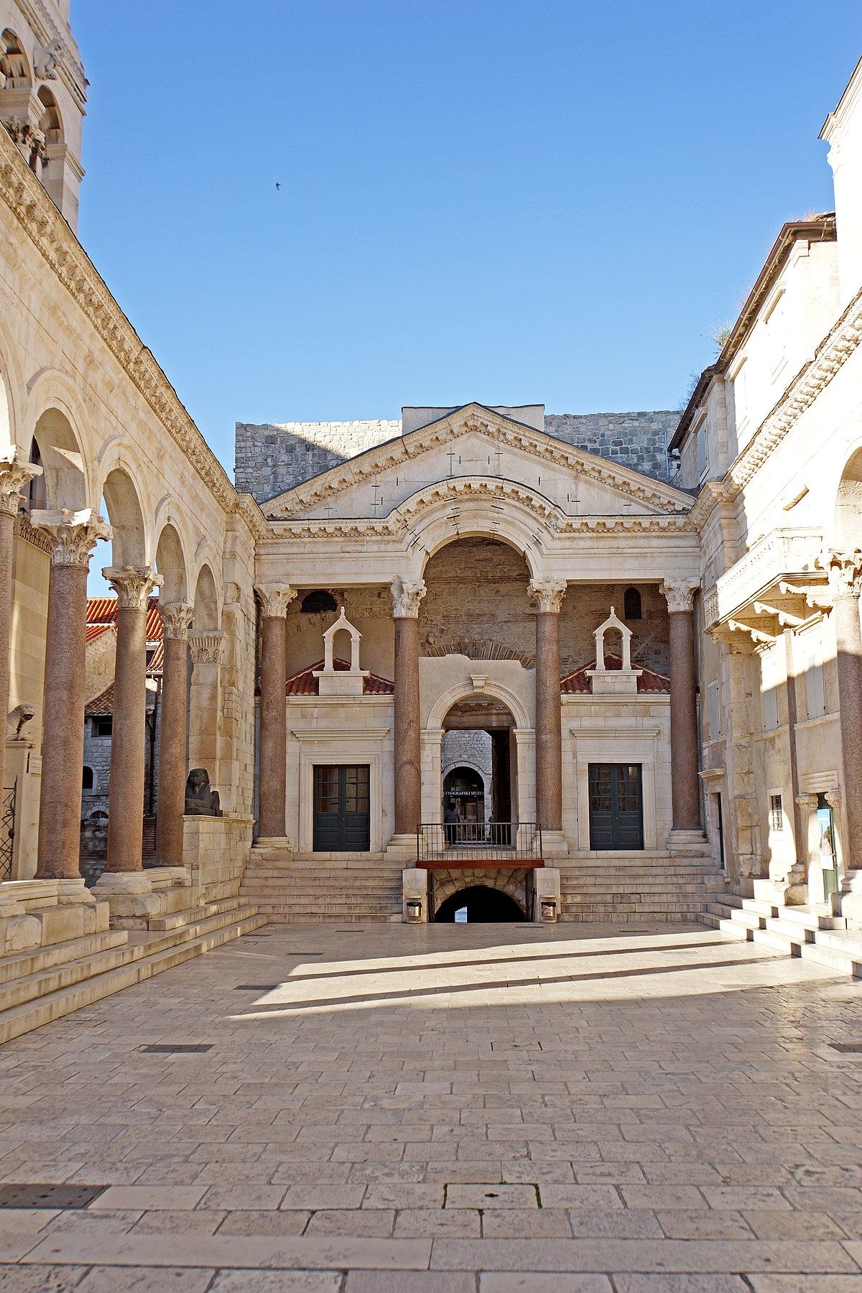

Slide 10
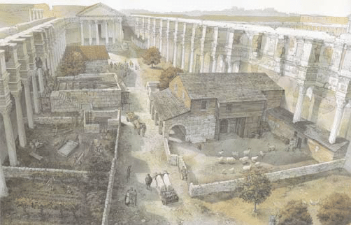
T. Empler, Cultural Heritage: Displaying the Forum of Nerva with New Technologies, 2015

Slide 11
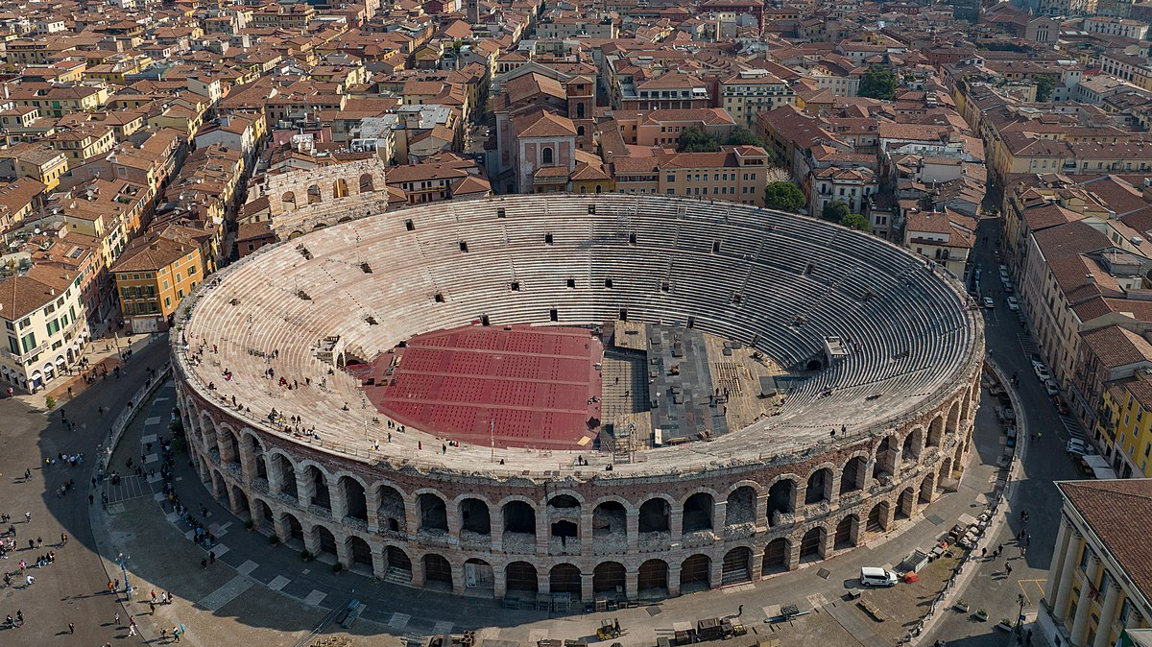

Slide 14
535 – 554 AD Gothic Wars
568 AD Lombard Migration
751 AD Fall of Ravenna to the Lombards
774 AD Fall of Pavia, End of the Lombard Kingdom
800 AD Coronation of Charlemagne

Slide 15
Transformation or ‘sharp-end’?

Slide 16
‘…like the black tent of the Bedouin pitched amid the colonnades of a stately Syrian temple, whose ruined glories touch no responsive chord in the soul of the swart barbarian.’
--- Thomas Hodgkin, Italy and her Invaders, VI, p.238.

Slide 17
The role of the ‘barbarians’?

Slide 18
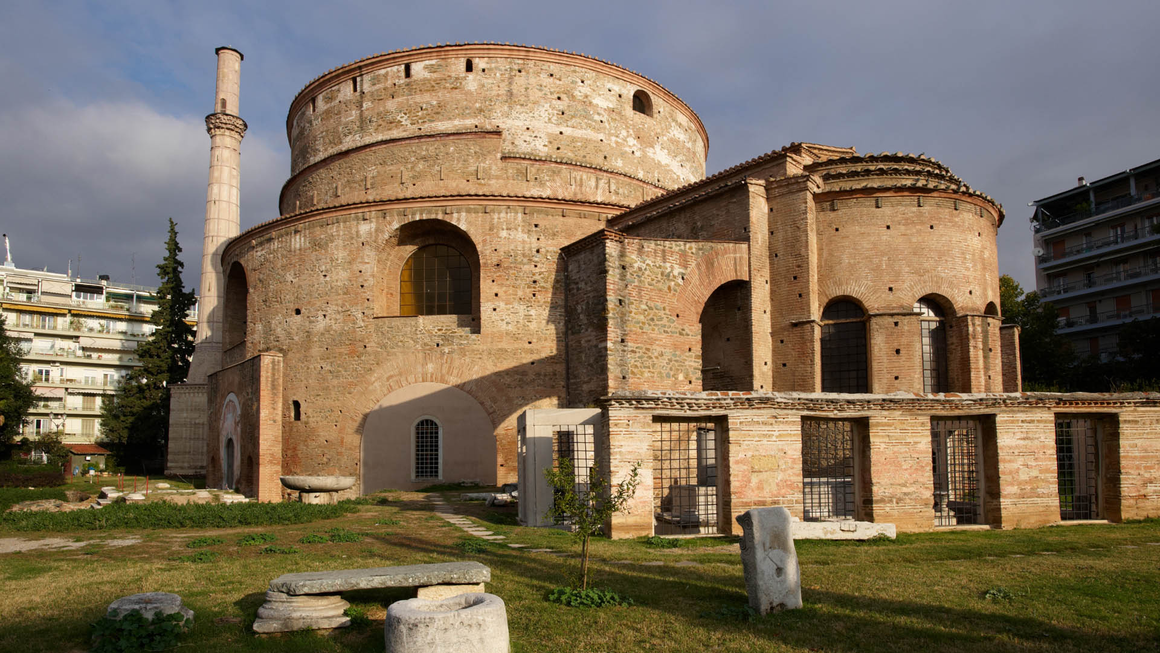
The Church

Slide 19
‘temple society’?

Slide 20
Aristocracy
--- Avitus of Clermont/Vienne
--- Ennodius of Pavia
--- Gregory of Tours
--- Ruricius of Limoges
--- Gregory the Great

Slide 21
Cursus publicus?
--- Salvian
--- Sidonius Apollinaris
--- Venantius Fortunatus
--- Gregory the Great
…

Slide 22
Co-operation or Military Conquer?

Slide 23
‘Militarization’

Slide 24
Socio-Economic:
Involution of long-distance trade
Decline of cities as trade centers (except for Italy)
Loss of settlement hierarchy
Contraction of public institution
Law functional --- figural?
The written words

Slide 25
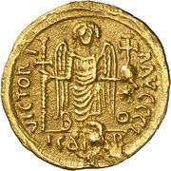
Meaning of 476 ?

Slide 26
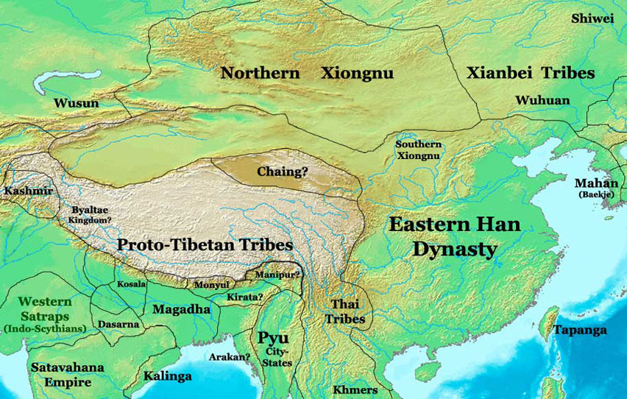
Comparison with China

Slide 27
First Chinese Empire
Qin unification of China 221 BC
Western Han & Eastern Han 202BC – 220 AD
Intervals Three Kingdoms 220 – 280 AD
Western Jin Dynasty 266 – 316 AD (start of Xiongnu incursion, 304 AD)
Interlude
North - sixteen kingdoms South - Eastern Jin
Northern Dynasties (Xianbei) Southern Dynasties
Second Empire
Sui Dynasty 581 – 618 AD (unification 589 AD)
Tang Dynasty 618 – 907 AD

Slide 28
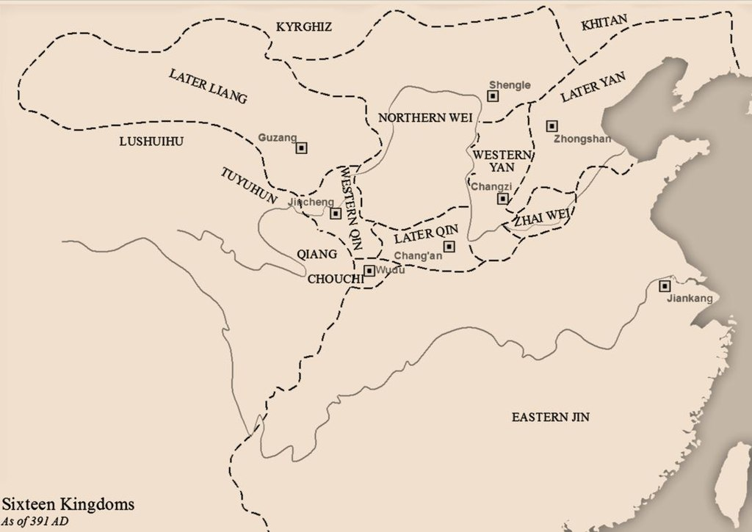

Slide 29
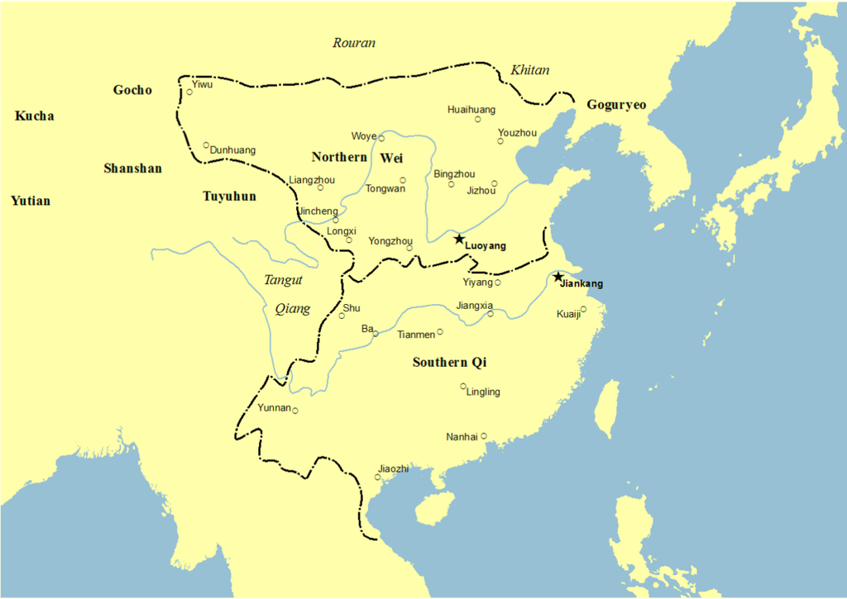

Slide 30
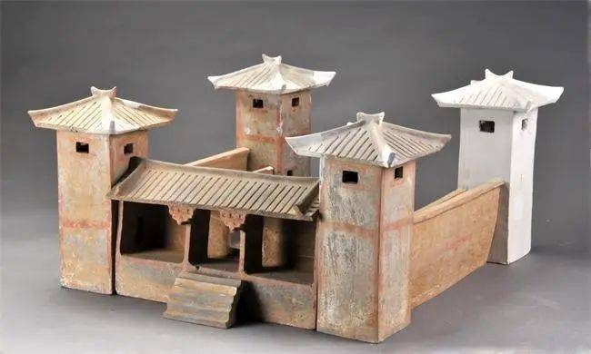

Slide 31
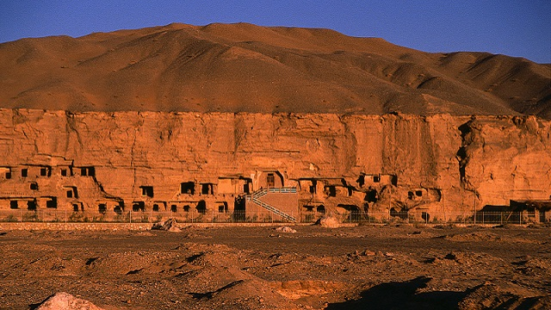

Slide 32
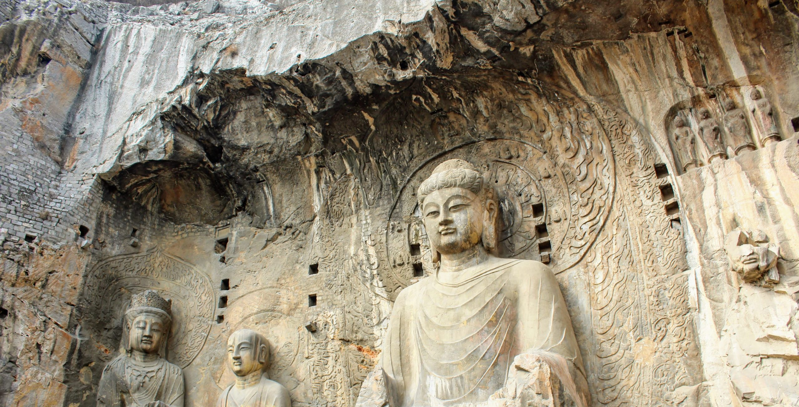

Slide 33
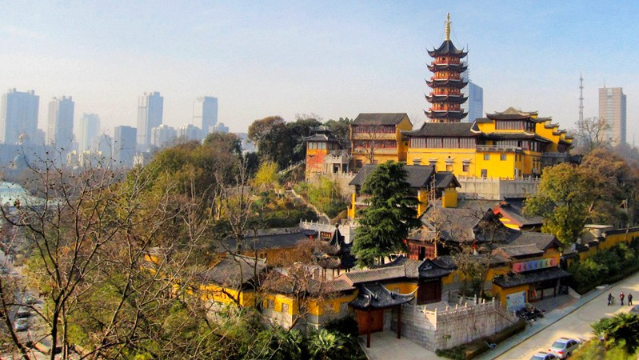

Slide 34
Lack of sources
First history writing from the north 450 AD

Slide 35
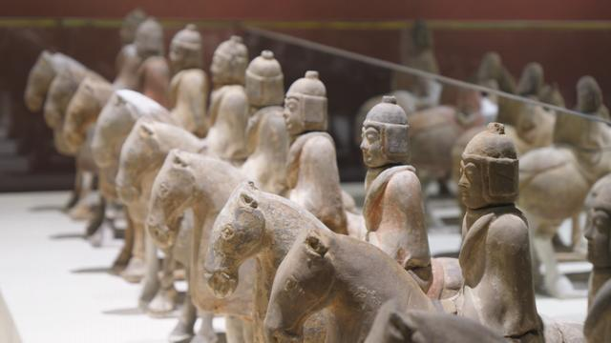

Slide 36
494 AD The Northern Wei moved capital to Luoyang
528 AD Massacre of sinicized Xianbei nobles in Luoyang
581 AD Yang Jian became the ruler of northern China
589 AD Fall of Southern Chen, unification of China

Slide 37
Grazie!

