Slide 1
Describing Gender in a Time of War. Procopius’s Gothic War (ca. 560) History of the Early Middle Ages a.y. 2023-2024
prof. Maria Cristina La Rocca mariacristina.larocca@unipd.it

Slide 2
Why War Time?
Scott, J.W. 1984, ‘Women and war: A focus for rewriting history’, Women’s Studies Quarterly 12, 2-6: 4.
«During war gender relationships, the traits and behaviors of male and female, are assigned a timeless quality, outside social and political systems. The turmoil of politics is then depicted as an overturning or inversion of the "natural" order: men are weak and impotent, "cut-off" and rendered unmanly; while women are strong, taking over public life, abandoning husbands and children, ugly, domineer […].
War is represented as a disorder; disorder is represented as sexual disorder. Peace thus implies a return to "known" or "traditional" gender relationships, the familiar and natural order of families, men in public roles, women at home».

Slide 3
The fate of the harmless
The wartime dimension also allows us to point out:
Gillingham, J. 2012, ‘Women, children and the profits of war’, in J.L. Nelson, S. Reynolds, S.M. Johns (eds.), Gender and Historiography. Studies in the earlier Middle Ages in honour of Pauline Stafford, London, 61-74.
"women and children were not the unlucky victims of the 'collateral damage' of war: rather they were among its intended victims".
The rhetoric used to describe the treatment reserved for women and children the two categories of defenseless people who, though not fighting, nevertheless participate in the conflict and suffer heavily from its effects

Slide 4
Women and children ensure the future of different communities.
Their fate and treatment is a significant factor in interpreting the results of a war and the strategies used, especially during sieges.
Their presence can be a stimulus to accentuate in men the effort of protection towards them;
their capture, or death is a means by which the assailants punish and defeat the community even more fiercely.
The narrative of the involvement of the unarmed in the sufferings of a siege constitutes a reflection of reality and at the same time contributes to the construction of a reality in which the fate of women and children is used as a moral yardstick for the behavior of men:
the assailants, who want to assault women and children
or
their relatives who, by not surrendering, did not want to save their wives and children from the ferocity of the enemy.

Slide 5
Procopius: who was he?
Procopius, (born probably between 490 and 507, in Caesarea, Palestine [now in Israel]—died c. 565).
From 527 to 531 he was adviser (consilarius) to the military commander Belisarius on his first Persian campaign. He was a notary.
In 533 and 534 he took part in an expedition against the Vandals and was in Africa until 536, when he joined Belisarius in Sicily.
He was in Italy on the Gothic campaign until 540, after which he apparently returned to Constantinople, since he describes the great plague of 542 in the capital.
He never came back to Italy after.

Slide 6
Procopius and his works.
History of the Wars
The first seven books seem to have been largely completed by 545 and may have been published as a unit. They were, however, updated to mid-century before publication, with the latest mentioned event occurring in early 551. The eighth and final book brings the history to 553.
Books 1-2: The Persian War (532)
Books 3-4: The Vandal War (533)
Books 5-8: Gothic War (535-553)
Historia Secreta, published only in the 10 century
De Aedificiis

Slide 7
Justinian Wars
532: peace with the Persian Empire (on condition of a heavy tribute)
533: General Belisarius reconquers Africa from the Vandals, including Corsica, Sicily, Sardinia
535: After the death of Amalasunta, Belisarius begins the conquest of Italy by the Goths.
Gothic War: 535-553 very long conflict with alternating phases (Totila 541-552)
553: beginning of operations in Hispania

Slide 8
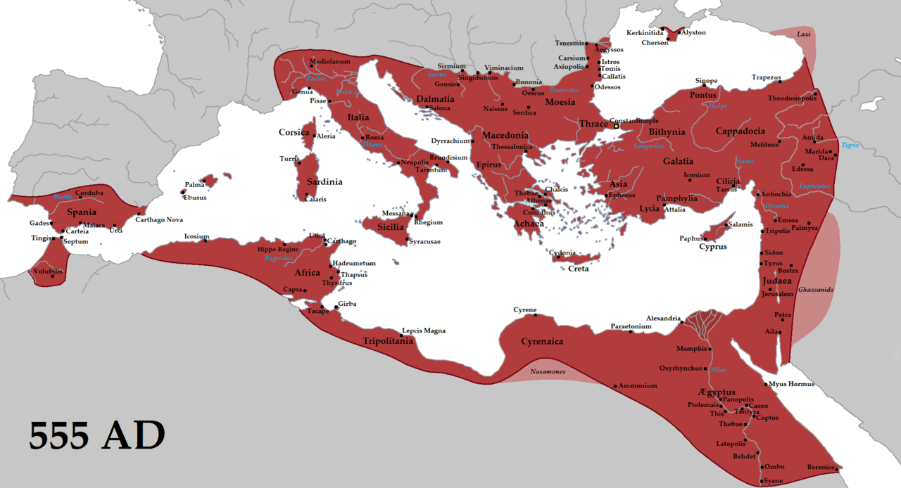
Justinian conquests(555)

Slide 9
Justinian (b.482-d. 565; emp. 527: achievements and difficulties
Change of direction in Byzantine policy:
Superiority of the empire over the barbarian kingdoms
Project for the restoration of imperial authority in the Mediterranean, which included the return to a single official religious denomination as a symbol of rediscovered political unity.
532: faces internal opposition (primarily in Byzantium) from the city demi-groups: Nika revolt by Byzantine demi-groups, bloodily repressed in the hippodrome: about 35,000 dead, primarily due to tax increases.
528-533 Drafting of the Corpus Iuris Civilis.
Codex Iustinianus (collation of all imperial edicts in force since Hadrian)
Digestum (collection of judgments of jurists of the classical age)
Institutiones (manual for the study of law)
Novellae (judgments promulgated after 533.

Slide 10
Justinian ecclesiastical policy
Justinian
Normative on marriages
The imperial example of Constantine was taken up: imperial power was superior and guarantor of ecclesiastical unity.
Justinian presided over councils, issued edicts and appointed bishops.
Fight against heresy: this involved a head-on collision with the religious identities that had developed in the East and West.
Abolition of divorce.
Theorisation of the principle of the wife's obedience to her husband.
Regulation on second marriages.

Slide 11
Marriage and love before the Gothic War
Marriage, the alliances that derive from it and its consequences on the male social rise are elements of discrete importance in the work of Procopius, who tends to emphasize how the enhancement of individual male status before the Gothic War is the result of a substantial reversal of traditional marriage practices, until then anchored to two specific basic rules.
First of all, the virilocality, that is, the transfer, after marriage, of women to the house of the husband: in this way the husband assumes, materially and symbolically, the responsibility and the role of providing resources and sustenance to the wife and her children (breadwinner).
The transfer of wives to the husband's house (deductio/traditio) is considered an aspect that characterizes the female life cycle and that differentiates it from the male one, which is more anchored to the residential permanence.

Slide 12
upside-down marriages
In Procopius' narration of the individual events immediately preceding and accompanying the long years of the Gothic war, both the traditional lines of structuring of matrimonial unions are to some extent questioned.
He underlines:
the diffusion of uxorilocal matrimonial alliances - where it is the man who moves and resides within the female household;
the fortunes of soldiers who, taking advantage of their conquests in the war, interweave matrimonial relationships with rich local women, allowing them to improve their social and patrimonial conditions.

Slide 13
Theudis in Procopius Gothic War (V, 12, 50-2)
After 508, Theoderic extended his power in Southern Gaul:
[ 50] But afterward, Theudis, a Goth, whom Theoderic had sent as commander of the army, married a woman from Spain, not of the Visigothic people, however, but from the house of one of the wealthy inhabitants of that land. She possessed great wealth and also owned large estates in Spain.
[51] From this he raised about two thousand soldiers and surrounded himself with a force of spearmen. While in name he ruled the Goths by Theoderic’s permission, he was in fact an out-and-out usurper.
[52] Theoderic, who was wise and experienced in the highest degree, was afraid to wage war against his own slave, in case the Franks meanwhile took the field against him, as they naturally would, or in case the Visigoths for their part began a revolt against him. Accordingly, he did not remove Theudis from office but even continued to command him to lead the army whenever it went to war.
[53] However, he directed the first men of the Goths to write to Theudis that he would be acting in a way that was just and befitting of his wisdom, if he came to Ravenna and saluted Theoderic.
[54] Theudis carried out all the commands of Theoderic and never failed to send the annual tribute, but would not go to Ravenna, nor promise to do so to those who had written him.

Slide 14
Optaris (Gothic War, I, 11 6-9) y. 536
[6] Theodahad, therefore, upon hearing this, rushed off in flight and headed for Ravenna. But Vittigis quickly sent Optaris, a Goth, instructing him to bring Theodahad alive or dead.
[7] Now it happened that this Optaris was hostile to Theodahad for the following reason. Optaris was wooing a certain young woman who was an heiress and extremely beautiful to look upon.
[8] But Theodahad, moved by a bribe, took the woman he was wooing from him and betrothed her to another man. And so, not only satisfying his own rage but rendering a service to Vittigis as well, he pursued Theodahad with great eagerness and enthusiasm, stopping neither day nor night.
[9] He overtook him while still on his way, laid him on his back on the ground, and slew him like a victim for sacrifice. Such was the end of Theodahad’s life and rule, which had reached the third year.

Slide 15
The pact between Amalaric and Athalaric (Gothic War, I, 13, 7-8)
[4] Amalaric, who was ruling the Visigoths, upon coming of age, became thoroughly frightened of the power of the Germans (the Franks) and so took to wife the sister of Theudebert, ruler of the Germans, and divided Gaul with the Goths and his cousin Athalaric.
[5] The Goths received the land to the east of the Rhone river, while that to the west fell under the control of the Visigoths.
[6] It was agreed that the tribute that Theoderic had imposed would no longer be paid to the Goths, and also Athalaric honestly and justly restored to Amalaric all the money that he had taken from the city of Carcassonne.
[7] As these two nations had united with one another by intermarriage, they allowed each man who had taken a wife from the other people to choose whether he wished to follow his wife or bring her among his own people.
[8] There were many who led their wives to the people they preferred and many also who were led by their wives.

Slide 16
Roman soldiers marrying Vandal widows (Vandal war, 2, 14, 7-10)
[7] At the opening of spring, when the Christians were celebrating the feast they call Easter, there occurred a mutiny among the soldiers in Libya. I will now tell how it arose and how it ended.
[8] After the Vandals had been defeated in battle, as I have told previously, the Roman soldiers took their daughters and wives and made them their wives.
[9] Each one of these women kept urging her husband to lay claim to possession of the lands that she had owned previously, saying that it was not right if, while living with the Vandals, they had enjoyed these lands, but after entering into marriage with their conquerors they were then to be deprived of their own possessions.
[10] With these things in mind, the soldiers did not think that they were bound to yield the lands of the Vandals to Solomon, who wished to register them as belonging to the public and to the emperor’s household; he said that while it was not unreasonable that the slaves and all other thingsof value should go as booty to the soldiers, the land itself belonged to the emperor and the empire of the Romans, which had nourished them and caused them to both become and be called soldiers not so that they might then claim for themselves any land that they might take from the barbarians who were trespassing on the Roman empire, but so that this land might come to the public, from which both they and all others secured their maintenance.

Slide 17
Uxorilocality : a source for confusion within the hierarchy of the family
The subversion of the rule of virilocality is the source of disorder and chaos in every respect, starting with the hierarchy within married couples.
Such asymmetrical unions placed husbands in an unprecedented position: the fact that they could not present themselves as the source of sustenance for their family group forced them to redeem their masculinity with exaggerated and ostentatious actions, if not open rebellion against authority.
Theudis: his union with a local woman had allowed him to increase his power to the point of establishing his own militia and presenting himself as a counterbalance to Theoderic, his king.

Slide 18
Athalaric and Amalaric: two fatherless teenagers.
Only the inexperience of Amalaric and Atalaric - two young fatherless teenagers, - could have led them to imagine systematically organising a marriage regime in which women and men were allowed to move around after marriage.
According to Procopius, Atalaric was in fact a presumptuous and rebellious adolescent: after opposing his mother's advice on his upbringing in a foolish manner, he chose a dissolute life at the side of the 'Goths' and would soon die a dishonourable death.
Amalaric appeared to be totally unaware of how to behave properly towards his wife's family, as Procopius states: after his marriage to a daughter of Clovis, he is said to have prevented the woman from freely professing her Catholic faith, harassing her in every way, thus prompting her to invoke the intervention of her Merovingian brothers .

Slide 19
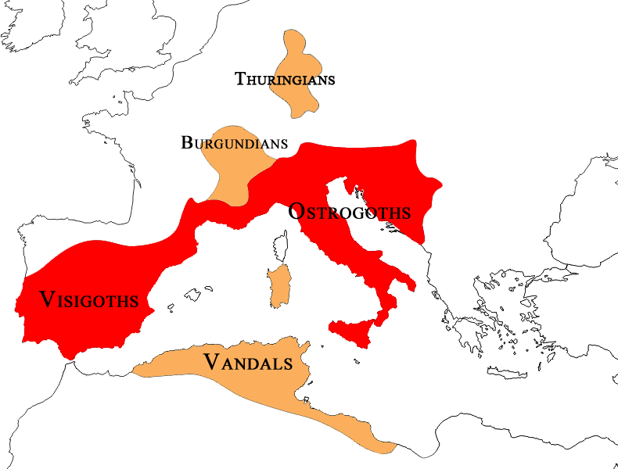
Variae IV.1: “you, who have descended from royal stock,
may now gleam even further with the brightness of Amal
blood. We send to you the jewel of a royal home, the
boon of a people, the comfort of faithful advice,
a wife delightful and most pleasing, who, with you,
should fittingly complete your dominion and arrange
your nation with a sweeter manner of living”.
Procopius' explanation for the defeat of the Visigoths at Narbonne in 531, as the revenge of the Frankish kings for the humiliation inflicted on their sister, is punctually linked to Amalaric's misunderstanding of the elementary rules of the game:
The daughter of a foreign king acted as his emissary and, as in the case of Theoderic's female relatives, her presence in Hispania had to be interpreted not only as a very precious gift, but as a witness to the overwhelming superiority of her family of origin.

Slide 20
An opposite model: the Rugians (Gothic Wars, III, 2, 2-3)
“The Rugi are a Gothic nation but in ancient times they lived autonomously. [2] Yet Theoderic had early persuaded them, along with certain other nations, to join with him and they were absorbed into the Gothic nation and did all things in common with them against their enemies. [3] But as they had absolutely no intercourse with women other than their own, each successive generation of children was unmixed and preserved the name of their people for themselves”.

Slide 21
The changing social context
Research in the field of both social history and family history has underlined that from the age of Diocletian transformations in the organization of relations between the center and the periphery of the empire had altered the practices of matrimonial alliances, that became oriented towards favoring socially unbalanced unions.
The accentuation of the role of the imperial court and the progressive loss of relevance of local contexts, had favoured the social rise of young individuals, willing to be mobile and available to take on roles and functions wherever they were needed.
Men's willingness to change their residential context and take root elsewhere implied both a detachment from the original place and the implementation of real innovative matrimonial 'strategies'.
the precarious and non binding relationship with one's place of origin had favoured in loco marriages with women of lower social status that could be discarded with relative ease, without creating relevant tensions: a male hypogamic mode.
In a diametrically opposite direction, the same 'career' men, once they had moved, were ready to enter into hypergamous relationships with women of higher social status, which would help them to integrate into the new context.
These changes were driven by the concrete possibility of increasing individual male status through the willingness to be mobile and constituted an important long-term transformation.

Slide 22
Legal transformations.
The spread of these unbalanced ties and the efforts to stop them are considered to have been the origin of the various legislative interventions in matrimonial matters, which were implemented by Constantine and then continued until the time of Justinian.
These changes focused on the ways in which marriage could be interrupted, substantially limiting the occasions on which divorce was considered possible,
on defining more precisely the difference in status between wives and concubines (especially as regards the right of children to inherit),
on discouraging unions between groups of different status
The obedience owed by the wife to her husband was emphasized
the progressive easing of the wife's dependence on her family of origin.

Slide 23
The reversal of the gender balance: public visibility
One of the consequences of hypergamy is a confusion of roles between men and women, which emerges in the public visibility of women and the spaces in which their actions are portrayed.
In the collective spaces of the cities, women in groups behave in a hostile and aggressive manner towards their husbands, who in turn do not seem able to elaborate an effective action and appear to be completely subservient to their desires and obstinacy.
The public occasions in which the conflicts between wives and husbands are represented by Procopius, seem to highlight the almost unthinkable fact that the wives, collectively, had been able to elaborate a sort of choral awareness of open disdain towards their husbands, whose authoritativeness appeared challenged and contested.

Slide 24
Nika revolt in 532
After sketching a dramatic picture of the urban violence caused in Constantinople by the equestrian competitions in the hippodrome between the Greens and the Blues, and describing in extreme terms the point of sectarianism reached by the fans, Procopius points out that the pervasiveness of the quarrels is such that it even involves women.
Persian War, I, 24,6
“[6] Even women join them in this unholy strife, and they not only follow the men but even fight them if that is how it turns out, even though they neither go to the spectacles at all nor are led by any other cause to get involved. So that I, for my part, do not know what to call this if not a mental disorder. This, then, is pretty much how matters stand among the people of each and every city.”

Slide 25
The entering of the imperial army into the city of Ravenna (y. 540)
Domestic quarrels find their reasons in the sphere of tensions related to a collective and masculine space that, in principle, should not concern them. Narratives of groups of women, usually without individual identities, acting collectively in public places.
“While I watched the entry of the Roman army into Ravenna at that time, it occurred to me that the outcome of events is not fulfilled by the wisdom of men or any other virtue on their part, but that there is some supernatural power that is ever warping their intentions and leading them in such a way that there will be nothing to hinder that which isbeing brought to pass.
[33] For although the Goths were greatly superior to their opponents in number and in power, and had neither fought a decisive battle since entering Ravenna nor been humbled in morale by any other disaster, still they were being made captives by the weaker army and were regarding the name of slavery as no insult.
[34] But the women spat in the faces of their husbands for they had heard from them that the enemy were men of great size and too numerous to be counted; but now they had seen the entire army that had invested the city and, pointing with their hands to the victors, reviled them for their cowardice” (Gothic War, VI, 29, 32-34).

Slide 26
The plague of 538
When deprived of male control, women can also act in secret and devise evil plans for their own survival: during the plague in Rimini, in the context of the famine and the spread of the disease in this area in 538, Procopius recounts the general prostration of the people and
“[27] Some too, overcome by hunger, fed upon each other. It is said that two women in a certain field in the country above the city of Rimini ate seventeen men, for these women, as it happened, were the only locals who survived. [28] Consequently, strangers traveling that way lodged in the little house where these women lived, and so they would kill these strangers while they slept and eat them. [29] The story goes that the eighteenth stranger was roused from his sleep just when these ladies were about to lay hands upon him. He leaped up, learned from them the whole story, and killed them both. [30] That is how they say it happened” (Gothic War, 2, 20 27-30)

Slide 27
Gender and cannibalism
Cannibalism, Pierre Bonnassie pointed out in 1989, is certainly part of the category of the abominable that normative sources, especially Christian ones, rarely dare to mention.
However, in the narratives of famines and tribulations for lack of food, some authors sometimes mention episodes of cannibalism as an extreme ratio to which the population, exhausted by hunger, resorts, as a desperate symptom of the 'madness' to which the need for food can lead.
These are images in which the upside-down world, constructed by desperate hunger, forces the population into elaborate survival strategies designed to arouse disgust and horror in the reader. If the act itself is considered abominable, there is certainly no moral condemnation of those who are driven to such actions by unbearable hunger.
Vincent Vandenberg has pointed out that the mention of cannibalism during a famine is strongly imbued with biblical examples that make the famine itself a divine punishment. Cannibals, in a sense, are the instrument through which God's curse is manifested: the breaking of the taboo is presented as the inevitable consequence of their sins.

Slide 28
Hunger in these contexts of desperation appears as the element capable of breaking social bonds, isolating groups and individuals, exacerbating pre-existing tensions and altering the perception of reality not only of those who suffer from it, but also of those who come into contact with them.
In the case recorded by Procopius and in his implicit, totally negative judgement, the two women are the protagonists of a veritable 'criminal association' that exploits the unconsciousness of foreigners and wayfarers to procure for themselves the resources to survive.
Cannibalism in this case not only alters the social practices of hospitality, but corrodes their functioning from within, placing the two women in a monstrous space, outside of humanity and outside of their gender. Their killing, by the eighteenth wayfarer, is therefore a just and legitimate act, which serves to restore order.

