Slide 1
HISToRY OF SLAVERY AND SLAVE TRADE IN THE GAMBIA
FATOU A JOBE

Slide 2
GEOGRAPHIC OVERVIEW
The Gambia is located within a tropical zone.
The Gambia is the smallest country in main land Africa.

Slide 3
HISTORICAL CONTEXT
SLAVERY EXISTED IN WEST AFRICA FOR HUNDREDS OF YEARS
African kingdoms HELD slaveS (Domestic slaves)

Slide 4
BEGINNING OF THE SLAVE TRADE
THE EARLY 16TH CENTURY, WITNESSED THE BEGINNING OF THE SLAVE TRADE

Slide 5
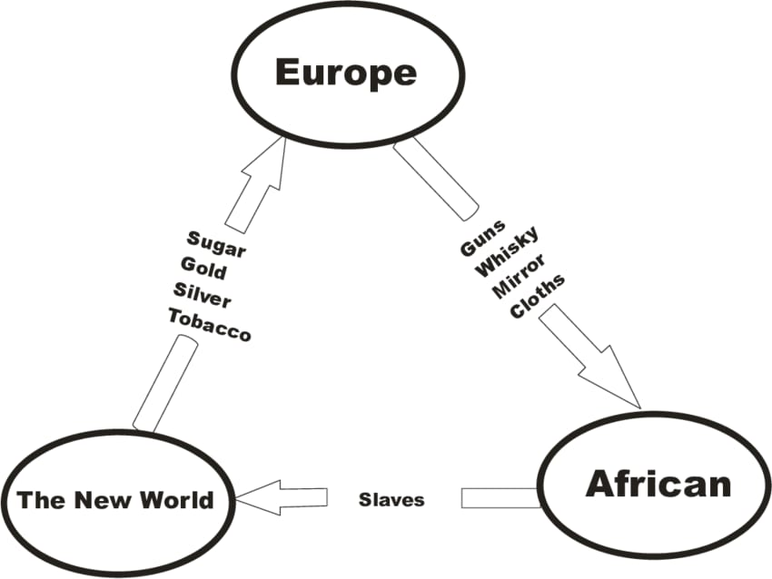
THE TRANS ATLANTIC SLAVE TRADE
The triangular slave trade

Slide 6
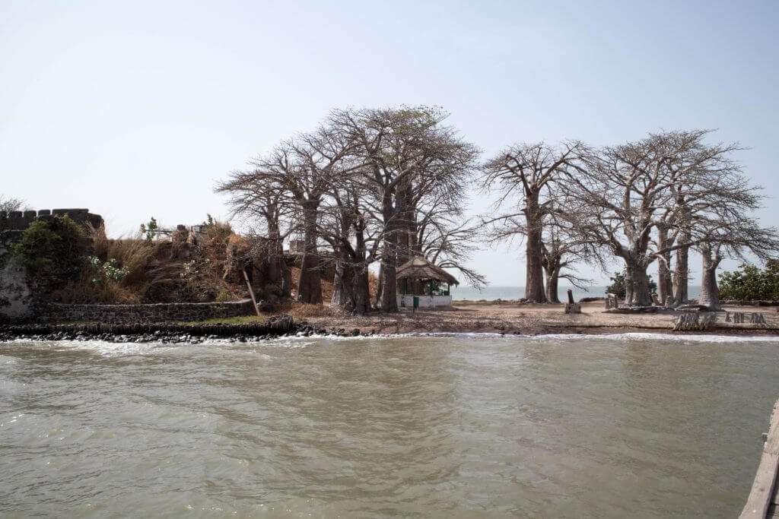
JAMES ISLAND(KUNTA KINTEH ISLAND)

Slide 7
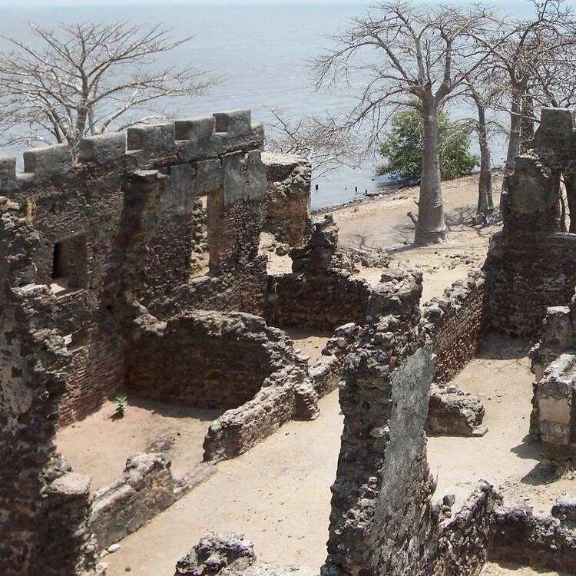
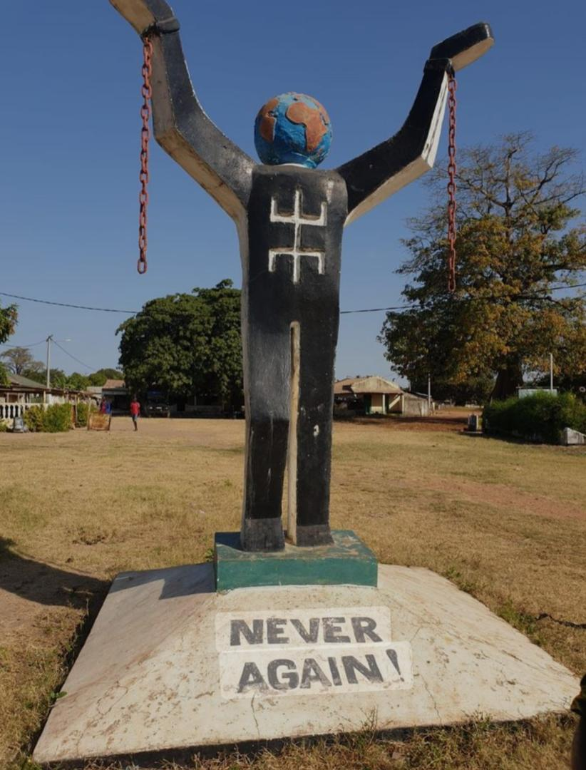
RUINS OF JAMES ISLAND AND THE NEVER AGAIN STATUE

Slide 8
ROOTS
In 1976, the novel “Roots”, written by the African-American writer Alex Haley WAS PUBLUSHED.
There have been disputes over Haley’s claims of descendancy and his account of Kunta Kinte’s life

Slide 9
ROOTS
Haley was forced to settle a plagiarism suit out of court.
Kunta Kinte’s story hit a nerve on both the West African and American coast
https://youtu.be/airEw5tG9eo?si=V6R3CO7ZWDpqcG5n

Slide 10
conclusion
Many are with the conviction that’ ROOTS’ – the book and mini series are historical fiction, and not documented fact.

Slide 11
REFERENCES
Winkle, T. A., & Lightfoot, D. R. (2014). Landscape of the slave trade in Senegal and The Gambia. Focus on Geography, 57, 14-23
Gijanto, L. (2011). Competing narratives: Tensions between diaspora tourism and the Atlantic past in The Gambia. Journal of Heritage Tourism, 6(4), 305-318.
Kroot, M. V., & Gokee, C. (2018). Histories and material manifestations of slavery in the Upper Gambia River region: Preliminary results of the Bandafassi Regional Archaeological Project. Journal of African Diaspora Archaeology and Heritage, 7(2), 74-104. https://doi.org/10.1080/21619441.2019.1589712
Thornton, J. (2017). Historical truth and fiction in the life of Kunta Kinte. Transition, 122, 47-63. Indiana University Press on behalf of the Hutchins Center for African and African American Research at Harvard University.

