Slide 1
SIGN AND (DE)SIGN
MARISOL BARENCO DE MELLO

Slide 2
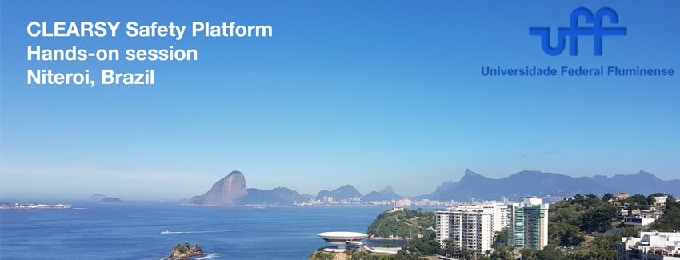

Slide 3
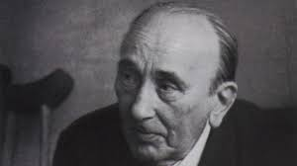

Mikhail Bakhtin
Pavel Medviédev
Valentin Volóchinov
Augusto Ponzio
Iuri Lotman

Slide 4
Reflections for a semiotic of the school space

Slide 5
semiotics should not be taken as a discipline or a theoretical set, but rather as a way of seeing how signs play a role in communicative and interpretive processes, therefore, semiotics would have a methodological character.
(Charles Morris)
Semiotics
In a global semiotics, or a semiotics of life, a method is de-totalizing, which is so much about criticizing universalist, mechanistic theories and those linked to the linguistics, with emphasis on the verbal paradigm.
(Thomas Sebeok)

Slide 6
In a complementary way aligns with learning as modelling processes
Semiosis
Modelling processes
To the school known as Moscow-Tartu, which included V. Ivanov and I. Lotman, among others, it is important to build models
Uexküll makes an important contribution to the study of semiotics - every living organism weaves around itself a network of relationships with specific properties of the objects that surround it. In this process, they organize and lead their own existence, actively existing in the world.

Slide 7
There is not, therefore, a “single world” in which we would all be, but the possibility of organizing reality spatio-temporally varies from species to species. No longer assuming the fracture of classical philosophical anthropology between the human being and the rest of living beings but understanding this living – human – formation as a discontinuity in continuity, we take the human being not as something “as much”, but something different, a species that it equally participates in the organic and inorganic worlds, but with the specificity of its species, which is language.

Slide 8
Human Language
Language as human exaptation allows the production of one's own world, the invention and hypothesizing of the world of others, artistic creation, philosophical and scientific reflection, the production of myths, utopias, and meta-operativity.
Human language goes beyond mere operability (perceiving the world functionally), but meta-operatively it considers the instruments as destined for other possible purposes, and even for no purpose at all, “doing for the sake of doing”, non-functionality.
Human semiosis, as a sign, allows meaning and action on absent things, non-existent things, and unknown things: language is not a mirror of reality, but has reflective, projective, and inventive properties.
The human being is emancipated from the simultaneous occurrence of the sign-referent – ​​adherence to the context – and through the capacity to produce and combine signs (semiotic capacity), he is capable of designing his own Umwelt, manipulating the possible, the impossible, the absent, the simulated, the hypothetical and the predictable.

Slide 9

Language human as exaptation
Until the emergence of Homo sapiens, humanity had been developing from language as an adaptation to the world and to the emerging social life. But verbal language, speaking, characteristic of Homo sapiens, which allowed verbal communication and the creation of symbolic systems, developed from language, but as an exaptation, while characteristics that evolved for other uses (or for none at all). We affirm, together with Sebeok, Ponzio and others, that human verbal communication, a specificity of the human species, is an exaptation of language as an adaptation to the world, from the beginning a deviation that made it possible for human semiosis to keep body, mind and culture together.

Slide 10
Human language, as a communicative and inventive capacity, was born exaptation, in the same cradle where culture was born.
In human cultural practices, it is the displacement of an object towards other interpretants that creates significance, creates culture.
Lotman states that the whole culture is condensed in its signs, making it possible to access its contradictory and historically and socially dispersed processes from the semiotic consideration.

Slide 11
Signs
Sign must be considered within a triadic relationship, which always involves
    something material;
    the interpreted – part of the world to be known/thought/opened; and
    the interpretant – another sign that gives meaning to the first.

Slide 12
To know
Oppose signs to signs
Consciousness to consciousness
Interpretative routes
The process that links interpreted to interpretants in an open series of interpretants
The interpretants never repeat or duplicate what is interpreted: in every act of signification, the subject in a living dialogue in the culture adds to this something new, shifts it to another direction – refracts the sign.
The relationship of interpretation is a relationship of alterity and exaptation, insofar as it is always dialogic and bearer of always new contexts.

Slide 13
Every sign is ideological
the study of ideological creation must necessarily be linked to the philosophy of language
objects in the world – physical bodies, instruments, consumer products – have a value in themselves, fully coinciding with their own physical or functional nature
these can become signs, perceived as symbols referring to reality outside themselves
every ideological product of culture, in its dimensions and fields, is part of a natural or social reality, but it can also reflect and refract another reality, having meaning, serving as a sign in a relationship of understanding

Slide 14
SEMIOSPHERE
Alongside the world of natural phenomena, technological materials and consumer products, there is another particular universe, the universe of signs
“
Everything ideological has semiotic value
Each field of ideological creation has its own way of orienting itself to reality, reflects and refracts reality in its own way, that is, it has a different worldview.

Slide 15
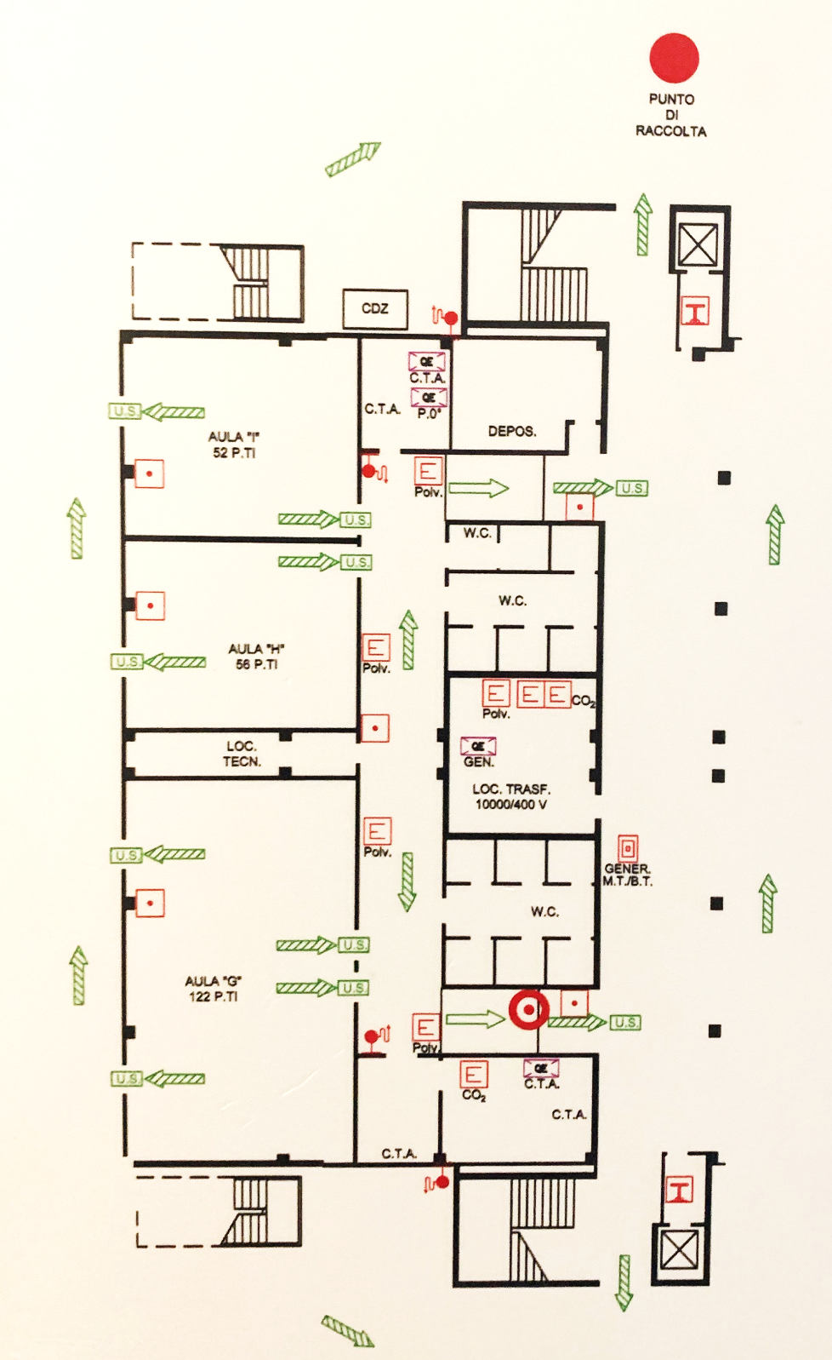
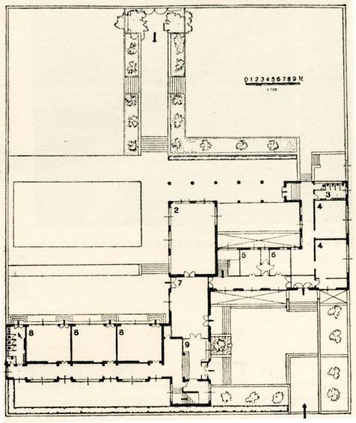
Pianta scuola elementare di Guidonia, 1937, Arch. Gino Cancellotti
Notes:
auditorium

Slide 16
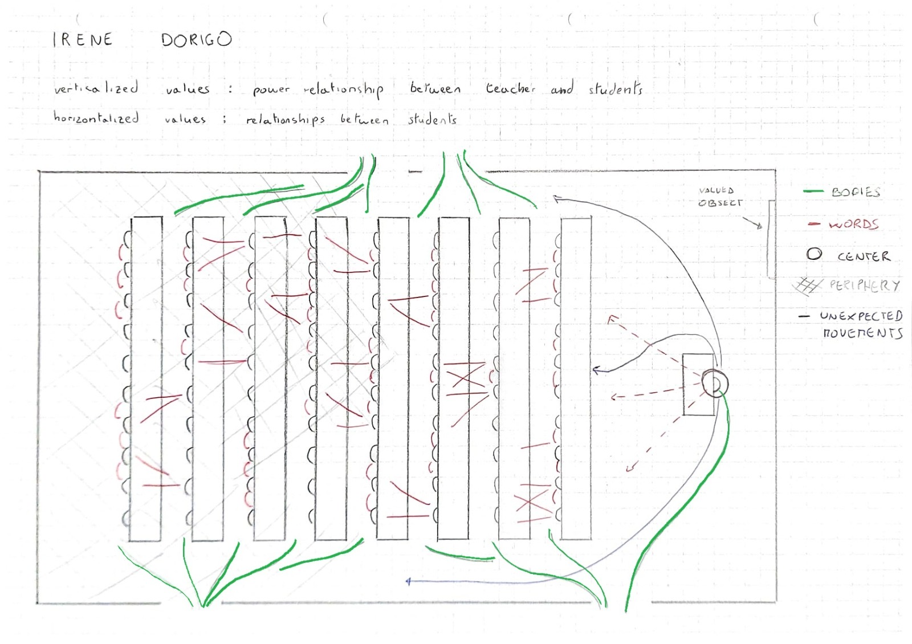
…

Slide 17
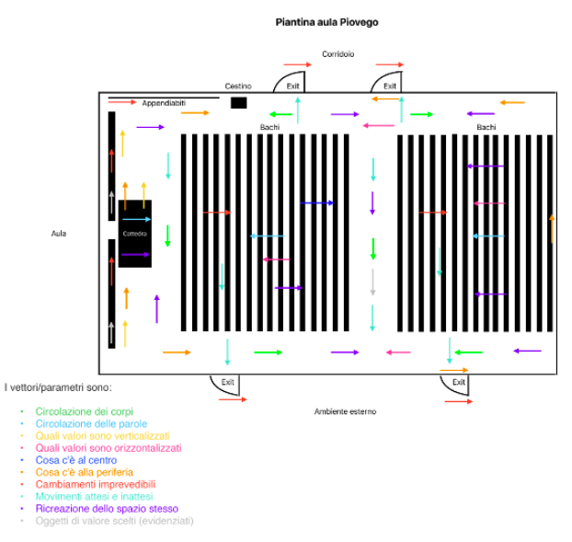
Veronica Civiero

Slide 18
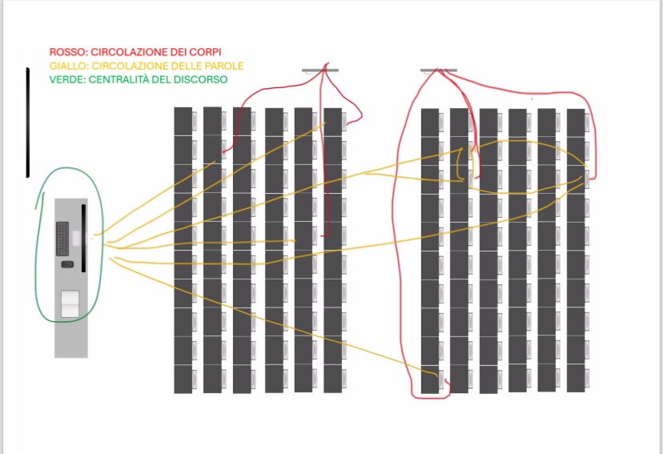

Slide 19
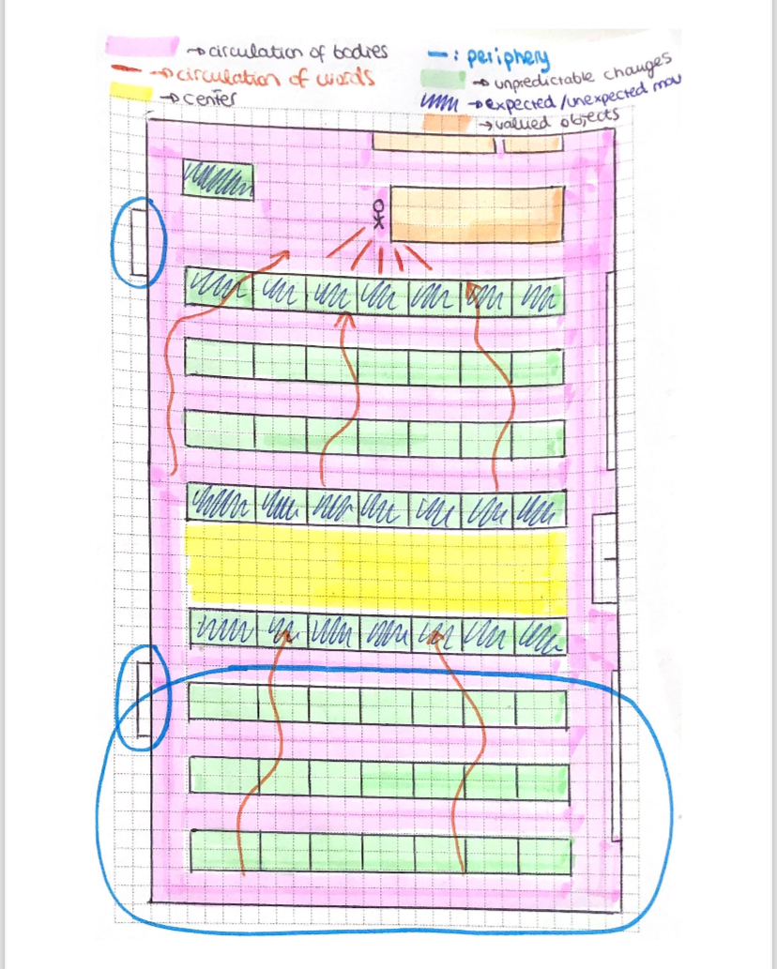
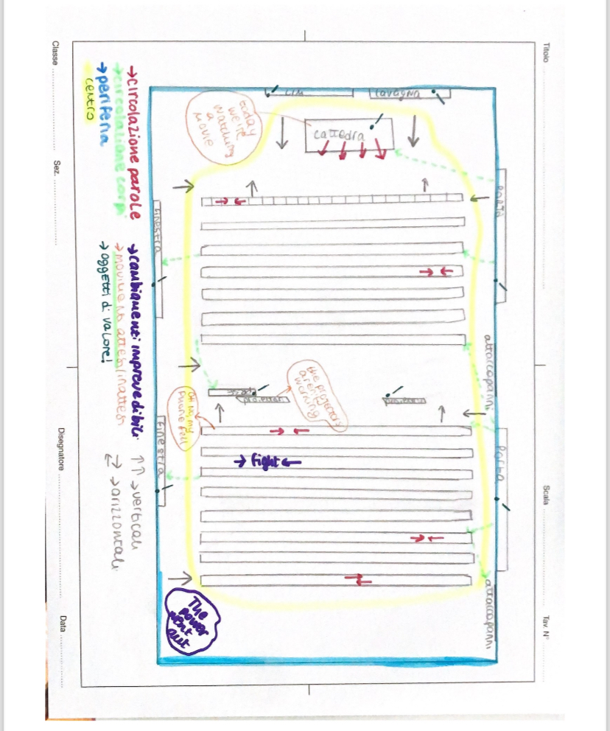

Slide 20
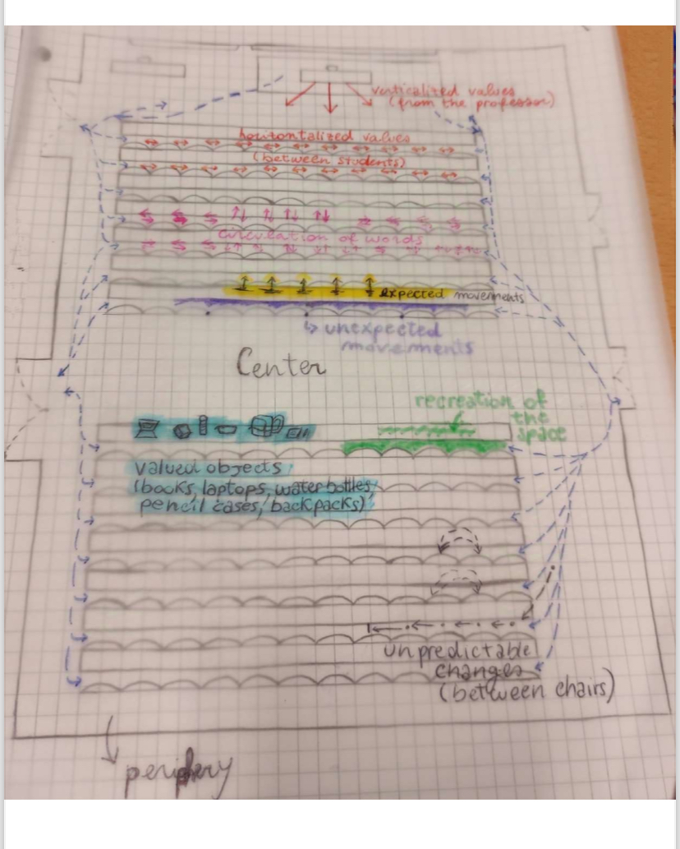

Slide 21
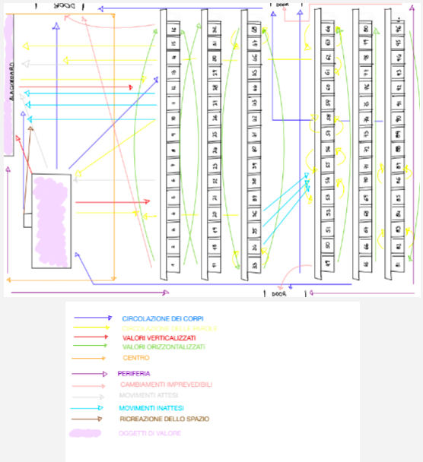

Slide 22
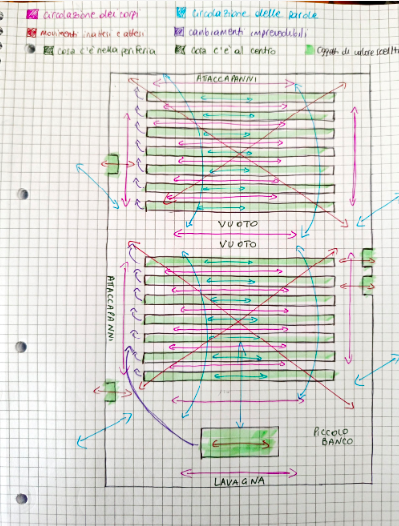

Slide 23
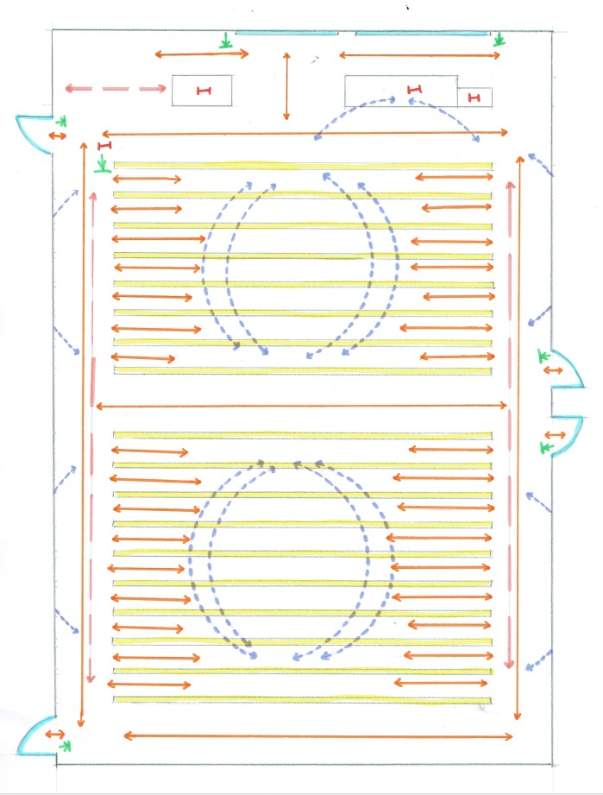

Slide 24
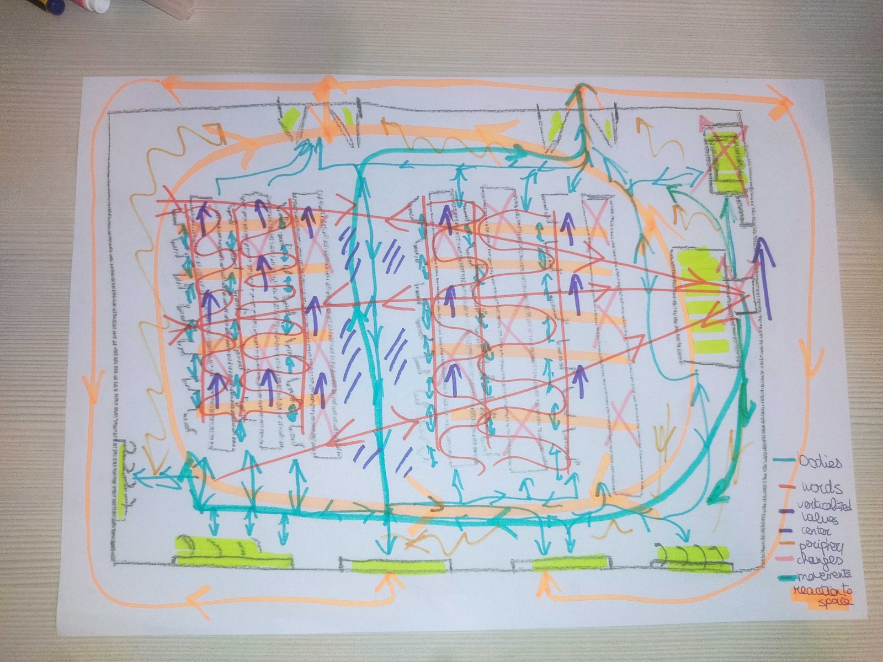

Slide 25
The architectural work as a text of culture

Slide 26
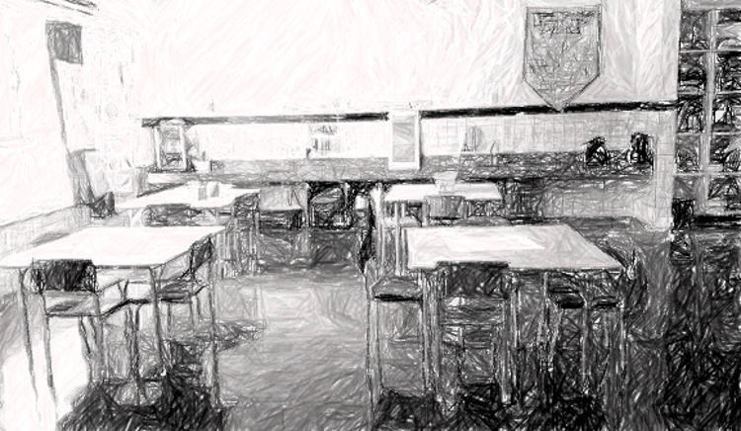
Notes:
Estranhar os espaços normalizados – aquilo sobre o que não se fala não entrou em crise

Slide 27
TEXT
one of the nodes in the network of interpretive routes
a historically stabilized discursive materiality, capable of producing other meanings
Lotman dedicated a large part of his work to the concept of text, for him that which, in the human world, gives us access to phenomena: “between the historian and the fact there is always the text: the historian necessarily needs to deal with texts”

Slide 28
Iuri Lotman
Lotman understands the text as a condensed program of the entire culture, insofar as, as a set of signs, they are models of culture, and at the same time they model it.
This property is called “semiotic double life”: the mechanism of culture is a system that seeks to transform the external sphere into the internal one, it lives from this opposition and from the passages between internal and external.

Slide 29
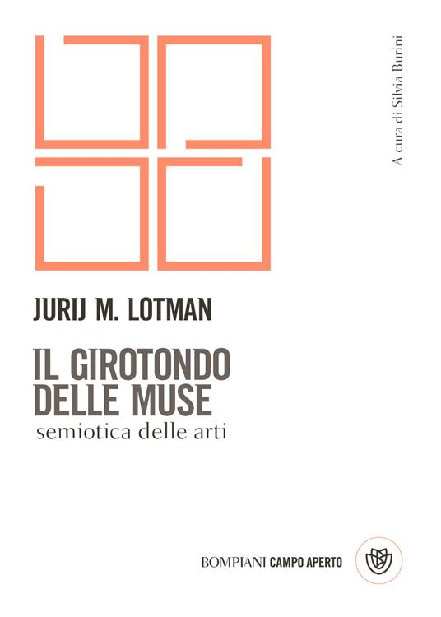
Architecture in the context of culture
Architecture is one of those modes of production of works – with form, content, and material – Lotman dedicates to it one of the parts of his work The circle of the muses: essays on the semiotics of the arts, in which, alongside of other forms of art, in permanent exchange, build the substrate of aesthetic values ​​of a culture.

Slide 30
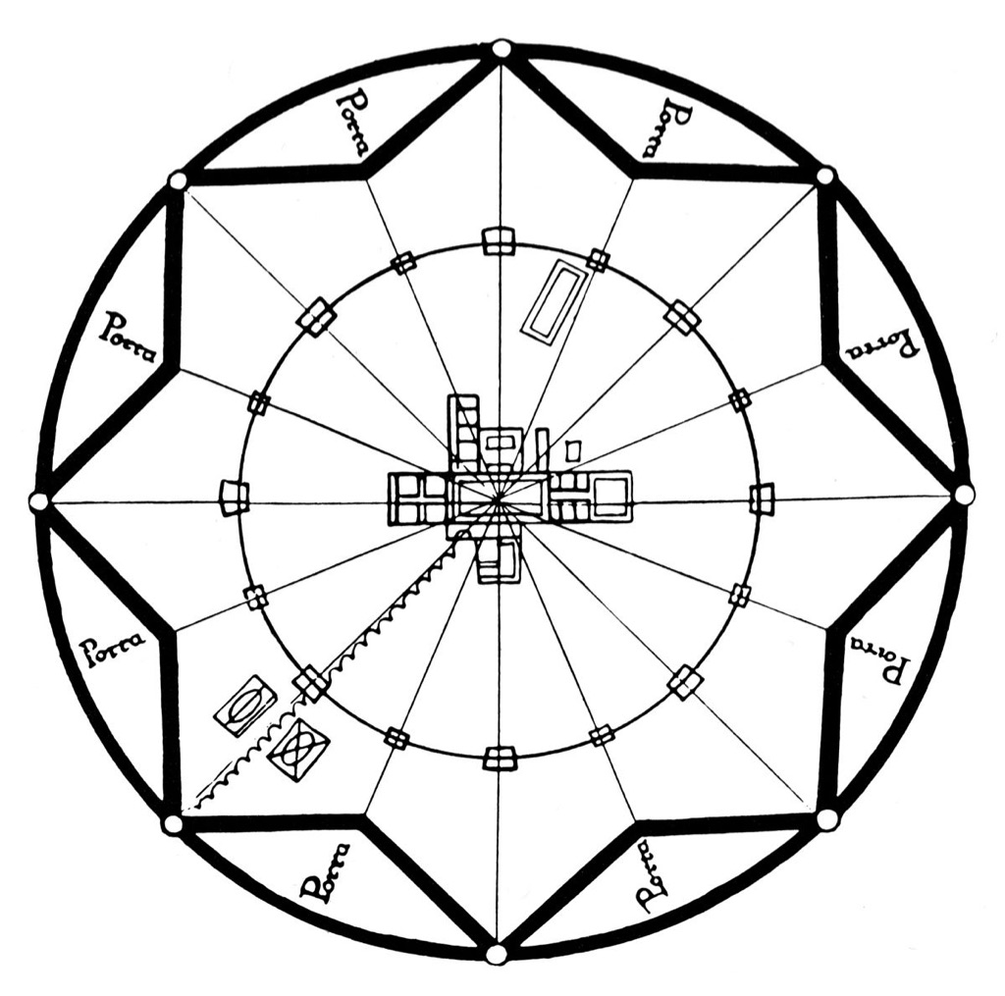
Architecturally created world as a microcosm of its idea of ​​the global structure of the world
For Lotman as well as Bakhtin, the value of human life or the semiotic function of any work in culture is at its core, and the closer we get to this center, the more we can understand how architectural elements are placed at the service of this valued image of human.
Sforzinda is the imaginary city on which the Treaty of Architecture, dated around 1464, by Antonio Averlino known as Filarete develops.

Slide 31
SIGN and (DE)SIGN
But architecture is not just made of architecture: it remains in constant relationship with the semiotics of non-architectural series that give meaning to cultural practices. It is here, within the scope of the historical and social formation of practices, that it becomes clear that the text will never be the realization of a design-project, because in relation to this invention and author's norm, the real text appears as something subject to unpredictable deviations, (de)signing. Here begins the domain of the unpredictable, of casual changes creating new formations, forcing dialogical relationships.

Slide 32
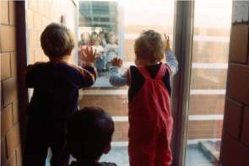

Slide 33
The semiotics of space has a vector character, is oriented, and always depicts points of view, spatial orientation vectors (to see from the outside, to see from above, or upwards, from a center, in the perspective of the passer-by, from east to west, etc.). Spatial relations represent parameters for the formation of ideological consciousness, vectorizing life and making itself invisible as a form. Architectural space is semiotic and can be understood from the reading of its elements as ideological signs – in the case of space, vector-oriented. Being semiotic, it is ideologically oriented, and materially possible to be understood by its lines of forces.

Slide 34
Bakhtin locates within the texts two forces in permanent struggle for meaning, in the multitude of ideological threads of all the voices that have enunciated this object in terms of value: the centripetal forces, interested in the stabilization of the senses and the maintenance of relationships, and the centrifugal forces, generally unofficial and destabilizing given meanings. The very fact that I deal with an object, says Bakhtin, already removes it from the realm of the given, opening it to the universe by giving of culture, always unpredictable in its multiple probabilities in the conflicting moments of the life of texts. For this theory, it is possible in the space-time indices saturated with senses (always in struggle) to understand the images of humans and their world that are created.

Slide 35
IMAGES OF HUMAN AND ITS WORLD
SEMIOTIC CENTER

Slide 36
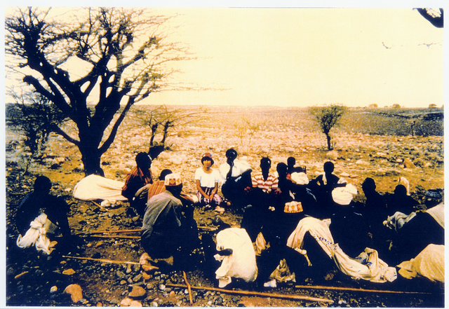
Unknown authorship, Nomads in a Culture Circle in Kenia, Instituto Paulo Freire, 1975

Slide 37
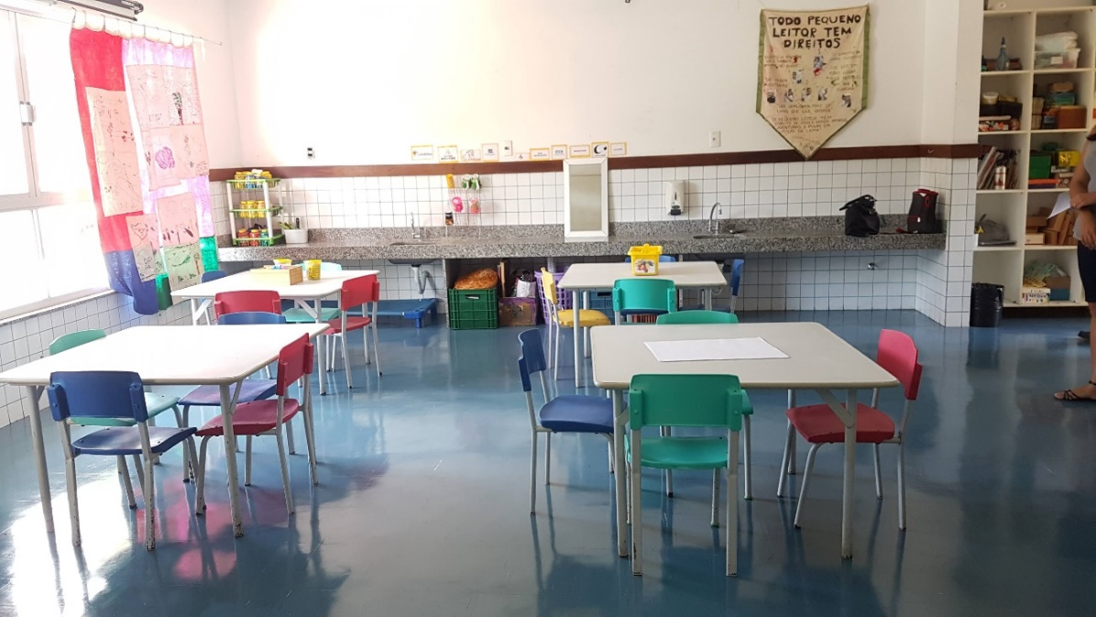
Notes:
Escritório – Office – Ufficio – scrivano, scrivania

Slide 38
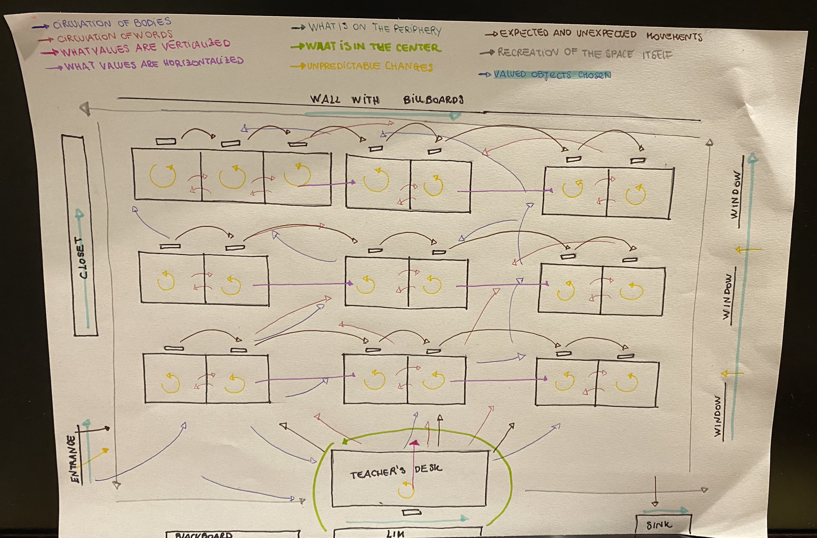

Slide 40
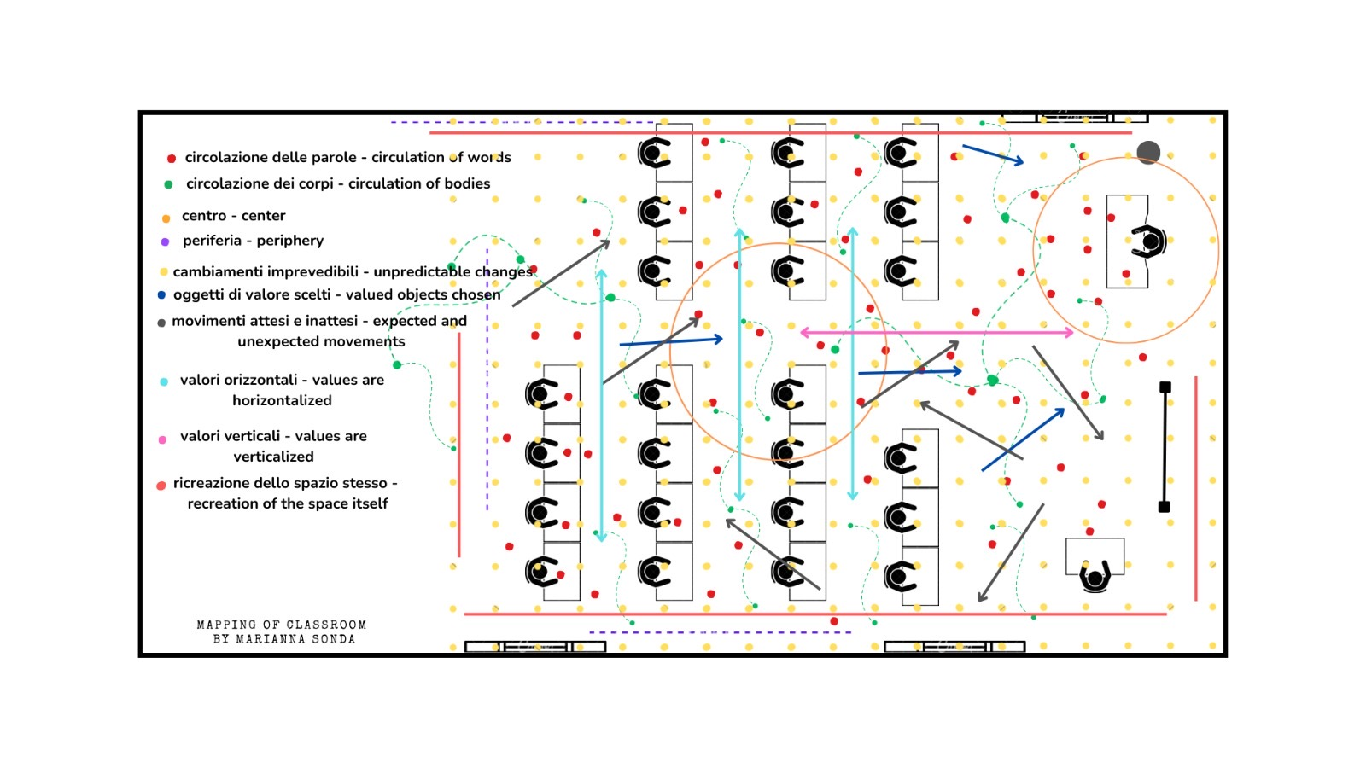

Slide 41
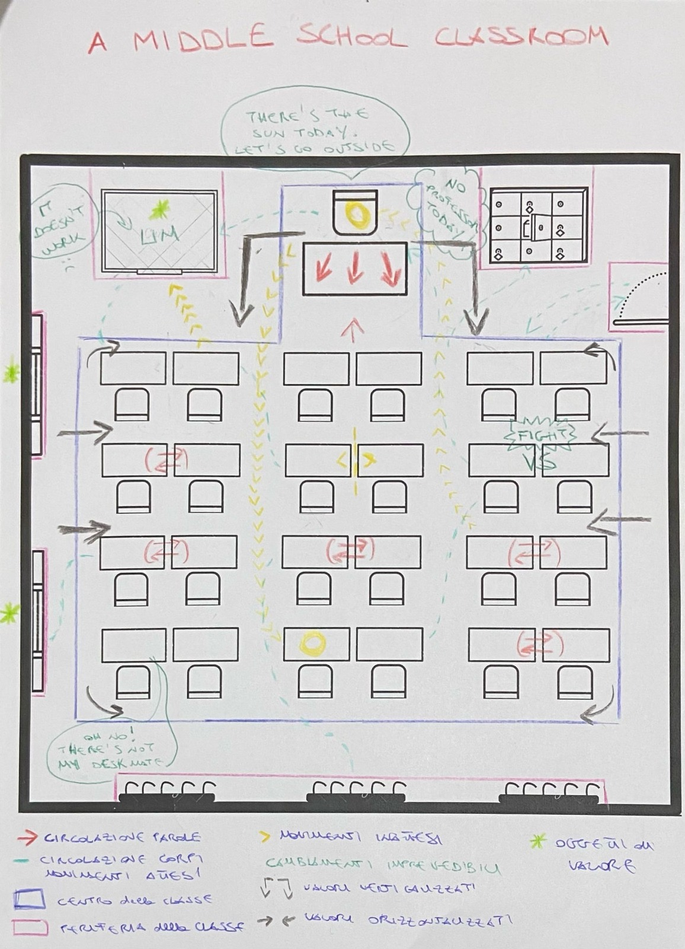

Slide 42
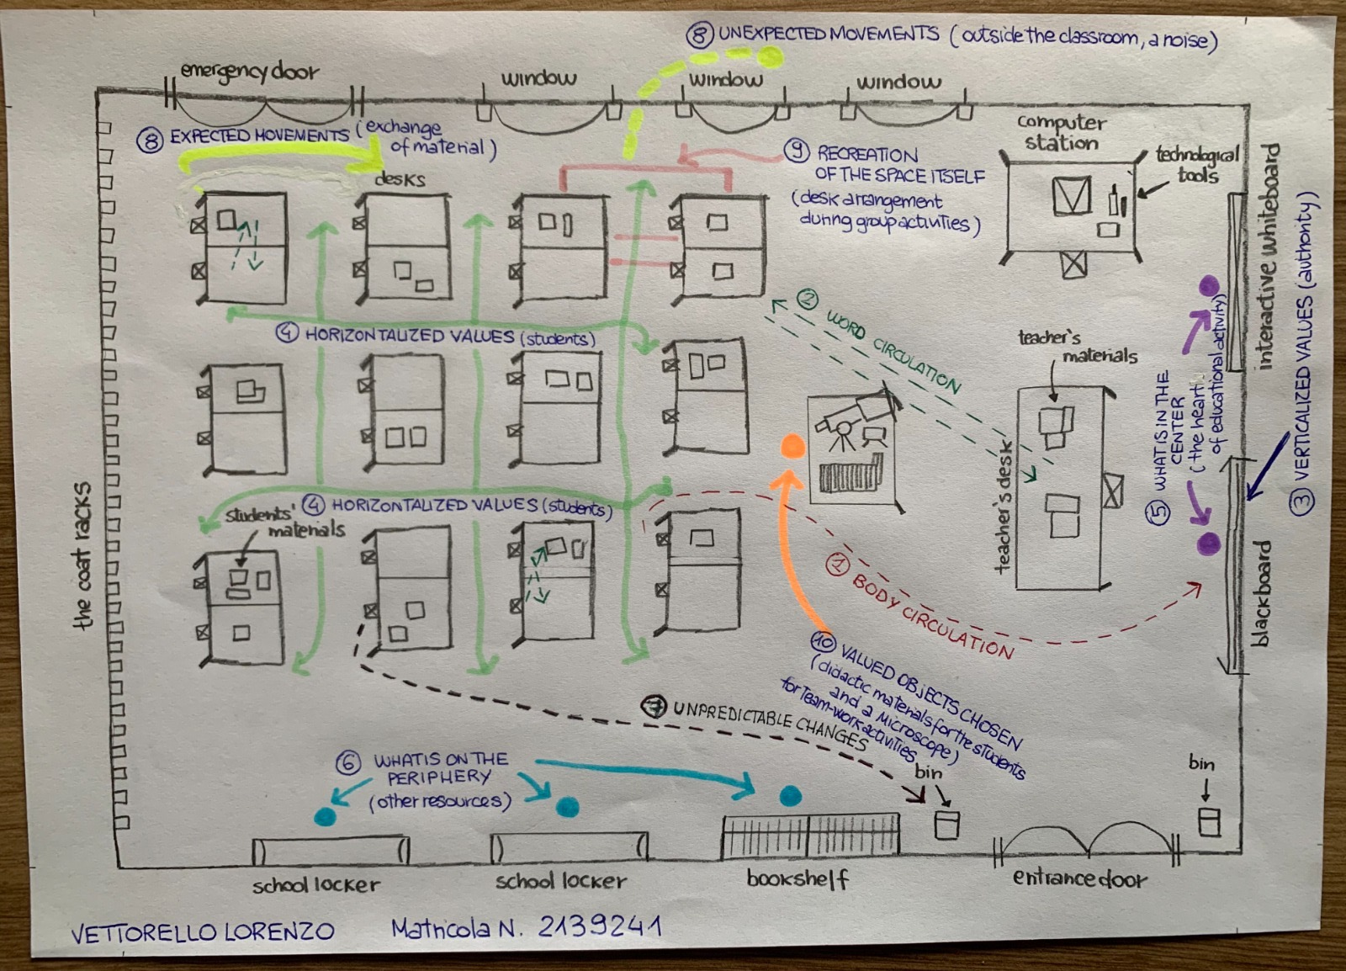

Slide 43
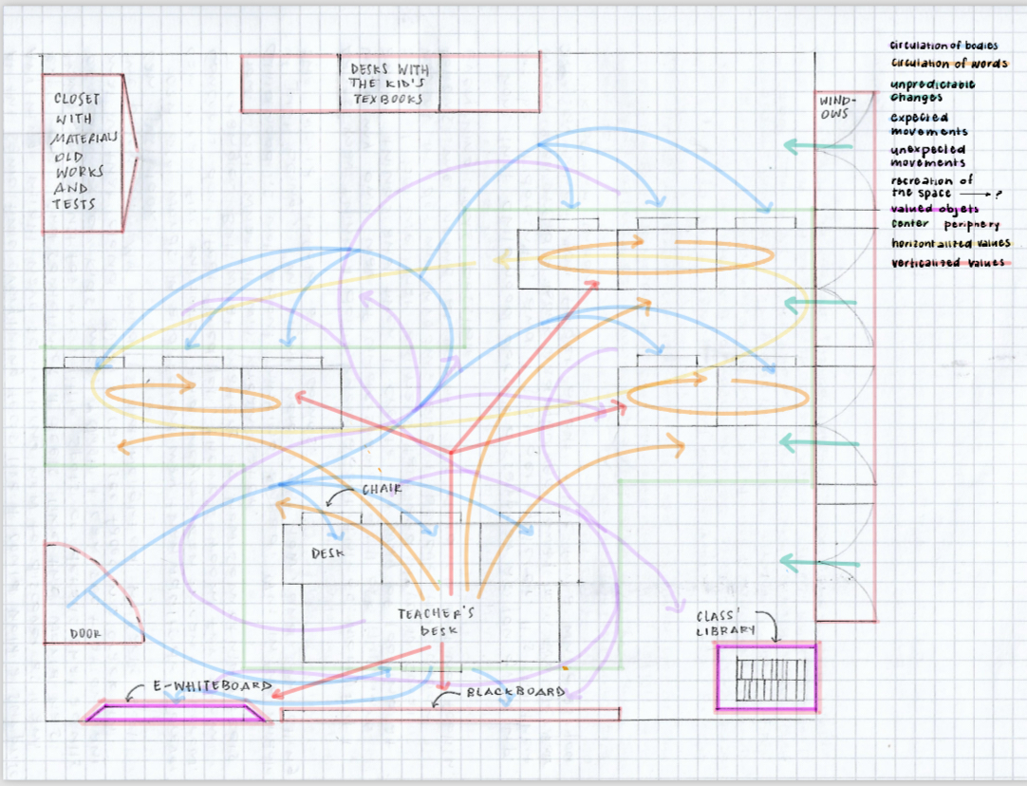

Slide 44
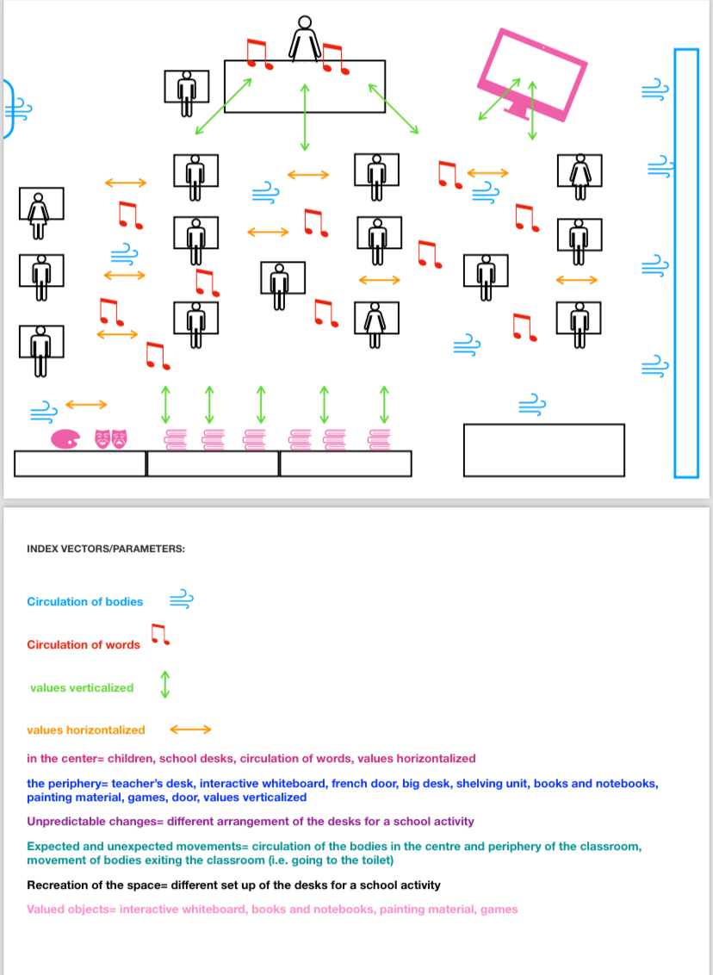

Slide 45
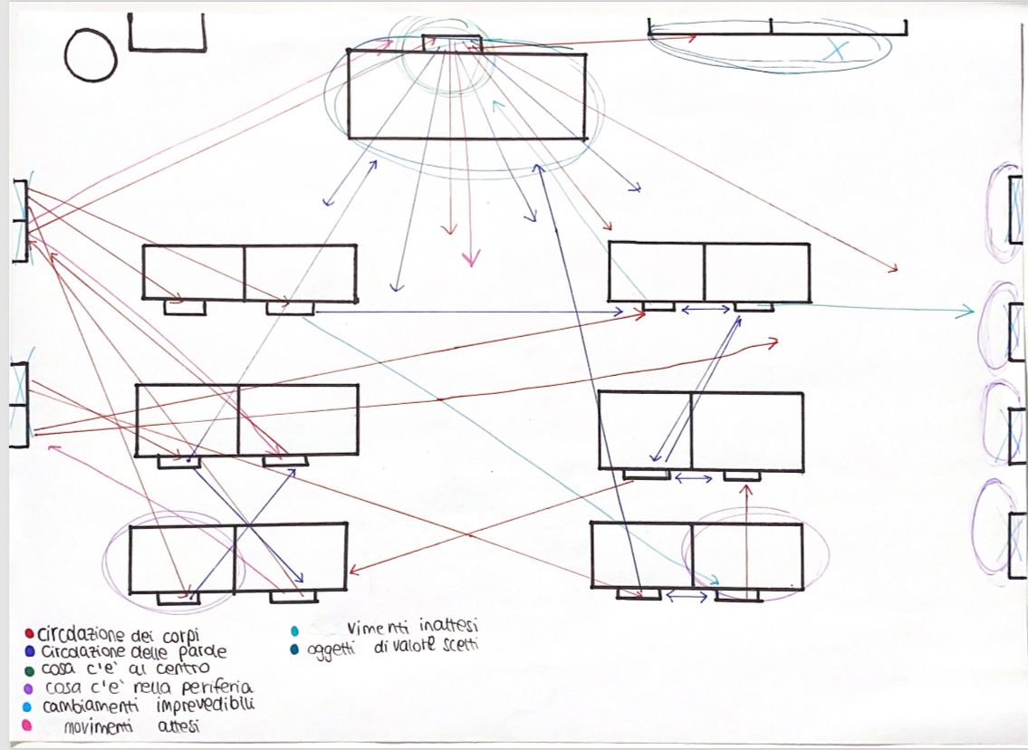

Slide 46
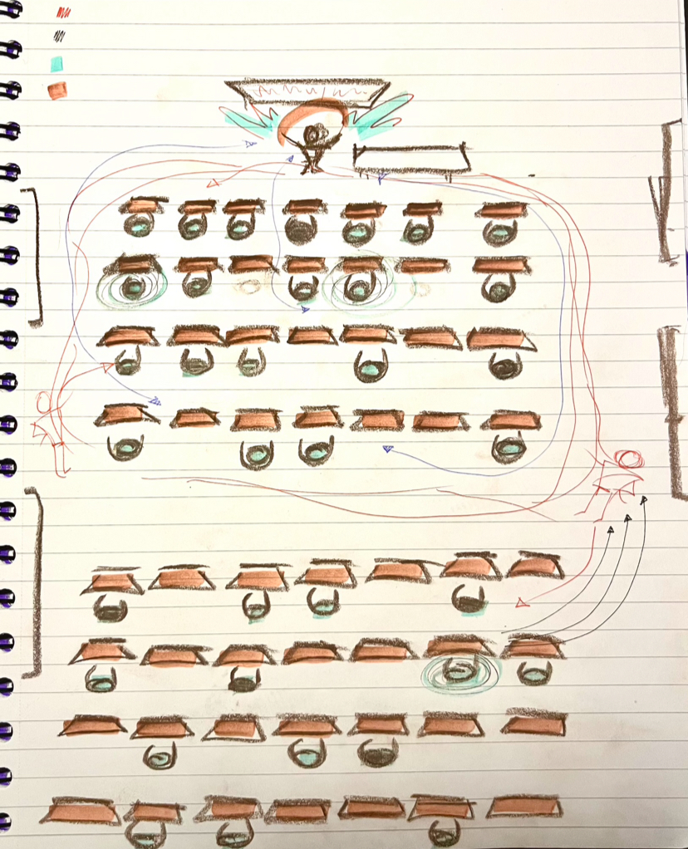

Slide 47
Explosive processes
On centrifugal forces and their renewing power, in another work Lotman will deal with the explosive processes of culture, which are events that interrupt the cause-effect chain of probable events, giving rise to spheres in whose limits new sets of possibilities arise. At the moment of the explosion, the intersection between past and future appears to be timeless, opening up within the system a map of equally possible points of future development, several equally possible paths of events.

Slide 48
Regularity as fatalism of form excludes the unpredictable and starts to see the historical process experienced as a one-way street. But at each moment an equally possible number of directions becomes possible, and explosive processes are nothing more than the realization of one among many possibilities. The moment of realization is the limit of indetermination, with inexhaustible possibilities, since it involves spheres that were previously located outside the limits of the given culture, and there are no known paths for that. The moment of explosion is the point at which new possibilities take shape, the moment of creation of another reality, with the displacement and reinterpretation of memory.

Slide 49

Understanding the elements of school architectural texts must be linked to some fundamental questions:
1) the recognition of their textual forms as syntactic and semantic organizations capable of ideological meaning, while specific modes of vision in a specific dimension of culture.

Slide 50
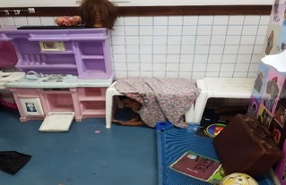
2) the search for its center of value and its semiotic center as the vortex where the forces are at their highest degree, there are the explosive moments in status nascendi.

Slide 51
3) the recognition of reading possibilities as a reconstruction and response to contradictory meanings and in dialogue between the author and the multiple meanings that are seen in the worldviews between which the text is placed as a concrete, but open reading position.
4) the understanding that the elements of the architectural text are woven around a human value, as combined moments of an open and disputed totality.

Slide 52
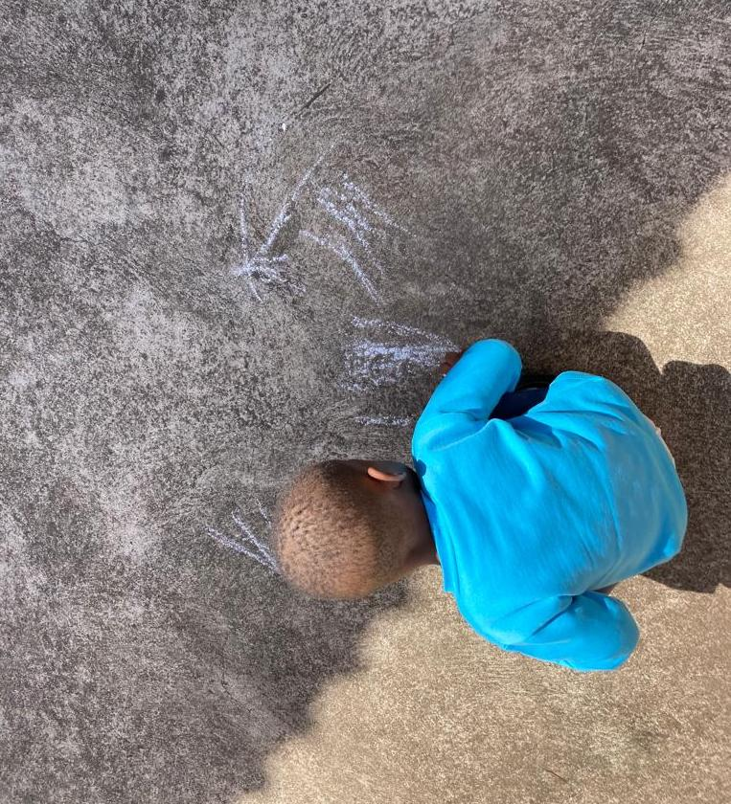
5) the search for text-context relations (in relations between models and in relations with non-architectural series) in their force games that appear images and conceptions of the world, of cosmos, of human.

Slide 53
6) the understanding that a spatial text has the forces represented in vectorial relations and that the life of these forces is found in the temporal elements that saturate and tension them to the point of maximum distension.
7) The acknowledgment of the possibilities of permanent changes and explosions, through the clashes between human images and the real life of human relations in school architectural spaces, and the need for a pedagogical intention to value and promote them.

Slide 54
8) The principle that we participate in these processes in a critical way, recognizing the authorship and human protagonism in children, young people and teachers who are the subjects of the act in educational environments, in relation to active and critical construction of their lives and their worlds.
Design with, not design / (de)sign for

Slide 55
We can propose the search for value centers in architectural spaces in their relations in culture, seeking the cultural programs that force the stability of their organization and the exaptation forces of language that force the derogation of the stabilized signs, which (de)signates the space -school time in their vital centers.

Slide 56
REFERÊNCIAS
ALIGHIERI, Dante. A Divina Comédia: Inferno. Edição bilíngue. São Paulo: Editora 34, 1998.
BAKHTIN, M. Os gêneros do discurso. Trad. Paulo Bezerra. São Paulo: Editora 34, 2016.
BAKHTIN, M. Para uma Filosofia do Ato Responsável. Trad. Valdemir Miotello & Carlos Faraco. São Carlos: Pedro & João Editores, 2010.
BAKHTIN, M. Questões de literatura e de estética: a teoria do romance. Trad. Aurora Fornoni Bernardini et alii. São Paulo: Hucitec, 2002.
BAKHTIN, M. Teoria do romance I: a estilística. Trad. Paulo Bezerra. São Paulo: Editora 34, 2015.
GOULD, S. J. & Vrba E. S. Exaptation: a missing term in the science of form. In: Paleobiology, 8, 1982, pp. 4-15.
LOPES, J. J. M. & MELLO, M. B. O jeito de que nós crianças pensamos sobre certas coisas: dialogando com as lógicas infantis. Rio de Janeiro: Rovelle Editora, 2010.
LOTMAN, I. Mecanismos imprevisíveis da cultura. Trad. Irene Machado. São Paulo: Hucitec, 2021.
LOTMAN, J. Il girotondo delle muse: semiotica delle arti. Trad. Silvia Burini. Milano: Bompiani; Campo Aberto, 2022.

Slide 57
LOTMAN, J. L’architettura nel contesto della cultura. Trad. Silvia Burini. In: eSamizdat, 2004 (II), 3.
LOTMAN, J. Tesi per una semiotica della cultura. Collana a cura di Franscicu Sedda. Roma: Meltemi editore, 2006.
LOTMAN, Y. “O problema do fato histórico”. In: SERRA et al. La exuberancia de los limites: homenaje a Jorge Lozano. Capítulo: BURINI, S. Yuri Lotman e o problema do fato histórico. Madrid: Biblioteca Nueva, 2013.
MELLO, M. B.; LOPES, J. J. “Il Cronotopo nelle immagini della povertà̀ in Gogol’ e Dostoevskij”. In: PETRILLI, Susan (cura). L’immagine nella parola, nella musica e nella pittura. Milano/Udine: Mimesis Edizione, 2018 (Mimesis / Athanor. Semiotica, Filosofia, Arte, Letteratura. Collana diretta da Augusto Ponzio. n.s. XXVIII, 21)
SANTI, M. “Adattamento (Esattamento)”. In: D’ALONZO, L. (ed.) Dizionario di pedagogia speciale, 2019, pp. 28-36.
UEXKÜLL, J. v. Dos animais e dos homens. Lisboa: Editora Livros do Brasil, 1982.
VOLÓCHINOV, V. N. Marxismo e filosofia da linguagem: problemas fundamentais do método sociológico na ciência da linguagem. Trad. Sheila Grillo; Ekaterina Vólkova Américo. 2 ed. São Paulo: Editora 34, 2018.

