Slide 1


Introduction to bibliographic research and library services
Workshop for Applied sciences to cultural heritage materials and sites students

Slide 2
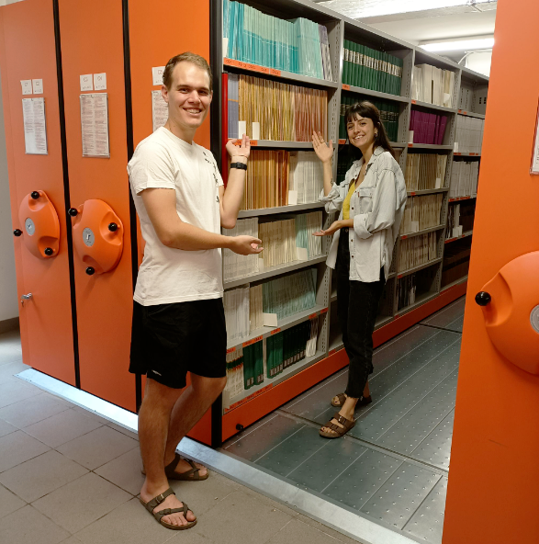
In the first part of this workshop
you’ll learn more about
the libraries at the University of Padova
how to find a book
how to borrow a book
how to access an ebook

Slide 3
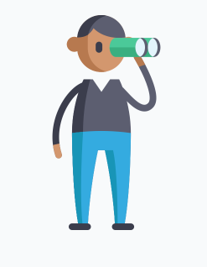
I’m looking for a library
As a student, you have access to all the libraries of the University Library System.
You can find all the information about locations and opening hours here: more info.

Slide 4

So…can I come in?
Absolutely, be our guest! Just make sure to:
reserve your spot using the Affluences
scan the QR Code when you arrive to confirm your reservation

Slide 5
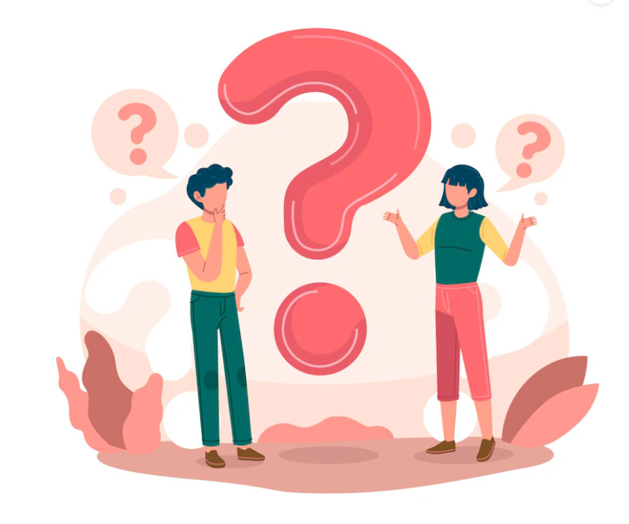
How to…find a book
(when you have one in mind)
Let’s say you’re writing a research paper on:
"The 3th millenium painted pottery from Mahtouthabad, Jiroft (Kerman, Iran): an integrated archaeometric approach to define the production technology of the polychrome decoration system"
And your supervisor suggests you start by reading this specific book:
Rice, Prudence M. Pottery analysis: a sourcebook. 2. ed. Chicago: University of Chicago Press, 2015.
Where is it? Can you borrow it?

Slide 6
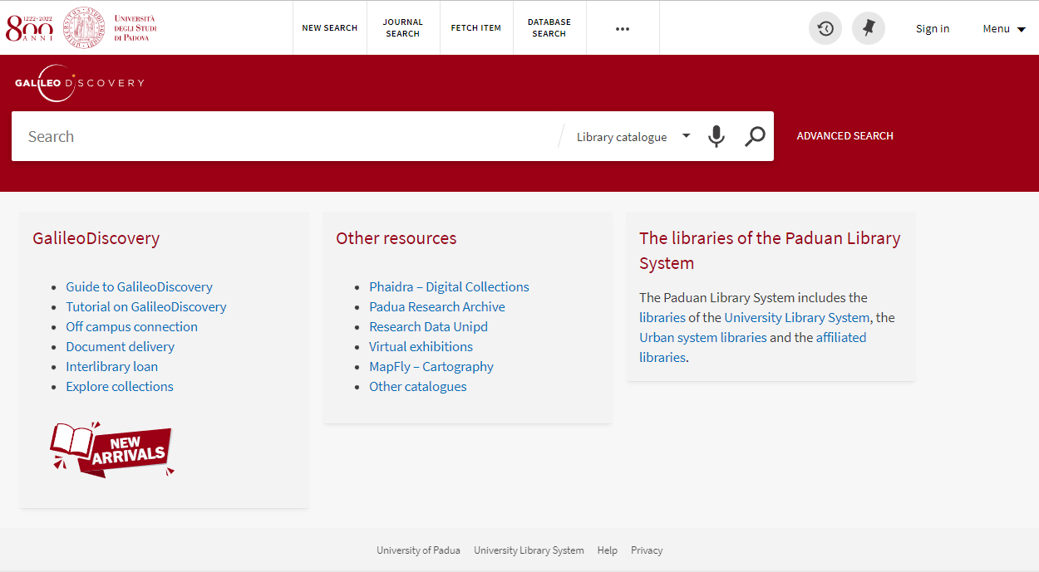

GalileoDiscovery
GalileoDiscovery is a tool for searching books, articles, journals, and many other resources within the Padua Library System collections, including:
- university libraries;
- public libraries;
- affiliated libraries.
Click on “menu” (top right of the page) and select English as your default language, if needed.

Slide 7

How to search
Rice, Prudence M. Pottery analysis: a sourcebook. 2. ed. Chicago: University of Chicago Press, 2015.
Author
Title
Edition
Publisher
Year
Use only a few, meaningful keywords

Slide 8
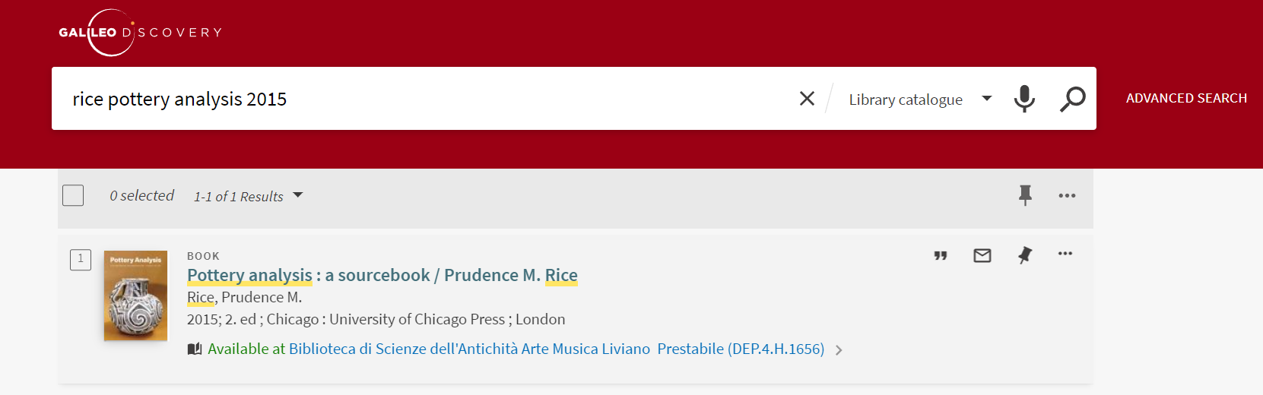
When you have a proper citation, use
author’s name
meaningful title words
add publication year if you want to quickly pick a specific edition
A reference, or citation, gives you the basic information needed to identify a publication.

Slide 9
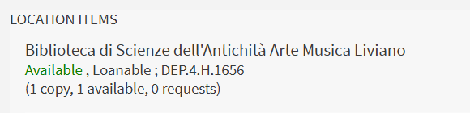

Item location (for the address, click on ) )
Call number (i.e. the specific location on the shelf)
Borrowing policies
Availability (available/out of library)

Slide 10
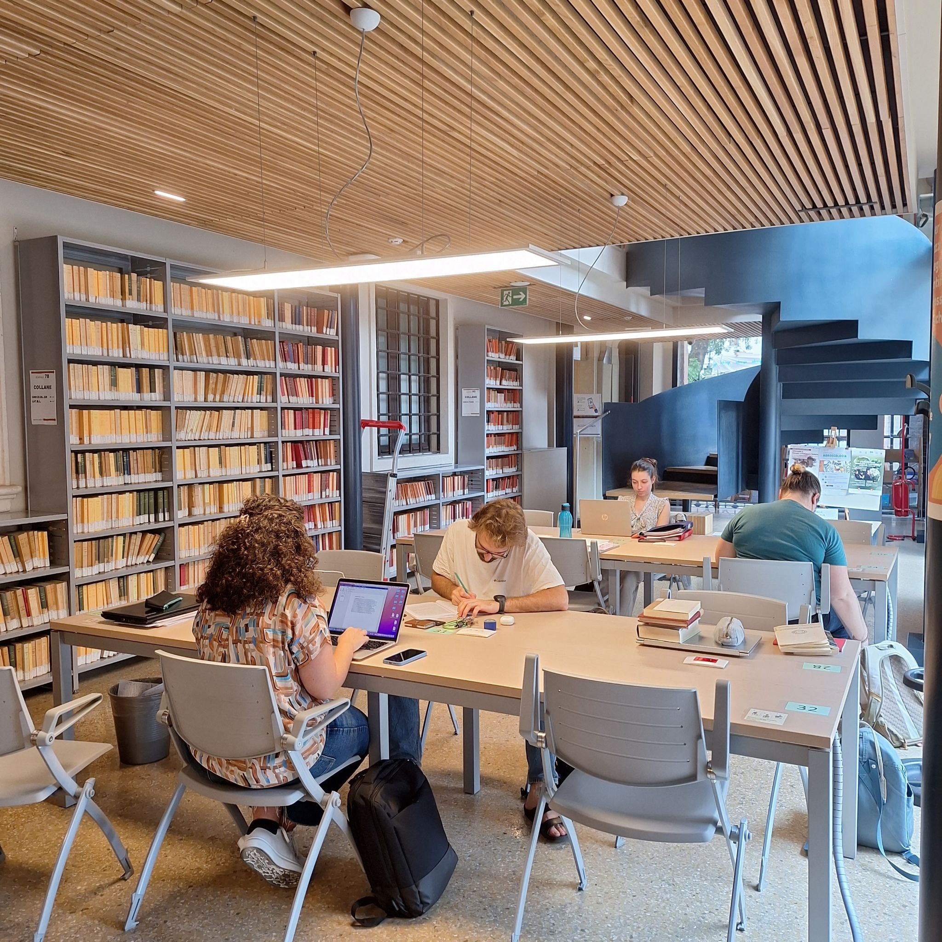
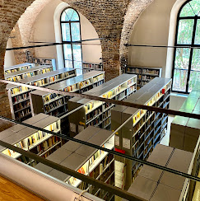
The Liviano Library
main subjects: Archeology; Greek and Latin literature and philology; Arts, Music
Monday-Friday 9 a.m - 11 p.m.
Saturday-Sunday 9:30 a.m. - 6:30 p.m.
134 seats
150,000 books/ebooks
1,300 journals
… and millions of ebooks and ejournals through the University library System
Most (but not all!) material on open shelves

Slide 11

Circulation services
Can I borrow items from any library of the University Library System?
Yes, from every library!
Take your student card or your fiscal code to the circulation desk.
Return the items to the same library.
How many items can I borrow and for how long?
Up to 15 books per library.
30 days (some loans are limited to 15 days or just 1: check GalileoDiscovery).
How can I extend my loans?
Login in GalileoDiscovery (SSO authentication) or ask the staff.
You can renew an item unless it's overdue or reserved by someone else.

Slide 12
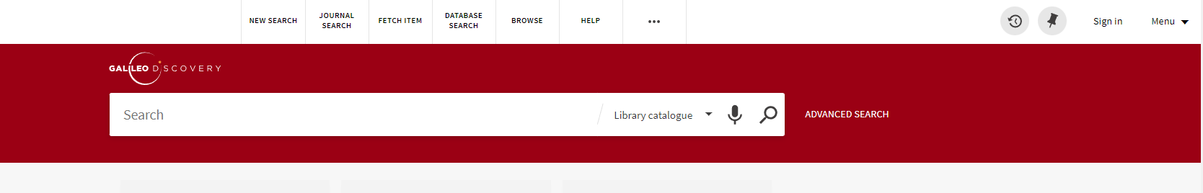
How to log in GalileoDiscovery
Click “Sign in” on top right of the home page.
Choose “Login with SSO authentication”.
Use your student mail (name.surname@studenti.unipd.it and you password).
…now you can renew yours loans and place reservations on items.
You can only place a reservation on items in closed shelves or those that are already on loan.

Slide 13
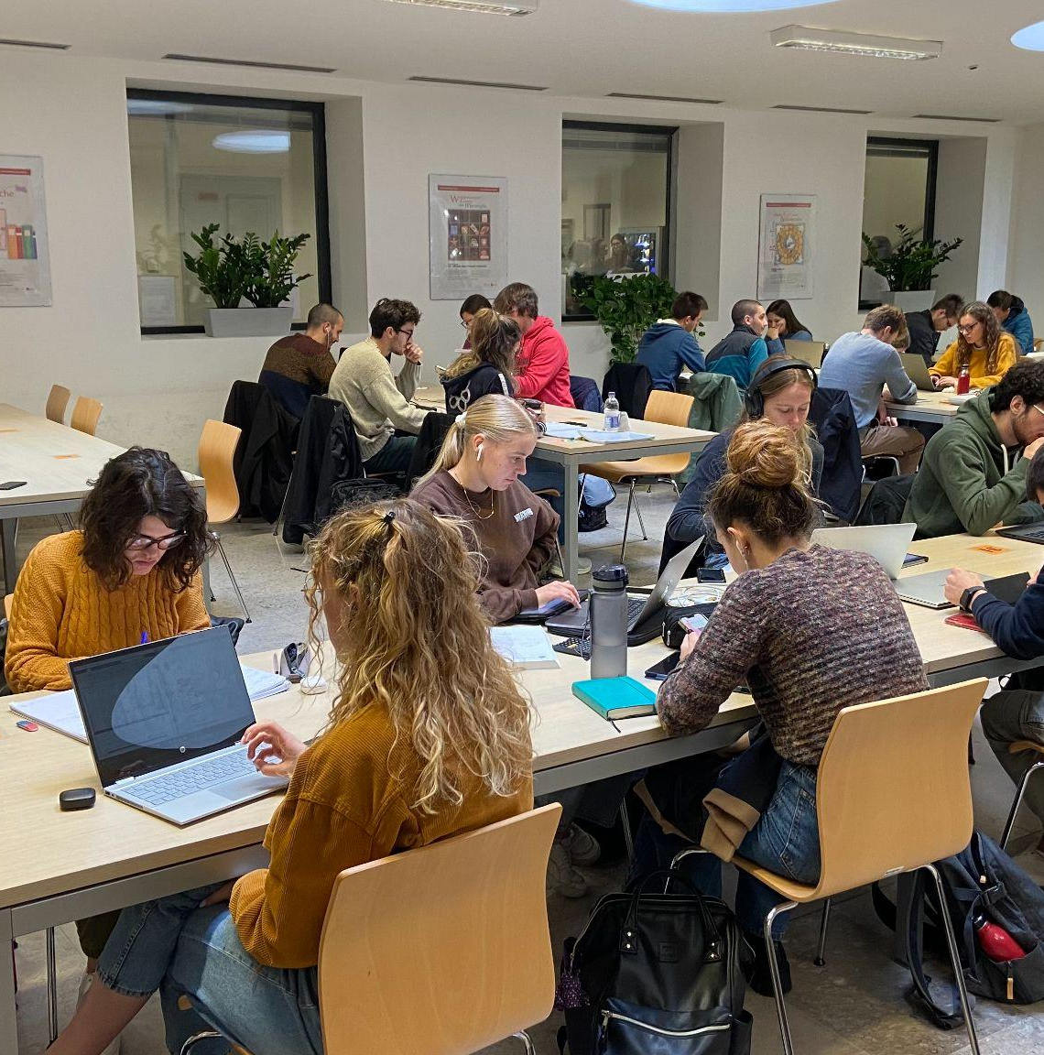
The Geosciences Library
Monday-Thursday 8:30 a.m - 18:00 p.m.
Friday 8:30 a.m - 2:00 p.m.
87 seats
10 notebooks for loan
15,000 books
2,000 journals
20,000 maps
… and millions of ebooks and ejournals through the University Library System

Slide 14
How to…find a book
(when you have only a few clues)
Let’s say you’re working on your thesis
"The Egyptian blue pigment: identification, manufacturing techniques, provenance"
and you remember seeing a handbook dedicated to historical pigments months ago in the new arrivals section.
If you’re not mistaken, the author’s name was something like Eastarch… Eastungh… something along those lines.
Notes:
[LEGGI SLIDE]
This time, we don’t have a full citation, just some clues. In situations like this, we need to use some retrieval strategies, starting with the information we’re sure about.

Slide 15
How to search
It was a sort of dictionary of pigments and, if I’m not wrong, the author was Eastarch…Eastungh… or something similar.
Advanced search:
keywords: pigment*
author: East*
Use only the information you’re sure of
Use advanced search when the collection of items is large and needs to be narrowed down.
Notes:
In this case, if we only use the vague information we have, we might end up with a really long list of results. So, it’s better to be one step ahead. I recommend using the advanced search.
With advanced search, you can look for multiple terms in different fields at once. You can specify exactly what you want to search for, like an author’s name or a title. It’s perfect when you have a lot of results and need to narrow them down.
It’s also really helpful when you’re searching for an author with a common name—just combine the name with a subject to make the search more specific.
Alright, let’s go back to GalileoDiscovery. Now, click on “advanced search.” From the drop-down menu, choose the data field you need.
We’re not sure if “pigment” is the subject (the main topic of the book) or part of the title. So, let’s choose “any field” and type in “dictionary pigment*”. I’ve added a star (*) to the end of “pigment” – this is called truncation, and it helps us find different forms of the word, like singular or plural, or related words.
Next, if we choose “any field” and type in the first few letters of the author’s last name we will have this number of results. Not that many (results) in this case, but it could be different with other searches. Let’s choose “author” and type in the first few letters.
Now, we see that we have more than one book that match our research. Unfortunately, the one we have at the Geoscience Library isn’t available, but there are two copies of the other book – one at the Liviano Library and one at the Chemistry Library. If you want to borrow the book, go for second copy (the one at the Chemistry library) since the first one is not for loan.
Just one more tip: if you're curious about other books by the same author, scroll down the page until you see the publication details, and click on the author’s name (it’s underlined). That will show you a list of all the titles linked to that author.

Slide 16
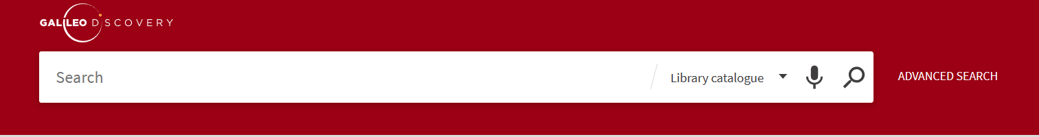
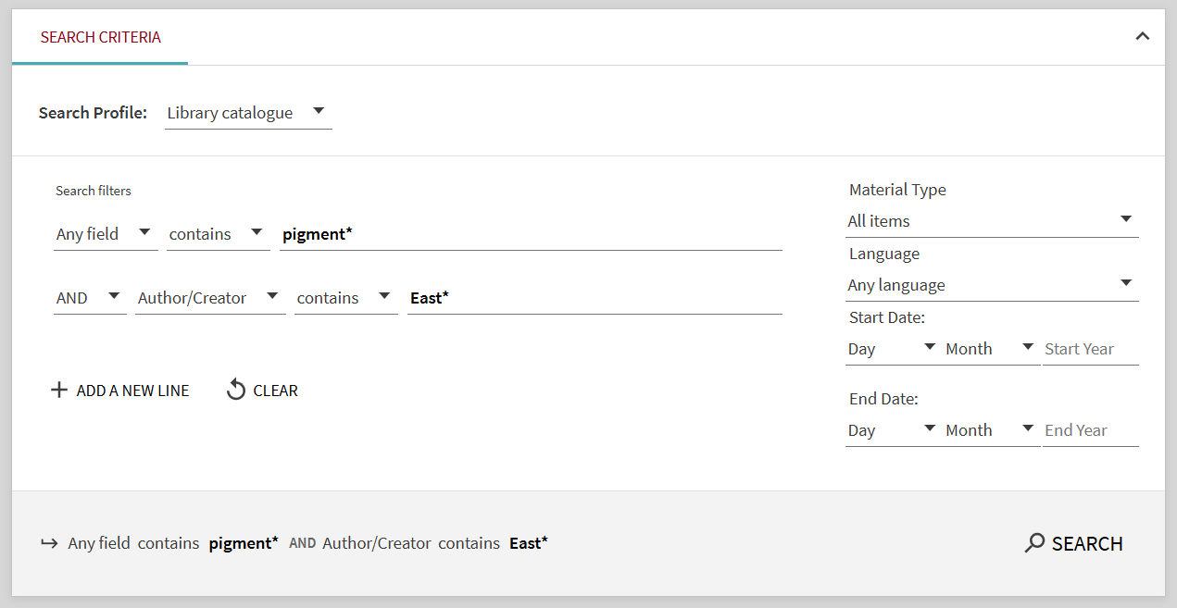
Add a truncation symbol (*) to the root of the words if you want to retrieve singular, plural, or similar forms of the word.

Slide 17
How to…find a book
(when you feel hopeless)
You were looking for this book
Creagh, D.C. and Bradley, D. A. Radiation in art and archeometry. Amsterdam: Elsevier, 2000.
but you couldn’t find it in GalileoDiscovery.
What can you do?
Notes:
First, let’s carefully check the catalog [ricerca in galileo]
If our search in GalileoDiscovery didn’t give us any results, what should we do next?
We can try checking on SBN, which is the collective catalogue of the National Library Service. It’s a network of Italian libraries, including universities, public institutions, and more.
You can click here... and you’ll see that other libraries in different cities have a copy of the book. So, what do we do now?

Slide 18
Interlibrary loan
What is the interlibrary loan service?
ILL service allows you to borrow materials from another library through your own library
Is it for free?
No.
6,50 euro: items from Italy
13,50 euro: items from abroad
How do I ask for an Interlibrary loan?
Submit your request by filling out the online request form.
The length of the loan and the possibility of extend it are determined by the lending library.
Notes:
You might be asking about interlibrary loan (ILL) – it’s a service that lets you borrow books and materials from other libraries through ours.
Just make sure that the Padua Library System doesn’t already have the book. If you’re not sure, don’t hesitate to ask us for help – we’re happy to assist!
A quick reminder: ILL is not a free service. You’ll need to pay a small fee to cover the shipping cost.

Slide 19
How to…access an ebook
(from home)
For the exam “Materials properties, use and conservation: metals and metallurgical processes” you need this book
Bachmann, H. G. The identification of slags from archaeological sites. Abingdon: Routledge, 2016, https://doi.org/10.4324/9781315418216.
and you’ve found it as ebook in GalileoDiscovery, but you can’t open it: why?
Notes:
[FARE LA RICERCA IN GALILEO DISCOVERY]
As you can see, if you scroll down a bit, there’s a “full text availability” section. Click on it, and it will take you to the publisher's website. Here we are!
Now, if we go back to GalileoDiscovery, you’ll notice this little note: “access only for university users.”

Slide 20

Proxy
Most of the scientific literature is expensive and accessible only by subscriptions reserved for university users:
in campus just connect to Eduroam
at home set up the browser add-on Proxy Docile or access to SSO authentication
If your proxy is on, you can access from Google to resources the University pays for
Notes:
The University Library System has agreements with electronic content providers for e-journals, online databases, and millions (yes, millions) of e-books.
These agreements usually allow us to give remote access to students, faculty, and staff at our University, but not to anyone else. Our content providers can recognise users who are on campus and connected to eduroam Wi-Fi and allow access.
But if you’re working off-campus, you’ll need to identify yourself. We use our proxy server to verify who you are and get you access to the library’s licensed content.
We recommend setting up the Proxy add-on on your browser for easy access from your laptop. It’s quick and simple to do.
We encourage you to make full use of these digital resources for your academic work, but please remember it’s for personal use and research/study purposes only. Please use the resources responsibly: downloading like there’s no tomorrow or using them inappropriately could lead to the service provider suspending access for everyone at the university. Both the library and the service provider monitor access, so... let’s keep it within limits!
W: Almost done, let’s go back for the last time to wooclap

Slide 21
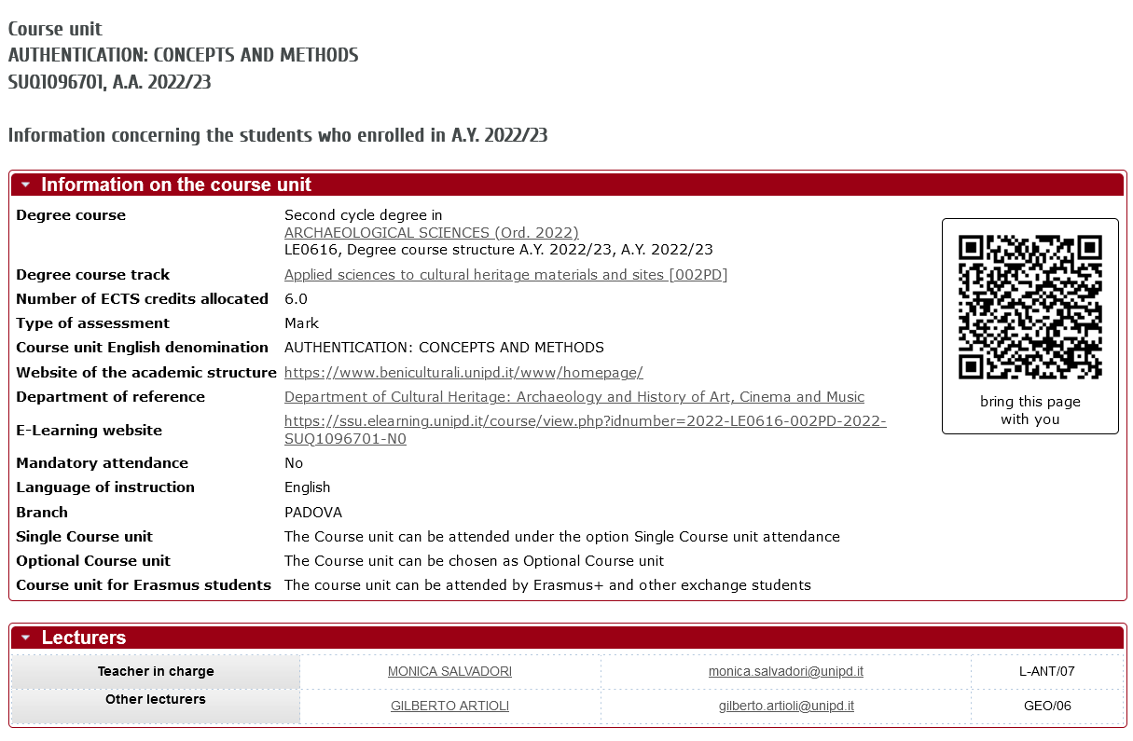
Let’s meet… The Syllabus

Slide 22
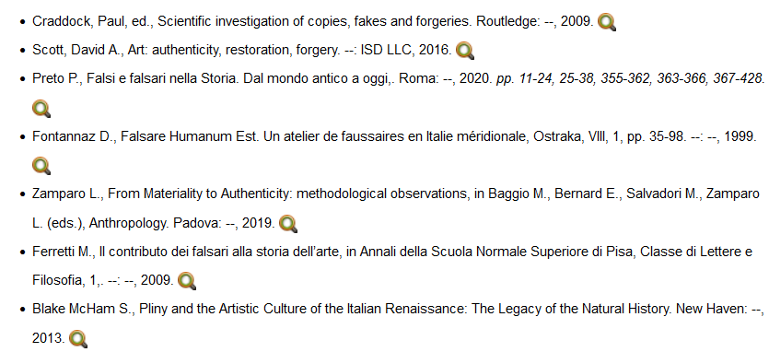
Click on the magnifying-glass

Slide 23
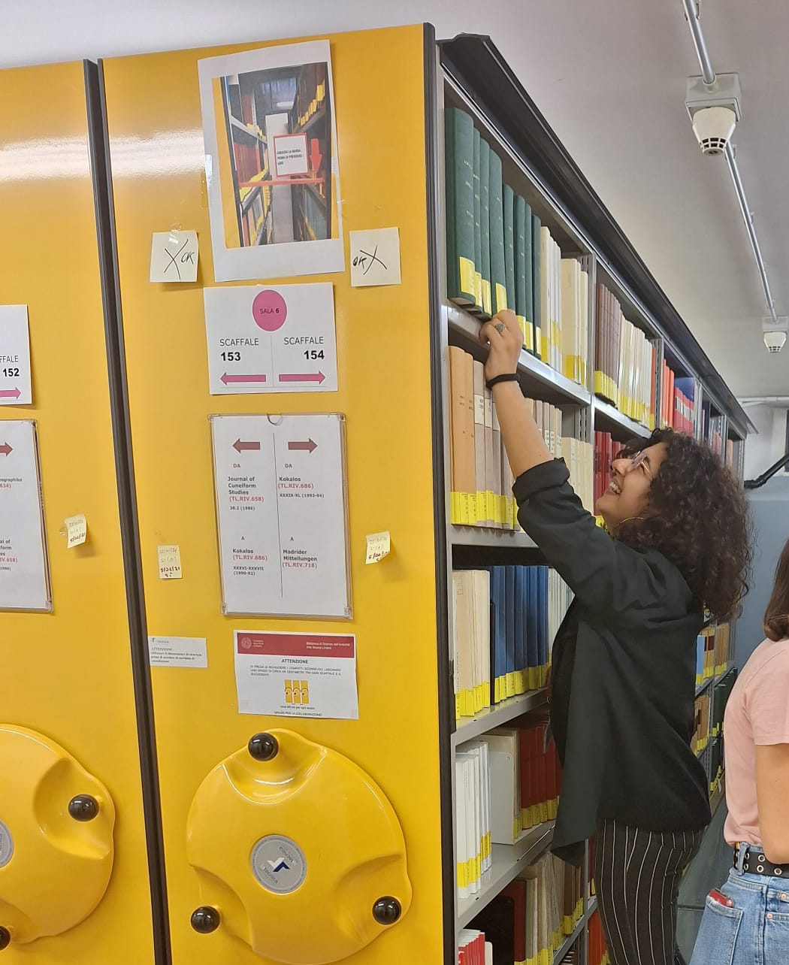
In the second part of this workshop
you’ll learn more about
how to find a journal
how to find an article
how to access an ejournal
how to ask for help

Slide 24
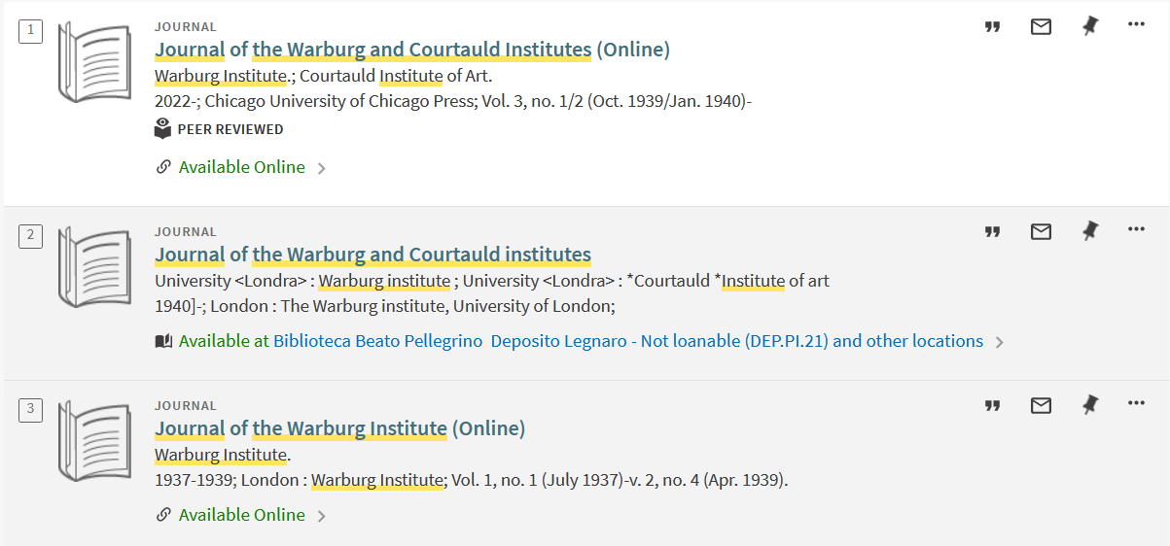
It is not on books alone…

Slide 25
Journals
An academic journal or scholarly journal is a periodical publication in which scholarship relating to a particular academic discipline is published. [...]
They nearly-universally require peer-review or other scrutiny from contemporaries competent and established in their respective fields.
"Academic journal." Wikipedia, The Free Encyclopedia. Wikipedia, The Free Encyclopedia, 20 Feb. 2023. Web. 20 Feb. 2023.

Slide 26
How to…find a journal
(when you have one in mind)
In order to start working on my thesis
“The bricks of ancient Nora (Sardinia, Italy)”
my supervisor suggests having a look to the journal
Quaderni Norensi.
Where can I find it?

Slide 27
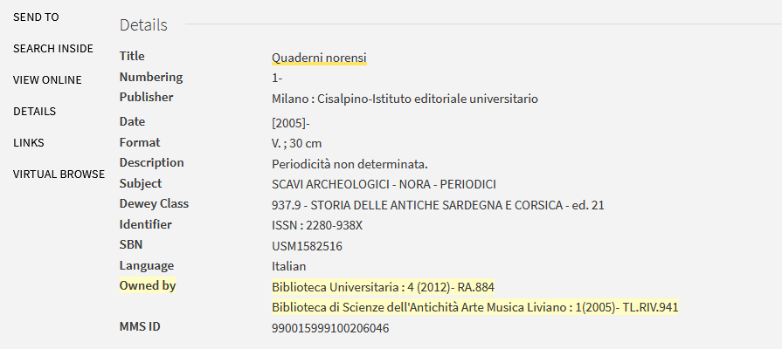
Look at the “Owned by” section

Slide 28
Journals
An academic journal or scholarly journal is a periodical publication [...]
Content typically takes the form of articles…

Slide 29
How to… find an article
(that is not available online)
I’m studying about “Authentication: concepts and methods”, and I want to read this article cited in the course syllabus.
Fontannaz D., Falsare Humanum Est. Un atelier de faussaires en Italie méridionale, Ostraka, VIII, 1, pp. 35-98. 1999.
What I need to put into GalileoDiscovery to find it?

Slide 30
How to search (1)
Gage J.,
A Locus Classicus of Colour Theory: The Fortunes of Apelles,
in “Journal of the Warburg and Courtauld Institutes”, XLIV.
1981
Author
Title of the article
Title, volume (and pages) of the journal
Year
Find the title of the journal and use it as a keyword

Slide 31
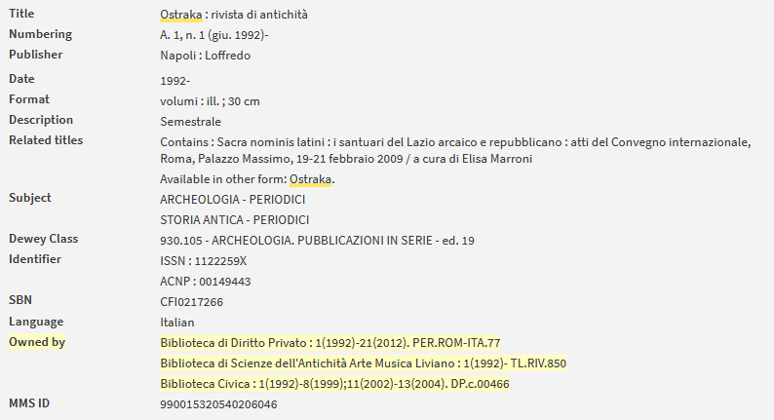
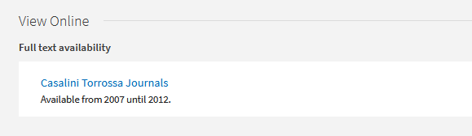

Slide 32
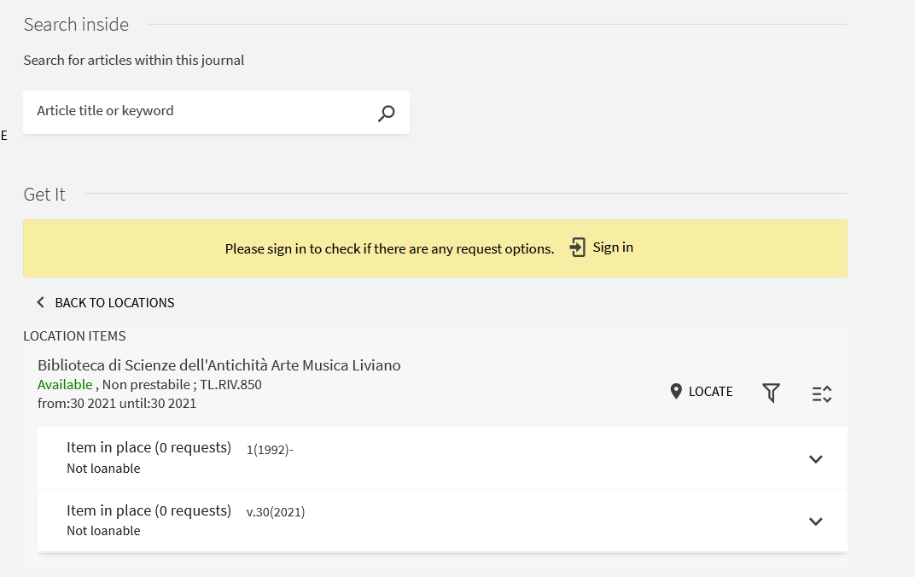
If you click on a journal location, you can see which one is the newest issue delivered to the library.
PRO TIP

Slide 33
How to… find an article
(when you have one in mind)
I’m still studying about “Authentication: concepts and methods”, and I want to read this article cited in the course syllabus.
Gage J., A Locus Classicus of Colour Theory: The Fortunes of Apelles, in “Journal of the Warburg and Courtauld Institutes”, XLIV. 1981.

Slide 34
How to search (2)
Gage J.,
A Locus Classicus of Colour Theory: The Fortunes of Apelles,
in “Journal of the Warburg and Courtauld Institutes”, XLIV.
1981
Author
Title of the article
Title, volume (and pages) of the journal
Year

Slide 35
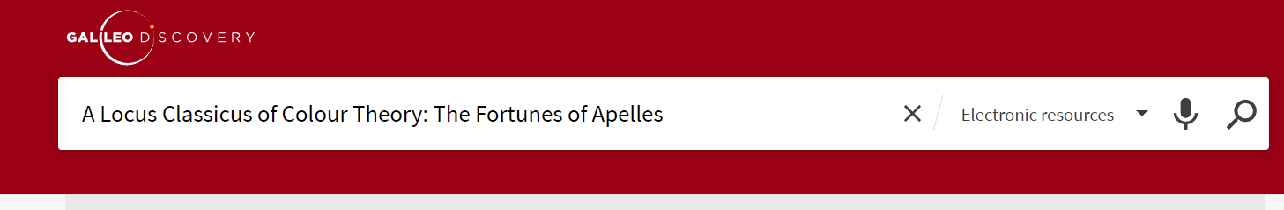
How to search (2)
Switch from “library catalogue” to “electronic resources” or “Everything” and search for the article title.

Slide 36
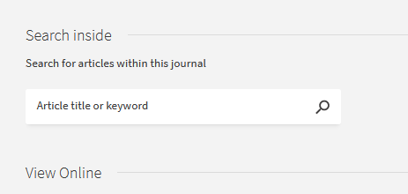
How to… find an article
and read it online

Slide 37
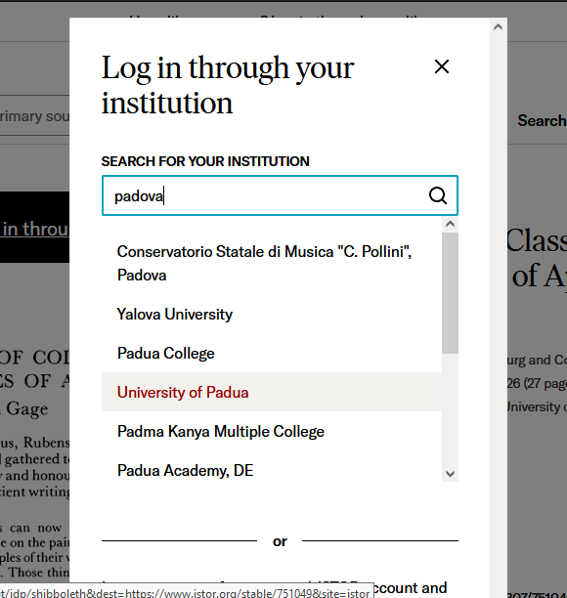
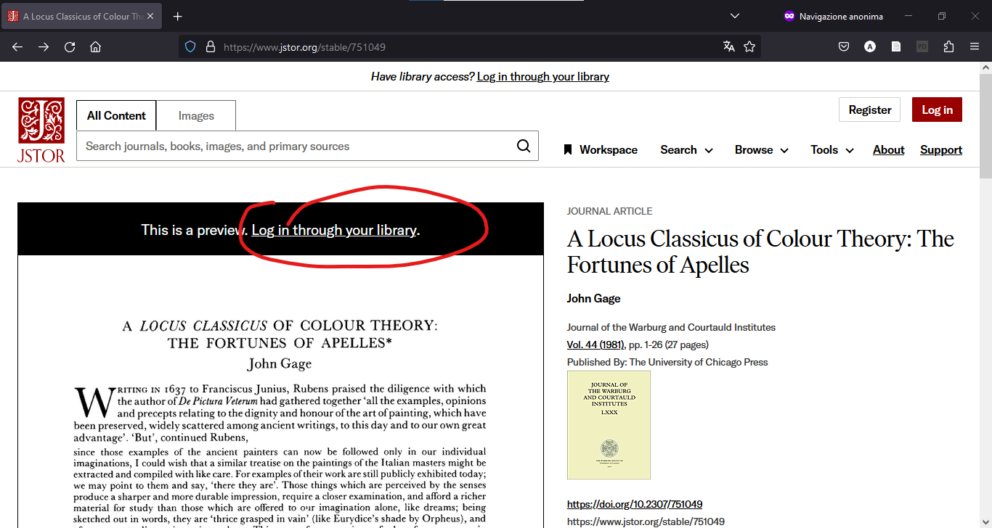
If you are off campus, access via SingleSignOn…

Slide 38
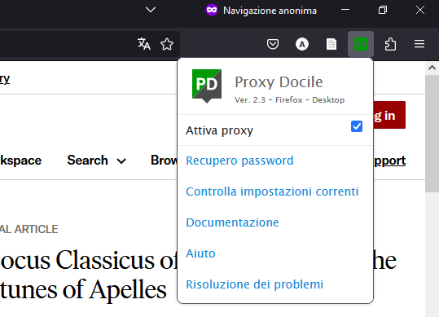
… or via Auth-proxy service

Slide 39

Document Delivery
What is document delivery service?
DD service allows you to have articles and part of books (up to 15% of the total pages) from another library through your own library.
Is it for free?
Most of the times.
If not, we will let you know.
How do I ask for a Document Delivery?
Submit your request by login to Nilde, select your preferred library and fill out the form.
The library provides printed copies of the material, we cannot send digital copies.

Slide 40

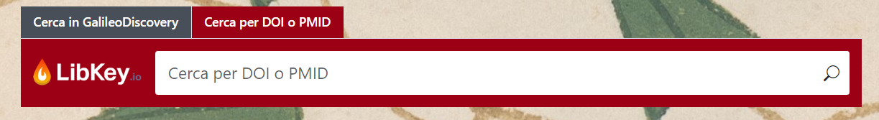

LibKey Suite
LibKey Nomad: it is an extension for major browsers that allows direct access to the full text of electronic resources acquired by the University Library System or available through Open Access.
LibKey.io: search for an article using the DOI and access full texts in no time. You can find it on the library university system website https://biblio.unipd.it/ .
BrowZine: access thousands of electronic journals. Browse, search, create your personal shelf, and receive updates on articles of interest. Available on Android, iOS, and FireOS.

Slide 41
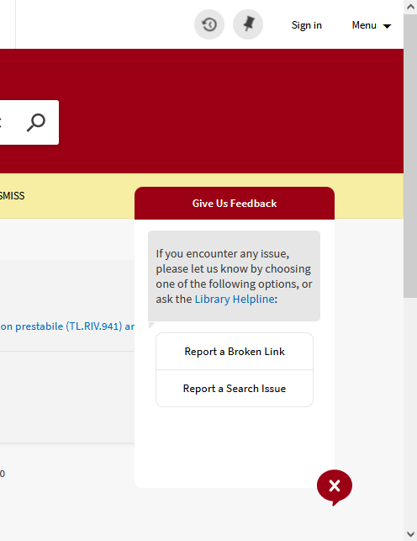
Need help?
GalileoDiscovery feedback
Library helpline
Ask a librarian!
biblio.geoscienze@unipd.it
biblio.liviano@unipd.it

