Slide 1
Lending form to the world
Michael Morris

Slide 2
Two strands
In Lecture 4, I suggested that Plato held an unusual (for us, anyway) view of artistic images or likenesses: someone who paints a face makes a kind of face. This means that when you look at a painting of a face there is a (kind of) face there: it really exists. I also suggested that this was quite an attractive view of painting.
Before that, in Lectures 2 and 3, I have been outlining a certain orthodox philosophy of language, which is hard to accept without abandoning realism.
This time I want to bring these two strands together, to find a way of defending realism.

Slide 3
An orthodox resemblance theory of painting
Here is a form of resemblance theory of painting (see Hopkins, Hyman):
(RP) A painting depicts a face if and only if part of its surface is properly seen as resembling a face in outline (or occluded) shape.
The idea is that the key to depiction is whether or not a mathematically specifiable relation properly seems to obtain between a part of the surface of a painting and something in the world.

Slide 4
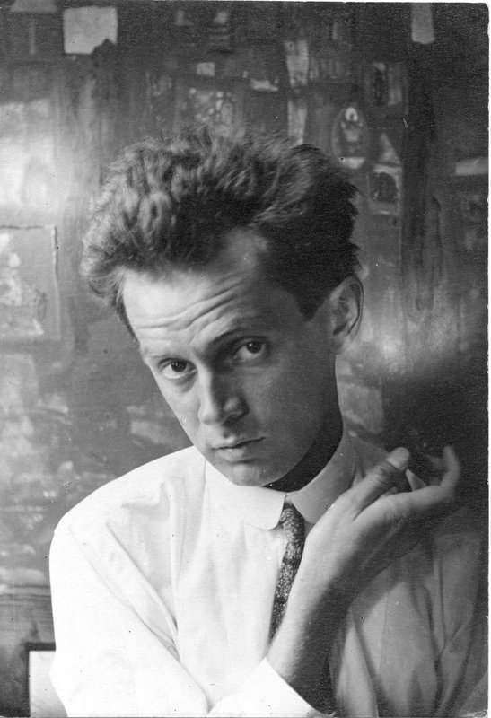
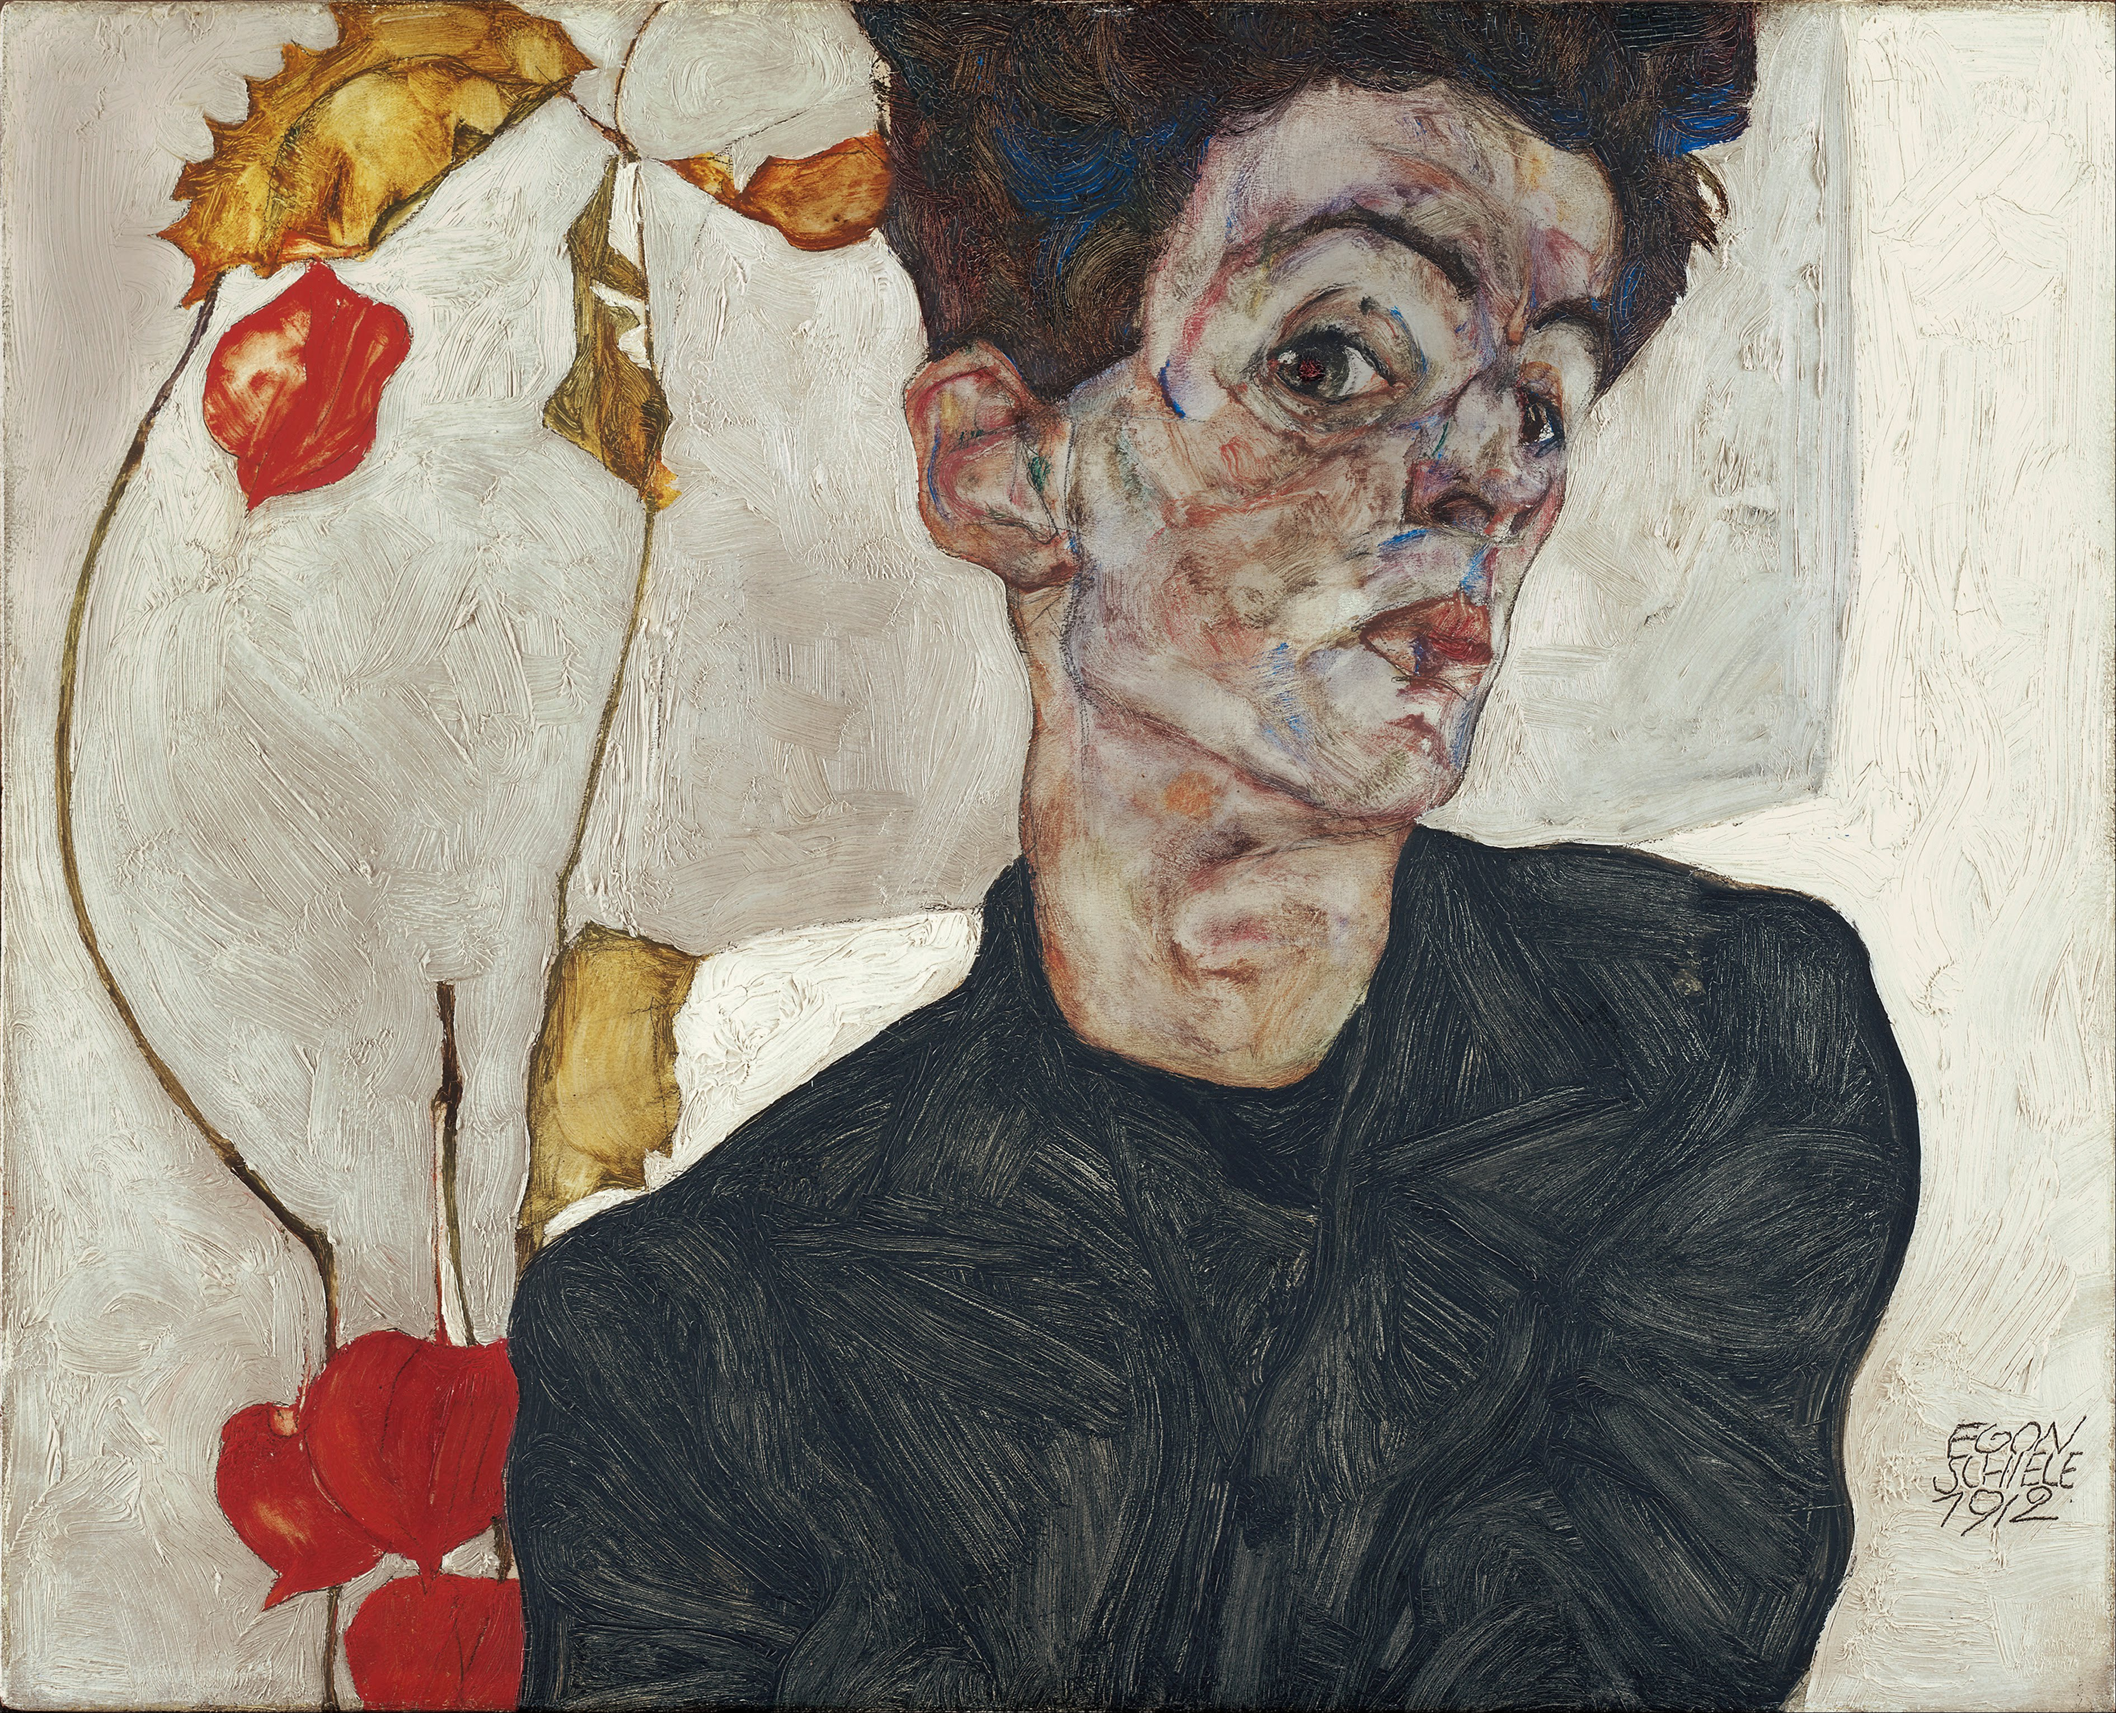
The problem
The obvious problem with this theory is caricature: this theory seems to have to treat it as misrepresentation, which it is not.

Slide 5
Resemblance in the Platonic theory
We can also appeal to resemblance within the Platonic theory. In fact, we may say that the face in the painting – the face made by the painter – counts as a face (or a kind of face) in virtue of resembling a real face. But the face in the painting is not obviously just part of the surface of the painting. It looks as if it’s something of which this normative interdependence claim is true:
(NI) No part or feature of it should be there and as it is unless it is appropriate for every other part or feature to be there and as it is.
The parts and features included in (NI) include parts and features of the paint (and more generally the use of the medium).

Slide 6
The key difference
In the Platonic theory, when we see that a face in a painting resembles a real face, what we see is that something of which (NI) is true resembles a real face. This is something we can only see in virtue of understanding how the medium – here painting – works.

Slide 7
Back to the philosophy of language
In lecture 3 we saw that the key thing about the orthodox philosophy of language which I found in McDowell was this:
(II) Basic sentences can be immediately and decisively justified by the world (their grounds are simply given by the world).
The immediate and decisive justification is provided by a rule such as this:
(RS) The sentence ‘Lewes is hilly’ is true if and only if Lewes is hilly.

Slide 8
The important point about that rule
The point of (RS) is that what it says can in principle be understood by someone who doesn’t understand the sentence ‘Lewes is hilly’ – or even English.
So the idea is that the fact that Lewes is hilly (for example) is simply given by the world. And then there’s a simple rule which takes one from that fact to its being justified to use the sentence ‘Lewes is hilly’.
And the fact that rule can be understood by someone who doesn’t understand that sentence allows the correctness of using the sentence to be shown by inference: the decisiveness of the justification is the decisiveness of inference.

Slide 9
The connection
The key similarity with the orthodox resemblance theory of depiction is this: just as what (RS) says can be understood by someone who doesn’t yet understand ‘Lewes is hilly’, or even English, so the resemblance between painted surface and object in the world can be recognized by someone who doesn’t yet understand the painting in question, or even the way that painting works.
Both the orthodox philosophy of language and the orthodox resemblance theory think the medium is connected to the world by means of a rule which can be understood without yet understanding the medium. The rule is, as we might say, perspective-neutral.

Slide 10
Why a perspective-neutral rule?
There are two obvious motivations. One is dialectical: if a rule is perspective-neutral, it’s easier to explain, since it can be explained to anyone.
The other looks as if it depends on something like a confusion, between two notions of objectivity, a metaphysical and an epistemic notion:
(MO) Something is metaphysically objective if and only if its nature is wholly independent of any way of knowing it or thinking about it.
(EO) Something is epistemically objective if and only if knowledge of it does not depend on any particular mode of access.

Slide 11
Elaboration
(MO) is clearly connected with the realism I defined in Lecture 1:
(R) The nature of the world as it is in itself is altogether independent of all thought about it or representation of it.
(EO) is an expression of something to do with neutrality, and is probably connected with the dialectical motivation for a perspective-neutral view.

Slide 12
Getting to an idealist view
(MO) and (EO) can be combined, of course, in this principle:
(ME) Something can only be metaphysically objective if it is epistemically objective.
(ME) is a clear statement of a form of idealism, in the terms of Lecture 1:
(I) The nature of the world as it is in itself somehow depends on thought or representation.
In general, insisting that there must be a perspective-neutral rule connecting a medium to the world looks as if it can only have idealist motivations.

Slide 13
The outline of an alternative
The contrast between the Platonic view of images and the orthodox resemblance theory suggests a way of making sense in outline of an alternative view of language. The key idea will be this:
(PR) Medium and world are linked by rules which can only be understood by someone who already understands the medium (perspectival rules).
The idea of such perspectival rules, or such perspectival knowledge, has in fact been largely championed by McDowell himself (e.g., ‘Non-Cognitivism and Rule-Following’). Given that it’s possible to distinguish between (MO) and (EO), (PR) poses no threat to realism.

Slide 14
A challenge
(PR) poses a challenge which I’m not yet in a position to meet:
(Q1) How are we to make sense of the difference which understanding a medium makes if (PR) is true?
One serious problem is to explain how one might come to understand a medium: we obviously can’t explain it as a matter of coming to know some perspective-independent rule.

Slide 15
Form
So far we’ve been looking at one way of formulating the orthodox philosophy of language (that given by (II)). But there was another:
(I) Language has the same form as the world (so the world has a counterpart to syntactic structure)
The Platonic view of images allows us to think of form slightly differently, in a way which is more natural in considering paintings. If what the painter does when painting a face, e.g., is make a kind of face in paint, we end up with a kind of face which already has characteristics of the medium.
If we give up the idea that we need a perspective-neutral rule connecting language to the world, there is no need to find in the world anything corresponding to the characteristics of the medium of language – so, in particular, no need to find anything quasi-syntactical in the world.

Slide 16
A second challenge
This poses a second challenge:
(Q2) How are we to make sense of the relation between language and the world if language and the world do not have the same form (if the world has no counterpart to syntactic structure)?
What I want to say next is a gesture in the direction of a way of meeting that.

Slide 17
Kant again
We can perhaps make some progress with (Q2) by turning to Kant. In the Critique of the Power of Judgement, Kant claims that when we ‘judge’ that something is beautiful, we are not, strictly speaking, making a judgement like other judgements.
When we make a judgement about an object, we bring that object under a concept: we apply a concept to it. But when we ‘judge’ that something is beautiful, we are not applying a determinate concept of beauty to it, and thereby classifying it among one group of things—the beautiful ones—as opposed to others.
Instead, judging that something is beautiful involves ‘the free play of the powers of representation in a given representation for a cognition in general’ (Kant CJ: 5:217). The powers in question are ‘imagination for the composition of the manifold of intuition and understanding for the unity of the concept that unifies the representations’ (Kant CJ: 5:217).

Slide 18
Unifying representations
It’s natural to think that there are two ways in which ‘representations’ may be unified by a concept in the understanding.
First, a range of not in themselves conceptual features of experience may be unified as belonging to something we identify as an object – a face, for example, or a couch.
And second, the thing which we identify as an object may be united with other things in making a judgement: grouping a face with other round things in judging that it is round, for example.

Slide 19
And back to language
Thinking again of the way in which McDowell’s account of the justification of judgement turned out to have no clear substance other than as a view in the philosophy of language, and the way in which judgement and fact have tended to shadow the notion of a sentence within the orthodox approach to language, it seems clear that the work which Kant attributes to understanding here is fundamentally a matter of the use of language.
In that case, what Kant is in effect inviting us to consider is a kind of free play of our capacity to use words: without actually applying any words to a scene which confronts us in perception, we are nevertheless aware of an indefinite range of possibilities of using words to describe the world.

Slide 20
And so
On this vision, the world presents itself to us as not already categorized, not already described, but yet such that categories and descriptions of an indefinite variety might be applied to it.
The world itself has no counterpart to syntax, but presents itself – to someone who understands a language – as apt, in some way, to be described within an essentially syntactical medium.
What this possibility gives us is a question for another day. Kant thought it was our sense of beauty. It may be a larger sense of the meaningfulness of things.

