Slide 1
History of Animation
Second Cycle Degree in Theatre, Film, Television and Media Studies
Academic Year 2018-2019
Lesson 1

Slide 2
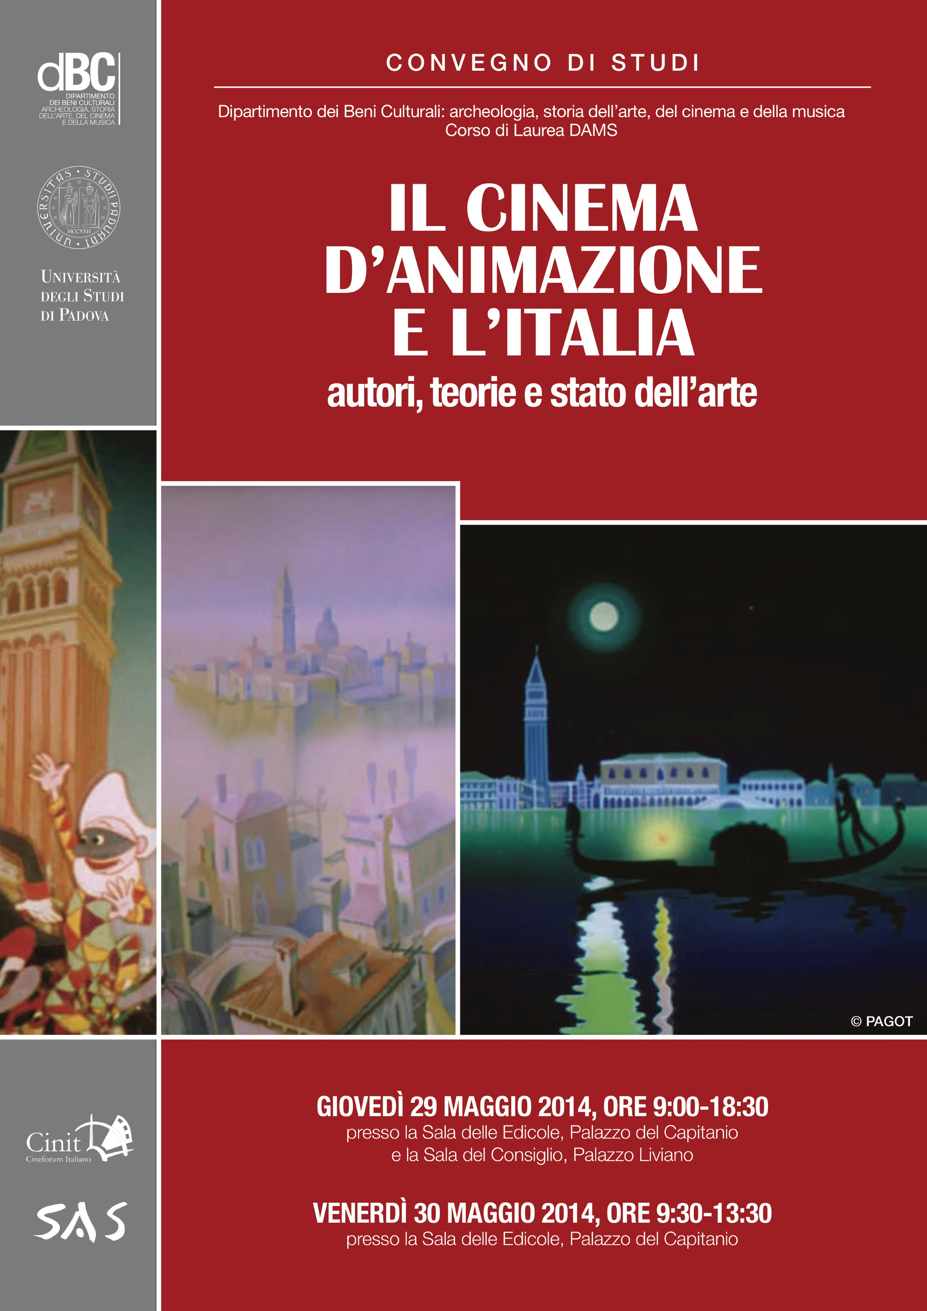
History of Animation
At the University of Padova

Slide 3
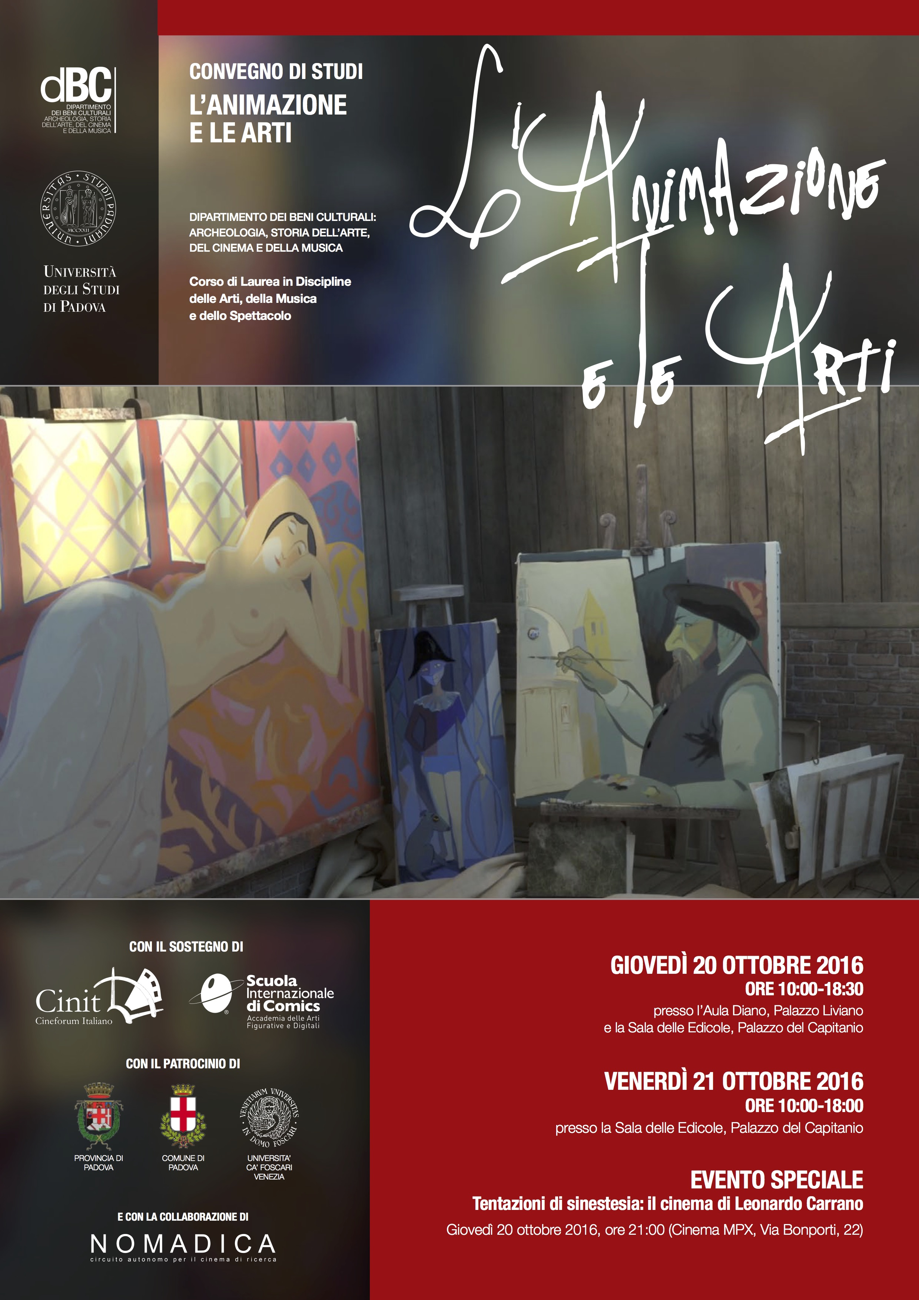
History of Animation
At the University of Padova

Slide 4
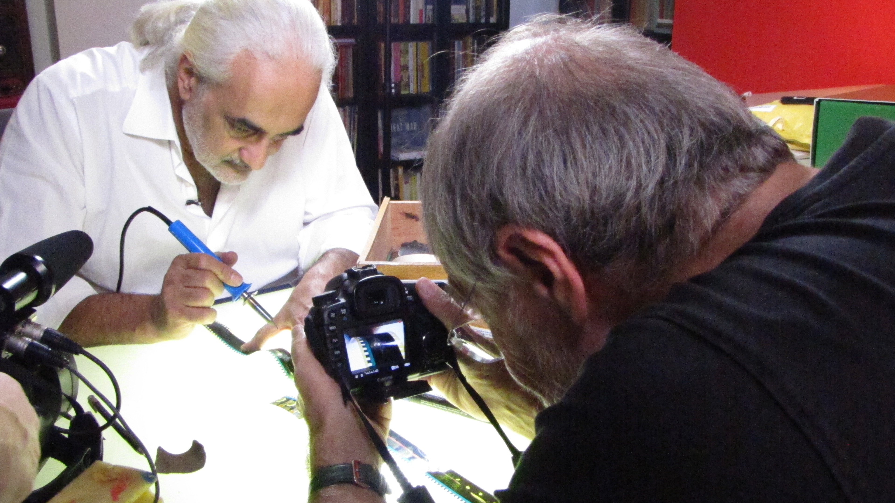
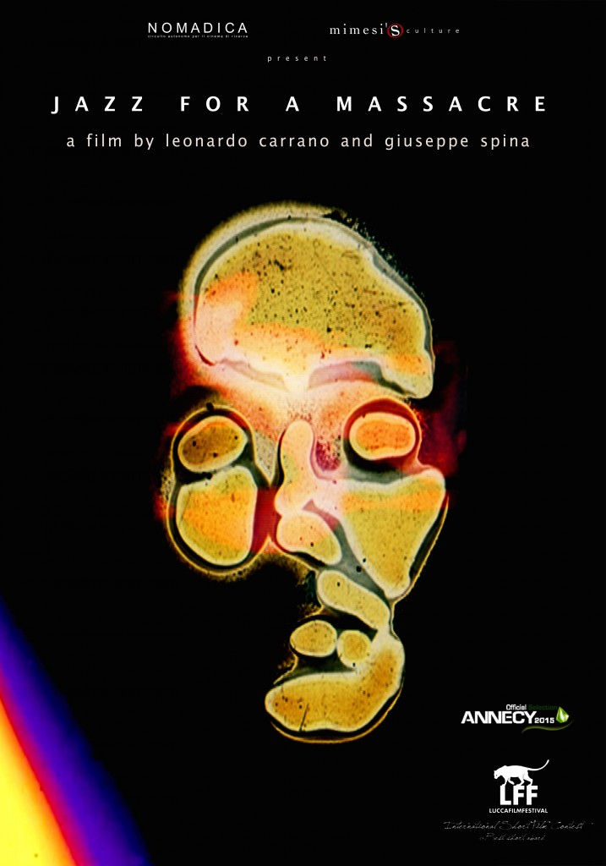
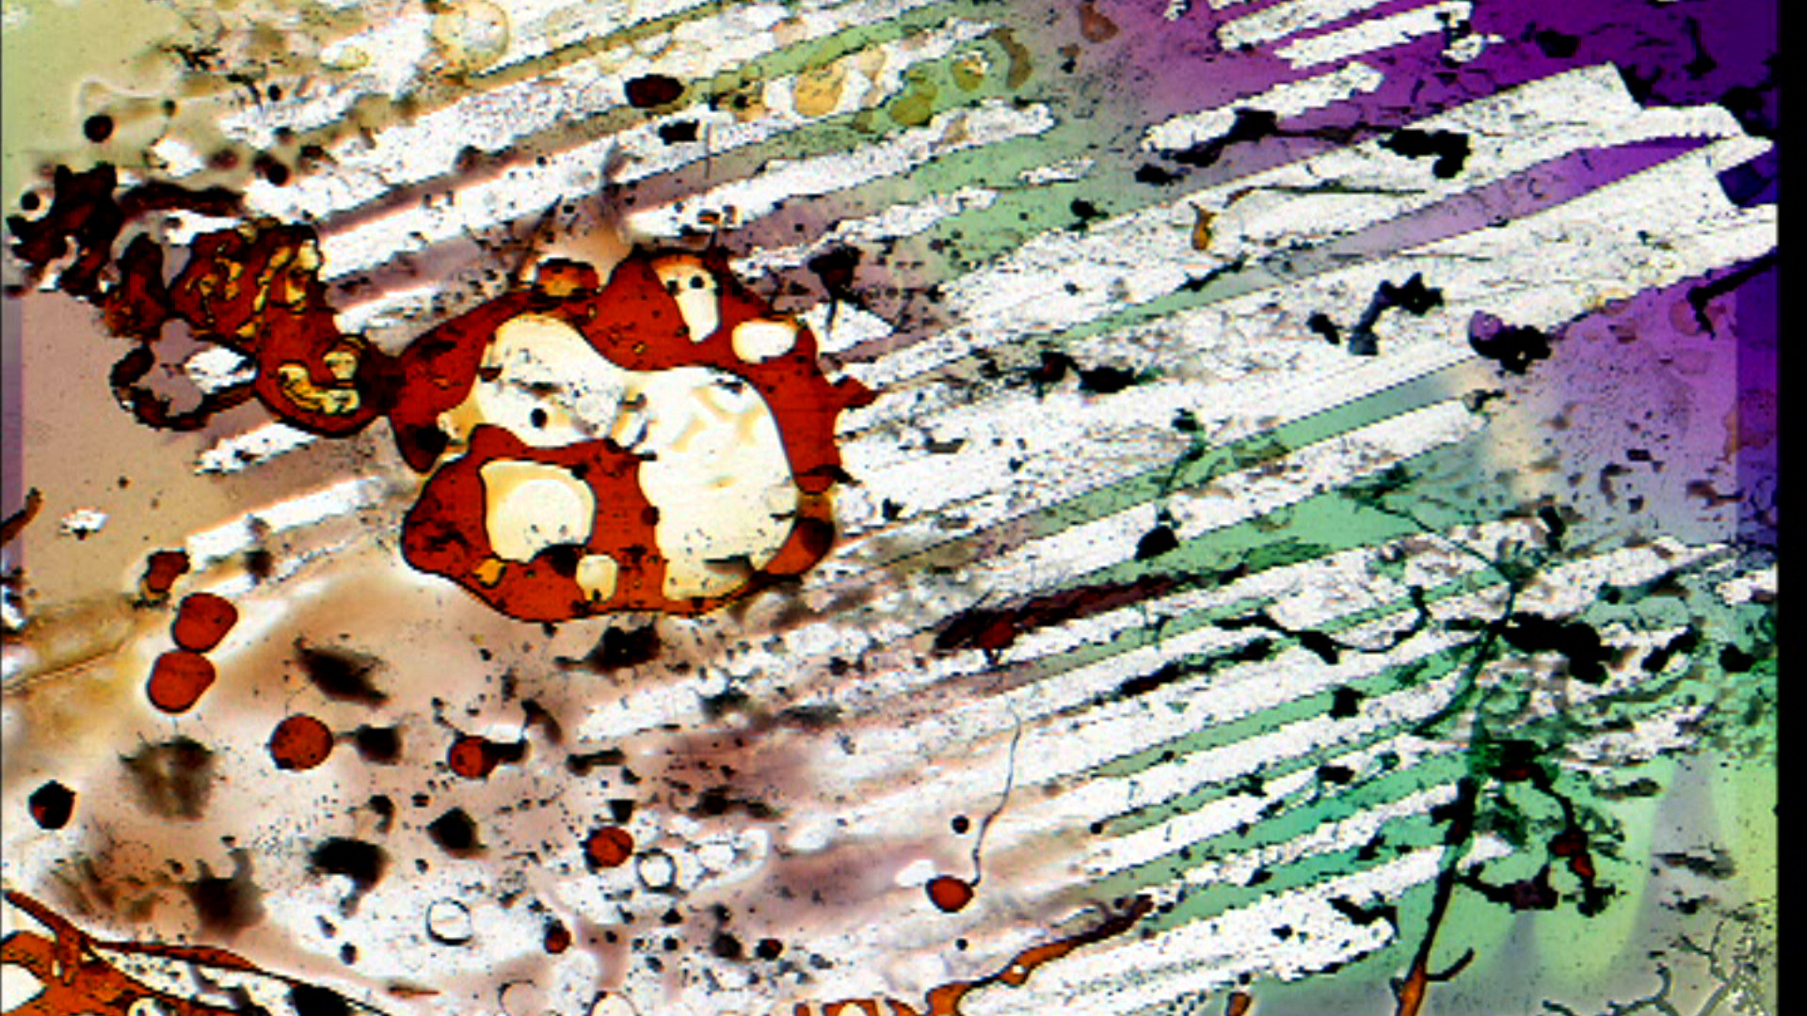
History of Animation
At the University of Padova

Slide 5
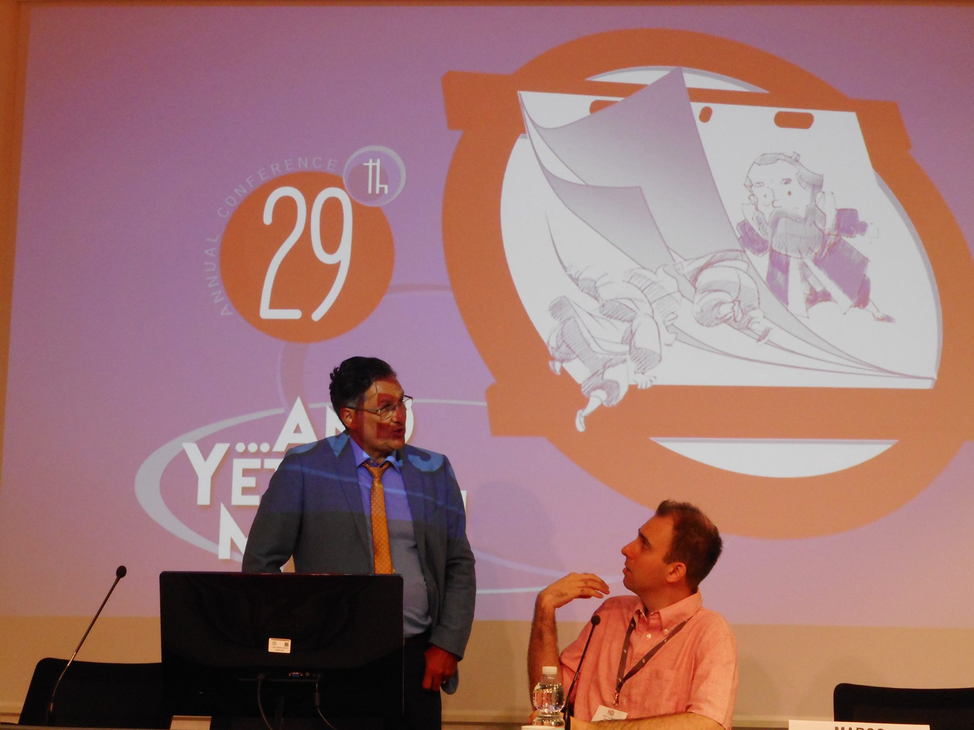
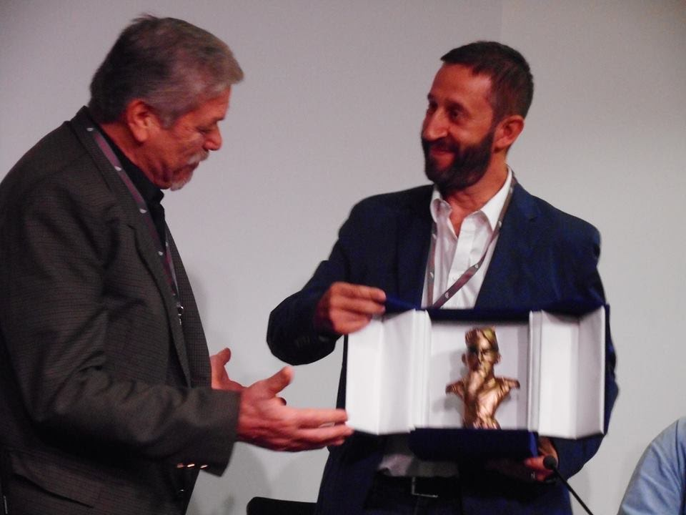
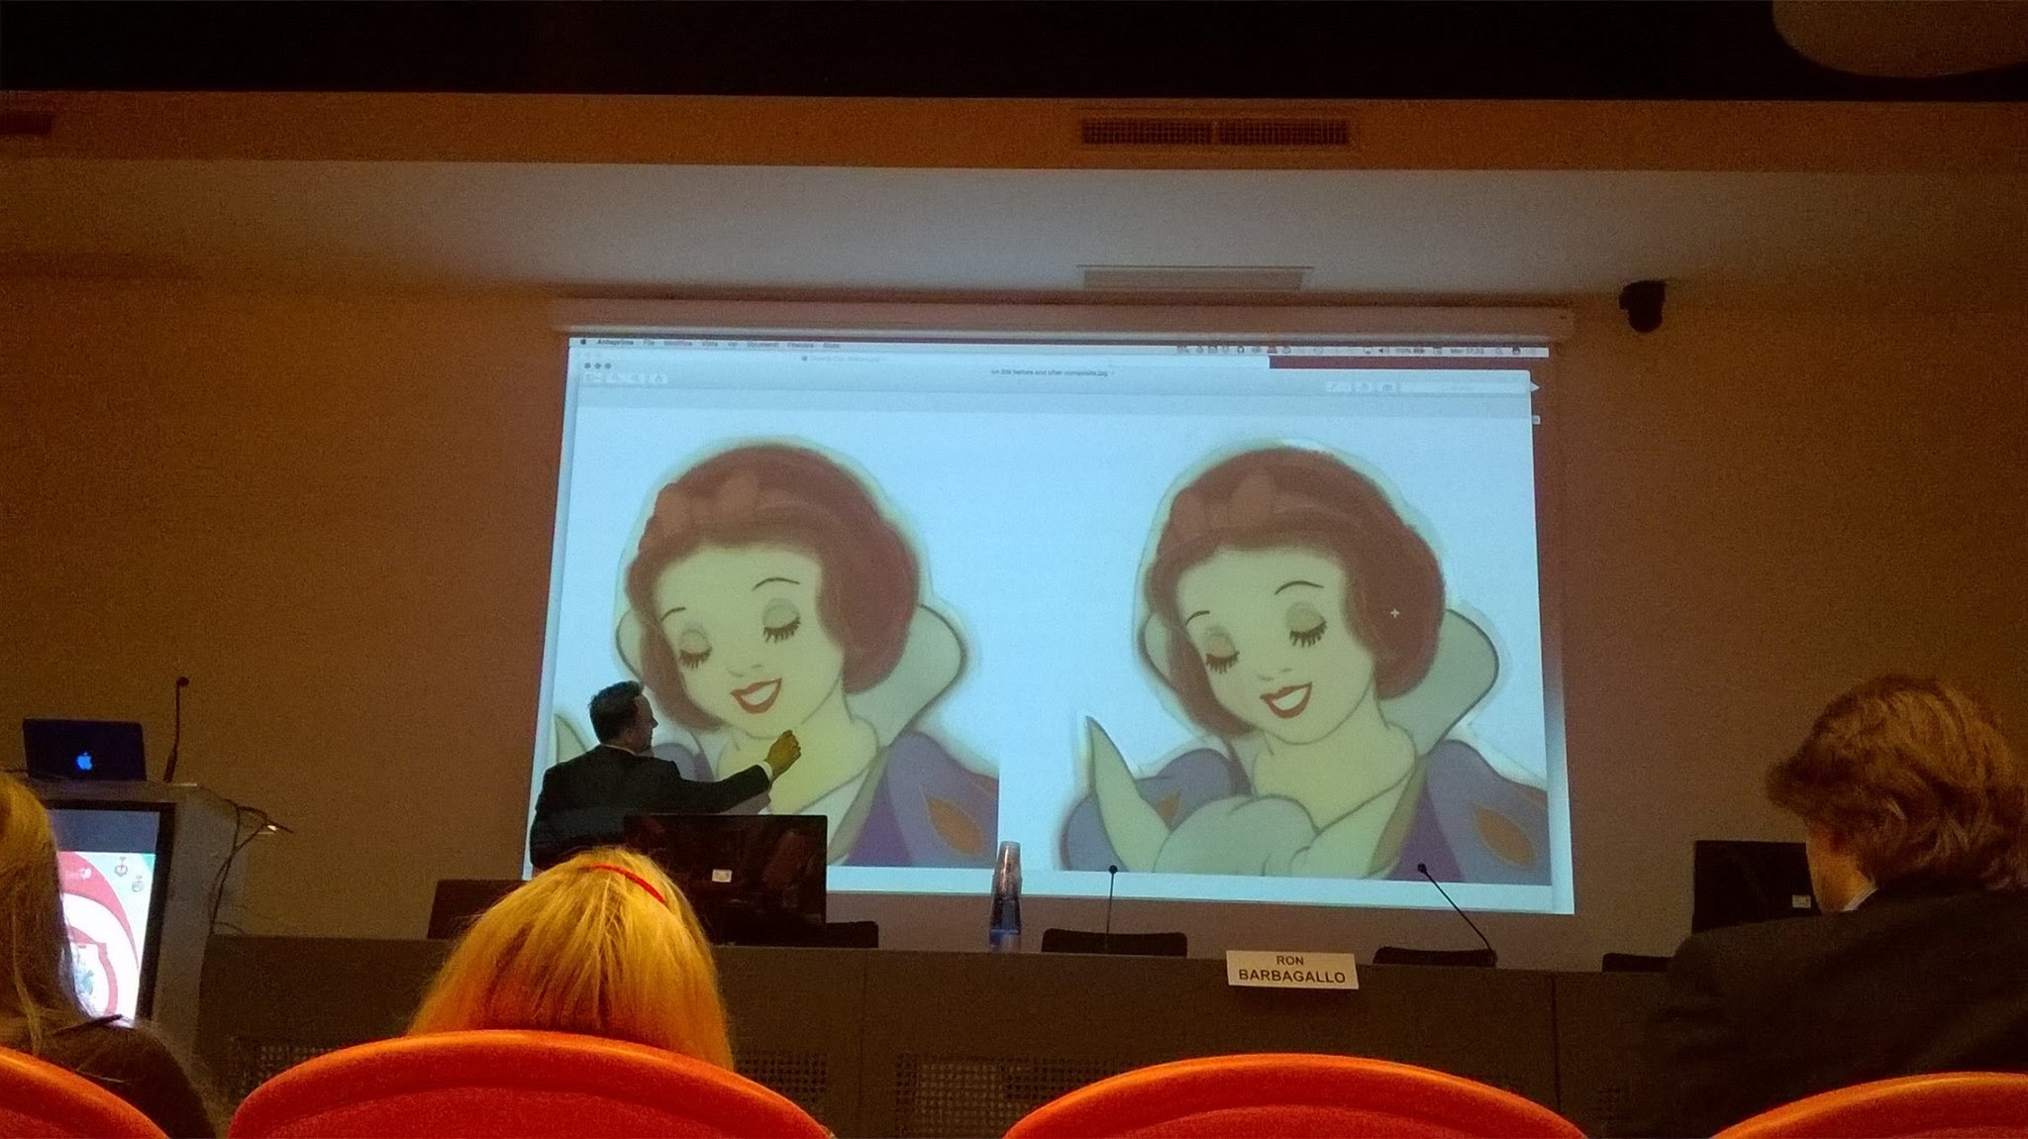
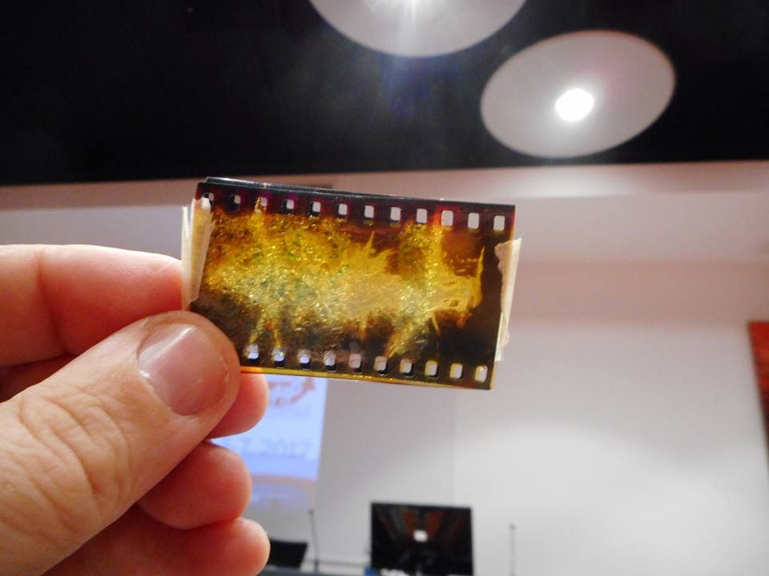
History of Animation
At the University of Padova
http://sas2017.beniculturali.unipd.it/web/

Slide 6
History of Animation
At the University of Padova
The Animation Workshop
Prof. Raffaele Luponio
Two course units:
A workshop for students of the First Cycle Degree in Visual and Performing Arts;
A workshop open to general audiences.
http://immagineperimmagine.wordpress.com

Slide 7
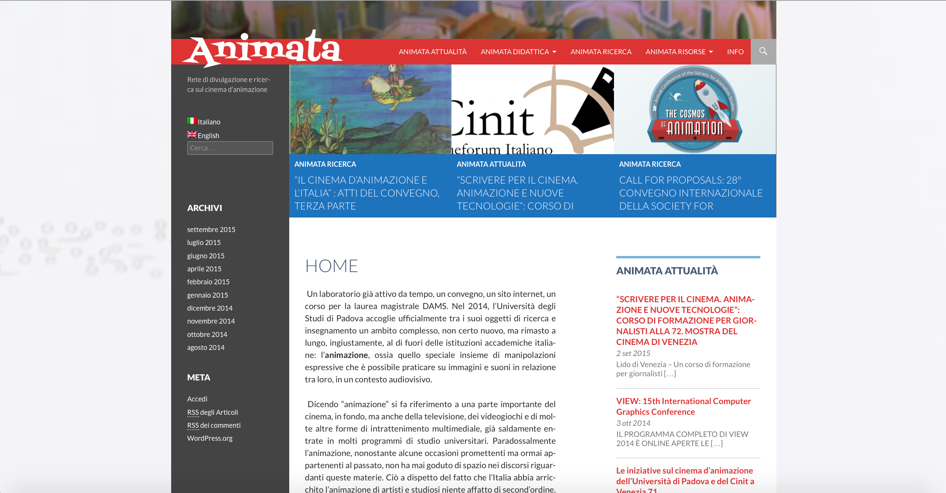
History of Animation
At the University of Padova
http://animata.beniculturali.unipd.it

Slide 8
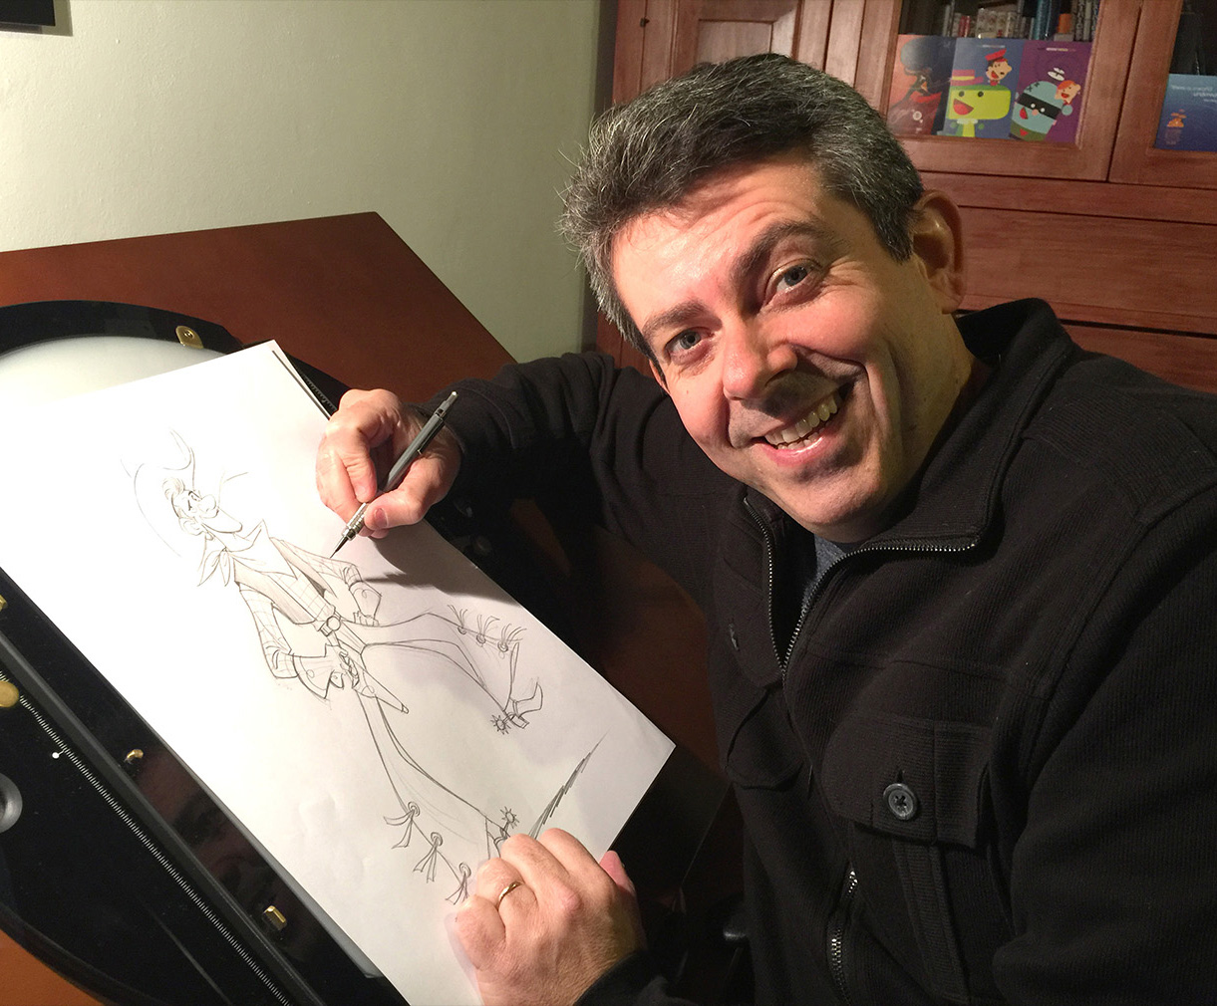
History of Animation
At the University of Padova
Guest Teacher: Sandro Cleuzo

Slide 9
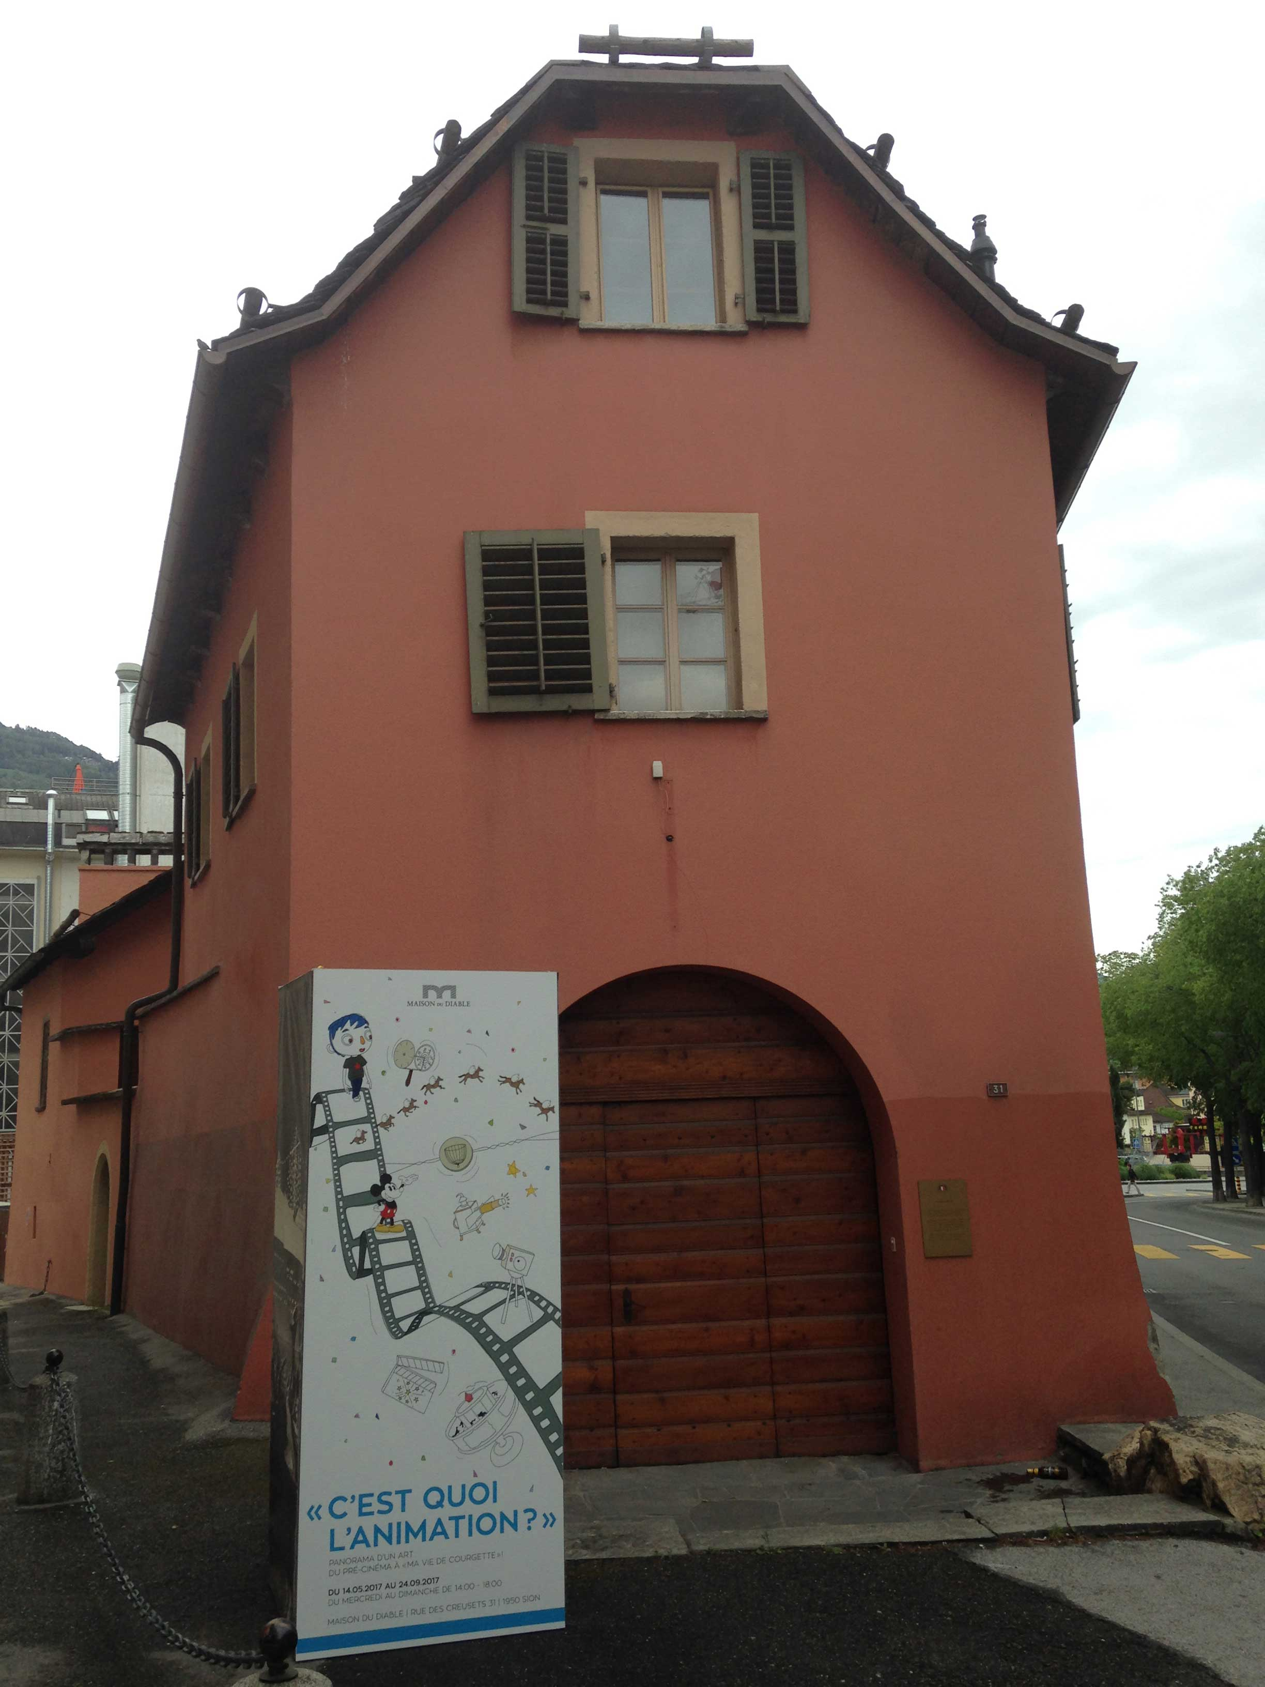
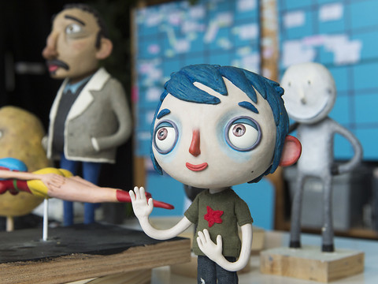
History of Animation
At the University of Padova
Guest Teacher: Federico Grandesso

Slide 10
Structure of the Course Unit
Definition of animation
Animation styles and techniques
Origins of animation: pioneers, early schools
Animation in the USA. Special focus: Fleischer Brothers; Pixar
Animation in Europe. Special focus: Jiří Trnka
Animation in Italy. Special focus: Bruno Bozzetto
Animation in Asia. Special focus: Studio Ghibli
Special focus: animated series

Slide 11
Structure of the Course Unit
42 hours, 21 lessons.
Monday-Tuesday, 16:30-18:15
Via Beldomandi, 1
Aula Spettacolo
First lesson: September 25, 2018.
Last lesson: December 18, 2018.
There will be no class on November 19, 20, 26, and 27.

Slide 12
Textbooks
Giannalberto BENDAZZI, Animation. A World History. 3 voll., Waltham, Massachusetts: Focal Press, 2015.
Andrew SELBY, Animation, Laurence King Publishing, London 2013.
Donald CRAFTON, Before Mickey. The Animated Film 1898-1928. Chicago: University of Chicago Press, 1993.
Carol A. STABILE, Mark HARRISON (eds.), Prime Time Animation. Television Animation and American Culture. London: Routledge, 2003.
Rayna DENISON, Anime: A Critical Introduction. New York: Bloomsbury, 2015.
Marco Bellano, Giannalberto Bendazzi (eds.), Animation Journal, Vol. 25. Santa Clarita, CA, USA: AJ Press, 2017.
Susan Smith, Noel Brown, Sam Summers (eds.), Toy Story. How Pixar Reinvented the Animated Feature. London, Oxford: Bloomsbury, 2018.
Raz Greenberg, Hayao Miyazaki. Exploring the Early Work of Japan's Greatest Animator. London, Oxford: Bloomsbury, 2018.
The books are available at the Visual Arts and Music Library (not for loan): via Beato Pellegrino, 26.

Slide 13
Textbooks
To get the course materials
Moodle
https://goo.gl/PohtAM
Access with your @studenti.unipd.it credentials.
Access as a guest ONLY if you do not have @studenti.unipd.it credentials.
Here you will find documents and teaching materials.
Animata
http://animata.beniculturali.unipd.it/
Reference videos will be uploaded here.

Slide 14
Final Exam
The final exam will be an oral test, both for attending and not attending students. The teacher will ask questions about the exam materials.
For attenders, the exam will focus on the contents of the course and on the documents provided by the teacher. Moreover, at the beginning of the course the students will receive a list of films, of which 15 have to be selected and integrally watched. Some of those films could be discussed during the exam.

Slide 15
Final Exam
The students can freely choose to talk in Italian or in English during the exam. However, the use of English will be obligatory during one small section of the test: all students (attending and not attending) are required to prepare a five minute talk in English, to be illustrated with a Powerpoint file. The talk and the Powerpoint need to focus on a general topic or a film discussed during the course (or included in the above mentioned list of films). In case of a different topic choice, please contact the teacher in advance. The students can use the Powerpoint files provided by the teacher during the course as a model for their work.

Slide 16
Final Exam
To take the exam as attenders, it is advised to be present for at least for 38 hours out of 42. Students have to make up for the missed lessons by getting informed about them from fellow students, through written notes and the like. All attending students are supposed to know 100% of the contents of the course. A missed lesson cannot be used as an excuse for an error during the exam.

Slide 17
Final Exam
It is recommendable to attend the course, as not attending students will not receive teaching materials such as videoclips and the like; they will be required to study two complete books written in English (Crafton and Selby). They will have to watch 15 films chosen from the list mentioned above, just like the attending students.
As it is expected that each session will see only a few students taking the test, the teacher kindly asks to be informed about eventual absences in a timely manner (at least one day before the test). The exam registration will close three days before the test.

Slide 18
Contacts and Information
Teacher’s email: marco.bellano@unipd.it
Students are recommended to activate and check their @studenti.unipd.it email address on a regular basis .
Student-teacher meetings: send an email and ask for an appointment. Usually, appointments are scheduled just before or after the lessons, Monday and Tuesday.
^{Course page:} https://goo.gl/KHc9zF
^{Teacher’s page:} https://goo.gl/vvRGco
^{EXAM FILMOGRAPHY:} https://goo.gl/MYM8Y5
^{WHAT TO STUDY:} https://goo.gl/vRDGQH

Slide 19
What is Animation?
Duck Amuck (Chuck Jones, 1953)

Slide 20
What is Animation?
What does Duck Amuck tell us about…
… framing and layout?

Slide 21
What is Animation?
What does Duck Amuck tell us about…
… sound?

Slide 22
What is Animation?
What does Duck Amuck tell us about…
… sound (again)?

Slide 23
What is Animation?
What does Duck Amuck tell us about…
… the grammar of cinema?

Slide 24
What is Animation?
What does Duck Amuck tell us about…
… the nature of cinema?

Slide 25
What is Animation?
What does Duck Amuck tell us about…
… the “author”?

Slide 26
Suggested readings
Richard Thompson, “Duck Amuck”, Film Comment, Vol. 11, No. 1, January-February 1975, pp. 39-43 (MOODLE).

