Slide 1
History of Animation
Second Cycle Degree in Theatre, Film, Television and Media Studies
Academic Year 2017-2018
Lesson 10

Slide 2
Animation in the USA 3
Fleischer Brothers
Max (1883-1972) and Dave (1894-1979) Fleischer were among the artists who worked at Bray Productions. They were hired after a successful test of a new animation device which would have later been patented as the rotoscope, in 1917. The test featured Dave wearing a clown suit.
That traced character would later became Ko-ko the clown, protagonist of the successful series “Out of the Inkwell” (1919).
Bray produced the series until 1921, when the Fleischer Brothers set up their own studio in New York –Out of the Inkwell, Incorporated.
Their efforts were remarkable: their success was heavily based on the “realistic” feeling of the rotoscoped animation.
The “Out of the Inkwell” series continued as “The Inkwell Imps” at Paramount (1928); later, it continued as “Talkartoons” after the conversion to sound and the advent of a new star: Betty Boop (1930-1939).

Slide 3
Animation in the USA 3
Fleischer Brothers
Comin’ Thro’ the Rye (Dick Huemer, 1926): the “Song Car-Tunes” were among the first ever animation with recorded and synchronized sound.

Slide 4
Animation in the USA 3
Fleischer Brothers
However, the Fleischer Brothers lacked the “industrial” and rational aptitude of Bray. The design of their characters tended to change from film to film, as they were assigned to different animators. Betty Boop (created with the participation of Grim Natwick, who would have later animated Snow White for Disney) was an exception.
The worst consequence of the Fleischers’ weak management of their studio (that was moved to Miami, Florida) was the big strike that hit the company during the production of their first full-length feature, Gulliver’s travels (1939). Their approach to rotoscoping looked too stiff, in comparison to Disney’s. Their invention triggered the beginning and the end of their success.
After a second full-length feature (Mr. Bug Goes to Town, 1941) and some moderately successful Superman and Popeye shorts, the studio shut down in 1942.

Slide 5
Animation in the USA 3
Fleischer Brothers
The Ouija Board (Dave Fleischer, 1920)

Slide 6
Animation in the USA 3
Fleischer Brothers
Ko-Ko Sees Spooks (Dave Fleischer, 1925)

Slide 7
Animation in the USA 3
Fleischer Brothers
Dizzy Dishes (Dave Fleischer, 1930)

Slide 8
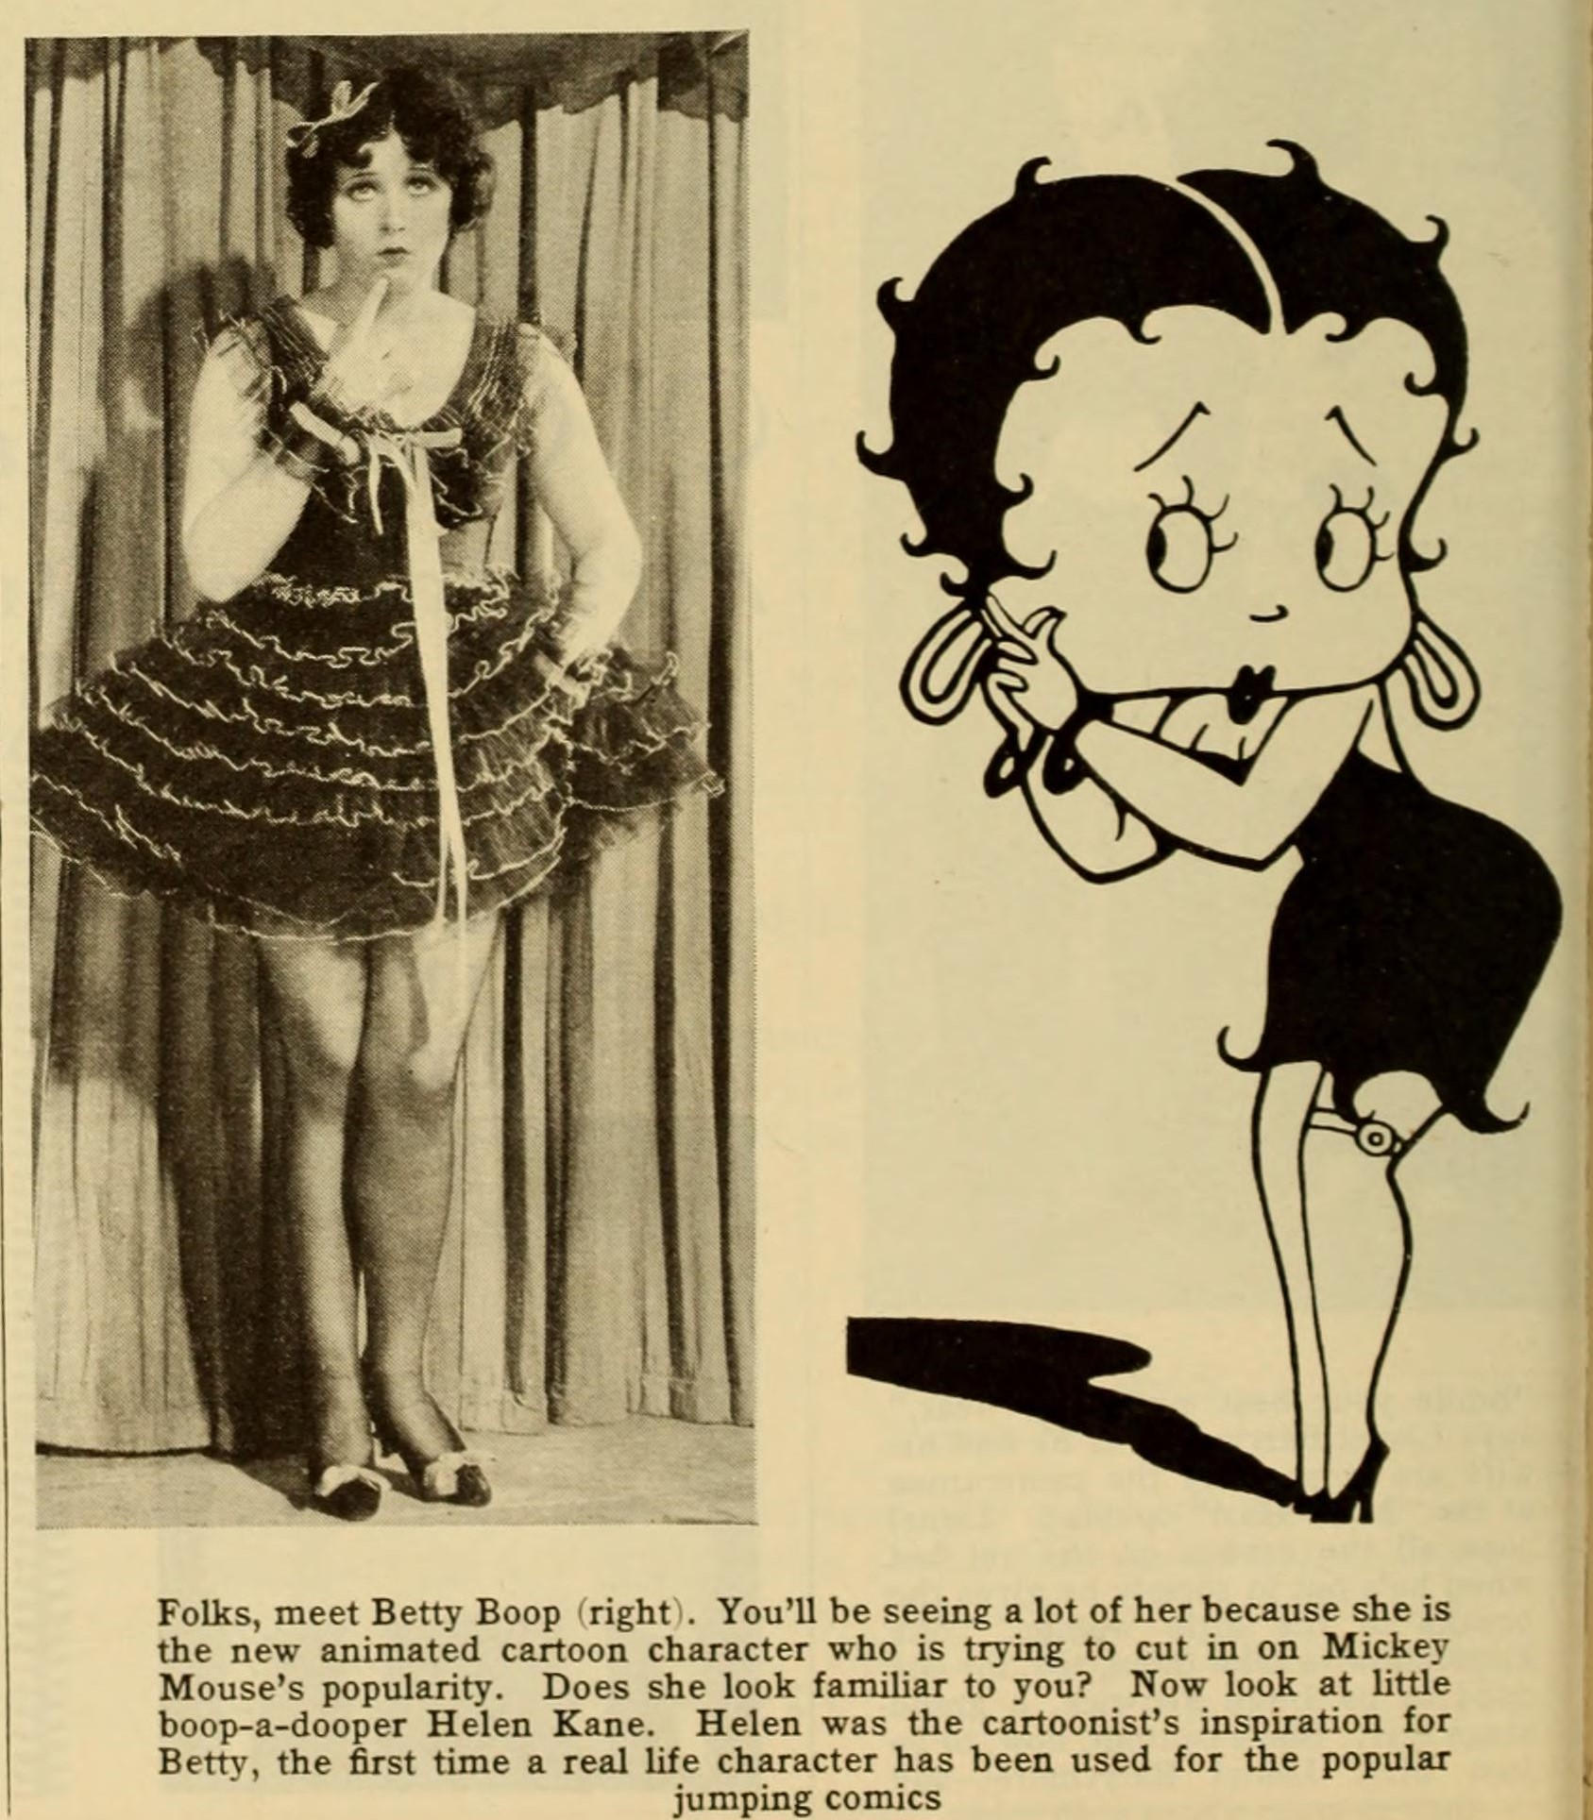
Animation in the USA 3
Fleischer Brothers

Slide 9
Animation in the USA 3
Fleischer Brothers
Boop-Oop-A-Doop (Dave Fleischer, 1932)

Slide 10
Animation in the USA 3
Fleischer Brothers
Popeye the Sailor Meets Sindbad the Sailor (Dave Fleischer, 1936)

Slide 11
Animation in the USA 3
Fleischer Brothers
The “Stereoptical” process

Slide 12
Animation in the USA 3
Fleischer Brothers
The Mechanical Monsters (Dave Fleischer, 1941)

Slide 13
Animation in the USA 3
Walt Disney 1
Walter Elias Disney (1901-1966)
- He was born in Chicago on December the 5°, 1901, the fourth son of the Irish-Canadian Elias Disney and Flora Call.
- 1906: the family moved to Marceline, Missouri. They stayed there for 4 years; in 1910 they moved to Kansas City.
«The four years spent in the country […] remained in the future filmmaker’s mind as a symbol of childhood happiness. Disney constantly returned to pastoral themes in his films, and he often gave his interviewers nostalgic, detailed descriptions of Marceline’s paths, willows and prodigiously large apples».
Giannalberto Bendazzi, Cartoons. One Hundred Years of Cinema Animation, John Libbey, London, 1994, p. 61.

Slide 14
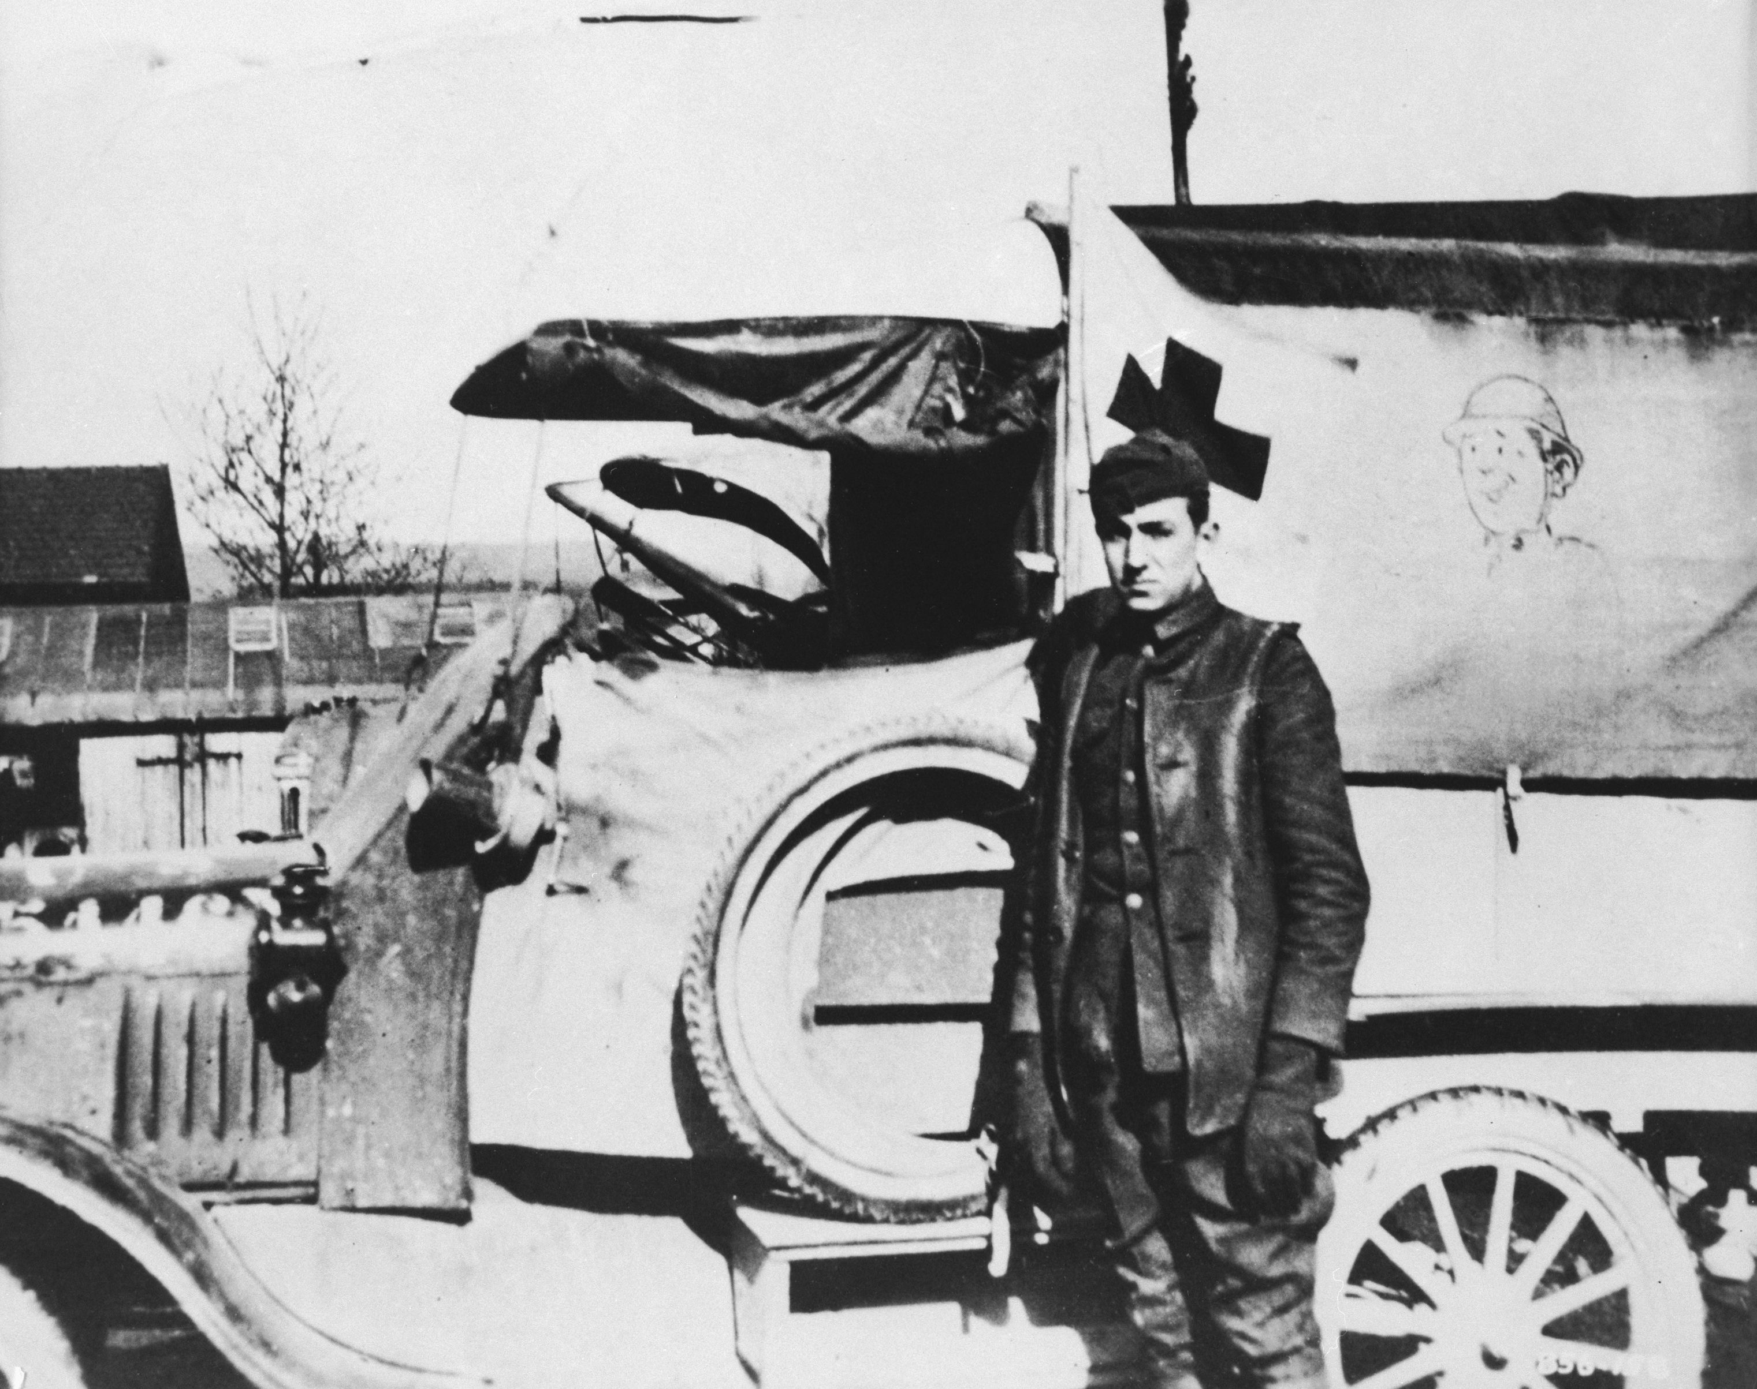
Animation in the USA 3
Walt Disney 1

Slide 15
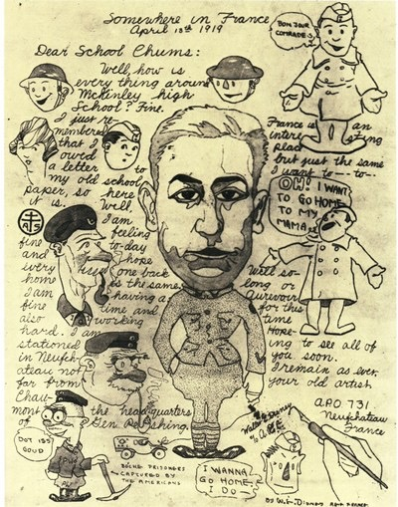
Animation in the USA 3
Walt Disney 1

Slide 16
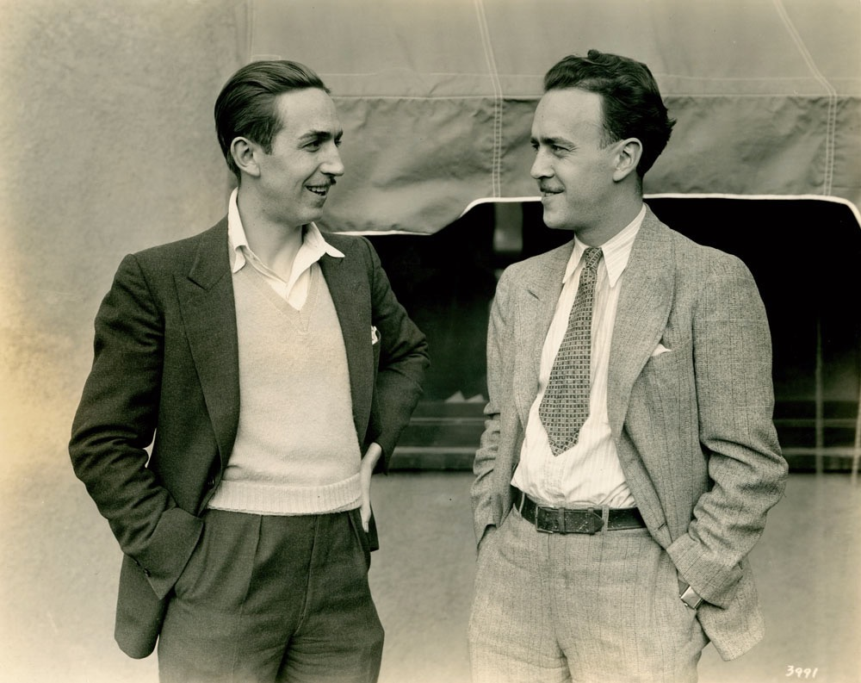
Animation in the USA 3
Walt Disney 1
1919: Walt Disney meets Ubbe Ert Iwwerks, a.k.a. Ub Iwerks (1901-1971) . 1920: Iwerks-Disney Commercial Artists, then at Kansas City Film Ad Company.

Slide 17
Animation in the USA 3
Walt Disney 1
1920-21: Newman Laugh-O-Grams, for Frank L. Newman’s cinemas.

Slide 18
Animation in the USA 3
Walt Disney 1
1922: Laugh-O-Gram Films. Seven short films based on comically “updated” fairy tales.
Late 1922: Disney’s committent, the Tennesse Pictorial Club, remained unsolved.
1923: a few experimental shorts: Tommy Tucker’s Tooth, the lost live-action “Song-O-Reel” to accompany the performance of a popular tune by Joe Sanders, Martha: Just a Plain Old-Fashioned Name, the lost Lafflets shorts and, more importantly, Alice’s Wonderland. However, Disney has to shut down the studio.

Slide 19
Animation in the USA 3
Walt Disney 1
Two of a Trade (Paul Terry, 1922)

Slide 20
Animation in the USA 3
Walt Disney 1
Little Red Riding Hood (Walt Disney, 1922)

Slide 21
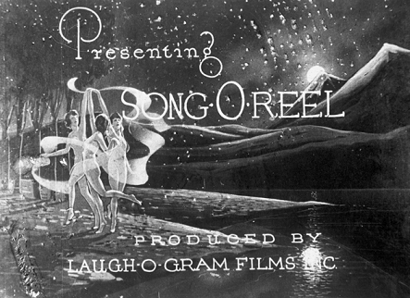
Animation in the USA 3
Walt Disney 1
Martha (Walt Disney, 1923)

Slide 22
Animation in the USA 3
Walt Disney 1
Alice’s Wonderland (Walt Disney, 1923)

Slide 23
Animation in the USA 3
Walt Disney 1
1923: Disney moves to Hollywood, to join his brother Roy. Alice’s Wonderland makes a good impression on a New York distributor, Margaret J. Winkler – Charles Mintz.
1924-1927: “Alice Comedies” (Virginia Davis, Margie Gay, Lois Hardwick). A first “cast” of funny animals (Peg-Leg-Pete…).

Slide 24
Animation in the USA 3
Walt Disney 1
Alice solves the puzzle (Walt Disney, 1925)

Slide 25
Suggested readings
Giannalberto Bendazzi, Animation. A World History. 3 voll., Waltham, Massachusetts: Focal Press, 2015. Vol. I, pp. 111-118 (to study from –and including- the section “Lantz from the Rabbit to the Woodpecker”, up to –and including- the section “The Fleischers: Betty Boop, Popeye, and Two Feature Films”); Vol. I, pp. 44-51: “Silent America II”.
Vol. I, pp. 95-109: “The Golden Age (1928-1951)”; “America Laughs!” (to study up to –and including- the section “The Twelve Rules of the Nine Men”). Vol. II, p. 12: “America” (only the section “Walt Disney”).

