Slide 1
History of Animation
Second Cycle Degree in Theatre, Film, Television and Media Studies
Academic Year 2018-2019
Lesson 12

Slide 2
Animation in the USA 4
Walt Disney 2
1927: “Oswald the Lucky Rabbit”
«[…] Producer Charles Mintz wrestled control of the Oswald production staff from Walt Disney in 1928, after Mintz presented him with an ultimatum in a meeting in New York City. Disney was devastated by the ensuing treachery, but as fate would have it, he sketched Mickey on the train ride back to Los Angeles. The rest, naturally, is the stuff of legend, exactly the sort of inspiring story that gets repeated endlessly, often not accurately».
Tom Klein, “Walt-to-Walt Oswald”, in Griffithiana, no. 71, 2001, p. 29.

Slide 3
Animation in the USA 4
Walt Disney 2
The Hand Behind the Mouse: The Ub Iwerks Story (Leslie Iwerks, 1999)

Slide 4
Animation in the USA 4
Walt Disney 2
Steamboat Willie (Walt Disney, 1928)

Slide 5
Animation in the USA 4
Walt Disney 2
The Skeleton Dance (Walt Disney, 1929)

Slide 6
Animation in the USA 4
Walt Disney 2
Pinocchio (Ben Sharpsteen et al., 1940)

Slide 7
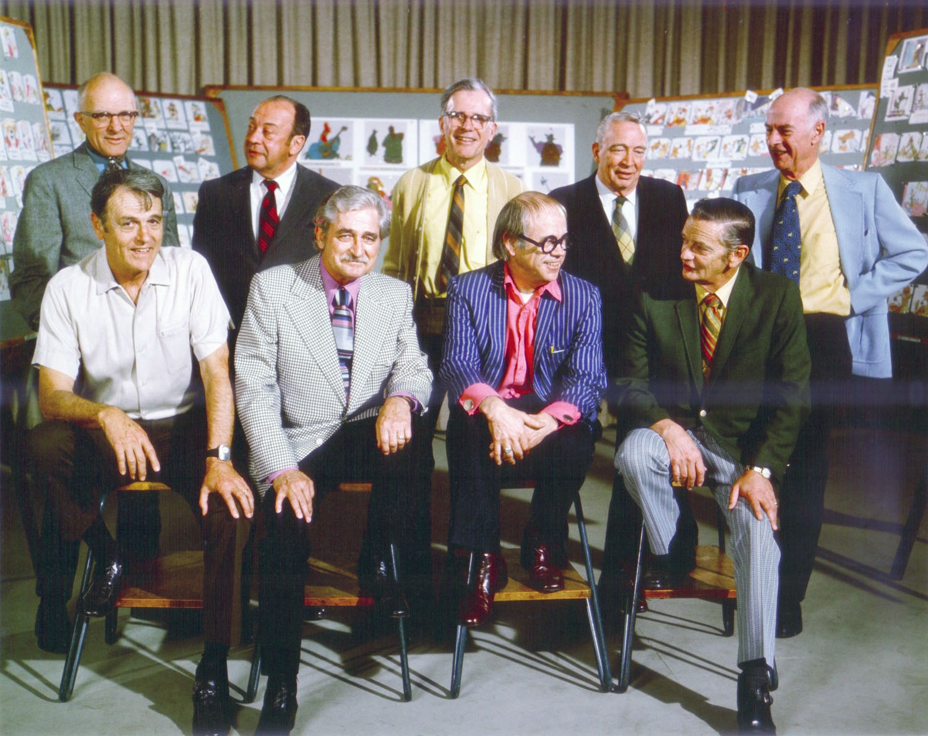
Animation in the USA 4
Walt Disney 2

Slide 8
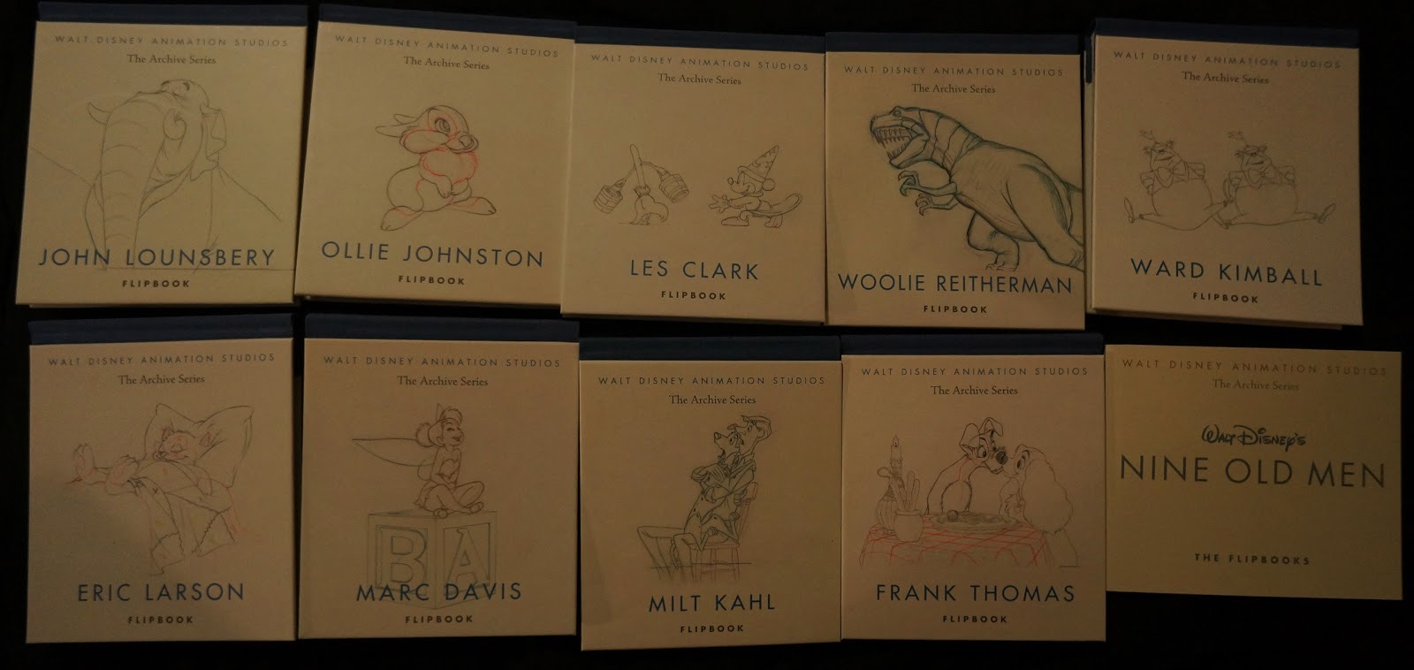
Animation in the USA 4
Walt Disney 2

Slide 9
Animation in the USA 4
Walt Disney 2

Slide 10
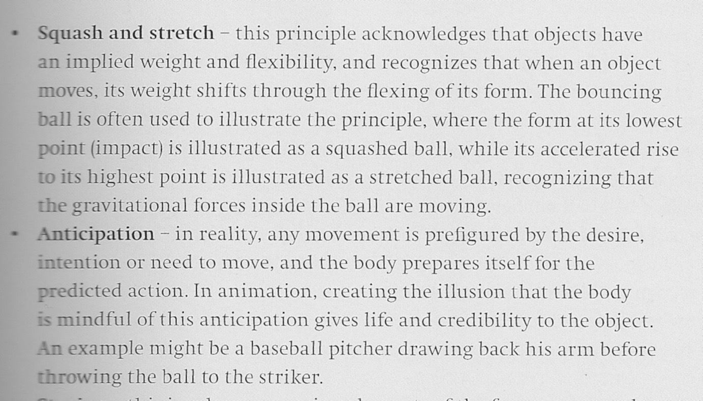
Animation in the USA 4
Walt Disney 2

Slide 11
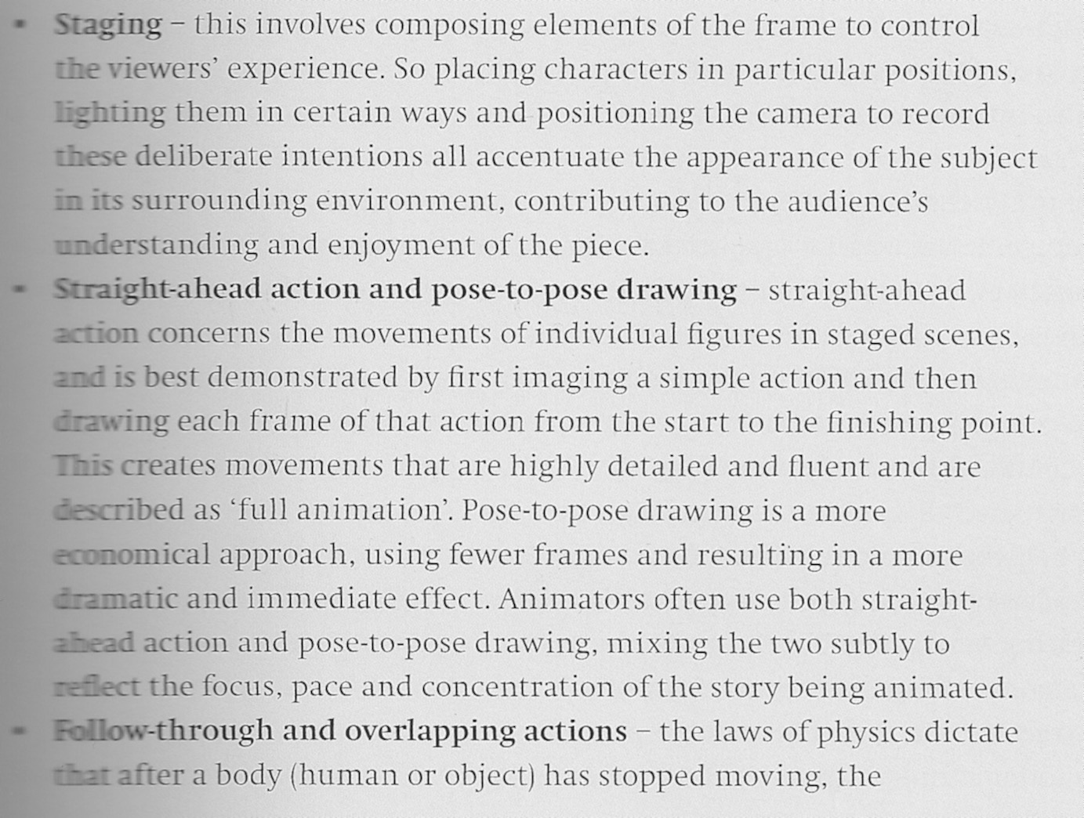
Animation in the USA 4
Walt Disney 2

Slide 12
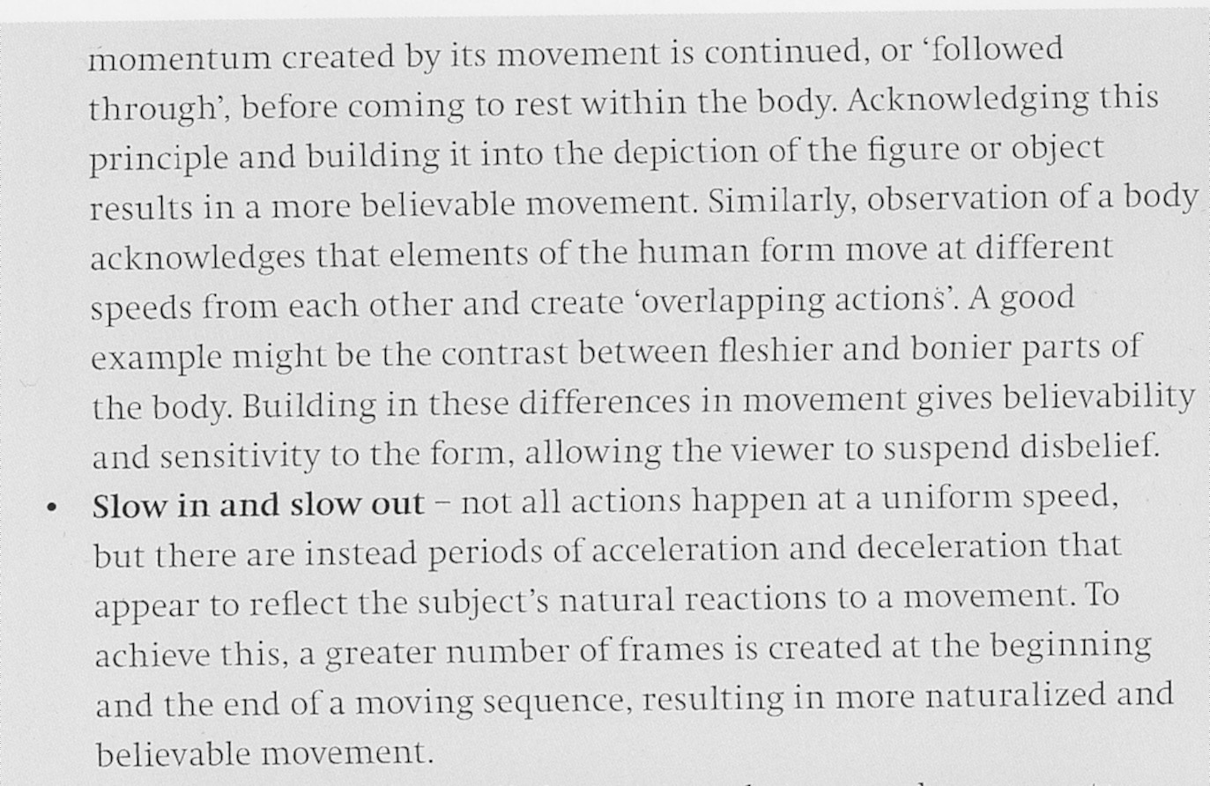
Animation in the USA 4
Walt Disney 2

Slide 13
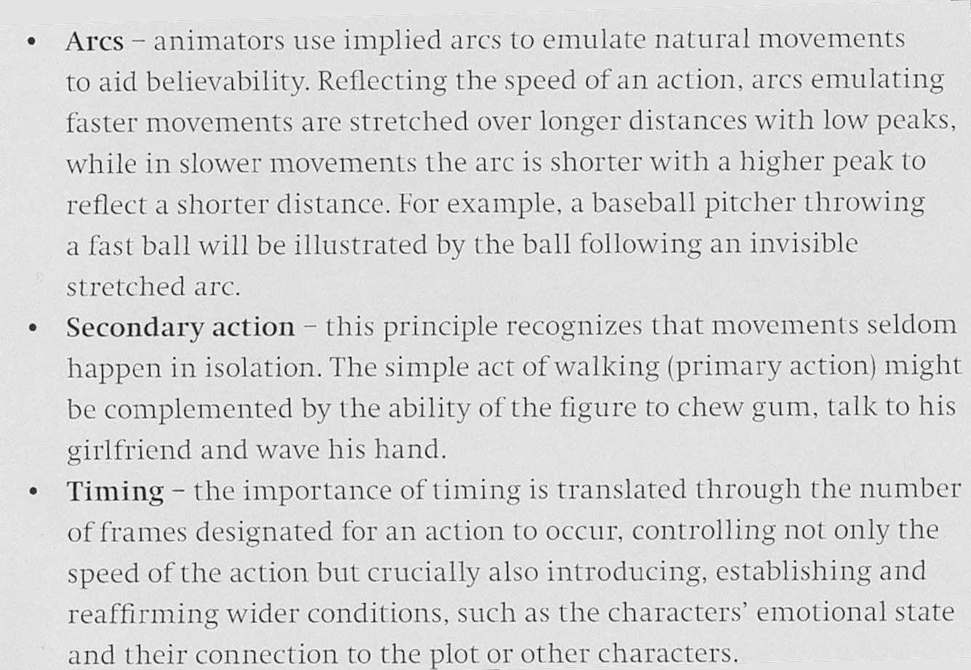
Animation in the USA 4
Walt Disney 2

Slide 14
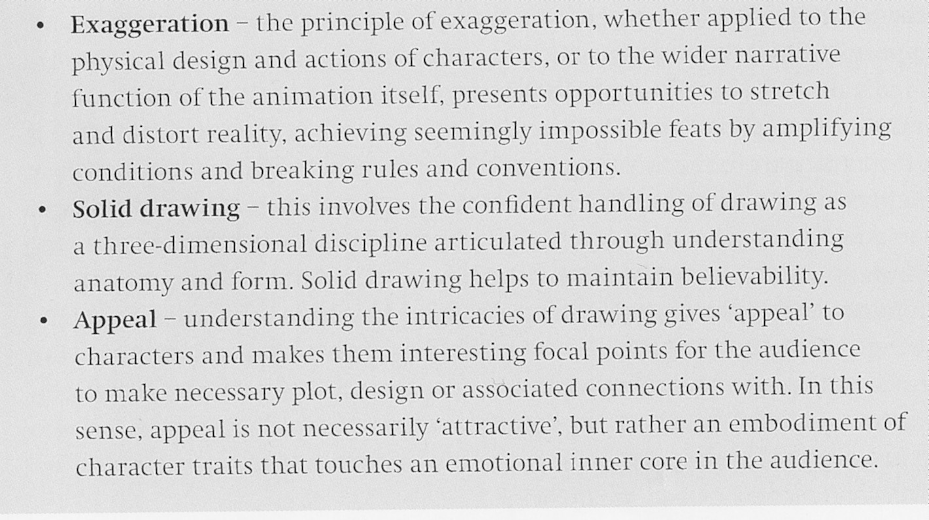
Animation in the USA 4
Walt Disney 2

Slide 15
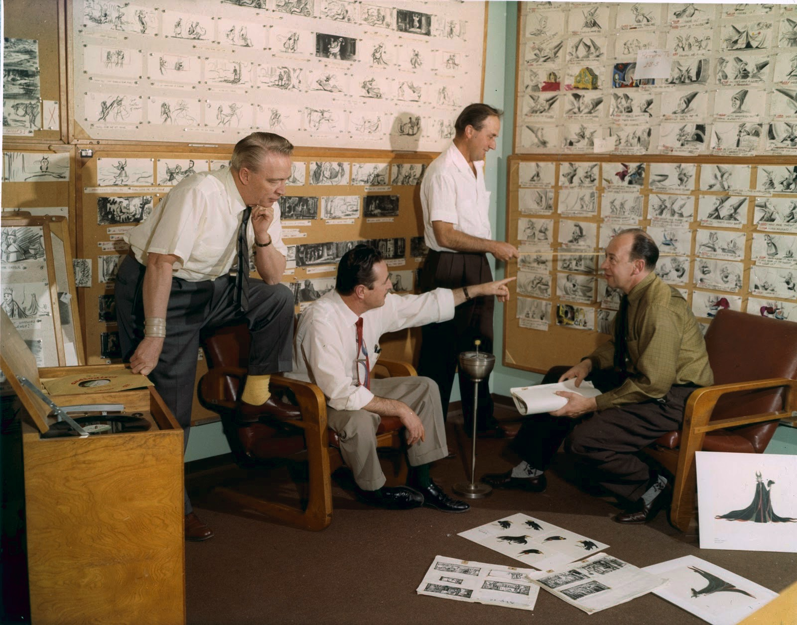
Animation in the USA 4
Walt Disney 2

Slide 16
Animation in the USA 4
Walt Disney 2
Education for Death: The Making of the Nazi (Clyde Geronimi, 1943)

Slide 17
Animation in the USA 4
Walt Disney 2
Make Mine Music (Jack Kinney et al., 1946)

Slide 18
Animation in the USA 4
Walt Disney 2
Alice in Wonderland (Clyde Geronimi, Wilfred Jackson, Hamilton Luske, 1951)

Slide 19
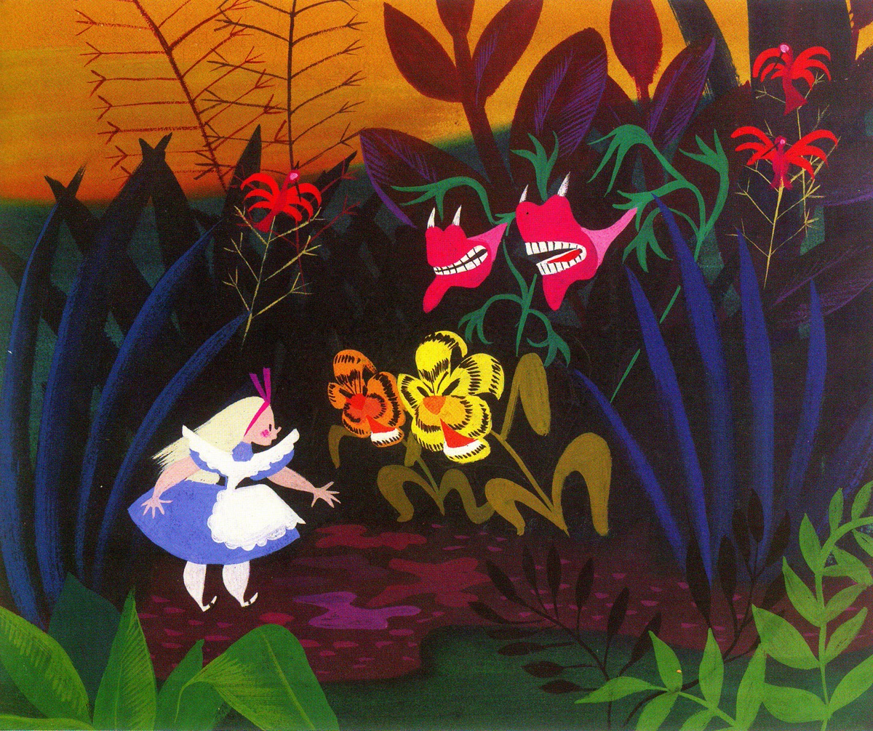
Animation in the USA 4
Walt Disney 2

Slide 20
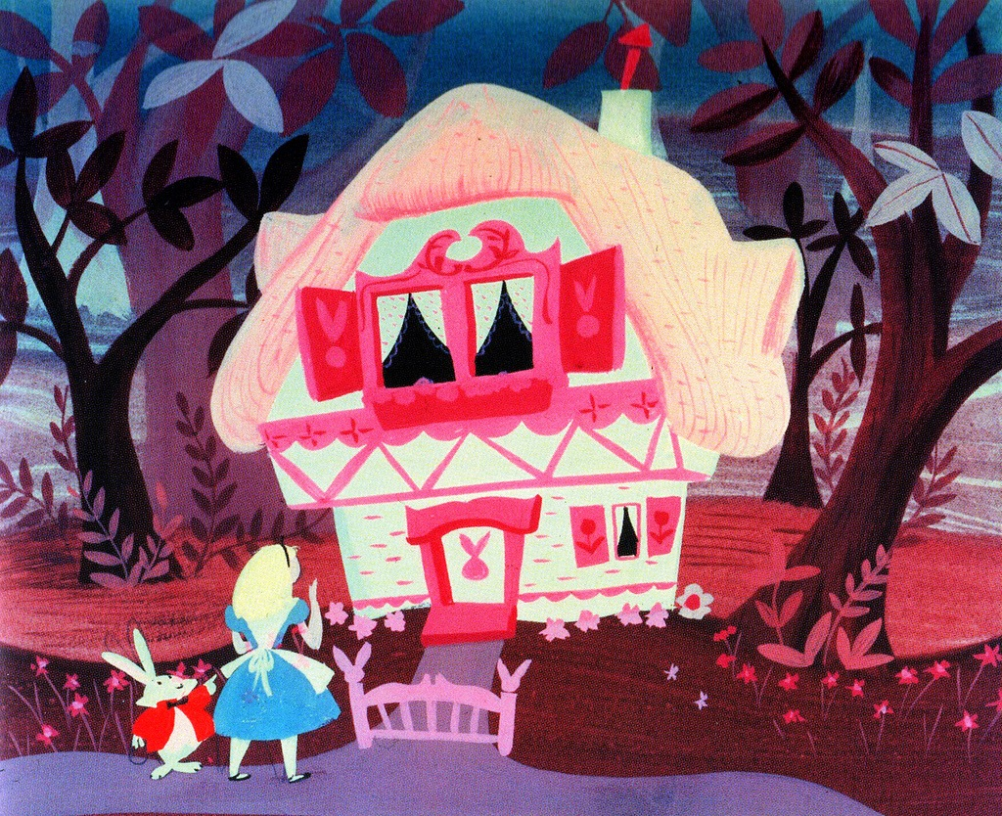
Animation in the USA 4
Walt Disney 2

Slide 21
Animation in the USA 4
Walt Disney 2
Sleeping Beauty (Clyde Geronimi, Les Clark, Eric Larson, Wolfgang Reitherman, 1959)

Slide 22
Animation in the USA 4
Walt Disney 2
The Hand Behind the Mouse: The Ub Iwerks Story (Leslie Iwerks, 1999)

Slide 23
Animation in the USA 4
Walt Disney 2
Disney after Disney: a timeline
1970: The Aristocats
1971: Walt Disney World
1973: Robin Hood
1977: The Many Adventures of Winnie the Pooh
1977: The Rescuers
1981: The Fox and the Hound
1982: EPCOT Center
1982: Tron
1983: Tokyo Disneyland
1984: Frank Wells from Warner Bros. is named Disney’s President; Michael Eisner from Paramount is named Disney’s CEO; Jeffrey Katzenberg from Paramount takes charge of Disney’s motion picture division.

Slide 24
Animation in the USA 4
Walt Disney 2
Disney after Disney: a timeline
1985: The Black Cauldron
1986: The Great Mouse Detective
1988: Who Framed Roger Rabbit
1988: Oliver & Company
1989: The Little Mermaid
1990: The Rescuers Down Under
1991: Beauty and the Beast
1992: Disneyland Paris (formerly Euro Disney)
1992: Aladdin
1994: The Lion King
1994: the first direct-to-video animated sequel, The Return of Jafar
1995: Pocahontas

Slide 25
Animation in the USA 4
Walt Disney 2
Disney after Disney: a timeline
1995: Toy Story
1996: The Hunchback of Notre Dame
1997: Hercules
1998: Mulan
1998: A Bug’s Life
1999: Tarzan
1999: Toy Story 2
1999: Fantasia 2000
2000: Dinosaur
2000: The Emperor’s New Groove
2001: Atlantis: The Lost Empire

Slide 26
Animation in the USA 4
Walt Disney 2
Disney after Disney: a timeline
2001: Monsters, Inc.
2002: Lilo & Stitch
2002: Treasure Planet
2003: Finding Nemo
2003: Brother Bear
2004: Home on the Range
2004: The Incredibles
2004: announcement of the conversion of Walt Disney Feature Animation into a fully CGI studio
2005: Robert Iger succeeds Michael Eisner as CEO
2005: Hong Kong Disneyland
2005: Chicken Little

Slide 27
Animation in the USA 4
Walt Disney 2
Disney after Disney: a timeline
2006: Disney acquires Pixar. Edwin Catmull and John Lasseter assume control of Walt Disney Feature Animation.
2006: Rebuilding of the Feature Animation Staff
2006: Cars
2007: Meet the Robinsons
2007: Ratatouille
2007: Enchanted
2008: WALL-E
2008: Bolt
2009: Up
2009: The Princess and the Frog

Slide 28
Animation in the USA 4
Walt Disney 2
Disney after Disney: a timeline
2009: Disney acquires Marvel Entertainment
2010: Toy Story 3
2010: Tangled
2011: Disney acquires Lucasfilm
2011: Cars 2
2011: Winnie the Pooh
2012: Brave
2012: Wreck-It Ralph
2013: Monsters University
2013: Frozen
2014: Big Hero 6

Slide 29
Animation in the USA 4
Walt Disney 2
Disney after Disney: a timeline
2015: Shanghai Disney Resort
2015: Inside Out
2015: The Good Dinosaur
2015: Star Wars: The Force Awakens
2016: Zootopia
2016: Finding Dory
2016: Moana
2017: Cars 3
2017: Coco
2018: Ralph Breaks The Internet: Wreck-It Ralph 2
2018: The Incredibles 2
2018: Mary Poppins Returns
2018: Mulan (live action)
2019: Toy Story 4
2019: Frozen 2
2019: The Lion King (live action)
2019: Tim Burton’s Dumbo

Slide 30
Suggested readings
Giannalberto Bendazzi, Animation. A World History. 3 voll., Waltham, Massachusetts: Focal Press, 2015. Vol. III, pp. 10-30 (from –and including- the section “Limited Disney” up to –and including- the section “Mike Johnson”. Vol. II, pp. 103-104: “America” (only the section “On the Big Screen – Feature Films”).
Tom Klein, “Walt-to-Walt Oswald”, in Griffithiana, no. 71, 2001, pp. 28-43.

