Slide 1
History of Animation
Second Cycle Degree in Theatre, Film, Television and Media Studies
Academic Year 2018-2019
Lesson 19

Slide 2
Animation in Asia 2
Japan
After the World War II, Japanese cinema slowly transitioned towards a rebirth.
Akira Kurosawa’s Rashōmon won the Golden Lion in Venice in 1951.
In 1955 the educational department of the Tōkyō Eigasha production company started to do animation (Ukare Violin, The Happy Violin, Taiji Yabushita, 1955). The department would become later (1956) known as Tōei.
In 1958, Tōei produced a new Japanese full-length film, the first one in full colour: Hakujaden (The White Serpent, Taiji Yabushita).
Yabushita (1903-1986) make the most of the contributions of the two main animators: Yasuji Mori (1925-1992) and Akira Daikubara. This successful production involved some future outstanding animators and directors, like Yasuo Ōtsuka and Rintarō).

Slide 3
Animation in Asia 2
Japan
Hakujaden (Taiji Yabushita, 1958)

Slide 4
Animation in Asia 2
Japan
Tōei was mostly concerned about imitating western models and producing full-length features for children (see the largely successful Nagautsu o Haita Neko, Puss in Boots, Kimio Yabuki, 1969).
However, the commercial and expressive potential of Japanese animation, and in particular of manga eiga (“comic films”, later identified as animeeshon and finally anime, for short), fully emerged thanks to Osamu Tezuka (1928-1989), the so-called “God of Manga” and “Godfather of Anime”.

Slide 5
Animation in Asia 2
Japan
Osamu Tezuka
1961: Mushi Productions
1963-1966: “Tetsuwan Atomu” (“Astroboy”): the first Japanese TV animated series. 193 episodes.
1968: Tezuka Productions

Slide 6
Animation in Asia 2
Japan
“Astroboy” (Osamu Tezuka, 1963)

Slide 7
Animation in Asia 2
Japan
Broken Down Film (Osamu Tezuka, 1985)

Slide 8
Animation in Asia 2
Japan
Daicon III Opening Animation (Hideaki Anno, Hiroyuki Tamaga, Takami Akai, 1981)

Slide 9
Animation in Asia 2
Japan
Some outstanding anime directors
Katsuhiro Ōtomo (1954)
Satoshi Kon (1963-2010)
Mamoru Oshii (1951)
Mamoru Hosoda (1967)

Slide 10
Animation in Asia 2
Japan
Akira (Katsuhiro Ōtomo, 1988)

Slide 11
Animation in Asia 2
Japan
Sennen Joyū (Millennium Actress, Satoshi Kon, 2001)

Slide 12
Animation in Asia 2
Japan
Kōkaku Kidōtai (Ghost in the Shell, Mamoru Oshii, 1995)

Slide 13
Animation in Asia 2
Japan
Toki o Kakeru Shōjo (The Girl Who Leapt Through Time, Mamoru Hosoda, 2006)

Slide 14
Animation in Asia 2
Japan
Summer Wars (Mamoru Hosoda, 2009)

Slide 15
Animation in Asia 3
Animation in Asia:
Studio Ghibli

Slide 16
Animation in Asia 3
Japan
Isao Takahata (1935-2018)
Hayao Miyazaki (1941)
Toshio Suzuki (1948)
Joe Hisaishi (1950)

Slide 17
Animation in Asia 3
Japan
Miyazaki’s early career
Born on January 5, 1941, in Akebono-cho, Bunkyo district of Tokyo.
His father worked in his brother’s aeronautic firm, Miyazaki Airplanes, producing the rudders for Zero fighters (theme: war and responsibility)
His mother was often hospitalized, from 1947 to 1955, because of spinal tuberculosis; however, she retained a central role in the family (theme: strong women, struggle to survive).

Slide 18
Animation in Asia 3
Japan
Miyazaki’s early career
In 1958, he “fell in love” with Pai Niang, heorine of Legend of the White Serpent (Hakujaden, Taiji Yabushita). Theme: metamorphosis, multifaceted heroine.
During his studies of political science and economics at Gakushuin University, he joined a group studying foreign literature for children. Theme: fantasy, storytelling for children, fascination with Europe.
In 1963, he joined Toei Animation studio working as an in-betweener (creating the movements of characters between an animator’s key poses). He took an active role in the Toei labor union. Theme: cooperation, solidarity.

Slide 19
Animation in Asia 3
Japan
Miyazaki’s early career
1968: The Great Adventure of Hols, Prince of the Sun (Taiyo no Ouji Horusu no Daibouken, Isao Takahata).
From 1971: left Toei, experiences at A-Pro, Zuiyo Eizo and Nippon Animation (“Lupin III”, 1971, “Heidi, girl of the Alps”, 1974, “3000 Leagues in Search of Mother”, 1976, “Anne of Green Gables”, 1979).
1979: first full-length feature, The Castle of Cagliostro (Rupan Sansei: Kariosutoro no Shiro).

Slide 20
Animation in Asia 3
Japan
Miyazaki’s early career
1982: Nausicaä of the Valley of the Wind starts as a manga on “Animage” (would end in 1994).
1983: green light to the Nausicaä film, from Tokuma Shoten and Topcraft, led by Toru Hara. The film production committee included Toshio Suzuki, an editor at “Animage” who would have produced all of Miyazaki’s films from the late 1980s onwards.
1984: overwhelming success of Nausicaä of the Valley of the Wind
1985: Takahata, Hara, Suzuki and Miyazaki create Studio Ghibli.

Slide 21
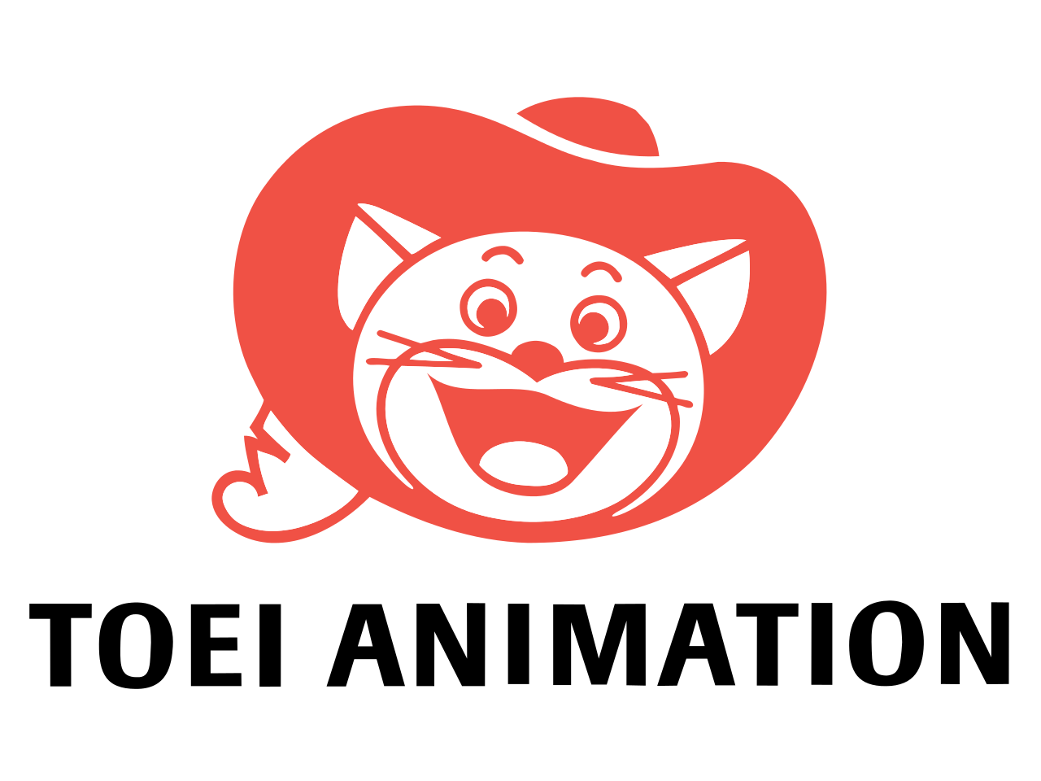
Animation in Asia 3
Japan

Slide 22
Animation in Asia 3
Japan
The Great Adventure of Hols, Prince of the Sun (Taiyo no Ouji Horusu no Daibouken, Isao Takahata, 1968).

Slide 23
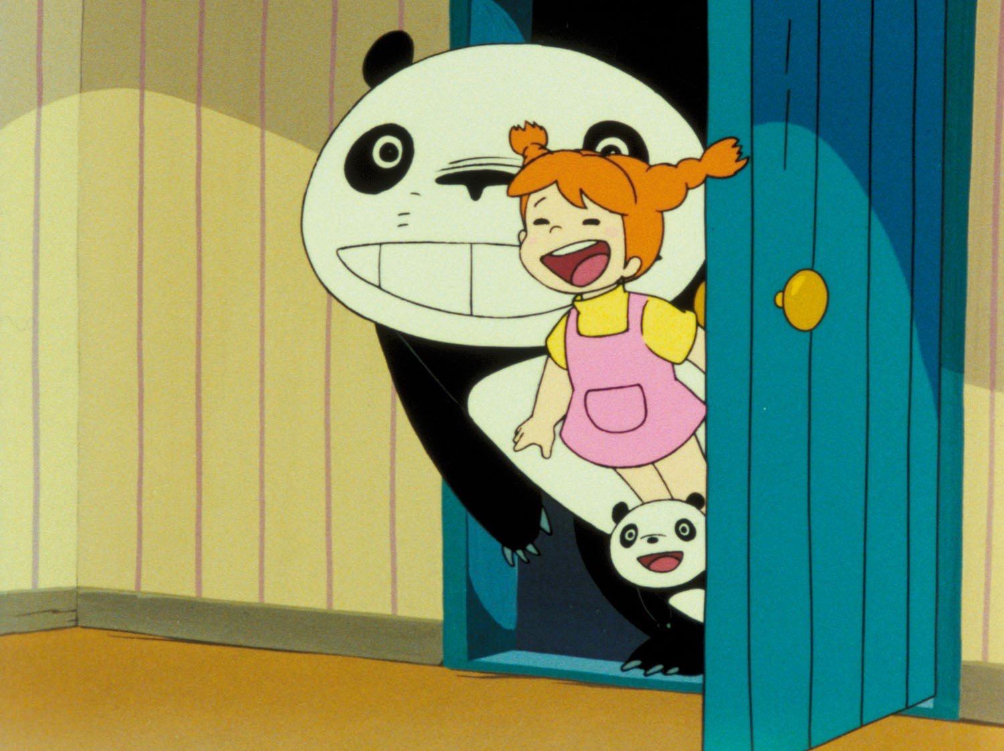
Animation in Asia 2
Japan

Slide 24
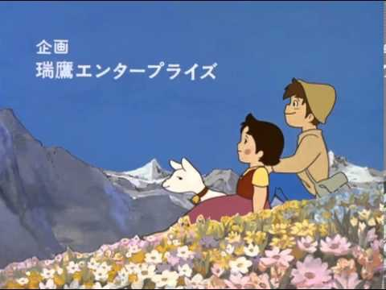
Animation in Asia 3
Japan

Slide 25
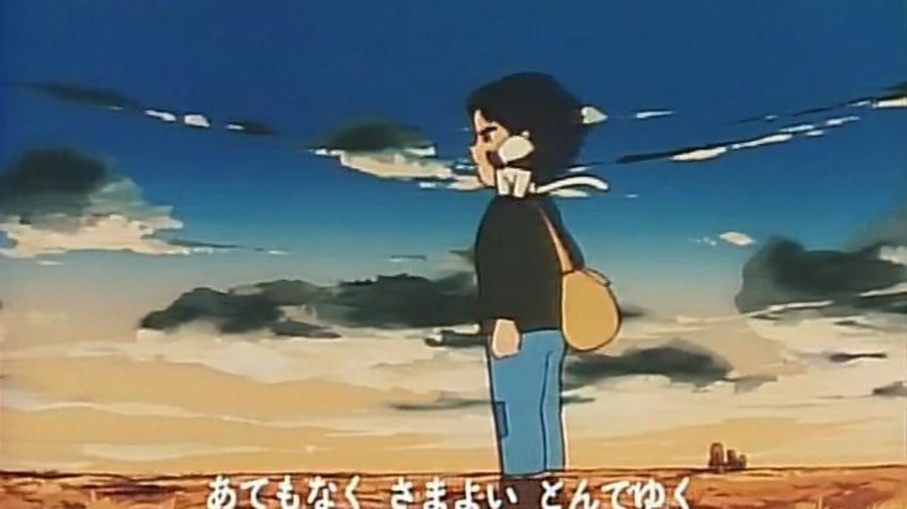
Animation in Asia 3
Japan

Slide 26
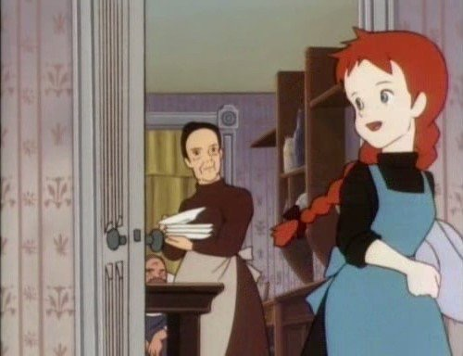
Animation in Asia 3
Japan

Slide 27
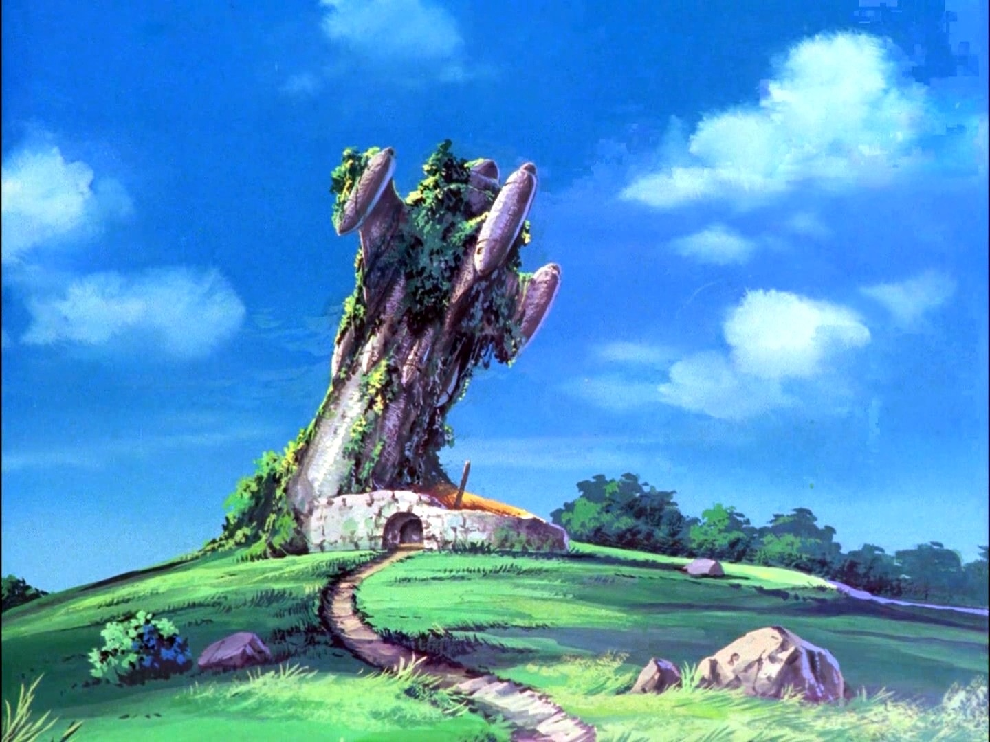
Animation in Asia 2
Japan

Slide 28
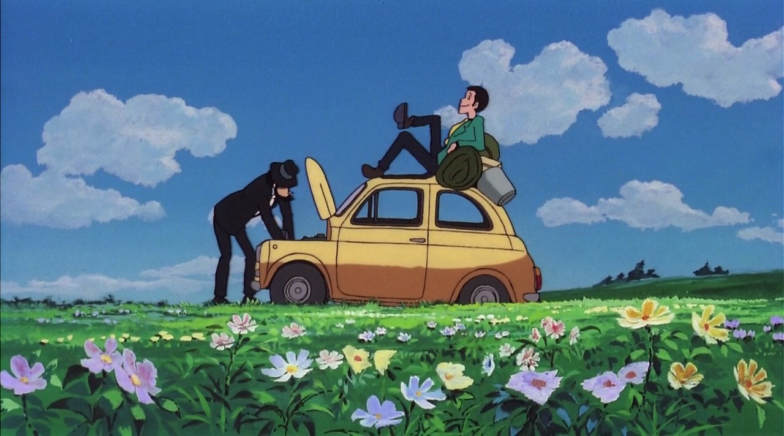
Animation in Asia 3
Japan

Slide 29
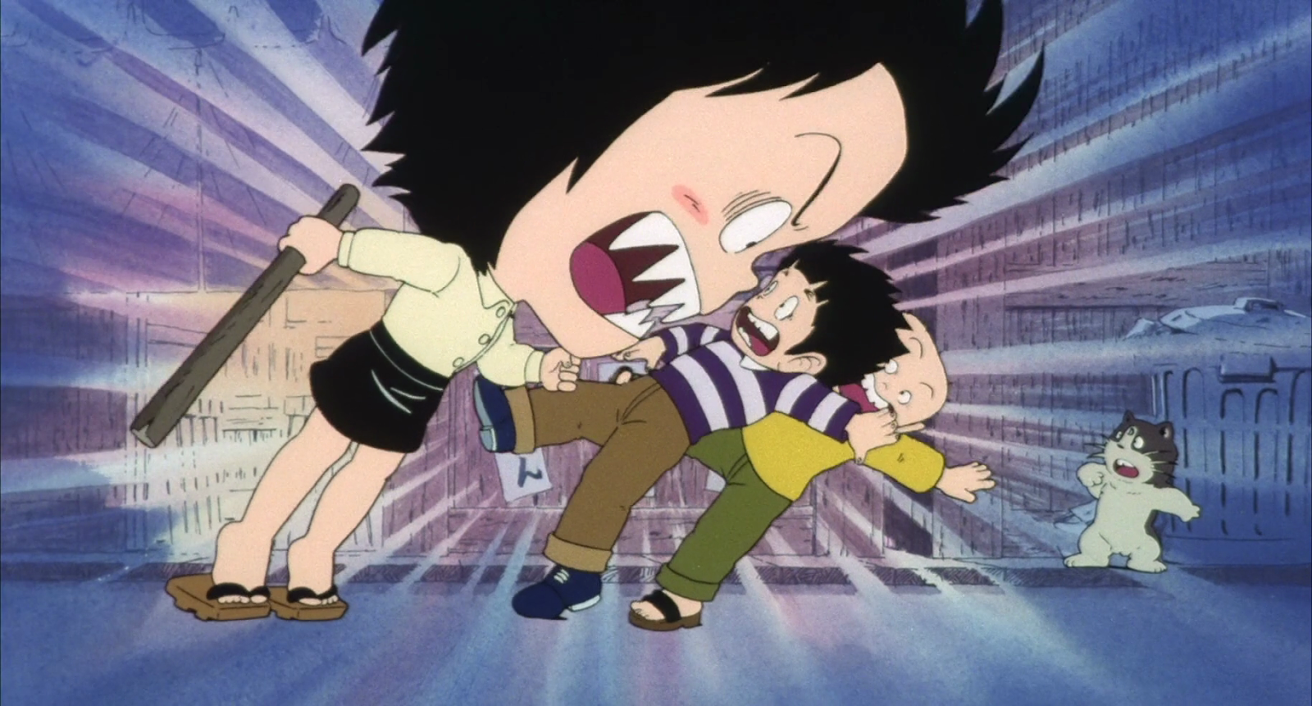
Animation in Asia 3
Japan

Slide 30
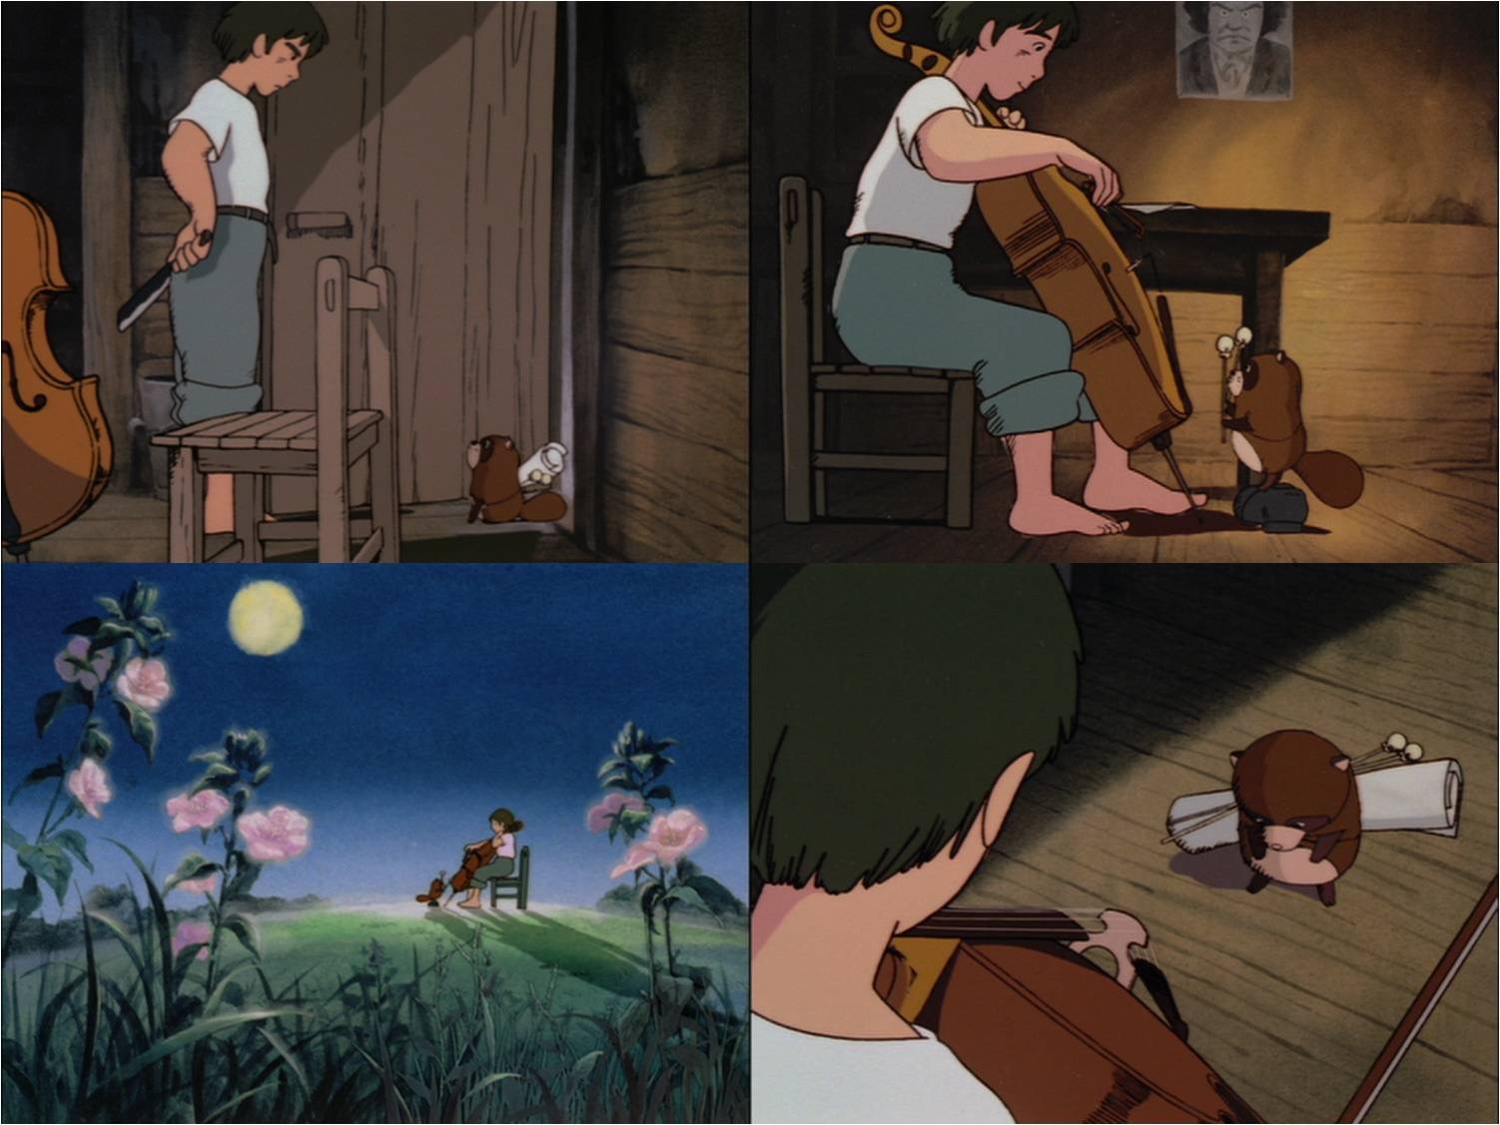
Animation in Asia 2
Japan

Slide 31
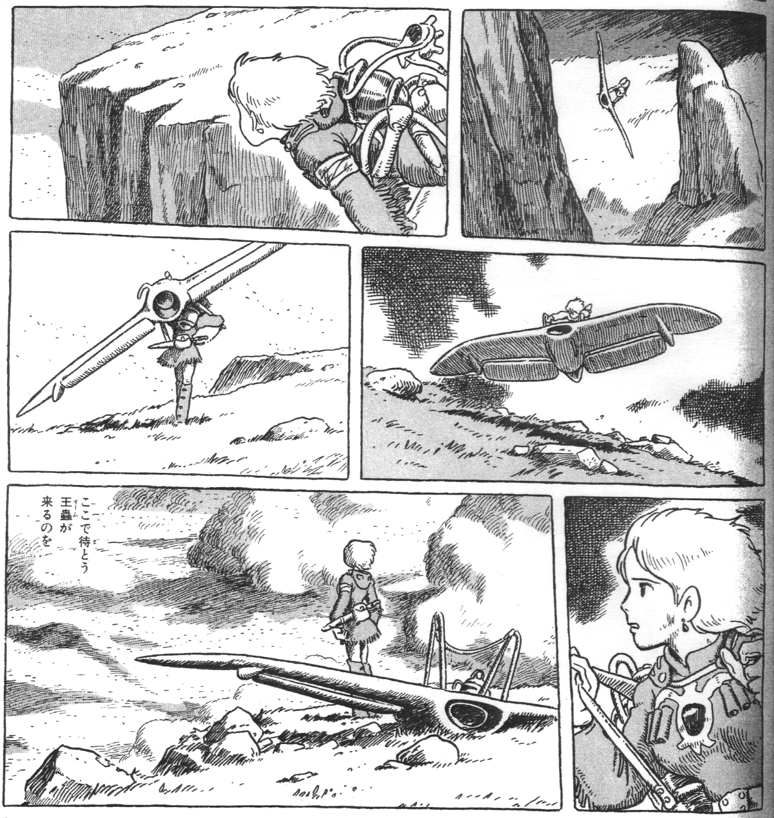
Animation in Asia 3
Japan

Slide 32
Animation in Asia 3
Japan
Kaze no Tani no Naushika (Nausicaä of the Valley of the Wind, Hayao Miyazaki, 1984).

Slide 33
Animation in Asia 3
Japan
Tenkū no Shiro Rapyuta (Castle in the Sky, Hayao Miyazaki, 1986).

Slide 34
Animation in Asia 3
Japan
«With the exception of Doraemon, most current animation is based on more serious, dramatic gekiga comics; Pazu will instead aim to help resurrect traditionally entertaining manga- or cartoon-style films. By focusing mainly on an audience of fourth graders […], it will reach an audience of even younger children, and expand even further in its age appeal. I am certain that hundreds of thousands of older anime fans will come to see this film no matter what, so there is no need to overtly cater to their tastes».
Hayao Miyazaki, “Original Proposal for Castle in The Sky”, 1984, now in in Jocelyne Allen (ed.), The Art of Castle in the Sky, San Francisco, 2016, p. 5.

Slide 35
Animation in Asia 3
Japan
Tonari no Totoro (My Neighbour Totoro, Hayao Miyazaki, 1988).

Slide 36
Animation in Asia 3
Japan
Hotaru no Haka (Grave of the Fireflies, Isao Takahata, 1988).

Slide 37
Animation in Asia 3
Japan
Majo no Takkyūbin (Kiki’s Delivery Service, Hayao Miyazaki, 1989).

Slide 38
Animation in Asia 3
Japan
Omohide Poro Poro (Only Yesterday, Isao Takahata, 1991).

Slide 39
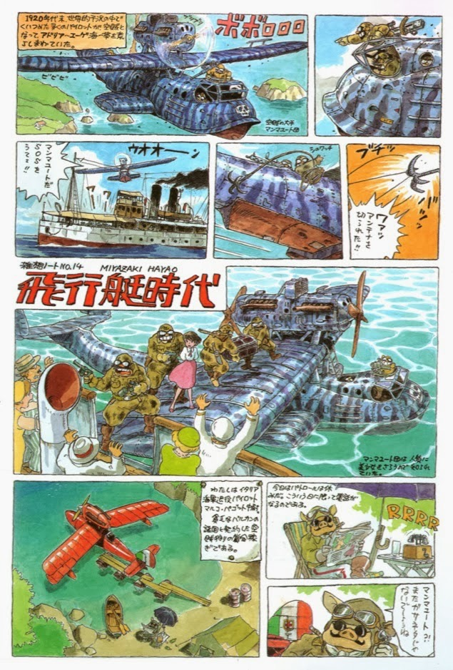
Animation in Asia 3
Japan

Slide 40
Animation in Asia 3
Japan
Kurenai no Buta (Porco Rosso,Hayao Miyazaki, 1992).

Slide 41
Animation in Asia 3
Japan
Mimi wo Sumaseba (Whisper of the Heart ,Yoshifumi Kondō, 1995).

Slide 42
Animation in Asia 3
Japan
Mononoke Hime (Princess Mononoke,Hayao Miyazaki, 1997).

Slide 43
Animation in Asia 3
Japan
Hōhokekyo tonari no Yamada-kun (My Neighbours the Yamadas, Isao Takahata, 1999).

Slide 44
Animation in Asia 3
Japan
Sen to Chihiro no Kamikakushi (Spirited Away, Hayao Miyazaki, 2001).

Slide 45
Animation in Asia 3
Japan
Hauru no Ugoku Shiro (Howl’s Moving Castle, Hayao Miyazaki, 2004).

Slide 46
Animation in Asia 3
Japan
Gedo Senki (Tales from Earthsea, Gorō Miyazaki, 2006).

Slide 47
Animation in Asia 3
Japan
Gake no Ue no Ponyo (Ponyo, Hayao Miyazaki, 2008).

Slide 48
Animation in Asia 3
Japan

Slide 49
Animation in Asia 3
Japan
Karigurashi no Arrietty (The Secret World of Arrietty, Hiromasa Yonebayashi, 2010).

Slide 50
Animation in Asia 3
Japan
Kokuriko Zaka-Kara (From Up on Poppy Hill, Gorō Miyazaki, 2011).

Slide 51
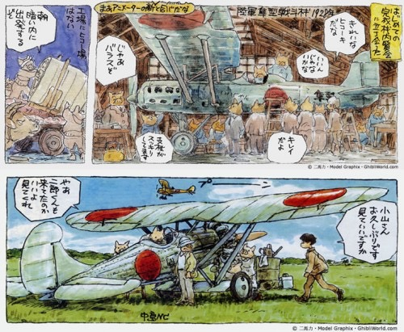
Animation in Asia 3
Japan

Slide 52
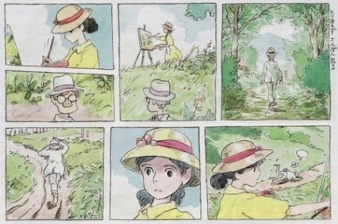
Animation in Asia 3
Japan

Slide 53
Animation in Asia 3
Japan
Kaze Tachinu (The Wind Rises, Hayao Miyazaki, 2013).

Slide 54
Animation in Asia 3
Japan
Kaguya-hime no Monogatari (The Tale of the Princess Kaguya, Isao Takahata, 2013).

Slide 55
Animation in Asia 3
Japan
Omoide no Marnie (When Marnie Was There, Hiromasa Yonebayashi, 2014).

Slide 56
Animation in Asia 3
Japan
“Sanzoku no Musume Rōnja” (“Ronja the Robber’s Daughter”, Gorō Miyazaki, 2014).

Slide 57
Animation in Asia 3
Japan
The Red Turtle (Michaël Dudok De Wit, Pascal Ferran, 2016).

Slide 58
Suggested readings
Giannalberto Bendazzi, Animation. A World History. 3 voll., Waltham, Massachusetts: Focal Press, 2015. Vol. II, pp. 360-374 (from –and including- the section “The Tokusatsu Factor” up to –and including- the section “Akira and the End of the Decade”).
Vol. III, pp. 214-243: “Asia” (to study up to –and including- the section “Yamamura Koji”); Vol. III, pp. 247-248 (from –and including- the section “Conclusions” up to –and including- the section “Challenges”).
Colin Odell & Michelle Le Blanc, Studio Ghibli. The Films of Hayao Miyazaki and Isao Takahata, Kamera Books, Harpenden, 2009, pp. 35-151.
Hayao Miyazaki, “Hayao Miyazaki on His Own Works”, in Hayao Miyazaki, Starting Point, Viz Media, San Francisco, 2009, pp. 311-332.
Isao Takahata, “The Fireworks of Eros”, in Miyazaki, op. cit., pp. 451-461.
Miyazaki, “Animation Directing Class”, in Hayao Miyazaki, Turning Point, Viz Media, San Francisco, 2014, pp. 128-133.
Miyazaki, “Snezhnaya Koroleva (The Snow Queen): A Film That Made Me Think Animation Was Worthy Work”, in Miyazaki, op. cit., pp. 410-415.

