Slide 1
History of Animation
Second Cycle Degree in Theatre, Film, Television and Media Studies
Academic Year 2018-2019
Lesson 20

Slide 2
Animated series
Animated (television) series:
USA and Japan

Slide 3
Animated series
Animated series
Features of an audiovisual series (general):
Episode
Continuity (various degrees: time scheme, consistency, characters…)
“small” screen space
Audience (also from the point of the media market)

Slide 4
Animated series
Animated series
Features of an animated series:
Limited animation
Focus on dialogue and sound (“illustrated radio”?)
“Reduced” styling /“simplified” design

Slide 5
Animated series
«[T]he technical requirements of television lend themselves well to animation. The small screen and the necessity for keeping both the background and the foreground flat and simple is completely within the province of the cartoon medium… television films can be handled by very small units with every chance of retaining the original conception of ideas».
John Halas, 1956, quoted in Paul Ward, “‘Smarter Than the Average Art Form’. Animation in the Television Era”, in Carol A. Stabile, Mark Harrison (eds.), Prime Time Animation. Television Animation and American Culture. London: Routledge, 2003, p. 18.

Slide 6
Animated series
“Limited” animation
“The Flintstones” (William Hannah, Joseph Barbera, 1960-1966)

Slide 7
Animated series
“Limited” animation
“Clutch Cargo” (Clark Haas, Cambria Productions, 1959)

Slide 8
Animated series
“Limited” animation
“Tetsuwan Atom” (“Astroboy”, Osamu Tezuka, 1963)

Slide 9
Animated series
“Reduced” styling /“simplified” design
Premises:
Disney (Toot, Whistle, Plunk and Boom, Ward Kimball, Charles A. Nichols,1953)
UPA
Zagreb School

Slide 10
Animated series
Styling/design
“Wacky Races” (William Hannah, Joseph Barbera, 1968-1969)

Slide 11
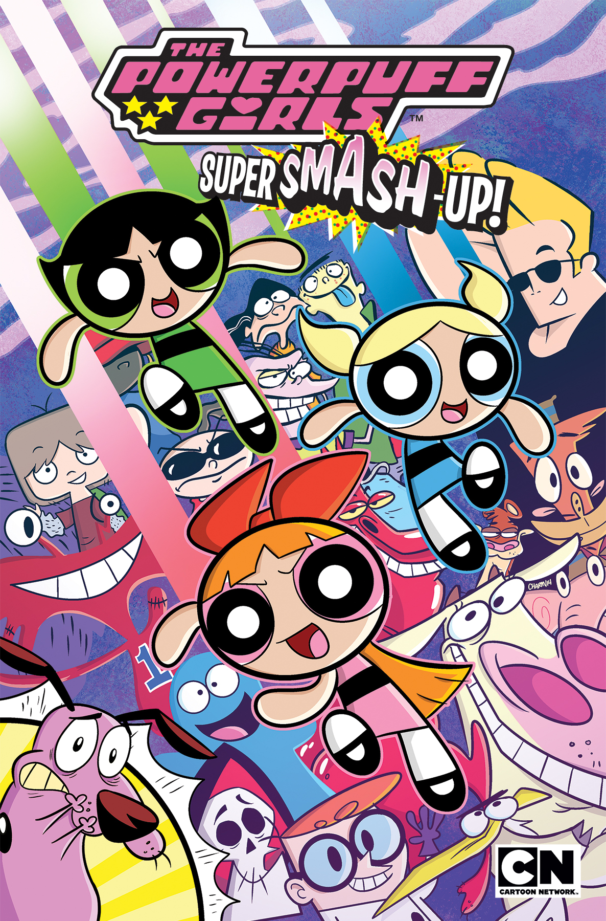
Animated series
Styling/design
Genndy Tartakovsky and the Cartoon Network TV series (1996-present)

Slide 12
Animated series
Styling/design
“Mickey Mouse” (Paul Rudish, 2013-present)

Slide 13
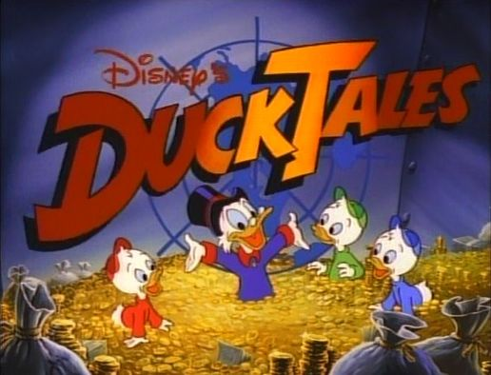
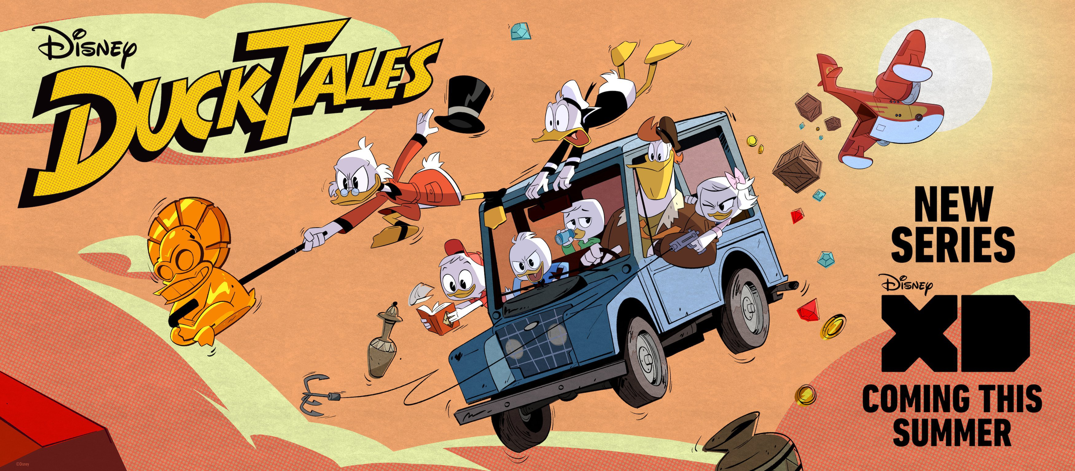
Animated series
Styling/design

Slide 14
Animated series
Styling/design
“Panty & Stocking with Garterbelt” (Hiroyuki Himaishi for Gainax, 2010)

Slide 15
Animated series
Target audience
Japanese series
The 1980s-1990s “reinassance”
Animation of film successes (The Real Ghostbusters, Beetlejuice)

Slide 16
Animated series
Animation for “adults” (?)
“The Simpsons” (Fox Television, 1989-present)

Slide 17
Animated series
Animation for “adults” (?)
“Tiny Toon Adventures” (Tom Ruegger, 1990-1995)

Slide 18
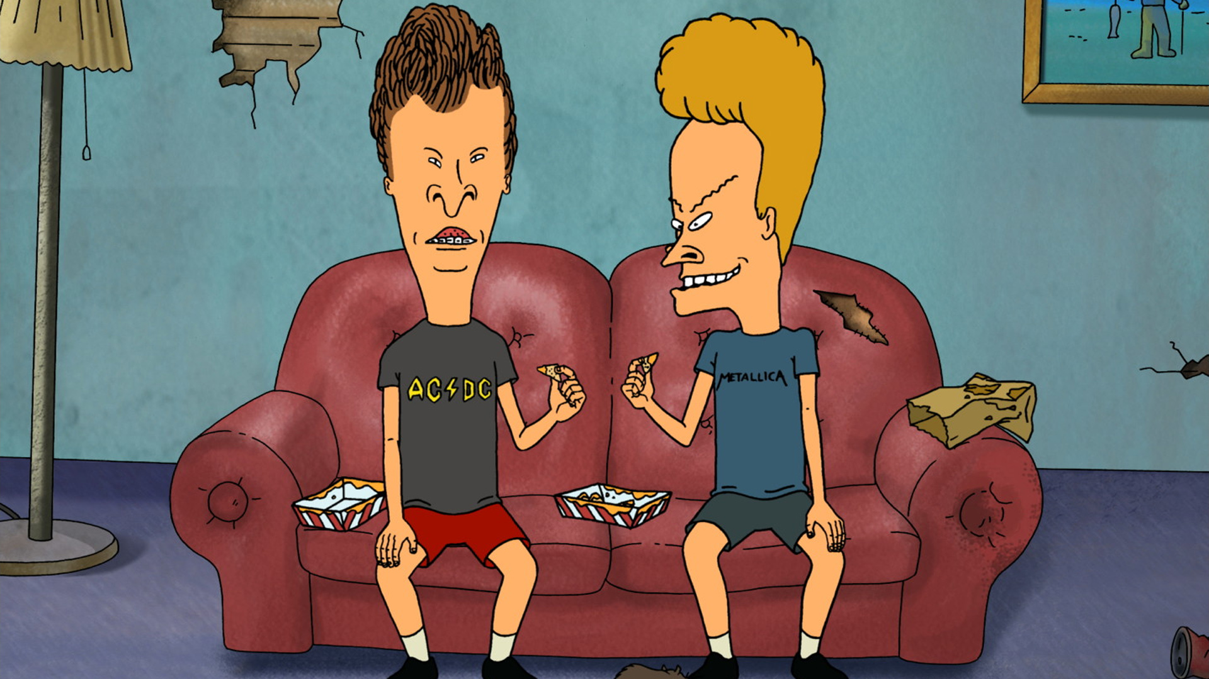
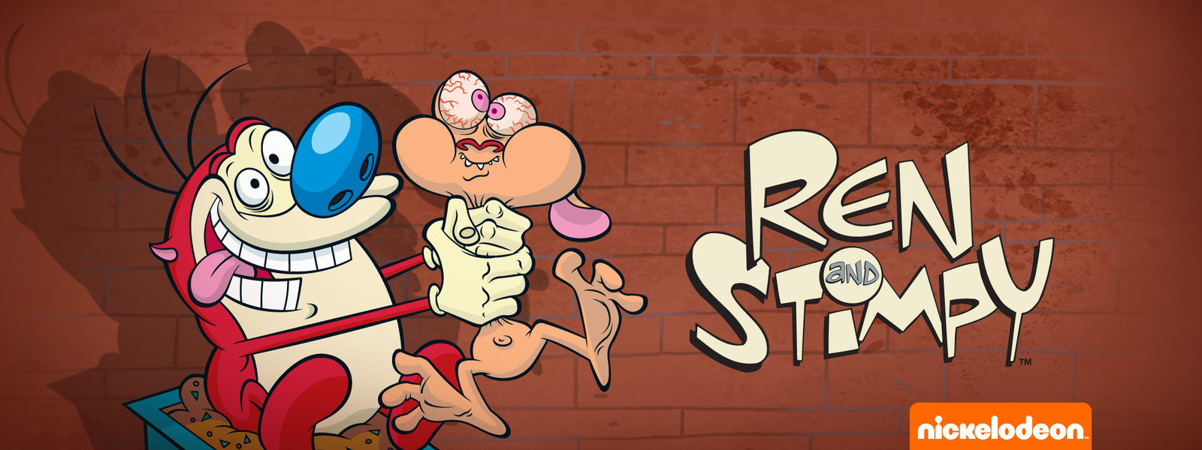
Animated series
Animation for “adults” (?)
“The Ren and Stimpy Show”, John Kricfalusi, 1991-1995
“Beavis and Butt-head” (Mike Judge, 1993-1997)
“South Park” (Trey Parker, Matt Stone, 1997-present)
“BoJack Horseman” (Raphael Bob-Waksberg, 2014-present)

Slide 19
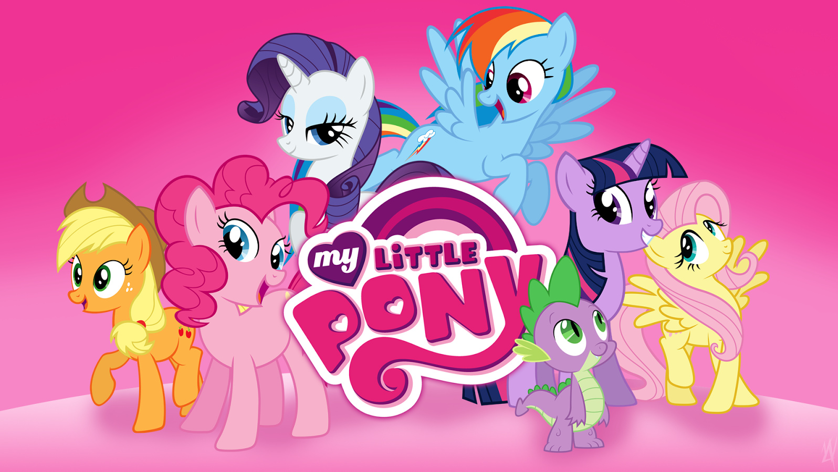
Animated series
Animation for “adults” (?)
“My Little Pony” (Lauren Faust, 2010-present)

Slide 20
Animated series
Anime and genre
Action, Adventure, Comedy, Drama, Horror, Science Fiction…
Target-specific: Shōnen, Shōjo, Seinen, Josei, Kodomo…
Specific: Mecha, Mahō Shōjo, Super Sentai…

Slide 21
Animated series
Anime: beyond “genres”
“Shin Seiki Evangelion” (“Neon Genesis Evangelion”, Hideaki Anno, 1995)

Slide 22
Animated series
Anime: beyond “genres”
“Shin Seiki Evangelion” (“Neon Genesis Evangelion”, Hideaki Anno, 1995)

Slide 23
Animated series
Anime: beyond “genres”

Slide 24
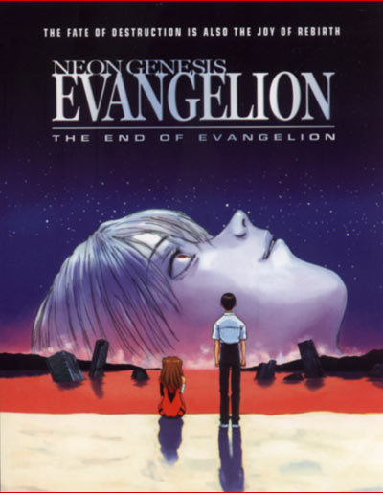
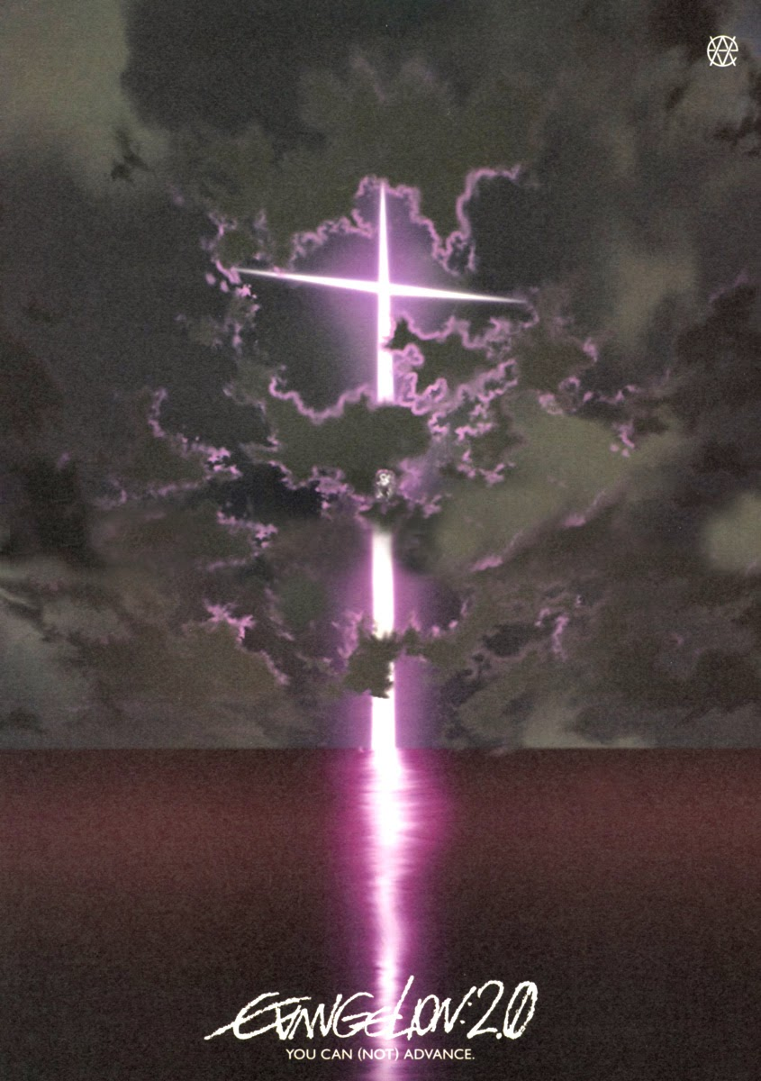
Animated series
1997
1997
2007-present

Slide 25
Animated series
Anime: beyond “genres”
“Mahō Shōjo Madoka Magica” (“Puella Magi Madoka Magica”, Akiyuki Shinbō, 2011)

Slide 26
Animated series
Anime: beyond “genres”
“Mahō Shōjo Madoka Magica” (“Puella Magi Madoka Magica”, Akiyuki Shinbō, 2011)

Slide 27
Suggested readings
Paul Ward, “’Smarter Than the Average Art Form’. Animation in the Television Era”, in Carol A. Stabile, Mark Harrison (eds.), Prime Time Animation. Television Animation and American Culture. London: Routledge, 2003, pp. 15-32.
https://books.google.it/books?id=wd_cAAAAQBAJ&printsec=frontcover&hl=it&source=gbs_ge_summary_r&cad=0#v=onepage&q&f=false
Rayna Denison, Anime: A Critical Introduction. New York: Bloomsbury, 2015, pp. 1-29.

