Slide 1
History of Animation
Second Cycle Degree in Theatre, Film, Television and Media Studies
Academic Year 2018-2019
Lesson 21

Slide 2
The Masters of Animation
Three Masters of Animation:
Alexander Alexeïeff
Norman McLaren
Oskar Fischinger

Slide 3
The Masters of Animation
Alexeïeff
Alexander Alexeïeff (1901-1982)
He was born in Russia (Kazan), son of a school principal and an officer of the Czarist army.
Since he was a child, he had been traveling a lot: his family moved to Constantinople soon after his birth; there, he learnt French even before Russian.
Alexander’s father mysteriously disappeared during a mission to Baden-Baden Germany. He was probably shot by a Turk. Soon after this event, Alexeïeff’s mother left to Germany without any explanation. She revealed the reason behind her journey only when she returned home.

Slide 4
The Masters of Animation
Alexeïeff
Alexeïeff experienced also another mysterious disappearance during his youth: his second oldest brother Nikolai went missing during the Russian Revolution of 1917.
Those early, unsettling experiences maybe influenced «Alexeïeff’s lifelong attachment to darkness, mystery and the spirit world». They «show themselves throughout his work in black figures rising from beneath the sidewalk, in gnomes and monsters, in empty streets and landscapes, in metamorphoses of every kind, and in his poetic use of blacks and whites and greys».
Cecile Starr, “Interview with Alexeïeff, quoted in Robin Allan, “Two Nights on Bald Mountain”, in Giannalberto Bendazzi (ed.), Alexeïeff – Itinerary of a Master, Dreamland, Annecy, 2001, p. 83.

Slide 5
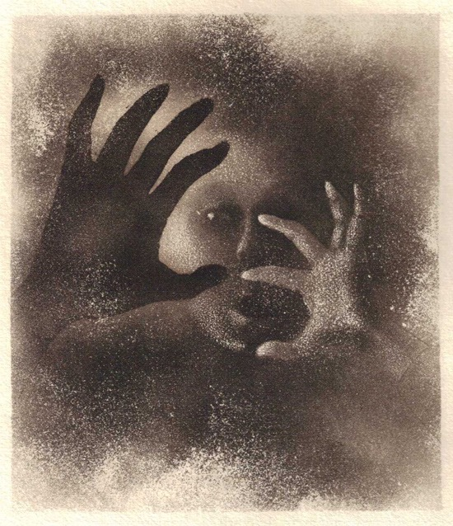
The Masters of Animation
Alexeïeff
From the illustrations for Adrienne Mesurat by Julien Green, 1929

Slide 6
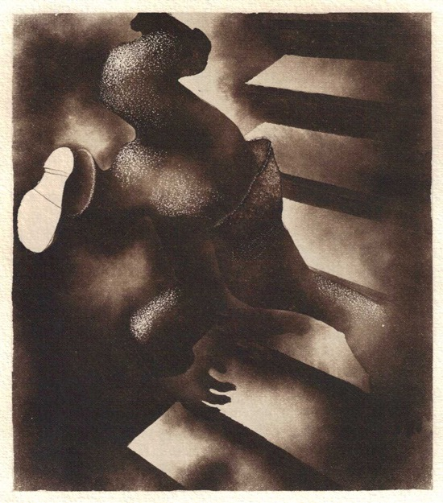
The Masters of Animation
Alexeïeff

Slide 7
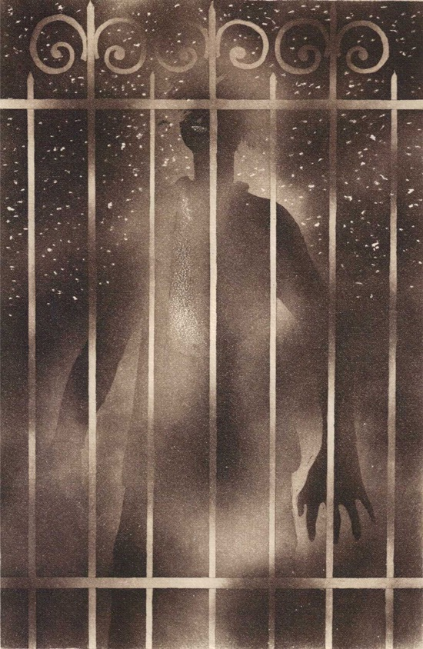
The Masters of Animation
Alexeïeff

Slide 8
The Masters of Animation
Alexeïeff
He studied Fine Arts at the St Petersburg’s Military School.
After he finished his courses, he boarded a military ship. Alexeïeff traveled to Japan, China, India and Egypt. In Dubrovnik, Yugoslavia, the crew dispersed. Alexeïeff traveled to Marseille and finally settled in Paris.
There, he completed his artistic training at the Académie de la Grande Chaumière in Montparnasse, and started working as a set designer and a book illustrator.
At the age of thirty, he started to become interested in cinema.

Slide 9
The Masters of Animation
Alexeïeff
Inspired by Fernand Léger’s Le ballet mécanique (1924) and Berthold Bartosch’s L’idée (1932), Alexeïeff sought a poetic form of animation, based on chiaroscuro. He envisioned an animated engraving; to achieve this result, he theorized the pinscreen.
It would have remained just a theory, however, without the practical aid of his first wife, Alexandra Alexandrovna Grinevskya, and then of Claire Parker (1906-1981). Parker was a young American student; she joined Alexeïeff’s studio in 1931 and soon after she became the artist’s lover. Alexeïeff divorced Alexandra Grinevsky and married Claire Parker in 1940, after they moved to the USA.

Slide 10
The Masters of Animation
Alexeïeff
1933: Une nuit sur le mont chauve. The film was highly appreciated, but it was not profitable. Afterwards, he turned to advertising (La belle au bois dormant, 1935).
1943: En passant, a new pinscreen production for the National Film Board of Canada. Alexeïeff kept working as an engraver; after the War, he returned to Paris.
1951: experimental period; animation of “illusory solids” (Ètudes de solides illusoires).
1962: title illustrations for Le procès (Orson Welles, 1962)

Slide 11
The Masters of Animation
Alexeïeff
1963: Le nez, after Gogol
1972: Tableaux d’une exposition, after Mussorgsky.
1977: Trois thèmes, a kind of “sequel” to Tableaux d’une exposition.

Slide 12
The Masters of Animation
Alexeïeff
Une nuit sur le mont chauve (Alexander Alexeïeff, 1933)

Slide 13
The Masters of Animation
Alexeïeff
La belle au bois dormant (Alexander Alexeïeff, 1935)

Slide 14
The Masters of Animation
Alexeïeff
En passant (Alexander Alexeïeff, 1943)

Slide 15
The Masters of Animation
Alexeïeff
Ètudes de solides illusoires (Alexander Alexeïeff, 1951)

Slide 16
The Masters of Animation
Alexeïeff
Le nez (Alexander Alexeïeff, 1963)

Slide 17
The Masters of Animation
Alexeïeff
Tableaux d’une exposition (Alexander Alexeïeff, 1972)

Slide 18
The Masters of Animation
Alexeïeff
Trois thèmes (Alexander Alexeïeff, 1977)

Slide 19
The Masters of Animation
McLaren
Norman McLaren (1914-1987)
Opening Speech (Norman McLaren, 1960)

Slide 20
The Masters of Animation
McLaren
He was born in Scotland. His father, an interior designer, encouraged young Norman’s enrollment at the School of Fine Arts in Glasgow, in 1933.
There, he distinguished himself by making films. He found an abandoned 35 mm projector in the school basement. He did not own a camera, so he started painting directly on film stock.
1937: He started working at the General Post Office, London, under the sponsorship of John Grierson. Love on the Wing (1938): his first “official” short film featuring animation painted directly on film.

Slide 21
The Masters of Animation
McLaren
1939: New York, Guggenheim Foundation. Dots and Loops, and a few of other experimental short films. John Grierson invited him to work at the new Canadian film office: the National Film Board of Canada.
1943: McLaren is asked to organize an animation department inside the National Film Board. He started working with animators such as George Dunning, Jean-Paul Ladouceur, René Jodoin, Jim McKay and Grant Munro.
1952: Neighbors is awarded an Oscar.

Slide 22
The Masters of Animation
McLaren
McLaren and animation as a complete form of art
Technique;
Free-flowing creation;
The social role of the free artist;
A cinema without words (“abstract”, just like music).

Slide 23
The Masters of Animation
McLaren
C’est l’aviron (Norman McLaren, 1944)

Slide 24
The Masters of Animation
McLaren
La poulette grise (Norman McLaren, 1947)

Slide 25
The Masters of Animation
McLaren
Begone Dull Care (Norman McLaren, 1949)

Slide 26
The Masters of Animation
McLaren
Pas de deux (Norman McLaren, 1968)

Slide 27
The Masters of Animation
McLaren
Synchromy (Norman McLaren, 1971)

Slide 28
The Masters of Animation
Fischinger
Oskar Fischinger (1900-1967)
He was born in Germany.
Early years: he studied violin and practiced as an organ-builder and as a technical artist at an architect’s office. After the War, his family moved to Frankfurt. There, he joined a literary circle and Bernhard Diebold, a local critic. Diebold encouraged his attempts in abstract painting and let him know the works by Walther Ruttmann. 1921: “Wax Experiments”. 1922: he moved to Munich; he founded a studio with Louis Seel, which produced animated shorts (and a second firm, aimed at developing a motor); he licensed the “Wax Machine” to Ruttmann.
1927: after many financial hardships, he left Munich for Berlin. He traveled 564 km on foot, while taking pictures. He later used them in a film, München-Berlin Wanderung (1927).

Slide 29
The Masters of Animation
Fischinger
1928: he joined UFA and created special effect for Fritz Lang’s Frau im Mond.
1929-1933: 12 Studien. Exploration of the sound-moving image relationship; abstract animations based on pieces from the “classical” repertoire. He also experimented with colour (Gasparcolor). The Studien were highly appreciated.
1934: Muratti Greift Ein, a cigarette commercial which was screened in cinemas around Europe.
1935: Komposition in Blau. An agent from Paramount invited Fischinger to work in the USA. He accepted, because of the consolidation of the Nazi power and its threats on avant-garde artistic expressions.

Slide 30
The Masters of Animation
Fischinger
1936: the film project The Big Broadcast of 1937, at Paramount. As the studio turned the film in black and white, Fischinger quit. He later completed his abstract sequence as the color short Allegretto.
1938: An Optical Poem, for MGM.
1940: Fantasia and Pinocchio, at Disney. Meanwhile, following advice from his friends, he started to make a living as a traditional painter.
1942: Radio Dynamics
1947: Fischinger’s last finished work, Motion Painting No. 1, based on Johann Sebastian Bach’s Third Brandeburg Concerto.
1950s: the Lumigraph, a new take on the color organ.

Slide 31
The Masters of Animation
Fischinger
Wax Experiments (Oskar Fischinger, 1921-26)

Slide 32
The Masters of Animation
Fischinger
Studie nr. 7 (Oskar Fischinger, 1931)

Slide 33
The Masters of Animation
Fischinger
Komposition in Blau (Oskar Fischinger, 1935)

Slide 34
The Masters of Animation
Fischinger
Radio Dynamics (Oskar Fischinger, 1942)

Slide 35
The Masters of Animation
Fischinger
Motion Painting No. 1 (Oskar Fischinger, 1947)

Slide 36
Suggested readings
Giannalberto Bendazzi, Animation. A World History. 3 voll., Waltham, Massachusetts: Focal Press, 2015. Vol. I, pp. 140-147: “Alexandre Alexeïeff”; Vol. I, pp. 153-157: Oskar Fischinger; Vol. II, pp. 30-36: “Norman McLaren”.

