Slide 1
History of Animation
Second Cycle Degree in Theatre, Film, Television and Media Studies
Academic Year 2018-2019
Lesson 3

Slide 2
Why Animation?
«In recent decades, animators have found increasingly inventive ways of using animation. Today it pervades much of the landscape of popular culture, being a medium of choice to push boundaries, cross traditional disciplinary divides and support and enhance other creative work. While animation’s history is relatively short compared to other arts disciplines, this needs to be juxtaposed against the prolific and accelerated advances in technology, such as the growth of the Internet, the developing reliance on mobile technology and the need for greater visually oriented support for social media. Such technical leaps have created changes in global social and economic conditions and have encouraged increased interest in the subject of animation – an interest that is likely to grow and spread over the coming years».
Andrew Selby, “Introduction”, in Id., Animation, Laurence King, London, 2013, p. 6.

Slide 3
Animation Styles and Techniques
Styles: A Brief Survey
Fantasia/2000 (Eric Goldberg et al., 1999).

Slide 4
Animation Styles and Techniques
Styles: A Brief Survey
Howl’s Moving Castle (Hauru no Ugoku Shiro, Hayao Miyazaki, 2004).

Slide 5
Animation Styles and Techniques
Styles: A Brief Survey
Idiots and Angels (Bill Plympton, 2009).

Slide 6
Animation Styles and Techniques
Styles: A Brief Survey
Sea Scouts (Dick Lundy, 1939).

Slide 7
Animation Styles and Techniques
Styles: A Brief Survey
Tangled (Nathan Greno, Byron Howard, 2010).

Slide 8
Animation Styles and Techniques
Styles: A Brief Survey
“Black Rock Shooter” (Shinobu Yoshioka, 2012).

Slide 9
Animation Styles and Techniques
A Few Basic Questions (And Answers) About Styles of Animation
How is the action broken down?

Slide 10
Animation Styles and Techniques
A Few Basic Questions (And Answers) About Styles of Animation
The number of images used to break down an action is related with two basic strategies, used in any kind of animation:
TIMING and SPACING

Slide 11
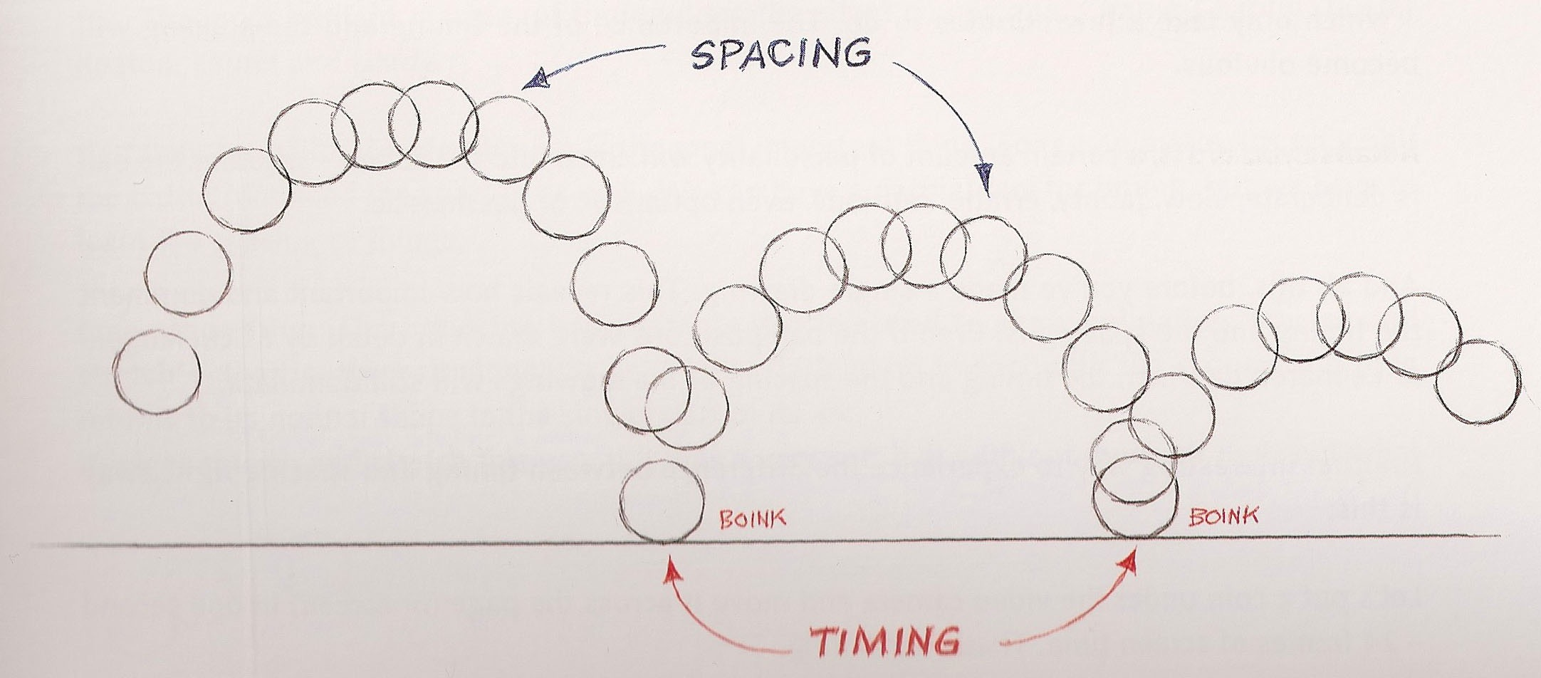
Animation Styles and Techniques
A Few Basic Questions (And Answers) About Styles of Animation
From Richard Williams, The Animator’s Survival Kit, Faber and Faber, London, 2001, p. 37.

Slide 12
Animation Styles and Techniques
A Few Basic Questions (And Answers) About Styles of Animation
How many images are used to break down the action?

Slide 13
Animation Styles and Techniques
A Few Basic Questions (And Answers) About Styles of Animation
Key Animation and Inbetweening
What is a “key” in animation?
The storytelling positions. The positions that show what is happening in the shot.

Slide 14
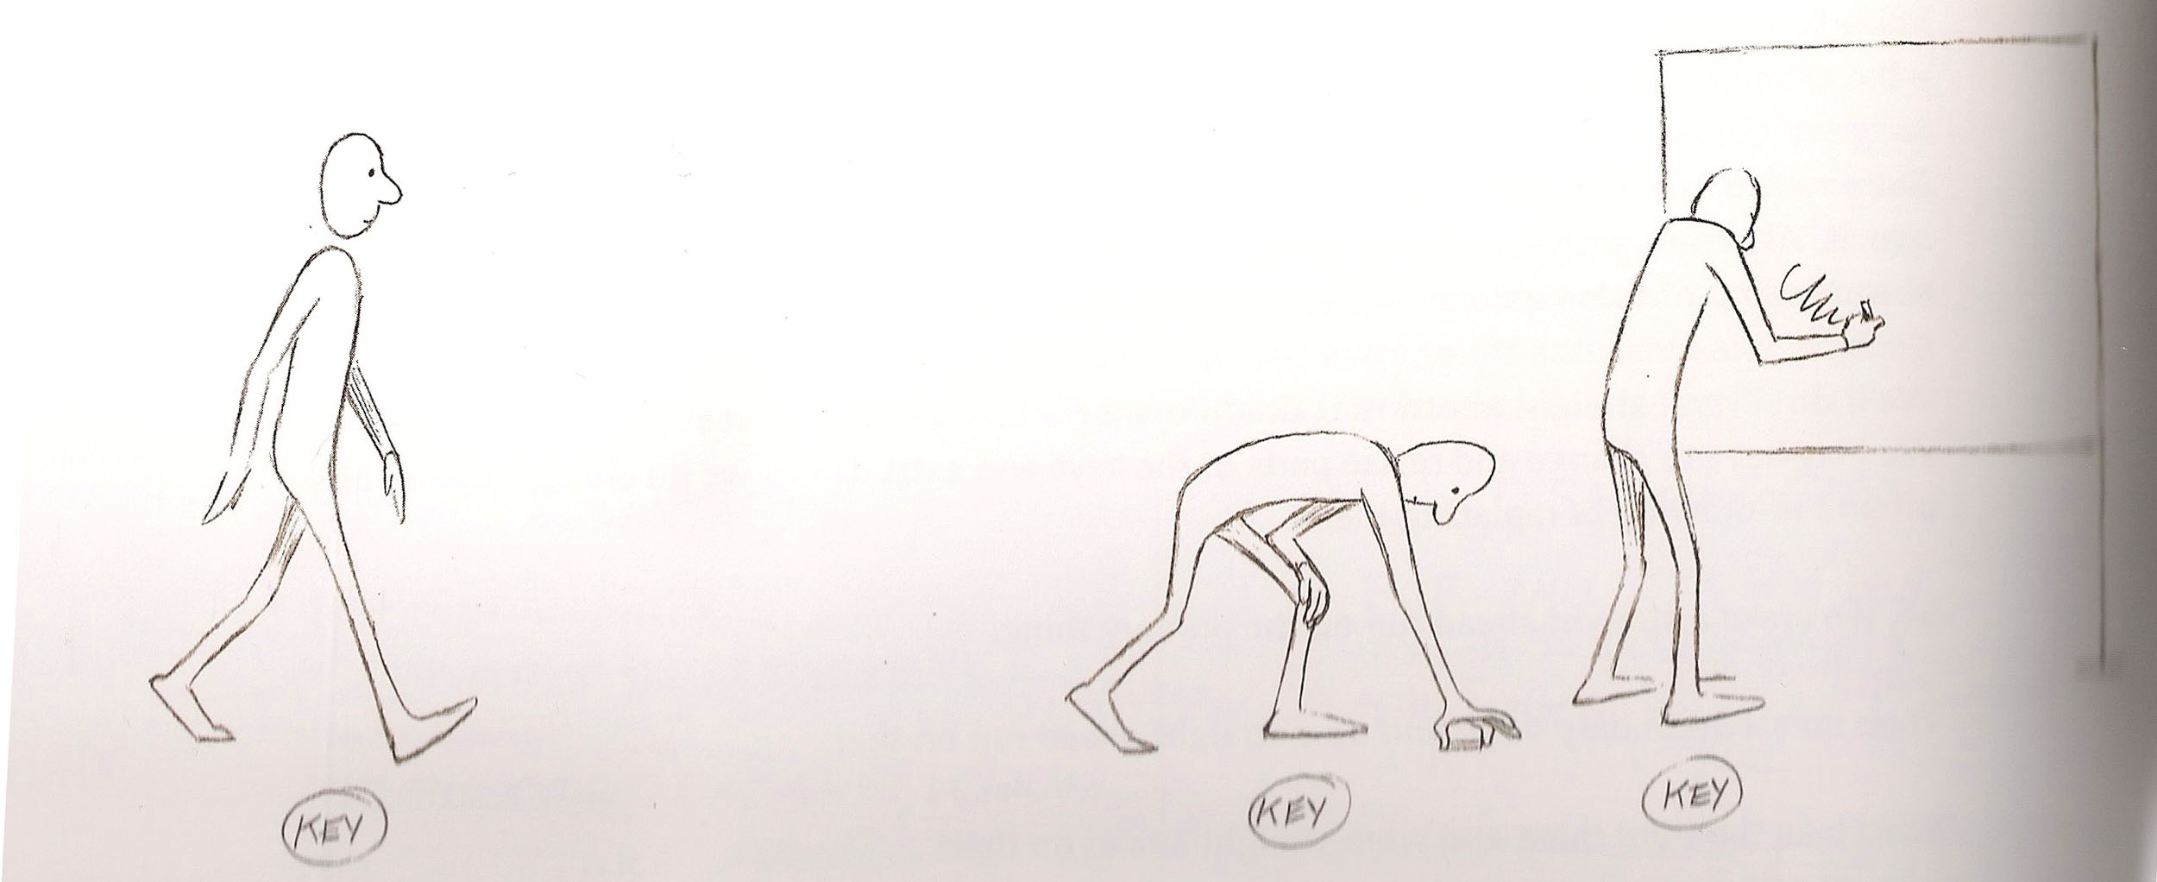
Animation Styles and Techniques
A Few Basic Questions (And Answers) About Styles of Animation
From Williams, op. cit., p. 64.

Slide 15
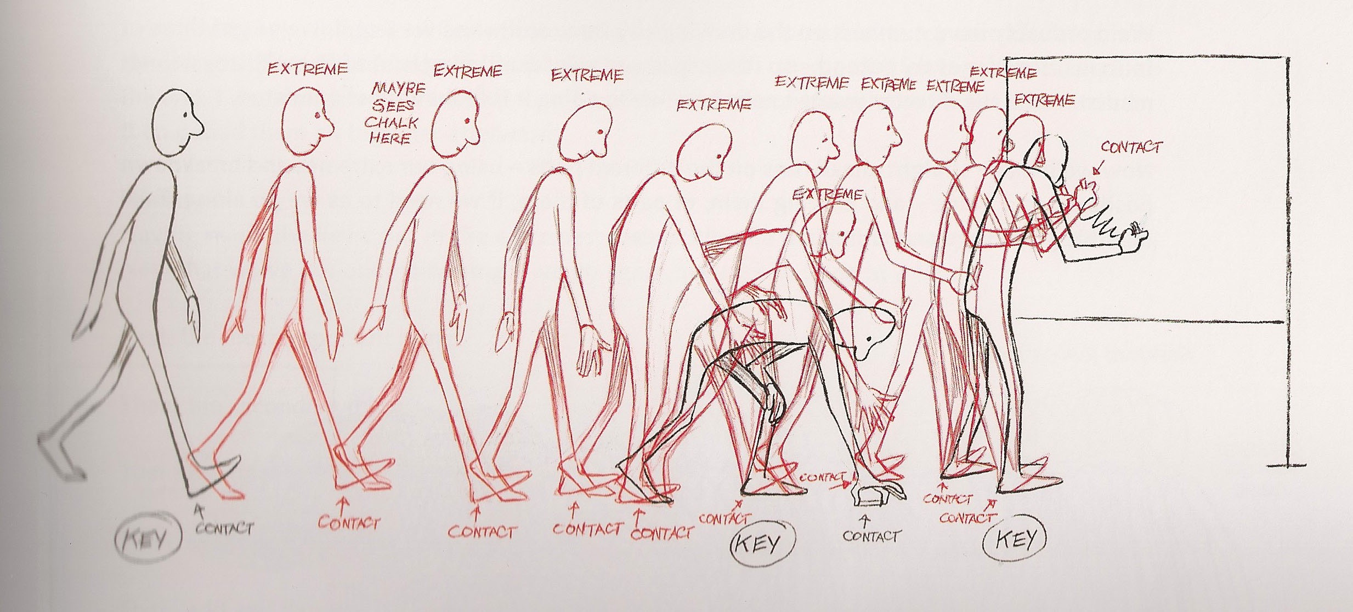
Animation Styles and Techniques
A Few Basic Questions (And Answers) About Styles of Animation
From Williams, op. cit., p. 65.

Slide 16
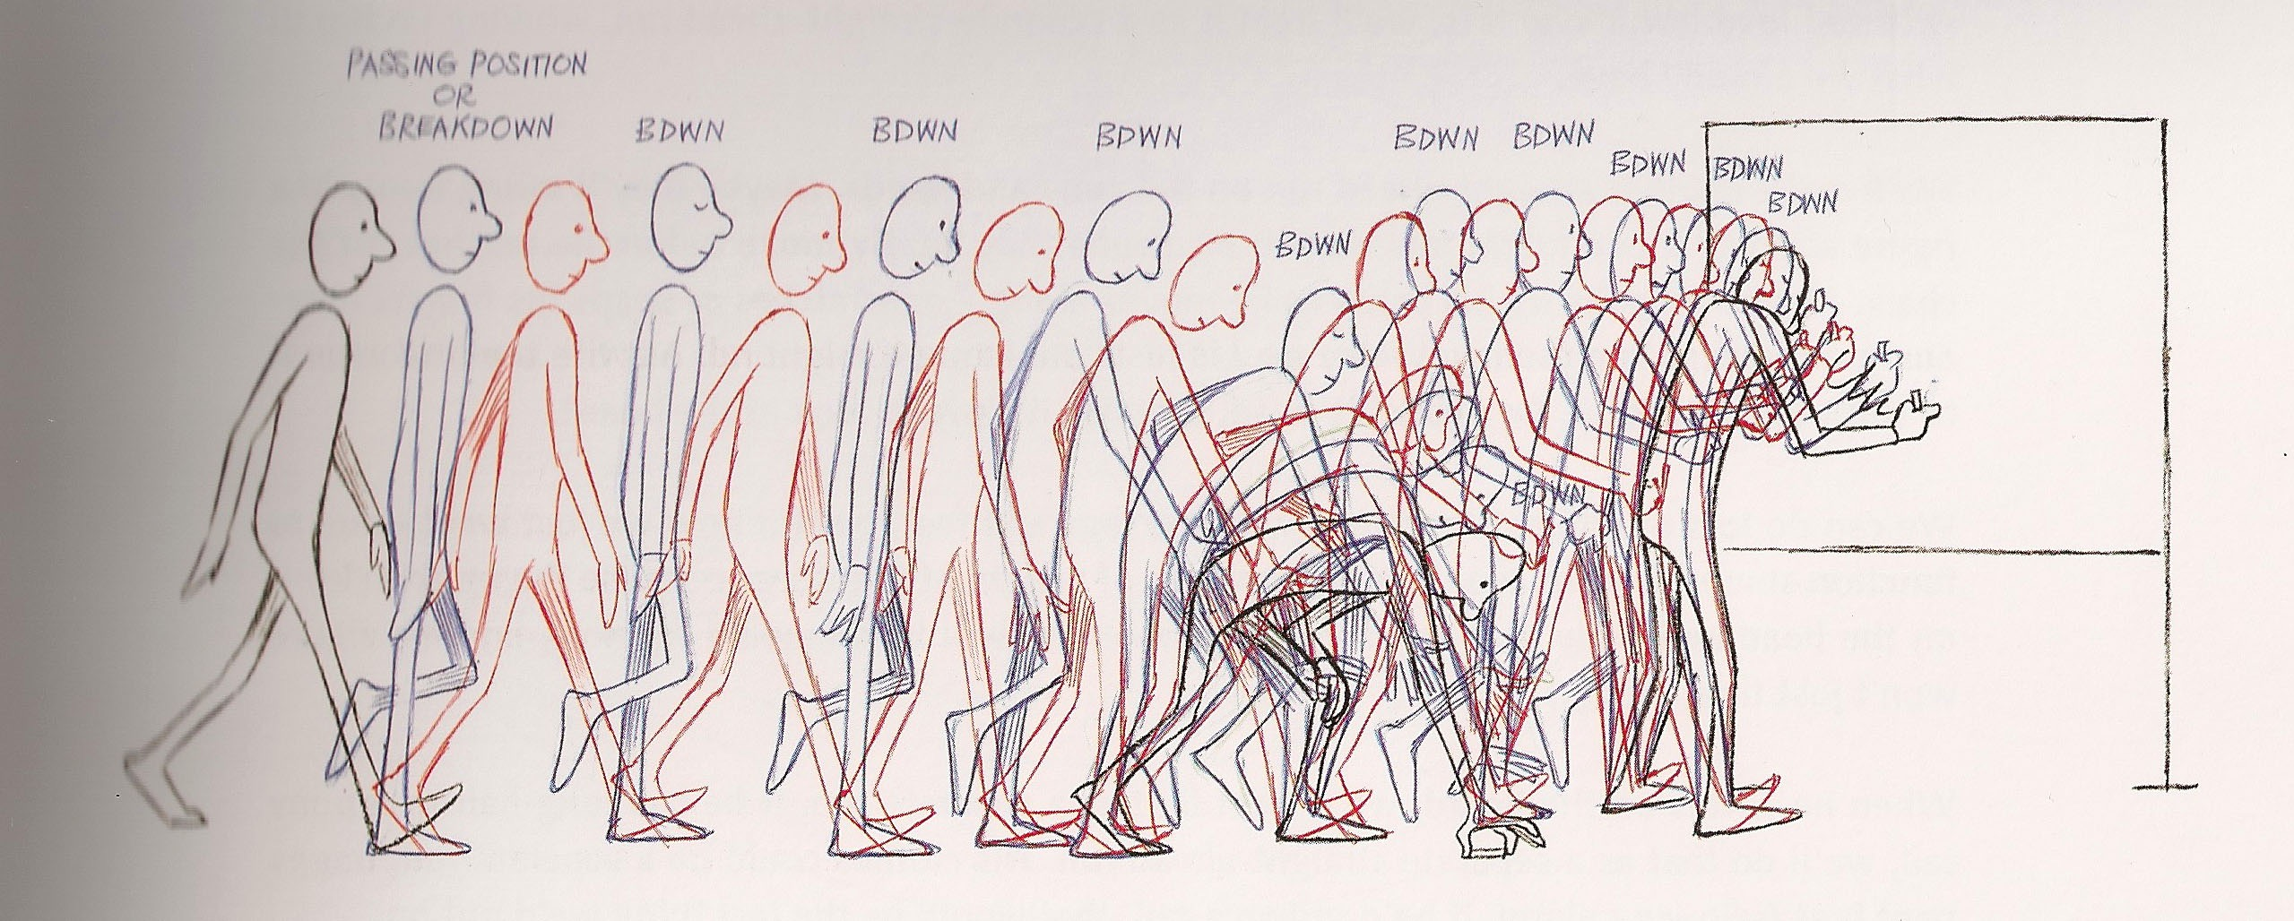
Animation Styles and Techniques
A Few Basic Questions (And Answers) About Styles of Animation
From Williams, op. cit., p. 65.

Slide 17
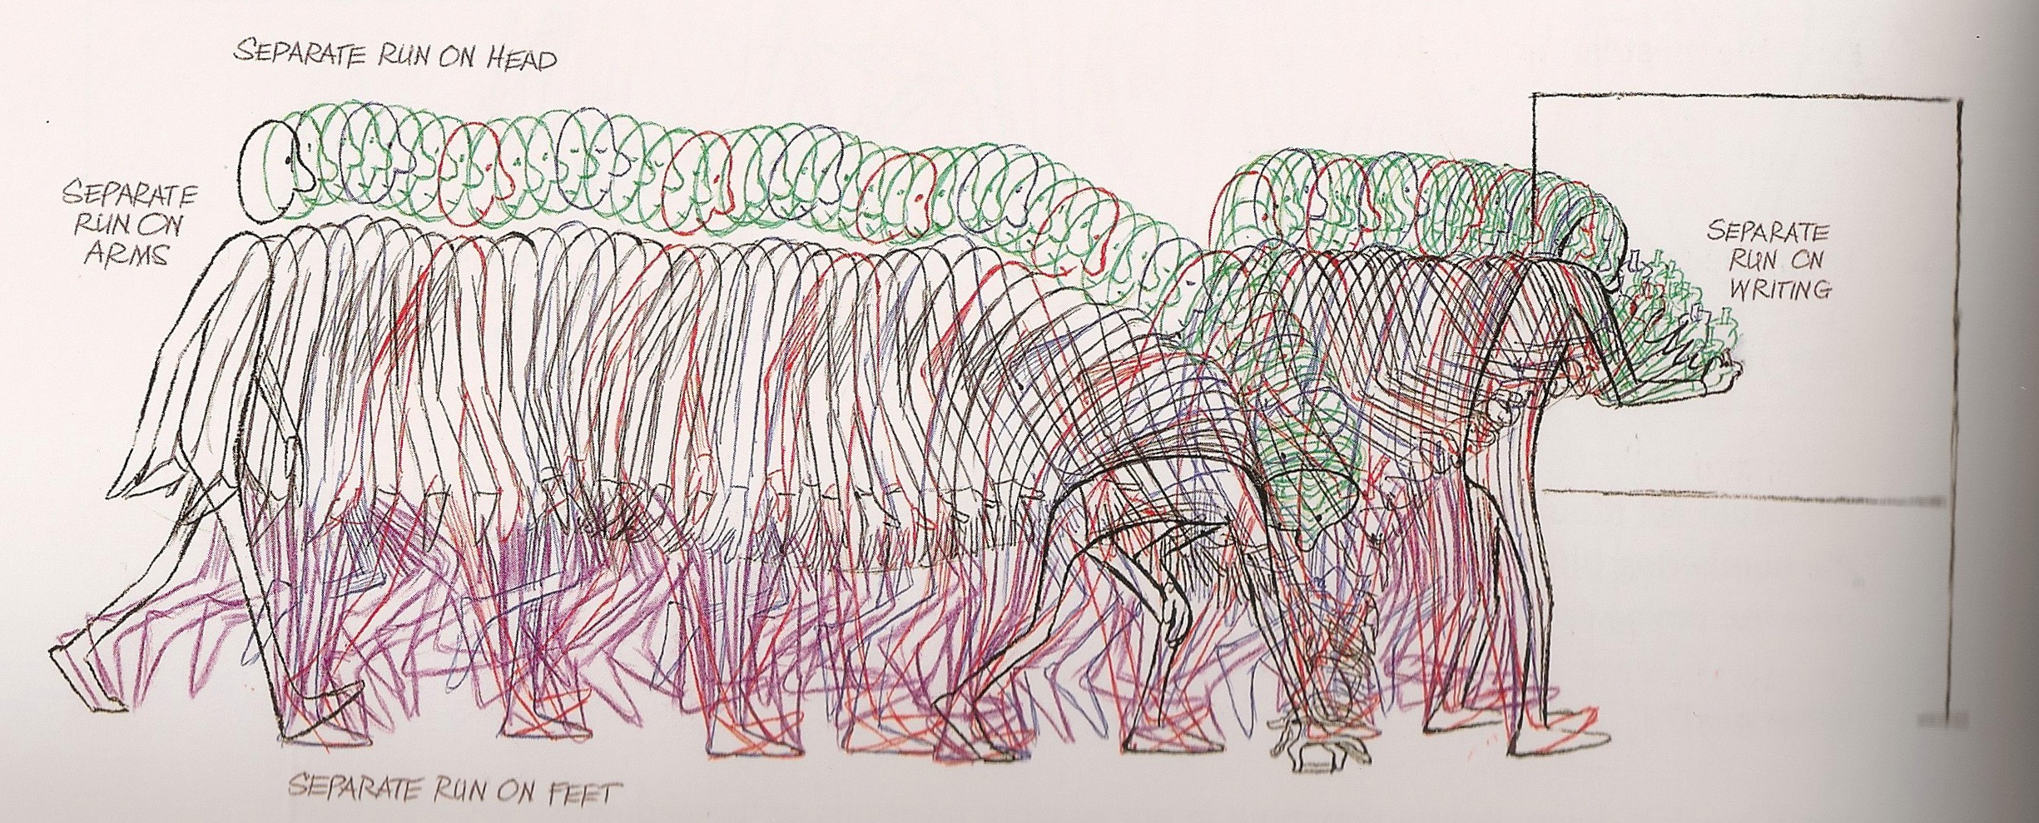
Animation Styles and Techniques
A Few Basic Questions (And Answers) About Styles of Animation
From Williams, op. cit., p. 66.

Slide 18
Animation Styles and Techniques
A Few Basic Questions (And Answers) About Styles of Animation
The “x-sheet” (“exposure sheet”) or “dope-sheet”.
From Williams, op. cit., p. 72.

Slide 19
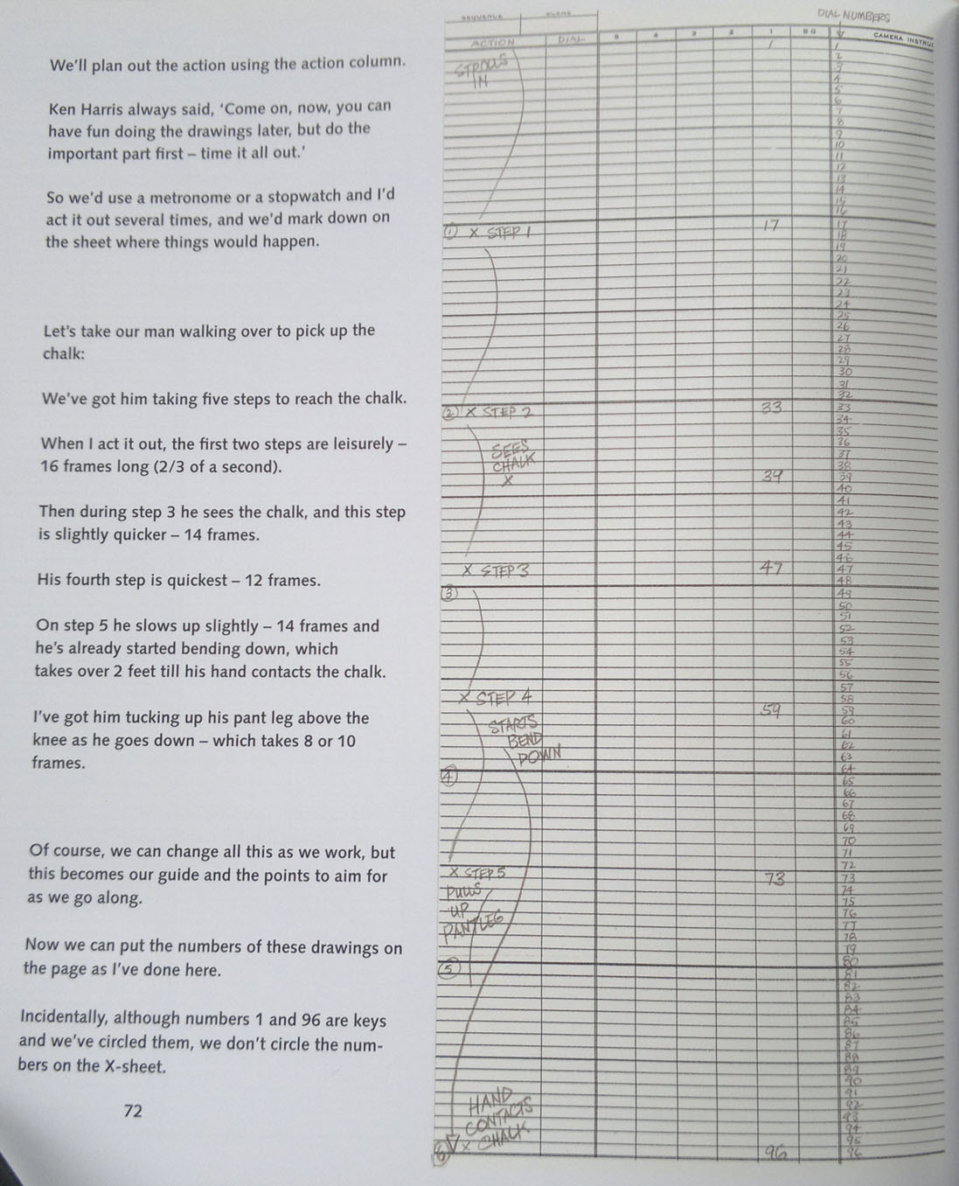
Animation Styles and Techniques
A Few Basic Questions (And Answers) About Styles of Animation

Slide 20
Suggested readings
Richard Williams, The Animator’s Survival Kit, Faber and Faber, London, 2001, pp. 35-39; 64-67.

