Slide 1
History of Animation
Second Cycle Degree in Theatre, Film, Television and Media Studies
Academic Year 2018-2019
Lesson 4

Slide 2
Animation Styles and Techniques
A Few Basic Questions (And Answers) About Styles of Animation
What is moving? The camera or what seems to lie in front of the camera (pro-filmic)? Or both?
(Is the space flat or three-dimensional)?

Slide 3
Animation Styles and Techniques
A Few Basic Questions (And Answers) About Styles of Animation
In animation, the simulation of camera movements is related with the construction of a visual style. Its effectiveness often depends on the interaction with other visual hints addressing our perception of space.

Slide 4
Animation Styles and Techniques
A Few Basic Questions (And Answers) About Styles of Animation
Our perception of space within a flat image is influenced by:
linear perspective;
overlapping;
height on the horizon;
focus;
chiaroscuro;
textural gradient;
parallaxes.

Slide 5
Animation Styles and Techniques
A Few Basic Questions (And Answers) About Styles of Animation
Trolley Troubles (Walt Disney, 1927).

Slide 6
Animation Styles and Techniques
A Few Basic Questions (And Answers) About Styles of Animation
The Hunchback of Notre Dame (Gary Trousdale, Kirk Wise, 1996).

Slide 7
Animation Styles and Techniques
A Few Basic Questions (And Answers) About Styles of Animation
The multiplane camera at Disney, invented by William Garity in 1937

Slide 8
Animation Styles and Techniques
A Few Basic Questions (And Answers) About Styles of Animation
Kiki’s Delivery Service (Majo no Takkyūbun, Hayao Miyazaki, 1989).

Slide 9
Animation Styles and Techniques
A Few Basic Questions (And Answers) About Styles of Animation
The Thief and the Cobbler (Richard Williams, 1993).

Slide 10
Animation Styles and Techniques
A Few Basic Questions (And Answers) About Styles of Animation
Prologue trailer (Richard Williams, 2015).

Slide 11
Animation Styles and Techniques
A Few Basic Questions (And Answers) About Styles of Animation
What kind of trajectories do the movements trace?
Do shapes participate in the movement?

Slide 12
Animation Styles and Techniques
A Few Basic Questions (And Answers) About Styles of Animation
Skippy, a character from Robin Hood (Wolfgang Reitherman, 1973) animated by Milt Kahl.

Slide 13
Animation Styles and Techniques
Basic Techniques of Animation
Animators have a wide range of possibilities in terms of choice of materials, dimensions and methods of capturing images.
Those possibilities can be combined within the same production.

Slide 14
Animation Styles and Techniques
Basic Techniques of Animation
Cel animation and traditional 2D processes
Drawn cel animation
Rotoscoping
2D computer-generated images

Slide 15
Cel animation and traditional 2D processes
Drawn Cel Animation
Patented by Earl Hurd in 1915.
Cel animation consisted of rough drawings which were drawn over in pencil or ink to finalize the design.
The individually inked line drawings were crafted onto single pre-punched acetate cels (or animation paper) by the animator at the animation table.
The table was tilted at an angle towards the animator, lit from underneath, with the cel fixed to a peg-bar directly over the light source, which illuminated a movable frosted glass or plastic disc in the centre of the table.
The illuminated disc allowed the animator to draw the new image onto a cel using the previous cel as a guide underneath, ensuring that moves previously drawn were incremental and consistent in keeping with the intended action.
The inked cels were turned over and painted on the back using acrylic paint on a factory line and, once dry, were turned right side up for filming.

Slide 16
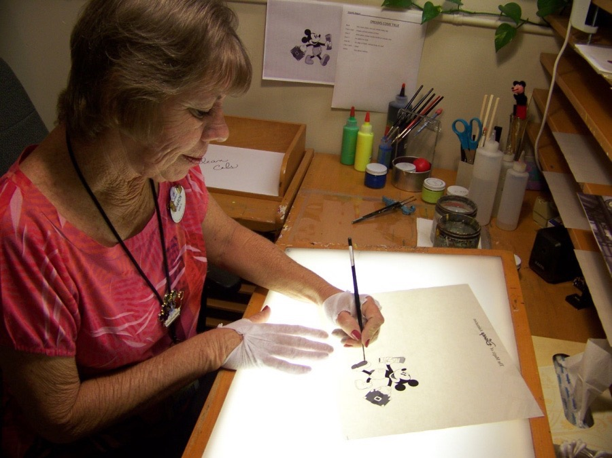
Cel animation and traditional 2D processes
Drawn Cel Animation

Slide 17
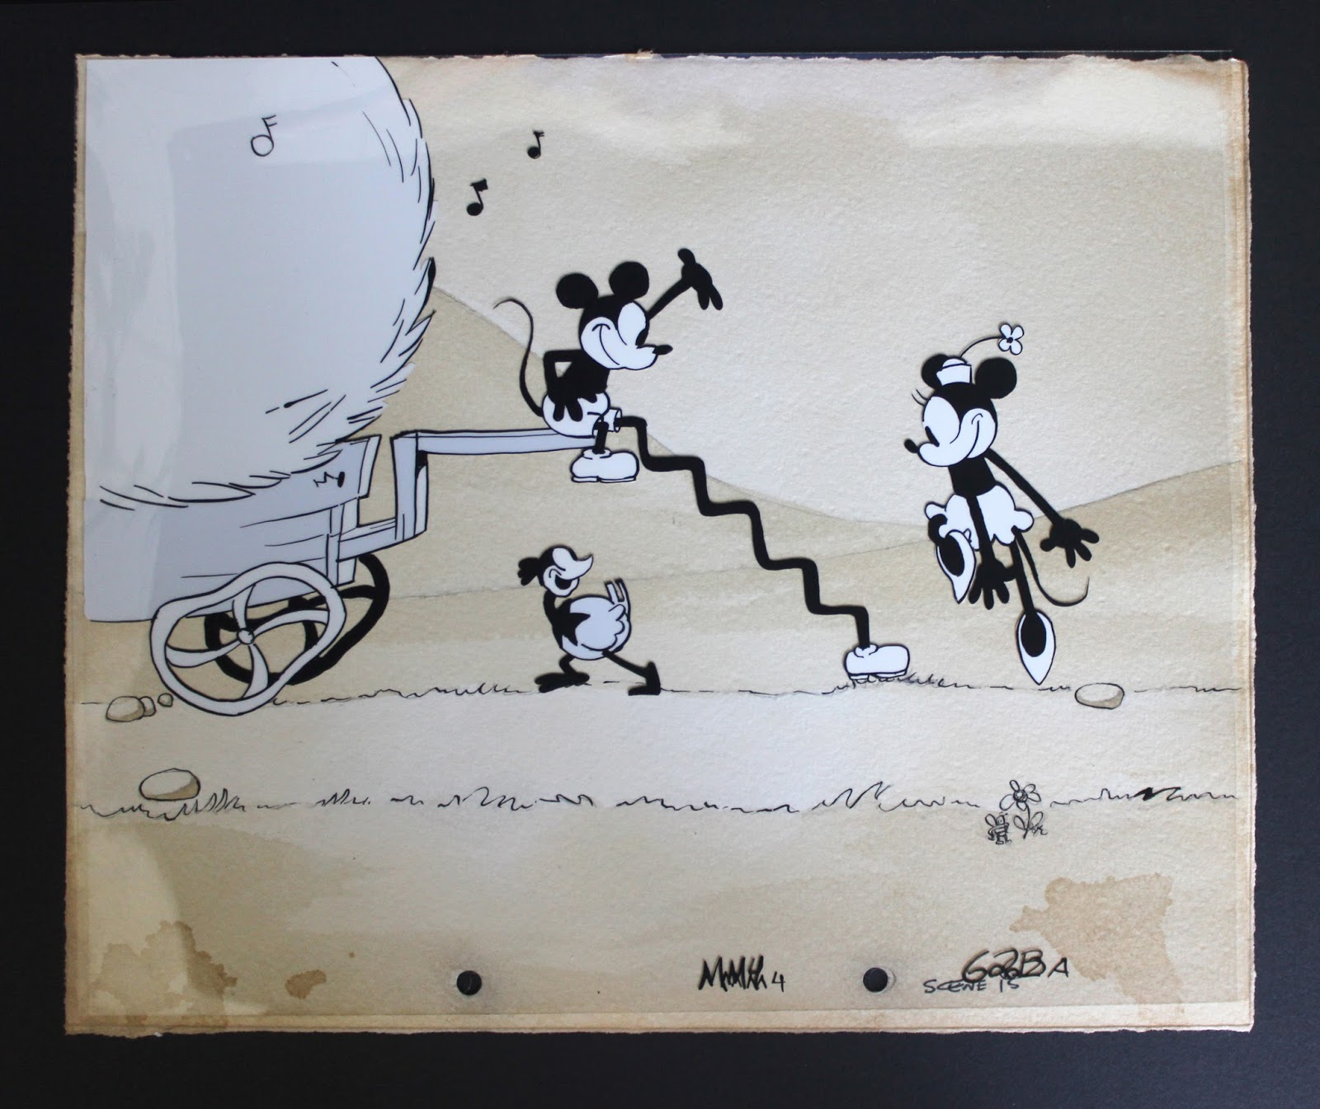
Cel animation and traditional 2D processes
Drawn Cel Animation

Slide 18
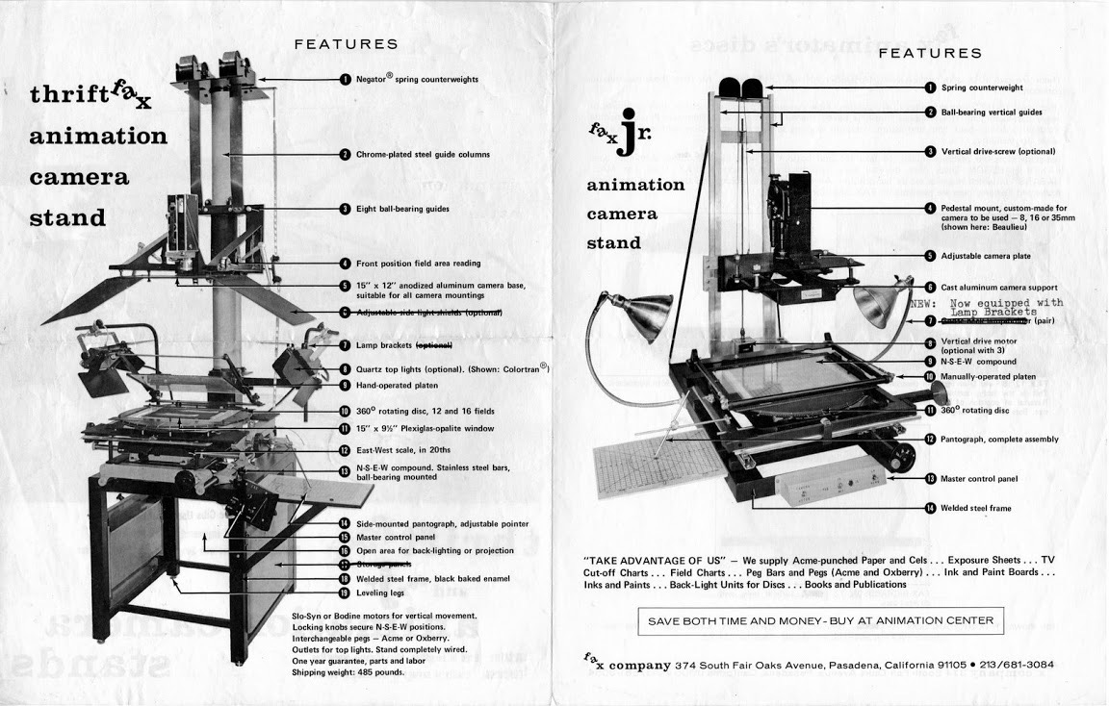
Cel animation and traditional 2D processes
Drawn Cel Animation

Slide 19
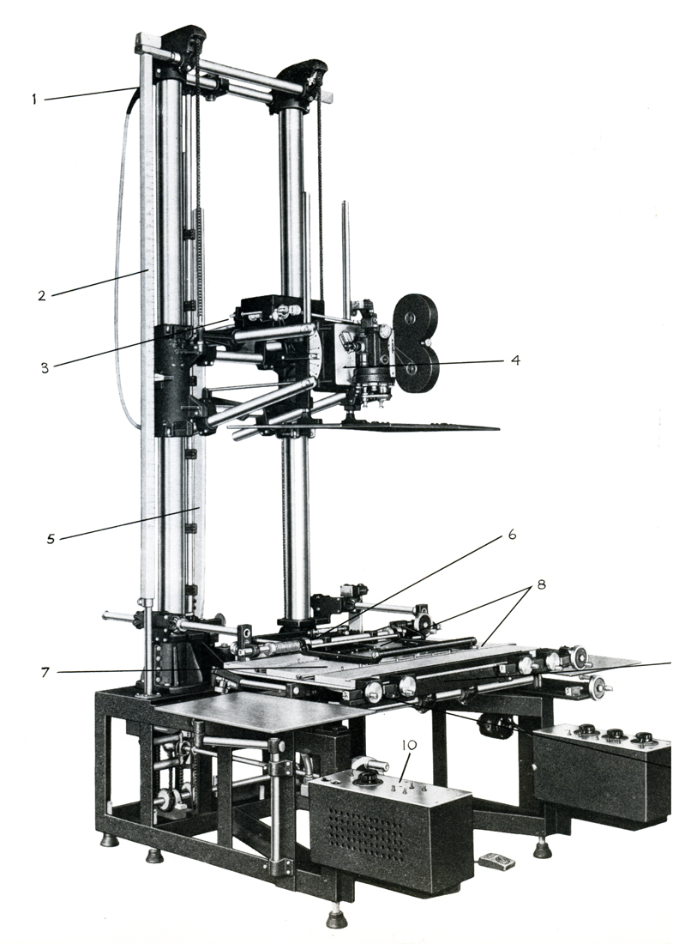
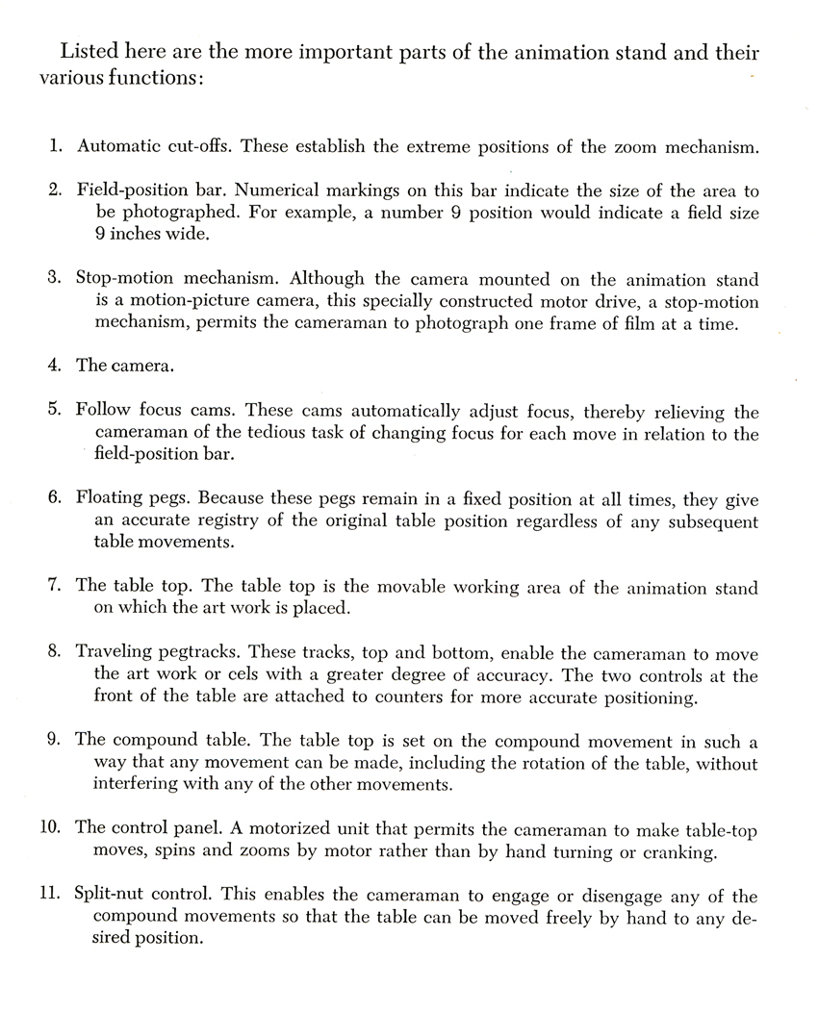
Cel animation and traditional 2D processes
Drawn Cel Animation

Slide 20
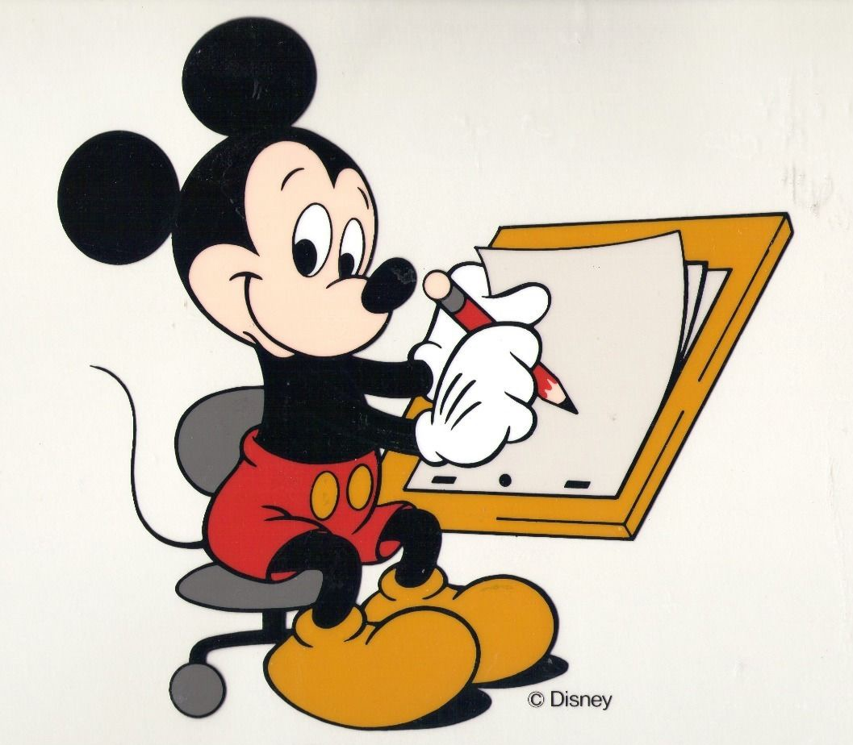
Cel animation and traditional 2D processes
Drawn Cel Animation

Slide 21
Cel animation and traditional 2D processes
Drawn Cel Animation
The Kingdom of Dreams and Madness (Yume to kyōki no Ohkoku, Mami Sunada, 2013)

Slide 22
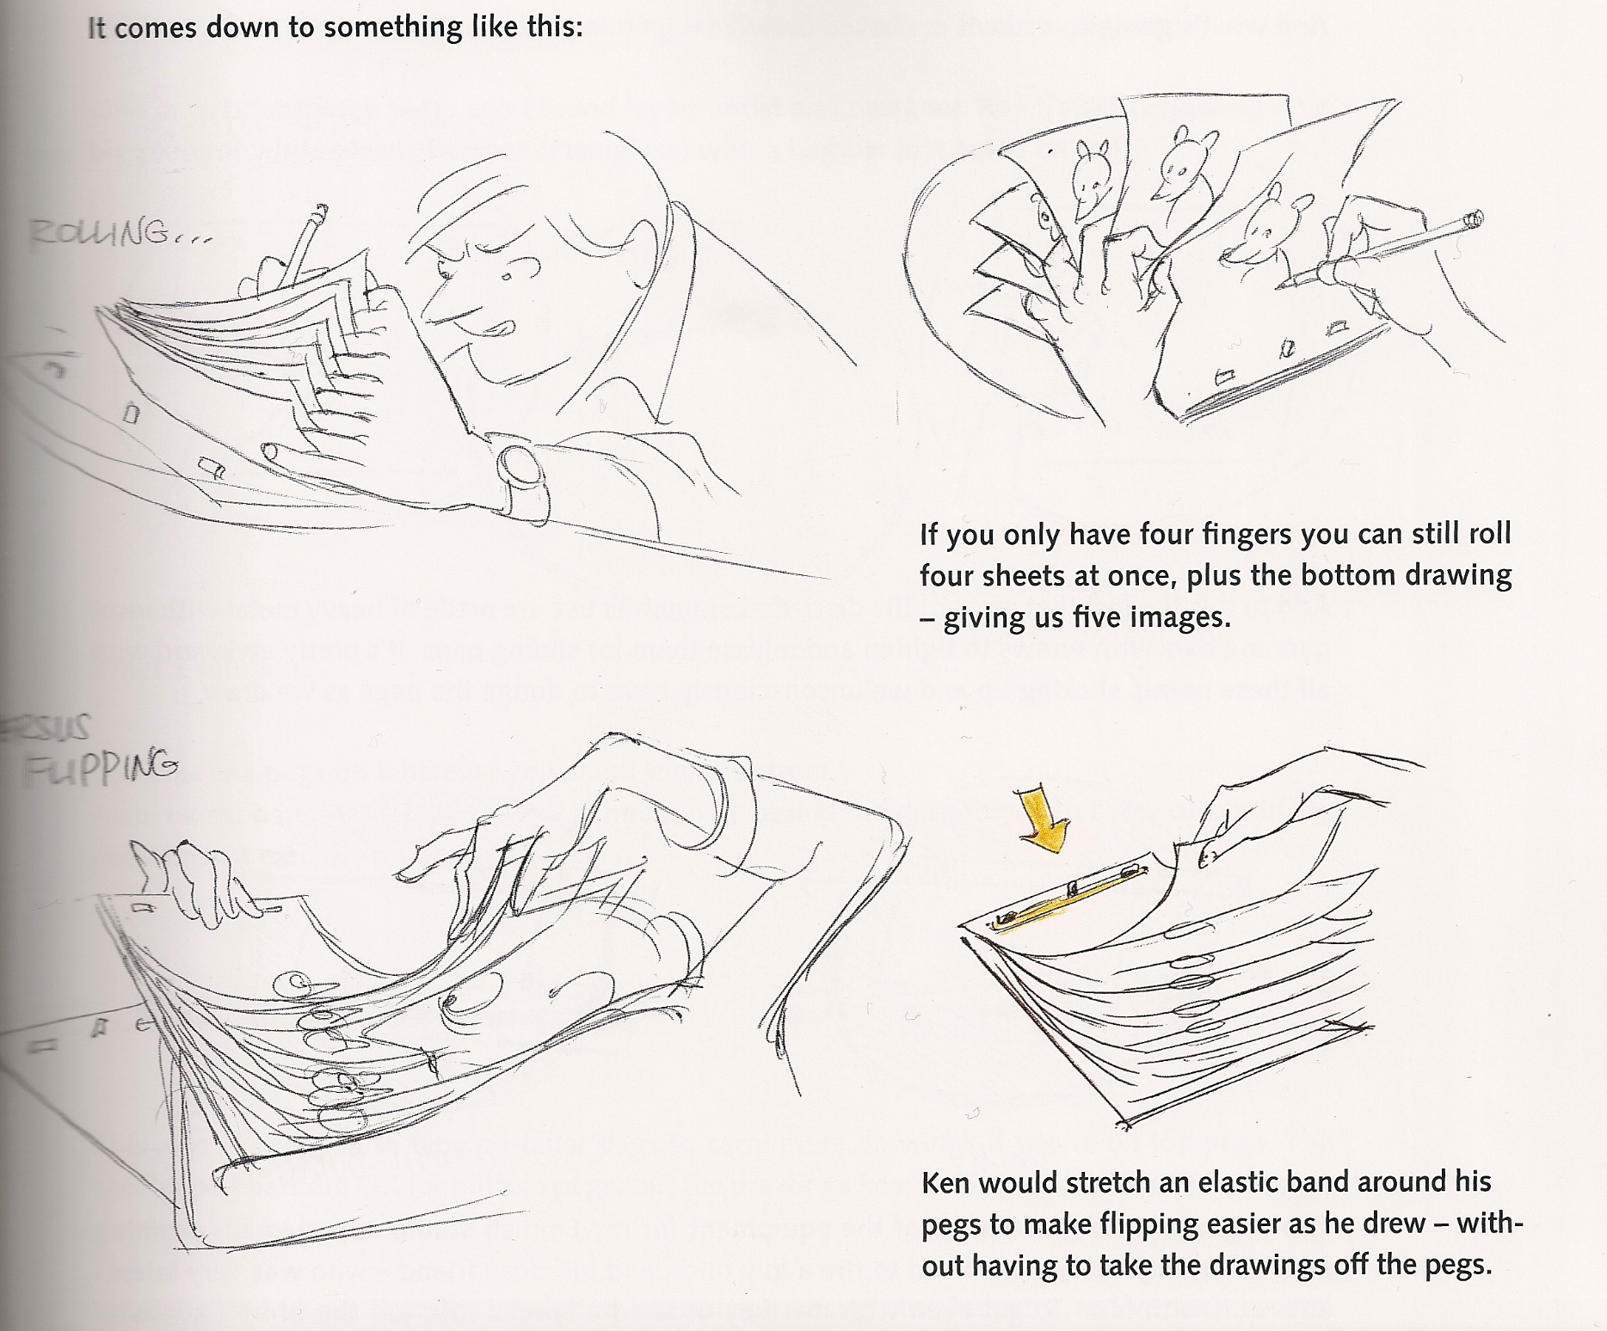
Cel animation and traditional 2D processes
Drawn Cel Animation

Slide 23
Cel animation and traditional 2D processes
Rotoscoping
Patented by the Fleischer Brothers in 1917.
A device that allowed the rear projection of a live-action film frame-by-frame on to a translucent surface set into a drawing board. An animator could simply trace each live-action image on to a piece of paper, advance the film by another frame and repeat the process. By these means, the live-action images became a guide to detailed and lifelike animation.
The instrument has been superseded by more efficient digital technology.

Slide 24
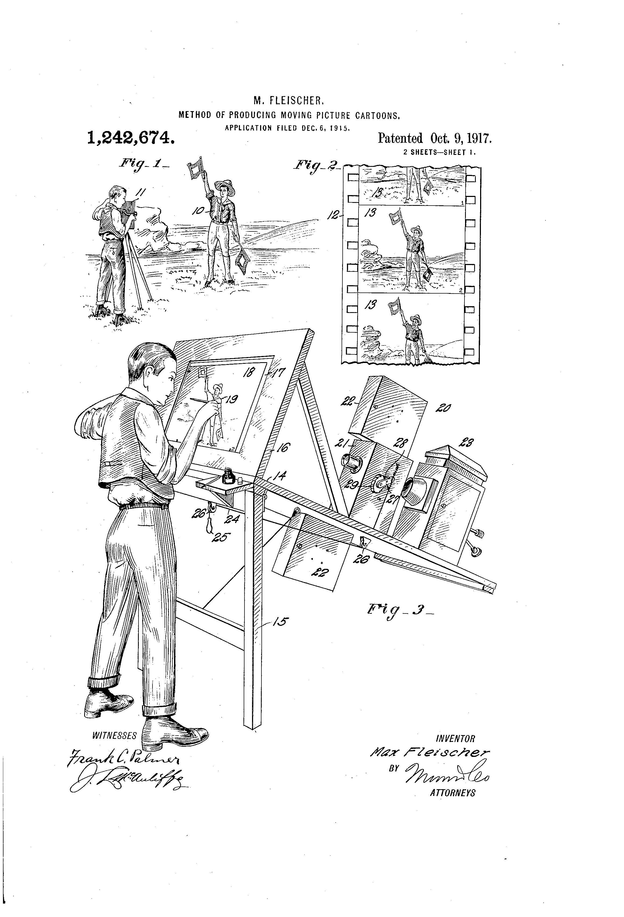
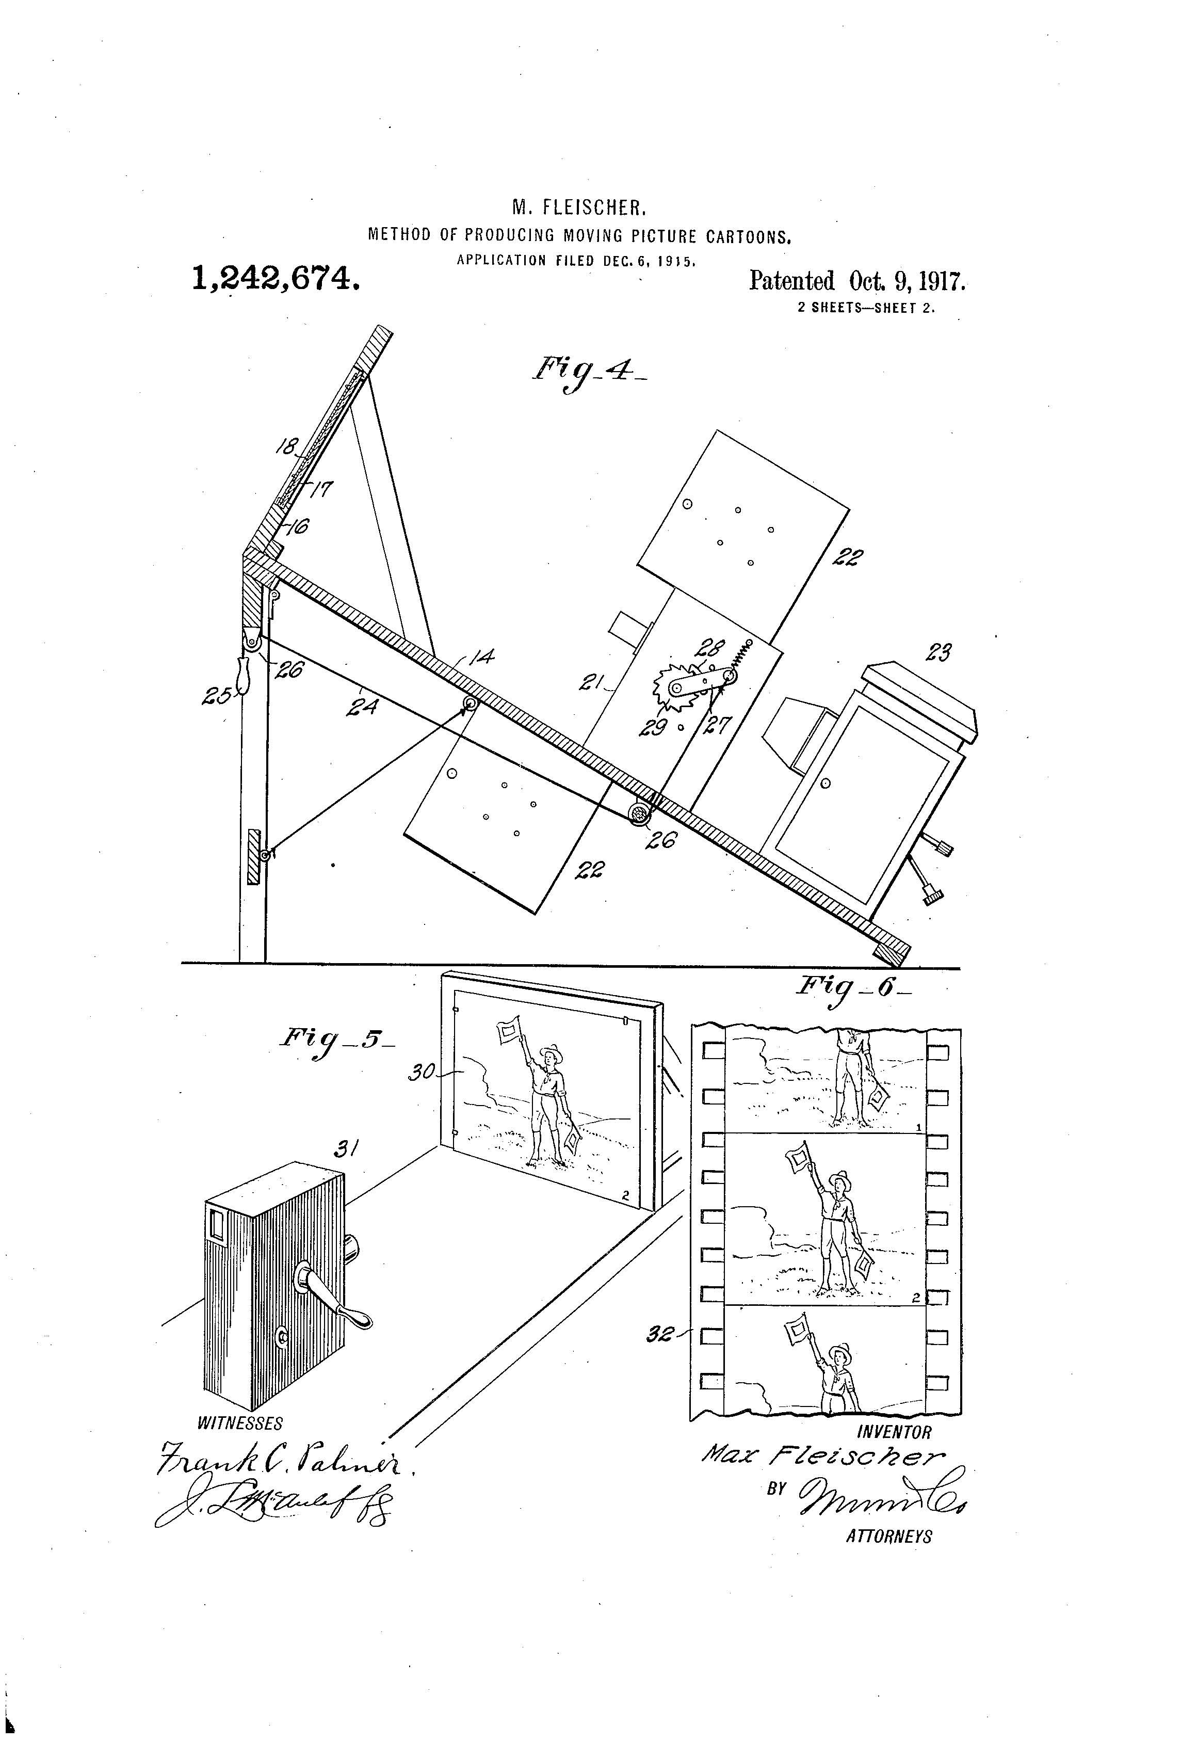
Cel animation and traditional 2D processes
Rotoscoping

Slide 25
Cel animation and traditional 2D processes
Rotoscoping
Snow-White (Dave Fleischer, 1933)

Slide 26
Cel animation and traditional 2D processes
Rotoscoping
Gulliver’s Travels (Max and Dave Fleischer, 1939)

Slide 27
Cel animation and traditional 2D processes
Rotoscoping
The Goddess of Spring (Wilfred Jackson, 1934)

Slide 28
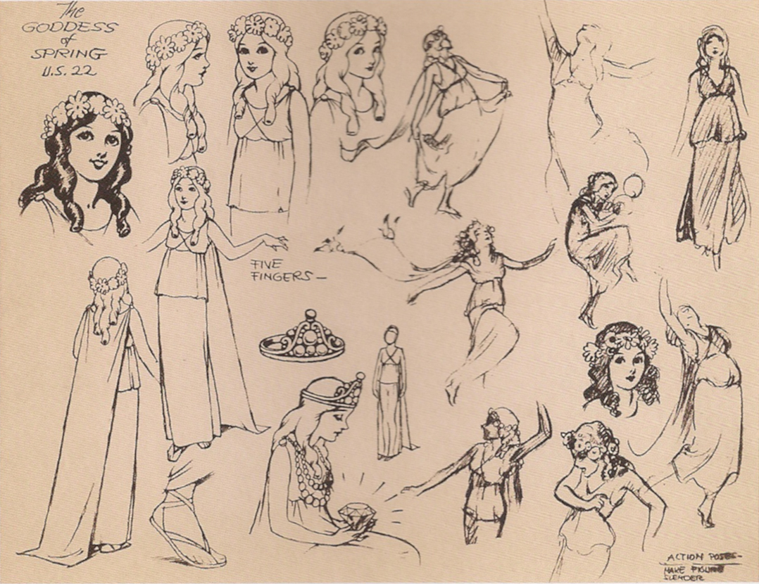
Cel animation and traditional 2D processes
Rotoscoping
The Goddess of Spring (Wilfred Jackson, 1934)

Slide 29
Cel animation and traditional 2D processes
Rotoscoping

Slide 30
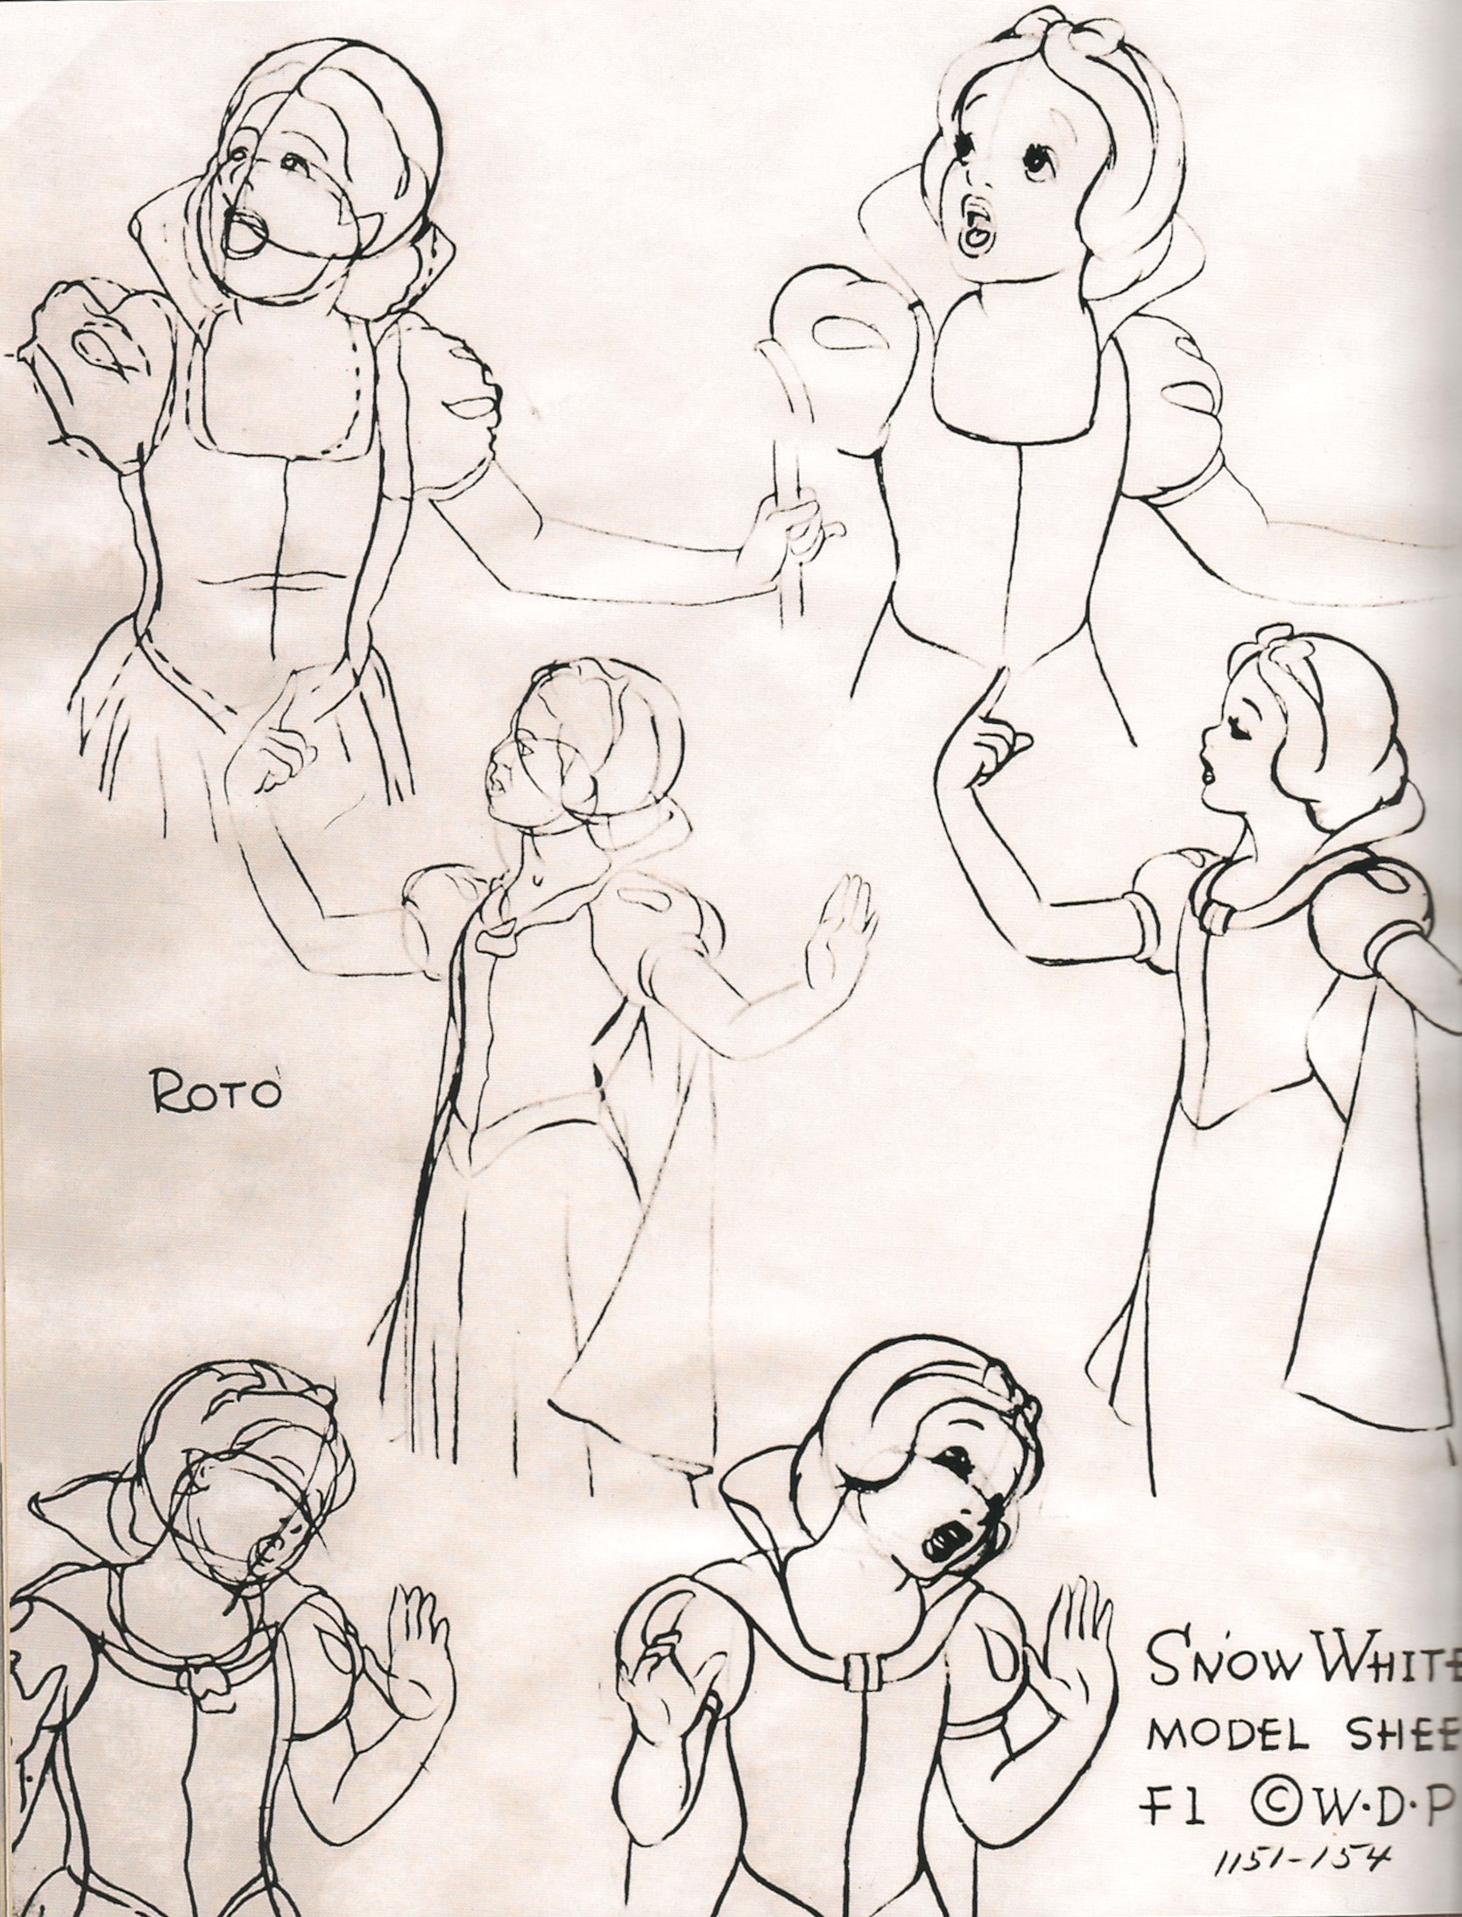
Cel animation and traditional 2D processes
Rotoscoping

Slide 31
Cel animation and traditional 2D processes
Rotoscoping
Snow White and the Seven Dwarfs (David Hand, 1937)

Slide 32
Cel animation and traditional 2D processes
2D computer-generated images
Two-dimensional computer-generated animation is created, produced and edited exclusively using digital technology.
Not to be confused with digitalized drawn animation.
Example: Adobe Flash

Slide 33
Cel animation and traditional 2D processes
2D computer-generated images
“The World of Stainboy” (Tim Burton, 2000)

Slide 34
Suggested readings
Marco Bellano, “La mappa della realtà. Il rotoscopio e l’estetica del realismo nel cinema d’animazione”.
Andrew Selby, ”Production”, in Id., Animation, Laurence King, London, 2013, pp. 128-135.
Richard Williams, The Animator’s Survival Kit, Faber and Faber, London, 2001, pp. 80-83.

