Slide 1
History of Animation
Second Cycle Degree in Theatre, Film, Television and Media Studies
Academic Year 2018-2019
Lesson 5

Slide 2
Animation Styles and Techniques
Basic Techniques of Animation
Stop-motion animation
2D stop-motion (sand, oil-paint, paper cut-outs)
3D stop-motion (puppets, claymation, object animation)

Slide 3
Stop-Motion Animation
2D Stop-Motion
There are several ways of working two-dimensionally in stop motion, each essentially applying the principle of incremental movement effected and recorded by the animator, creating a frame of film.
Some media which have been extensively used by animators: sand, oil-paint, paper cut-outs.

Slide 4
Stop-Motion Animation
2D Stop-Motion
Sand and oil-paint are useful to animate with: dry sand can be worked endlessly and oil paint remains wet under lights that become increasingly hot, allowing the animator to draw or paint.
Shooting each movement from above using a suspended camera attached to a secured metal framework –known as “rig”- makes for a rewarding working method.
Those materials are particularly apt to create animations of metamorphosis.

Slide 5
Stop-Motion Animation
2D Stop-Motion
Carmen Habanera (Aleksandra Korejwo, 1995)

Slide 6
Stop-Motion Animation
2D Stop-Motion
Aleksandr Petrov

Slide 7
Stop-Motion Animation
2D Stop-Motion
Aleksandr Petrov

Slide 8
Stop-Motion Animation
2D Stop-Motion
The Old Man and the Sea (Aleksandr Petrov, 1999)

Slide 9
Stop-Motion Animation
2D Stop-Motion
The process of paper cut-out animation is a technique best employed where only simple or limited incremental movements are required.
To create a character using such a technique the animator must create a series of heads, torsos and limbs that can be placed, removed and replaced by others incrementally to create a desired move. The greater the number of interchangeable parts, the more sophisticated the movements can become.

Slide 10
Stop-Motion Animation
2D Stop-Motion
Pulcinella (Giulio Gianini, Emanuele Luzzati, 1973)

Slide 11
Stop-Motion Animation
3D Stop-Motion
3D stop-motion enables three-dimensional forms to be created, manipulated and captured.
Sets, props and characters are imaginatively constructed from a variety of materials to make full use of the spatial possibilities of this kind of format.
Stop motion as a technique encompasses areas such as puppet animation, clay animation (also known as “claymation”), model or object animation.

Slide 12
Stop-Motion Animation
3D Stop-Motion
A Midsummer Night’s Dream (Sen noci svatojánské, Jiří Trnka, 1959).

Slide 13
Stop-Motion Animation
3D Stop-Motion
Allegro non troppo (Bruno Bozzetto, 1977).

Slide 14
Stop-Motion Animation
3D Stop-Motion
Interstellar Movie Trailer (CBL Animation, 2014).

Slide 15
Animation Styles and Techniques
Basic Techniques of Animation
3D computer-generated images

Slide 16
3D Computer-Generated Images
3D computer-generated animation merges stop-motion animation and frame-by-frame animation by allowing animators to create and manipulate worlds in which characters and environments are constructed as mathematically-rendered data.

Slide 17
3D Computer-Generated Images
Like stop-motion animation, three-dimensional computer-generated imagery is predominantly created in an artificial state, and every aspect of what is seen on screen needs to be constructed. This primarily includes characters, props and sets, but also involves how these elements are painted, lit and positioned, and indeed, how they move.

Slide 18
3D Computer-Generated Images
Animators working in this field, therefore, need to have not only complete knowledge of the programs they are using to create the production but also a significant awareness of cinematography, movement and narrative techniques to bring ideas to life.

Slide 19
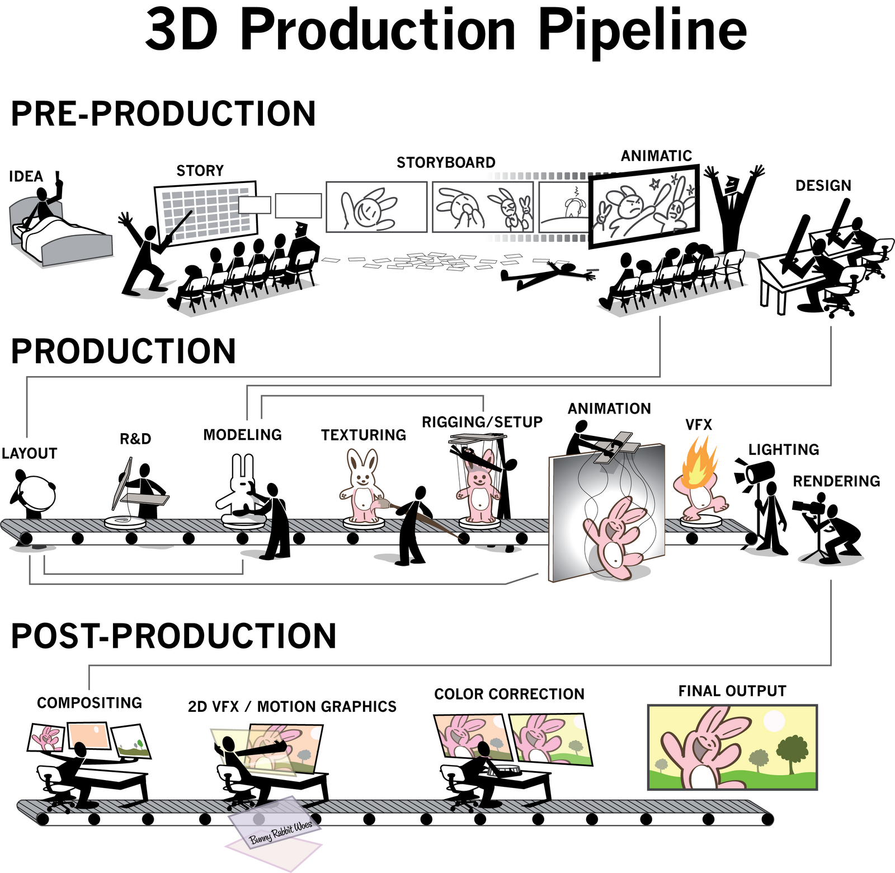
3D Computer-Generated Images

Slide 20
3D Computer-Generated Images
The Black Hole (Gary Nelson, 1979)

Slide 21
3D Computer-Generated Images
Young Sherlock Holmes (Barry Levinson, 1985)

Slide 22
Suggested readings
Andrew Selby, ”Production”, in Id., Animation, Laurence King, London, 2013, pp. 135-158.

