Slide 1
History of Animation
Second Cycle Degree in Theatre, Film, Television and Media Studies
Academic Year 2018-2019
Lesson 6

Slide 2
Animation Styles and Techniques
Basic Techniques of Animation
Unorthodox animation
Pixilation
Auteur or artistic processes
Machinema
Augmented reality

Slide 3
Unorthodox Animation
Pixilation
Food (Jídlo, Jan Švankmajer, 1993)

Slide 4
Unorthodox Animation
Auteur or Artistic Processes
Night on Bald Mountain (Une nuit sur le Mont Chauve, Alexander Alexeïeff, Claire Parker, 1933).

Slide 5
Unorthodox Animation
Auteur or Artistic Processes
Here and the Great Elsewhere - Michèle Lemieux and the Secret of Pinscreen (Making of)

Slide 6
Unorthodox Animation
Machinema

Slide 7
Unorthodox Animation
Augmented Reality

Slide 8
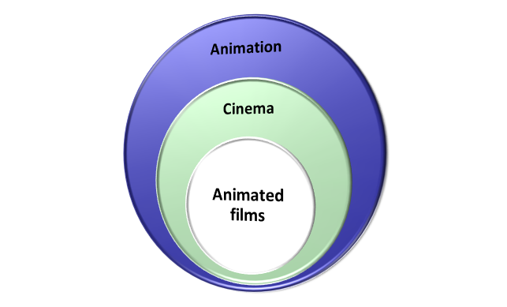
Origins and Pioneers of Animation

Slide 9
Origins and Pioneers of Animation
To animate (to give an “anima”, Latin word for “soul”) is a desire as old as humanity: to give life.
Many beliefs, myths and legends stemmed from this desire.
In western culture, for example…

Slide 10
Origins and Pioneers of Animation
Der Golem, wie er in die Welt kam (Paul Wegener, 1920)

Slide 11
Origins and Pioneers of Animation
Close to the golem tradition:
Lucian’s Philopseudes (150 A. D.) and its legacy (Der Zauberlehrling by Goethe… );
Frankenstein by Mary Shelley (1818);
R. U. R. - Rosumovi Univerzální Roboti (Rossum’s Universal Robots), by Karel Čapek (1921).

Slide 12
Origins and Pioneers of Animation
The animated figures stand
Adorning every public street
And seem to breathe in stone, or
move their marble feet.
From Pindar, 7th Olympian Ode
For Diagoras of Rhodes Boxing-Match 464 B. C.

Slide 13
Origins and Pioneers of Animation
Pierre Jaquet-Droz, the writing automaton (1774)

Slide 14
Origins and Pioneers of Animation
Traditional forerunners of animation as communication through related images
Egyptian hieroglyphs;
Chinese and Japanese scrolls (emaki);
The Bayeux tapestry;
…

Slide 15
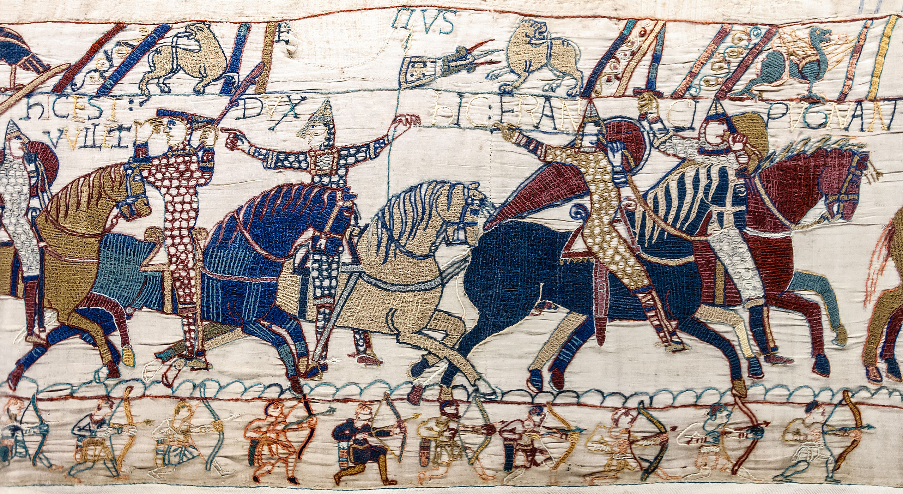
Origins and Pioneers of Animation
The Bayeux Tapestry (late 11th century)

Slide 16
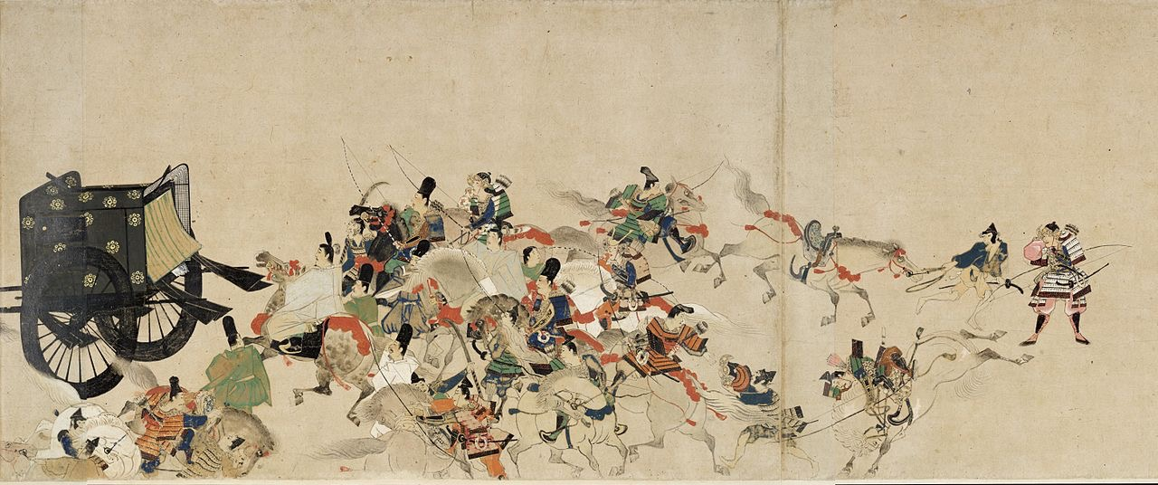
Origins and Pioneers of Animation
Illustrated Tale of the Heiji Civil War (Scroll of the Imperial Visit to Rokuhara), late 13th century

Slide 17
Origins and Pioneers of Animation
Kaguya-hime no Monogatari (The Tale of Princess Kaguya, Isao Takahata, 2013)

Slide 18
Origins and Pioneers of Animation
Reconstruction of movement as suggested by some Paleolithic cave paintings

Slide 19
Origins and Pioneers of Animation
Traditional forerunners of animation as optical entertainment
The “apparition” as an early kind of animation: see the warnings by Athanasius Kircher in his Ars Magna Lucis et Umbrae, 1646;
Also, later: Étienne-Gaspard “Robertson” Robert and his fantasmagorie (Paris, 1797), which perfectioned a previous attempt by Paul Philidor;
“Special” magic lantern slides;
The théâtre d’ombres at the cabaret Le chat noir (1890)
In this field, the archaeologies of cinema and of animation often overlap.

Slide 20
Origins and Pioneers of Animation
The “wheel of life”, a magic lantern slide (1871)

Slide 21
Origins and Pioneers of Animation
1824: Peter Mark Roget presented his paper “Explanation of an optical deception in the appearance of the spokes of a wheel when seen through vertical apertures” to the British Royal Society. The work explained that an image was retained by the retina for fractions of a second before being replaced by another image and that if these images appeared at a sufficient rate of a change, the viewer had a perception of motion when looking at still images. This probably influenced the creation of optical devices such as the thaumatrope, the phenakistoscope and the zoetrope.

Slide 22
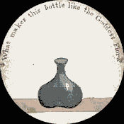
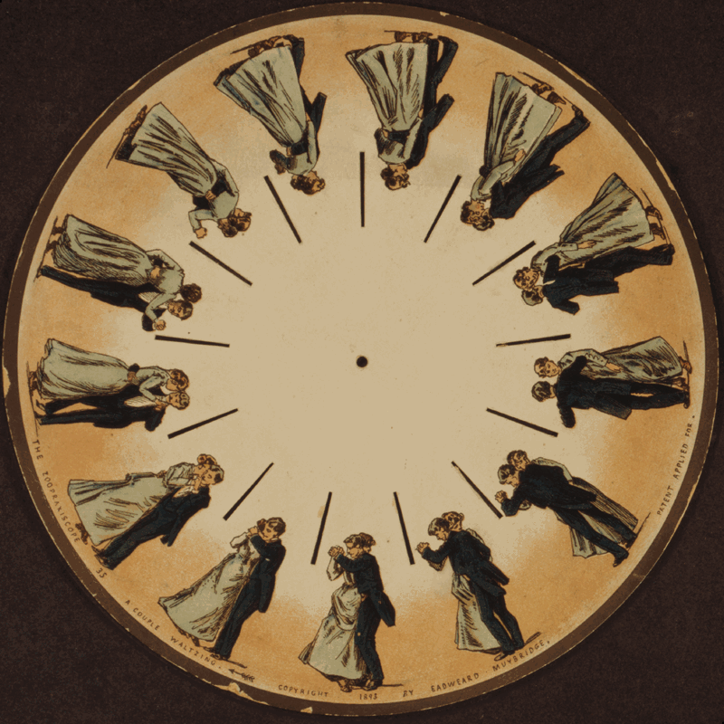
Origins and Pioneers of Animation
Phenakistoscope (Joseph Plateau, 1841)
Thaumatrope (John Ayrton Paris, 1824)

Slide 23
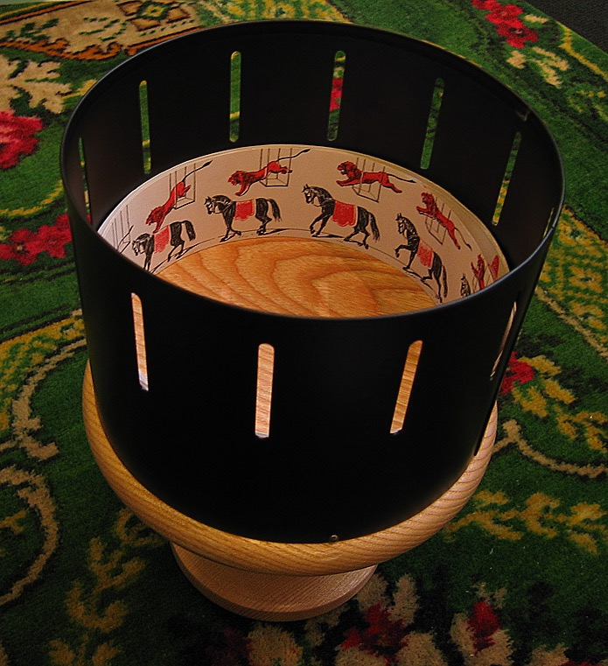
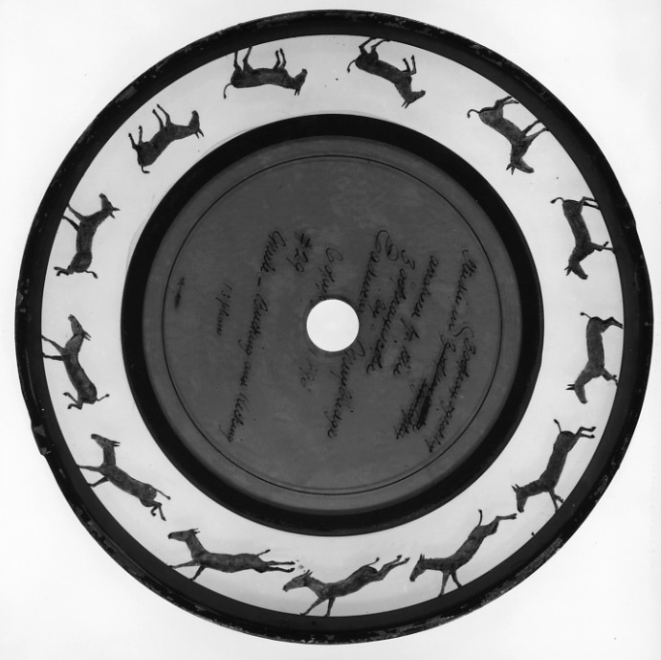
Origins and Pioneers of Animation
Zoopraxiscope
(Eadweard Muybridge, 1879)
Daedaleum (William George Horner, 1833-34);
later, zoetrope (William F. Lincoln)

Slide 24
Origins and Pioneers of Animation
Eadweard Muybridge (1830-1904) and Ètienne-Jules Marey (1830-1904) both contributed to cronophotography, mostly for scientific purposes. Their efforts demonstrated how any movement can be fragmented into still pictures and then recomposed.

Slide 25
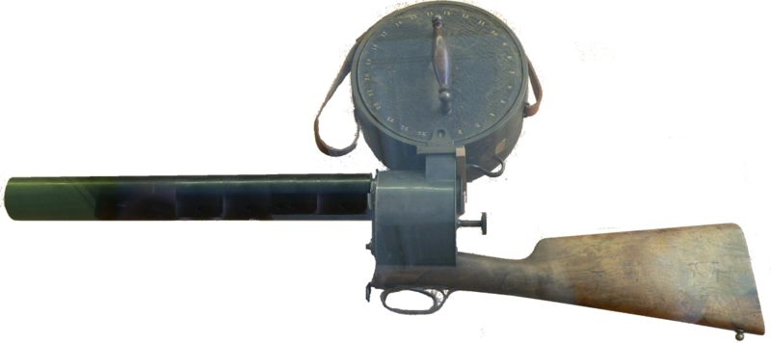
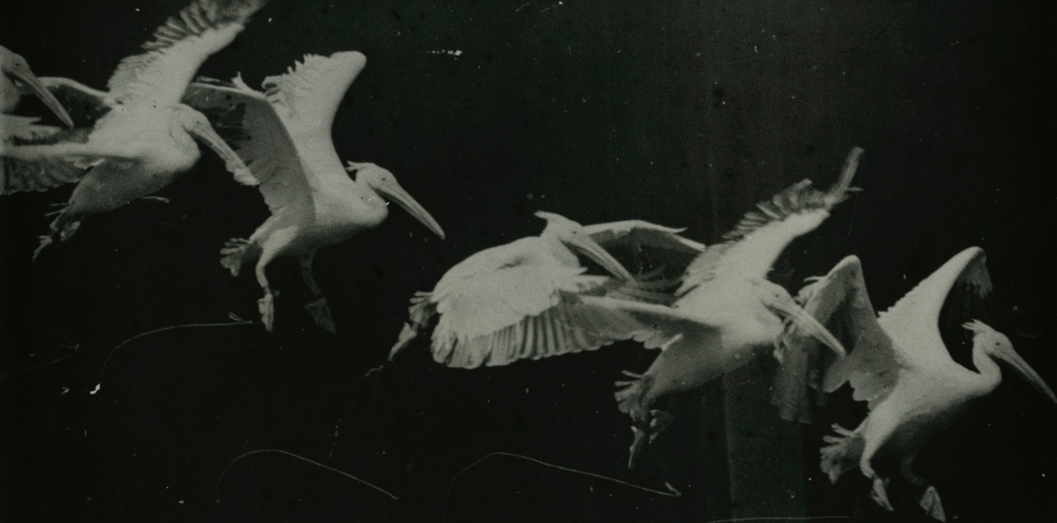
Origins and Pioneers of Animation
Marey: the cronophotographic gun

Slide 26
Origins and Pioneers of Animation
Charles-Émile Reynaud (1844-1918): the praxinoscope (1877), the “praxinoscope theater” (1888) and the Théâtre optique (first public show at the Musée Grevin, Paris: October the 28th, 1892).

Slide 27
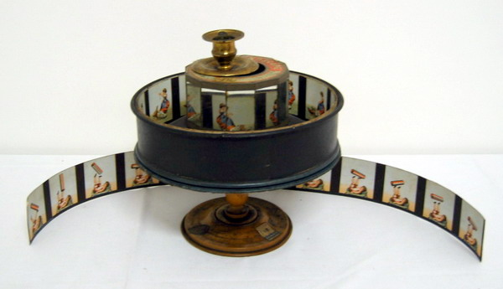
Origins and Pioneers of Animation

Slide 28
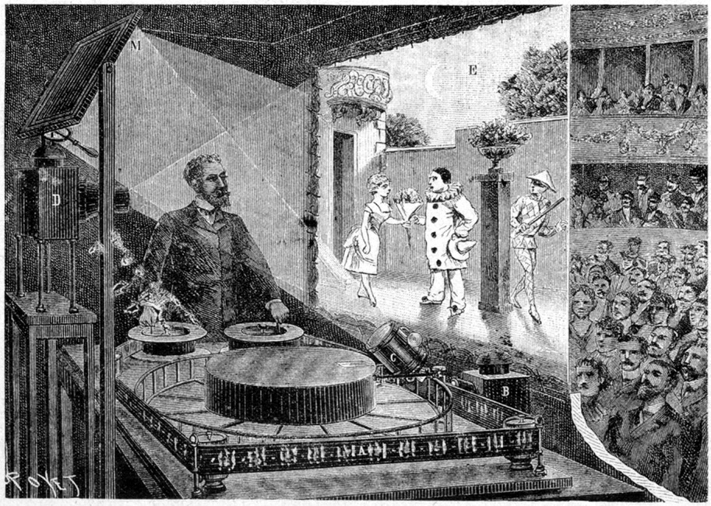
Origins and Pioneers of Animation

Slide 29
Origins and Pioneers of Animation
Pauvre Pierrot (Émile Reynaud, 1892)

Slide 30
Origins and Pioneers of Animation
Autour d’une cabine (Émile Reynaud, 1893)

Slide 31
Origins and Pioneers of Animation
A reconstruction of Reynaud’s show

Slide 32
Suggested readings
Donald Crafton, “Animation: Myth, Magic and Industry”, in Before Mickey. The Animated Film 1898-1928, The University of Chicago Press, Chicago, 1993, pp. 3-12.
Giannalberto Bendazzi, Animation. A World History. 3 voll., Waltham, Massachusetts: Focal Press, 2015. Vol. I, pp. 7-34: “Before Fantasmagorie (0-1908); “The Silent Pioneers (1908-1928)” (to study up to –and including- the section “Georges Méliès”).

