Slide 1
History of Animation
Second Cycle Degree in Theatre, Film, Television and Media Studies
Academic Year 2018-2019
Lesson 8

Slide 2
Animation in the USA 1
Cohl’s presence in the USA was probably highly influential for local animators.
Cohl could have been visited by Canadian Raoul Barré during his 1912-13 stay in Fort Lee.
Writing in 1927, Winsor McCay recalled that his first inspiration for “modern cartoon movies” came to him in 1909. Although he did not acknowledge Cohl, the date corresponds to the height of the French filmmaker’s American vogue.

Slide 3
Animation in the USA 1
Winsor McCay
Winsor McCay (1869 or 1871- 1934) was a self-taught artist from Spring Lake, Michigan. He studied only for a few days in a commercial art school when his family moved to Chicago.
He perfectioned his skills by drawing billboard signs in Cincinnati. But his career as a comic artist and illustrator started when he became an artist-reporter for the Cincinnati Commercial Tribune.
Starting from 1903, he worked on multiple comic series for the Evening Telegram and the Herald, in New York.

Slide 4
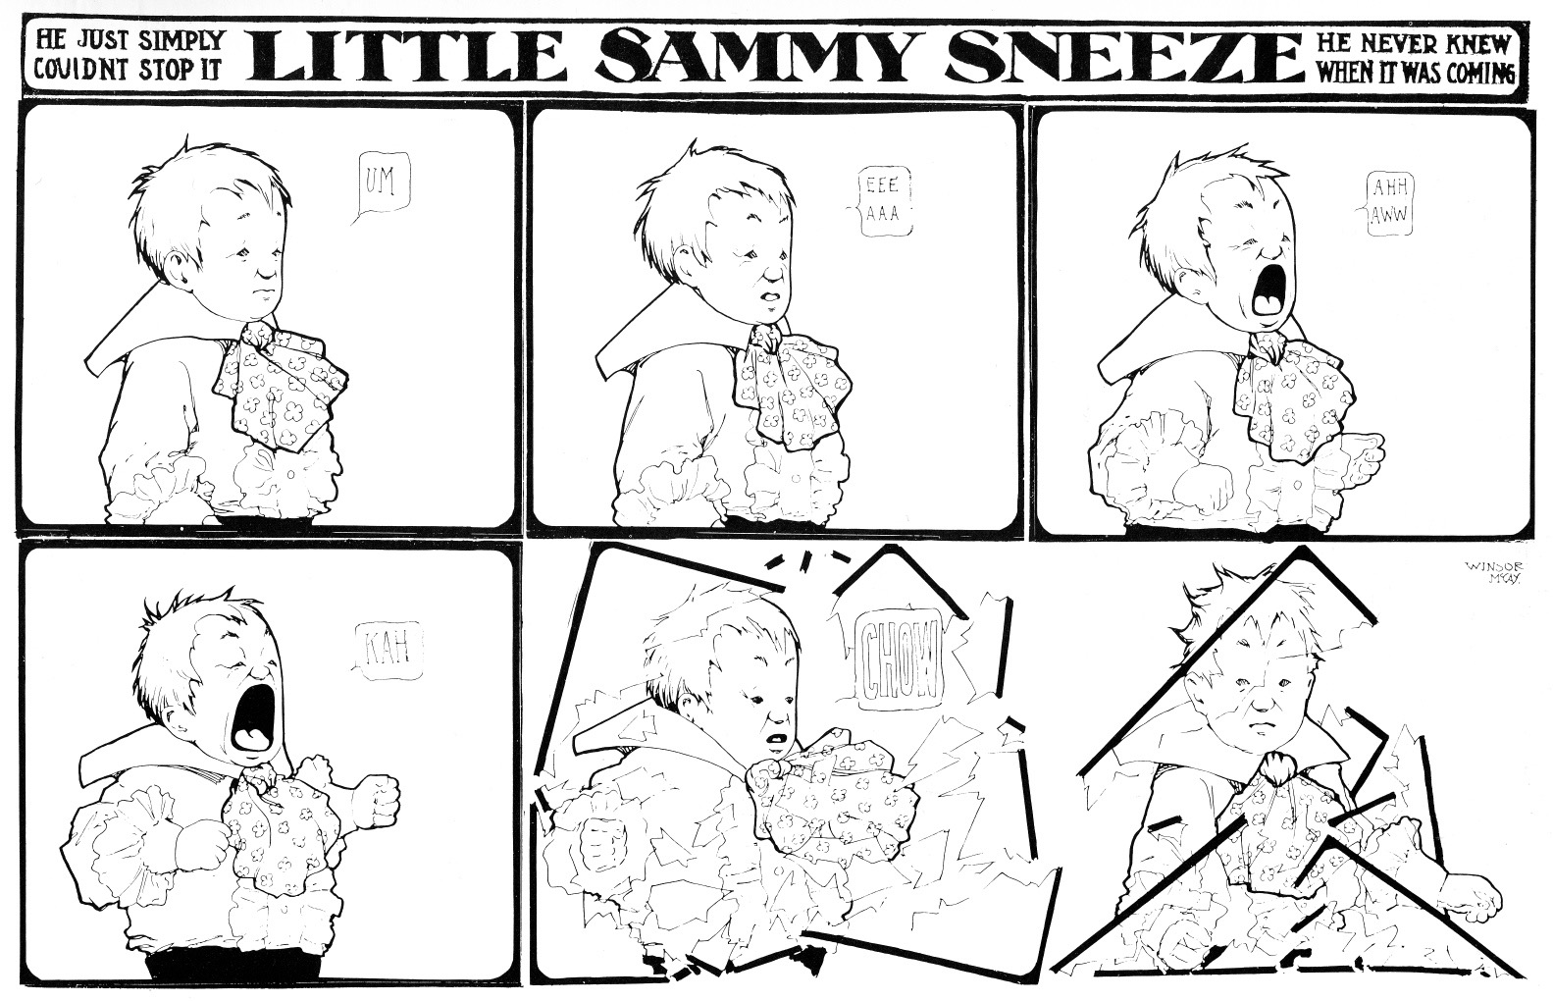
Animation in the USA 1
Winsor McCay

Slide 5
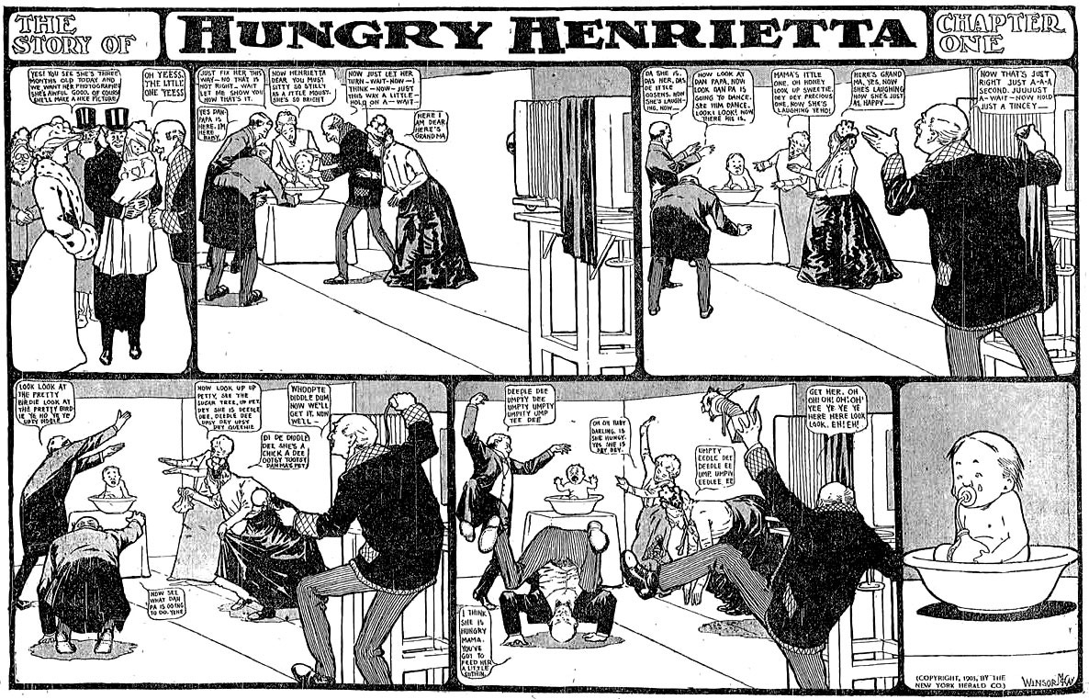
Animation in the USA 1
Winsor McCay

Slide 6
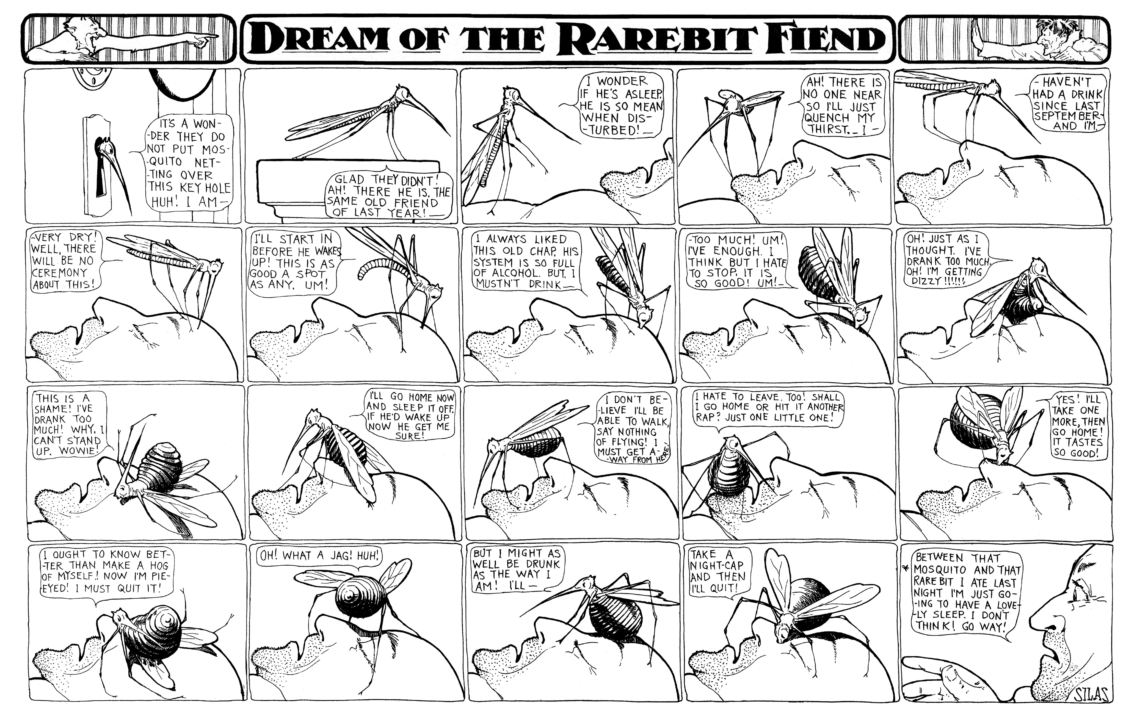
Animation in the USA 1
Winsor McCay

Slide 7
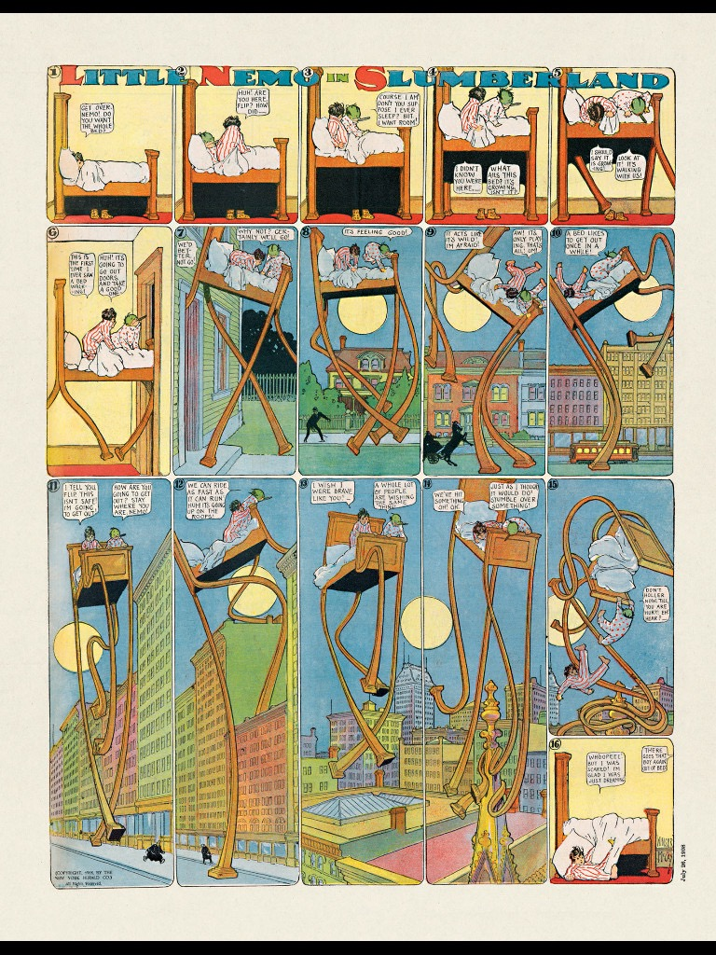
Animation in the USA 1
Winsor McCay

Slide 8
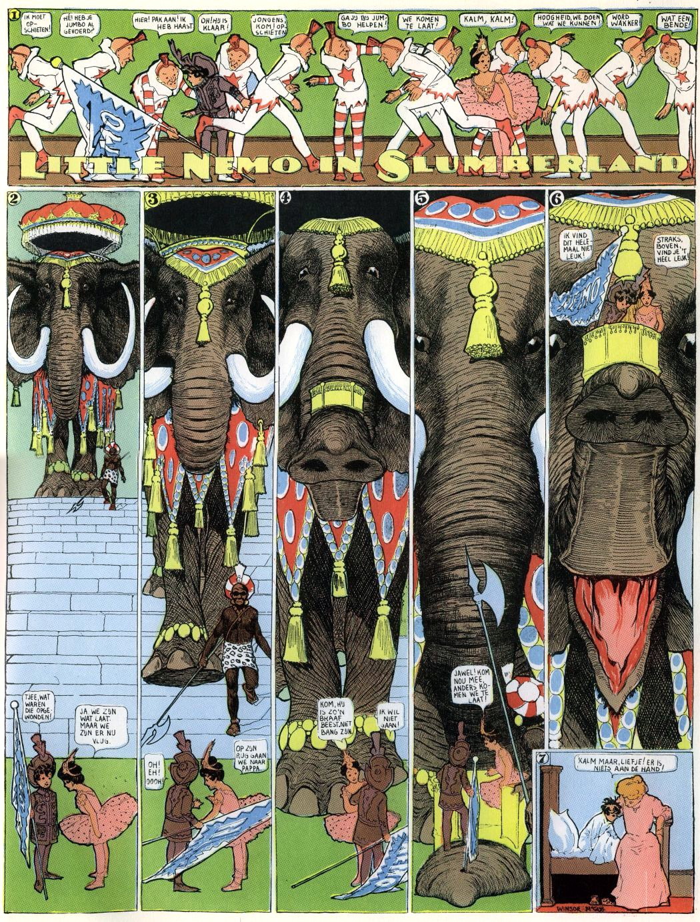
Animation in the USA 1
Winsor McCay

Slide 9
Animation in the USA 1
Winsor McCay
From 1906, McCay started also acting as the main performer of his “Seven Ages” vaudeville act. He also collaborated on a Broadway staging of his Little Nemo in Slumberland (written by Harry B. Smith and scored by Victor Herbert).
In 1906, Edwin S. Porter filmed an adaptation of McCay’s Dream of a Rarebit Fiend.
In 1911, McCay signed with the newspaper company of William Randolph Hearst.
Little Nemo in Slumberland continued until 1914, with the new title In the Land of Wonderful Dreams. But the Herald obtained an injunction, and McCay had to stop drawing his comic.
He reprised it only when he returned to the Herald (1924-1926)

Slide 10
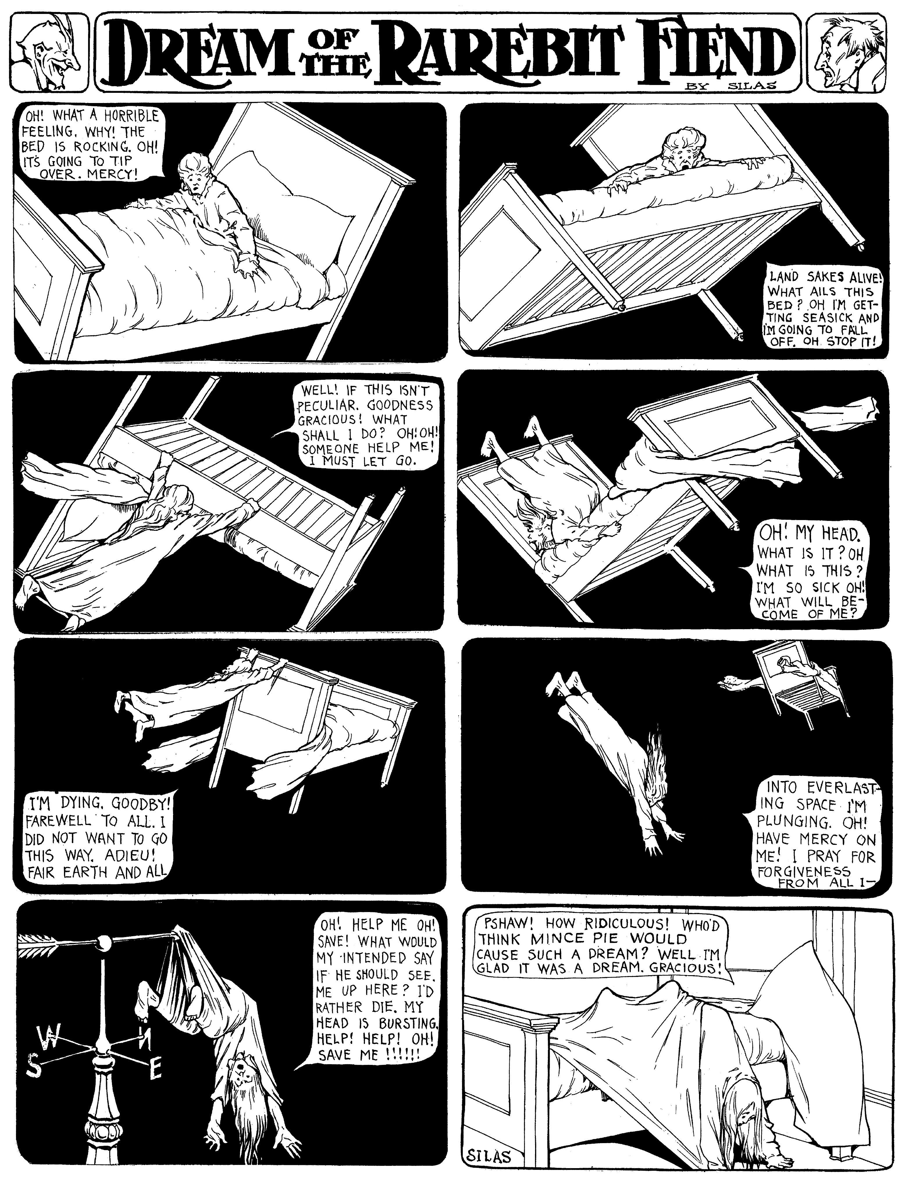
Animation in the USA 1
Winsor McCay

Slide 11
Animation in the USA 1
Winsor McCay
Dream of a Rarebit Fiend (Edwin S. Porter, 1906)

Slide 12
Animation in the USA 1
Winsor McCay
In 1911 McCay released his first film, Little Nemo (1911). The live action parts were shot by James Stuart Blackton.
It was followed by at least three outstanding works:
How a Mosquito Operates (1912); live prolog lost. It was produced and photographed by Vitagraph, but McCay did not allow the studio to distribute the film in the USA, where it would compete with his vaudeville act.
Gertie (1914), made especially for a vaudeville act. Because of the success of this film, Hearst invoked the exclusivity clause in his contract. McCay had to restrict his show to New York; his vaudeville career was finished. He later adapted Gertie for screening in theaters, by adding a live prolog and intertitles.
The Sinking of the Lusitania (1918): an animated propaganda documentary, and the first attempt of McCay at using cels.

Slide 13
Animation in the USA 1
Winsor McCay
Little Nemo (Winsor McCay, 1911)

Slide 14
Animation in the USA 1
Winsor McCay
How a Mosquito Operates (Winsor McCay, 1912)

Slide 15
Animation in the USA 1
Winsor McCay
Gertie (Winsor McCay, 1914)

Slide 16
Animation in the USA 1
Winsor McCay
The Sinking of the Lusitania (Winsor McCay, 1918)

Slide 17
Animation in the USA 1
Winsor McCay
McCay returned to animation during the 20s; however, he was no more competitive. Animation, in the USA, was undergoing a radical change in its production system: the painstaking and time-consuming efforts of single artists were giving place to studios were work was rationally parcellized among a team of professionals. This speeded up the production, reduced the costs and boosted the income.
McCay was not an industrial or a technician. His legacy consists of extraordinary artistic insights about naturalism in animation. He took Cohl’s aesthetics of metamorphic motion and joined it with a new interest in trompe l’oeil illusionism. This mix of free creativity and naturalism defined the aesthetic ground rules for all later American animation.
In McCay’s animation, even if the author is often part of the show, there is also a complementary and contrary tendency of the work to absorb and replace its creator. Little Nemo draws; McCay leaves as an animated drawing on top of Gertie; animation can become a “historical record”. This tendency would also leave a mark in the history of American animation.

Slide 18
Suggested readings
Donald Crafton, “Watch Me Move! The Films of Winsor McCay”, in Before Mickey. The Animated Film 1898-1928, The University of Chicago Press, Chicago, 1993, pp. 89-135.

