Slide 1
History of Animation
Second Cycle Degree in Theatre, Film, Television and Media Studies
Academic Year 2019-2020
Lesson 13

Slide 2
Animation in Europe 2
Italy 1
Italian cinema has always offered to the techniques and aesthetics of animation a very fertile, but hard soil. From its beginnings, marked by the late-XIX-century experiences of the Fregoligraph, to the most recent and digitally animated commercial productions, four complementary dimensions, divided into “conflicting” couples, traced the intricate path of this expressive domain: “schools” vs. individuals, imitation vs. originality.

Slide 3
Animation in Europe 2
Italy 1
Those dimensions were already vital in the first two full-length animated features produced in Italy, which established the transition from the early period to the first maturity of the medium. I fratelli dinamite (Nino Pagot, 1949) is the place for transgression and eclecticism, where the animation of drawings and the Technicolor process are craftily reinvented by makeshift means, and Disney influences are only a basis for improvisation and corrosive satire, anticipating thus the spirit of the future “schools” responsible for the commercial animations of “Carosello”; La rosa di Bagdad (Anton Gino Domeneghini, 1949), instead, follows more closely the lush American models, gathering many artists destined to continue their career in commercials but ultimately remaining an isolated attempt with no heirs in the Italian tradition.

Slide 4
Animation in Europe 2
Italy 1
Animation in Italy: the early period
Earliest examples of “tricks” and stop-motion animation: Pinocchio (Giulio Antamoro, 1911).
Stop motion animation in two propaganda film of the World War I:
Il sogno del bimbo d’Italia (Riccardo Cassano, Cines, 1915)
La guerra e il sogno di Momi (Segundo de Chomón, Itala Film, 1917)
(Il sogno del bimbo d’Italia was the second propaganda film featuring the character of Cinessino, played by Eraldo Giunchi; the first one was Il sogno patriottico di Cinessino, Gennaro Righelli, Cines, 1915).

Slide 5
Animation in Europe 2
Italy 1
Pinocchio (Giulio Antamoro, 1911)

Slide 6
Animation in Europe 2
Italy 1
Il sogno del bimbo d’Italia (Riccardo Cassano, Cines, 1915)

Slide 7
Animation in Europe 2
Italy 1
La guerra e il sogno di Momi (Segundo de Chomón, Itala Film, 1917)

Slide 8
Animation in Europe 2
Italy 1
1920: Antonio Bottini “rediscovers” the production techniques of cel animation and creates La cura contro il raffreddore. Later, in 1933, he released La rana dispettosa, a sound cartoon.
1923-31 the Roman scene designer Guido Presepi created short films for children (Il topo di campagna e il topo di città); in 1930 he planned a full-length feature, Vita di Mussolini.

Slide 9
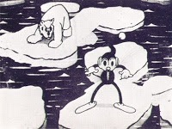
Animation in Europe 2
Italy 1
1932: in Milan, Carlo and Vittorio Cossio create Zibillo e l’orso, a short film with a soundtrack.
Early Italian animators mostly used drawn cel techniques and they were highly inspired by American productions.

Slide 10
Animation in Europe 2
Italy 1
1935: the musician Romolo Bacchini joins comic artists Attalo (Gioacchino Colizzi), Mameli Barbara and Raoul Verdini to produce a full-length feature inspired by Collodi’s Pinocchio. The film was never completed.
During the 30s and early 40s, Italian animation seems to be searching for a kind of artistic independence: references to Italian literary sources become more common.
Il prode Anselmo (Gino Parenti, 1936, from Giovanni Visconti Venosta)
La secchia rapita (Carlo and Vittorio Cossio, 1937, from Alessandro Tassoni)
The “Pulcinella” shorts (Luigi Giobbe, Cossio brothers, 1941)
Chichibio (Piero Crisolini Malatesta, 1944, from Giovanni Boccaccio)

Slide 11
Animation in Europe 2
Italy 1
During the World War II, Italian animation devotes itself also to advertising, education and propaganda.
Luigi Liberio Pensuti (1903-1945)
Crociato 900 (1938)
Il Dottor Churkill (1941)

Slide 12
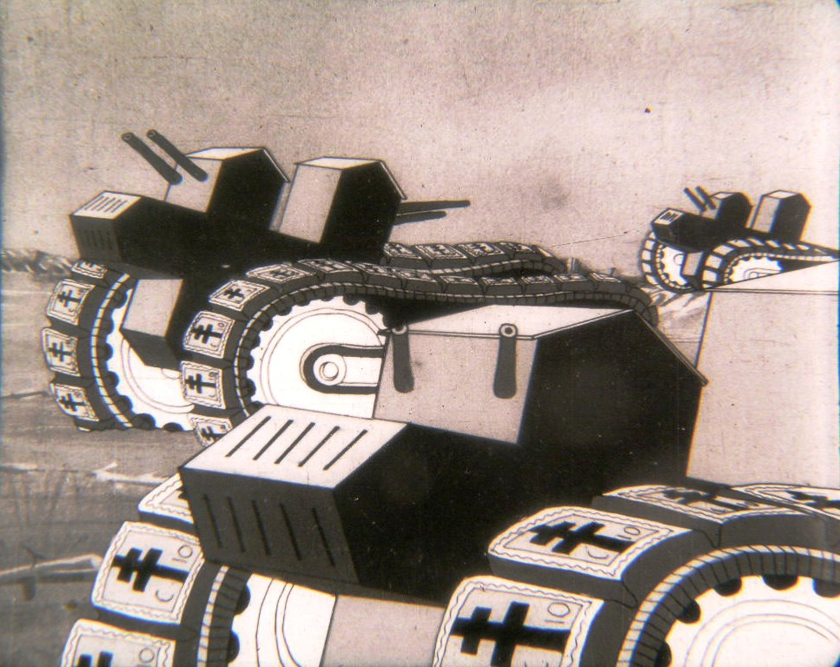
Animation in Europe 2
Italy 1
Crociato 900 (Luigi Liberio Pensuti, 1938)

Slide 13
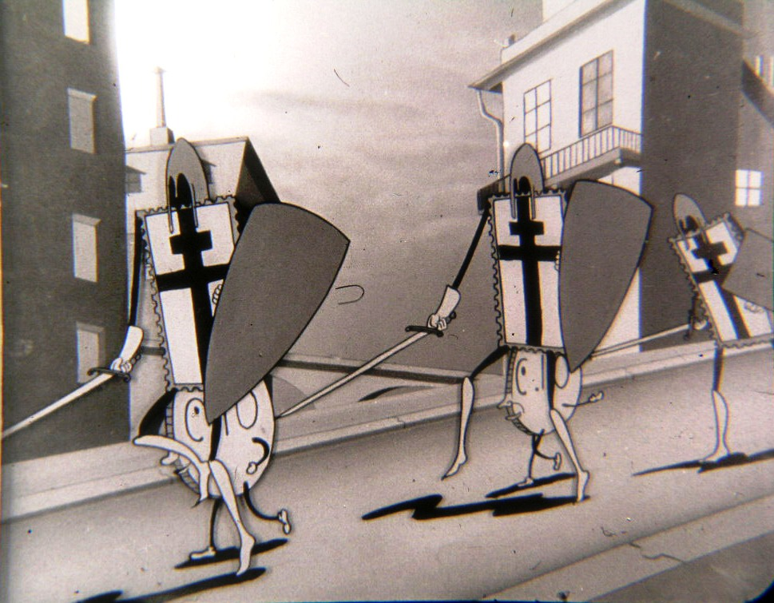
Animation in Europe 2
Italy 1
Crociato 900 (Luigi Liberio Pensuti, 1938)

Slide 14
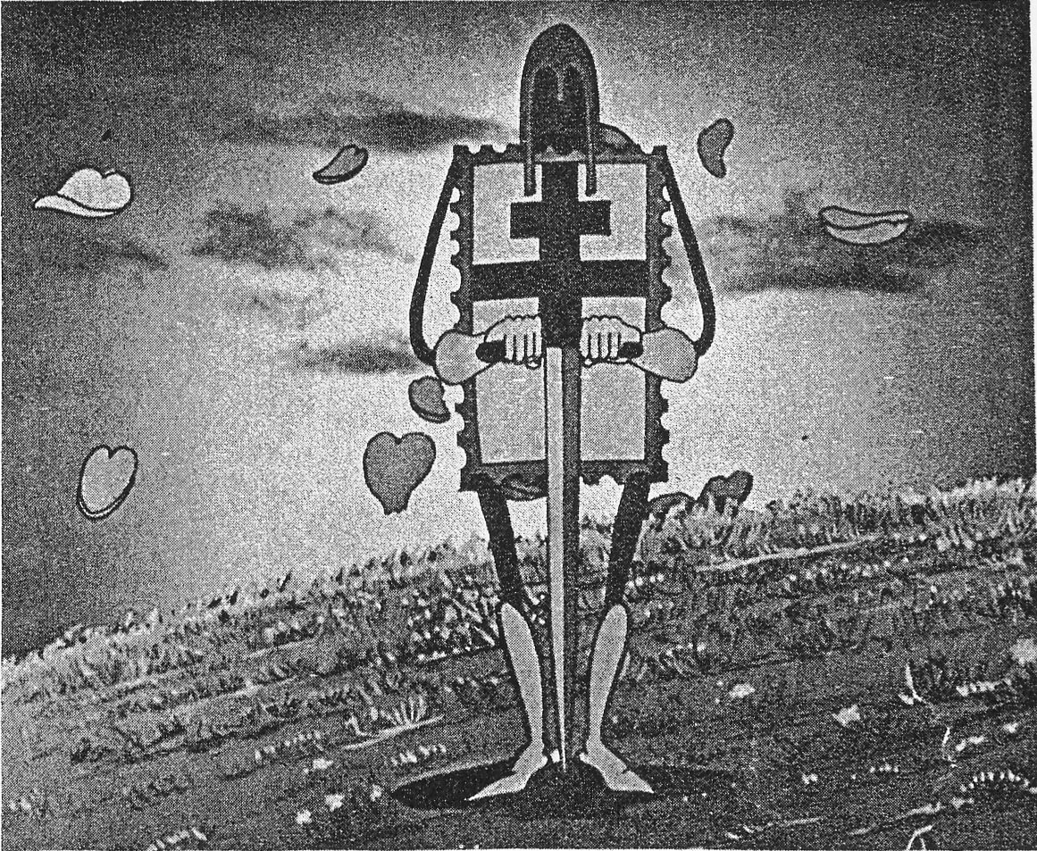
Animation in Europe 2
Italy 1
Crociato 900 (Luigi Liberio Pensuti, 1938)

Slide 15
Animation in Europe 2
Italy 1
Il Dottor Churkill (Luigi Liberio Pensuti, 1941)

Slide 16
Animation in Europe 2
Italy 1
Other relevant Italian animations from World War II:
Anacleto e la faina (Roberto Sgrilli, 1941)
Nel paese dei ranocchi (Antonio Rubino, 1941)

Slide 17
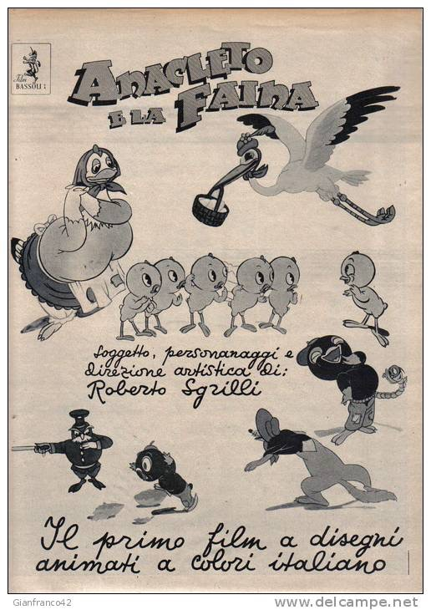
Animation in Europe 2
Italy 1

Slide 18
Animation in Europe 2
Italy 1
After World War II
Gibba (Francesco Maurizio Guido, 1924-2018): L’ultimo sciuscià (1947).
(The voice of the unnamed “sciuscià” is by Luciano De Ambrosis, who debuted at 5 in I bambini ci guardano, Vittorio De Sica, 1943).

Slide 19
Animation in Europe 2
Italy 1
L’ultimo sciuscià (Gibba, 1947)

Slide 20
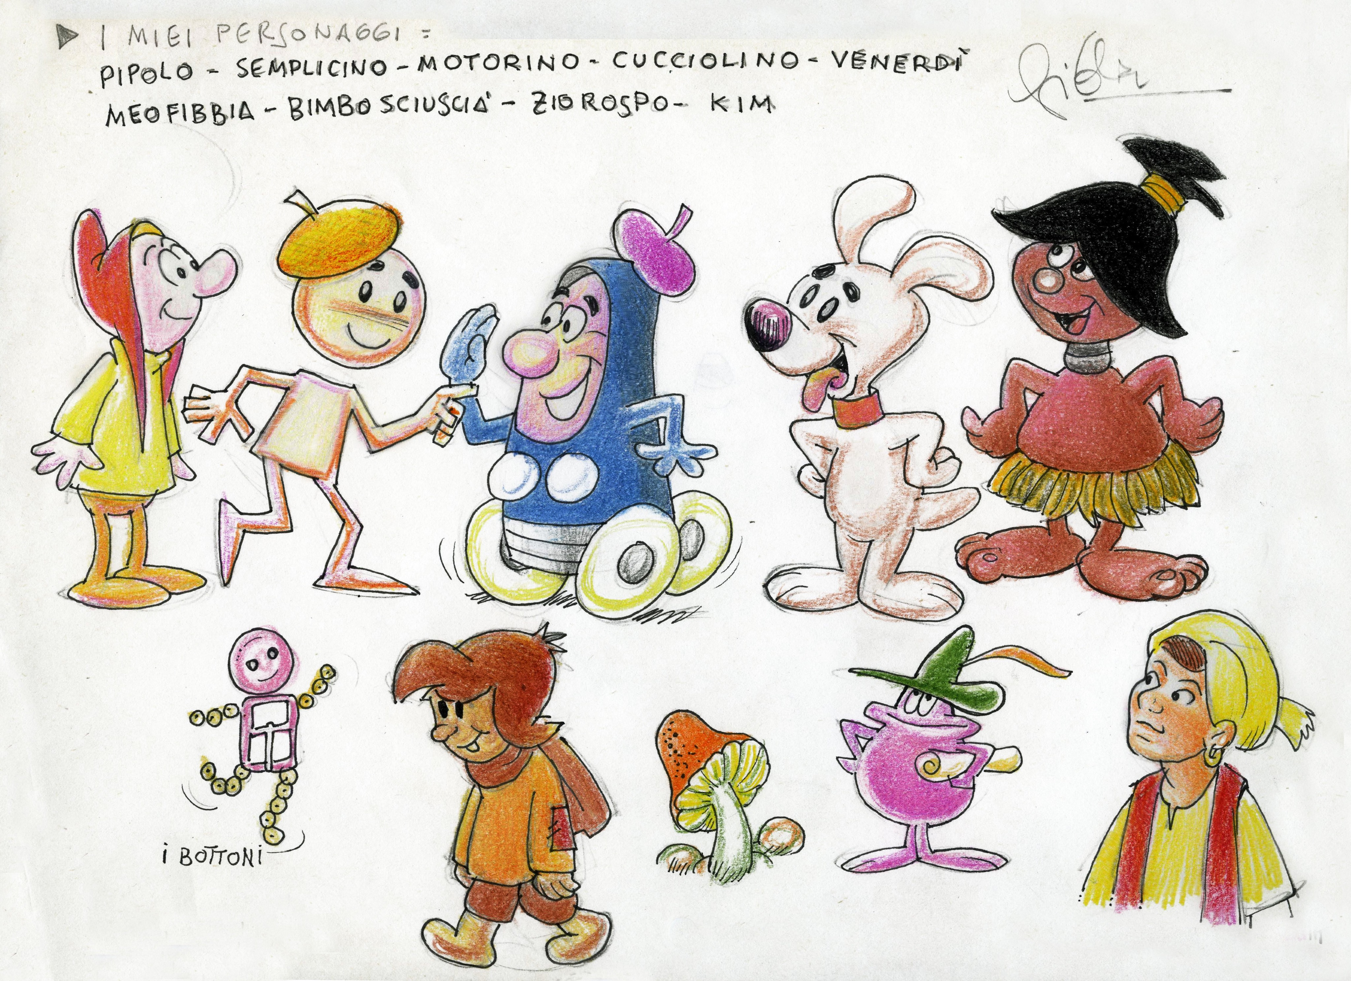
Animation in Europe 2
Italy

Slide 21
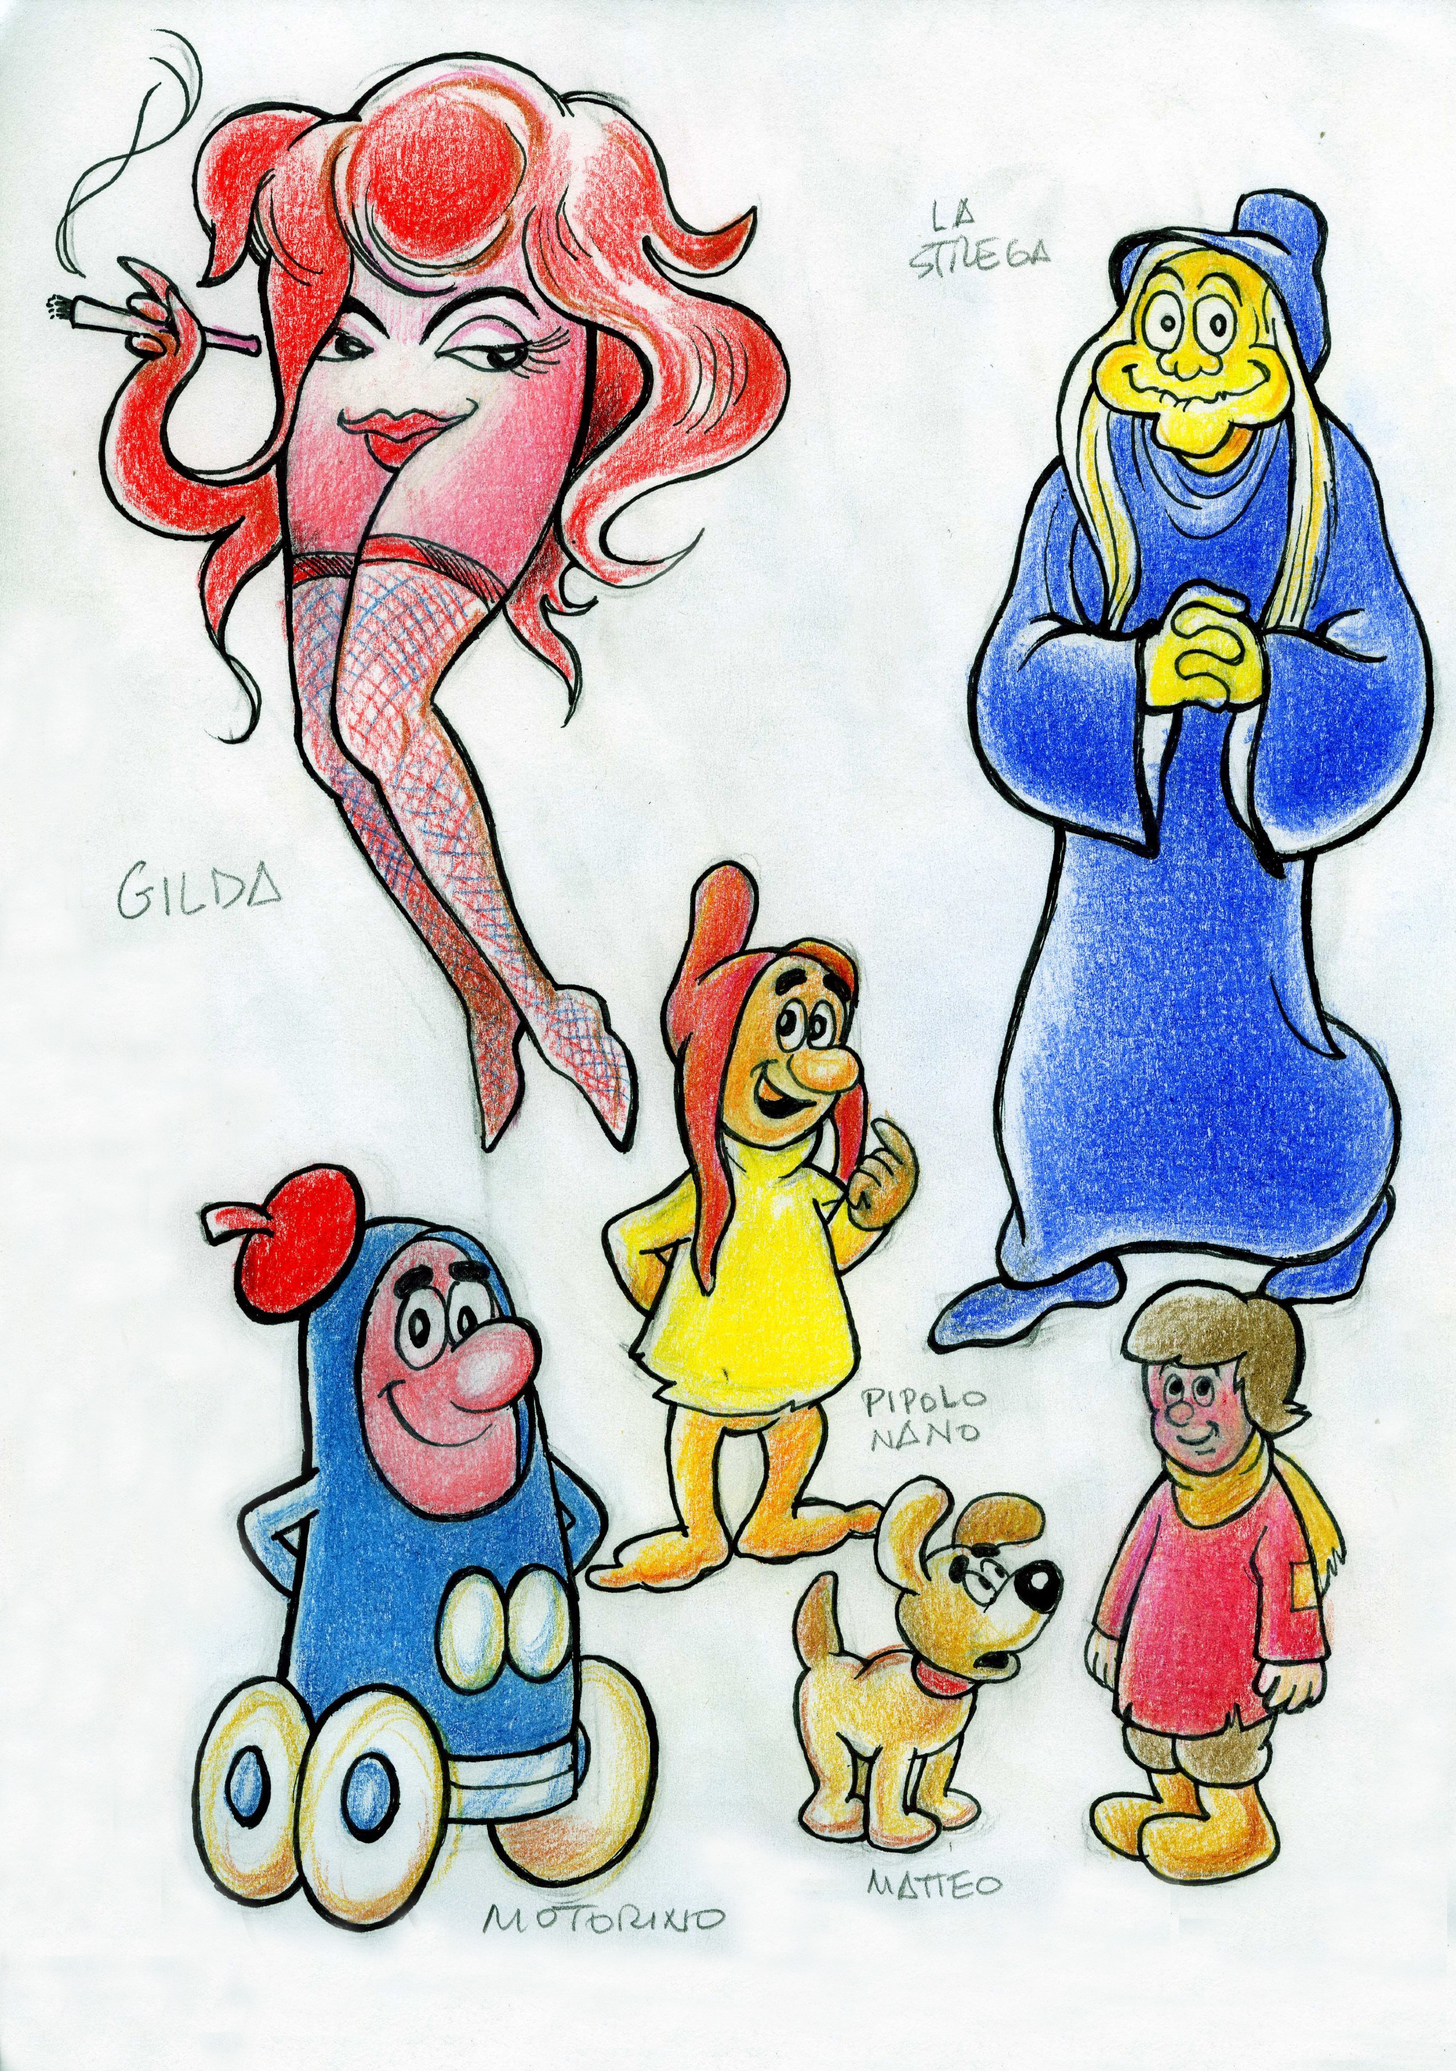

Slide 22
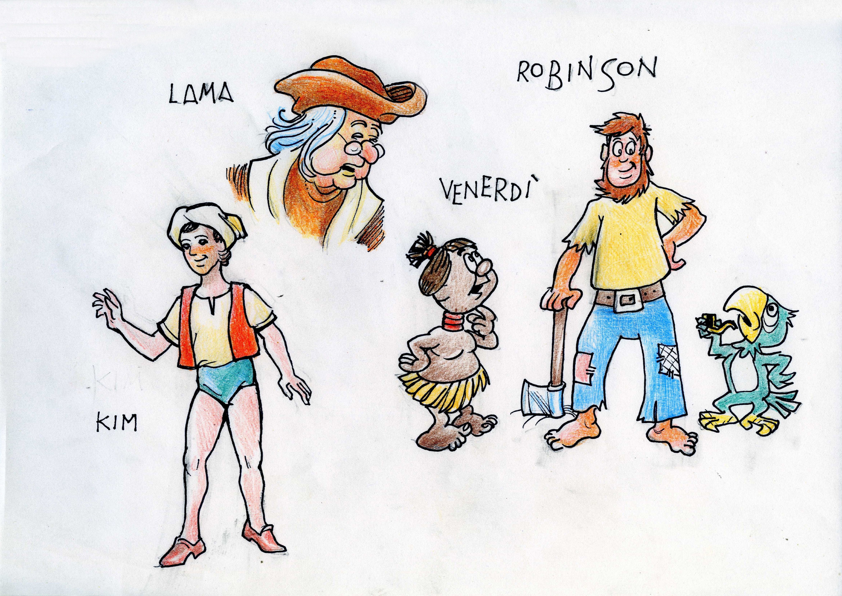

Slide 23
Animation in Europe 2
Italy 1
1949: Italy’s first full-lenght animated films
I fratelli dinamite (Nino Pagot, 1949)
La rosa di Bagdad (Anton Gino Domeneghini, 1949)

Slide 24
Animation in Europe 2
Italy 1
I fratelli dinamite (Nino Pagot, 1949)

Slide 25
Animation in Europe 2
Italy 1
La Rosa di Bagdad (Anton Gino Domeneghini, 1949)

Slide 26
Animation in Europe 2
Italy 1
1957-1977: “Carosello”
An advertising series which would mark a turning point in the history of Italian animation.

Slide 27
Animation in Europe 2
Italy 1
Some artists and studios involved in “Carosello”:
Paul Campani (Omino coi baffi; Angelino)
Roberto and Gino Gavioli (Gamma Film: Ulisse e l’ombra)
Armando Testa (Papalla; Carmencita)
Studio Pagot (Calimero; Grisù)
Osvaldo Cavandoli (La Linea)
Bruno Bozzetto (Kuko; Unca Dunca; Pildo, Poldo e Baffoblù)

Slide 28
Animation in Europe 2
Italy 1
“Calimero, pulcino nero” (Studio Pagot, 1963)

Slide 29
Animation in Europe 2
Italy 1
“La linea” (Osvaldo Cavandoli, 1969)

Slide 30
Animation in Europe 2
Italy 1
Putiferio va alla guerra (Gino e Roberto Gavioli, 1968)

Slide 31
Animation in Europe 2
Italy 1
Un burattino di nome Pinocchio (Giuliano Cenci, 1972)

Slide 32
Animation in Europe 2
Italy 1
Pulcinella (Giulio Gianini, Emanuele Luzzati, 1973)

Slide 33
Animation in Europe 2
Italy 1
After “Carosello”
TV series, financed by the RAI
“Resurgence” of the feature-length films: Enzo D’Alò
Internationalization: Iginio Straffi, Rainbow and Winx Club
Individual experimentation: the Neo-pictorial current

Slide 34
Animation in Europe 2
Italy 1
Film n. 4 (Luigi Veronesi, 1940)

Slide 35
Animation in Europe 2
Italy 1
Point and Counterpoint (Cioni Carpi, 1960)
L'uccello Maya (Cioni Carpi, 1961)
I Will... I Shan’t: A Study on Human Behavior (Cioni Carpi, 1962)

Slide 36
Animation in Europe 2
Italy 1
La piccola Russia (Gianluigi Toccafondo, 2004)

Slide 37
Animation in Europe 2
Italy 1
Dell’ammazzare il maiale (Simone Massi, 2011)

Slide 38
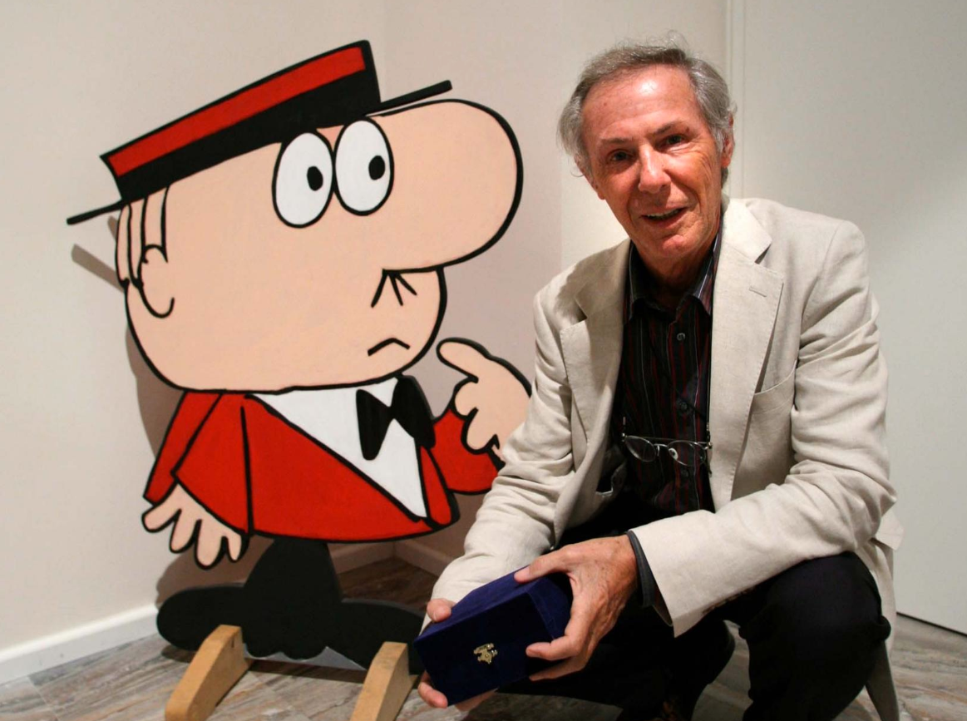
Animation in Europe 2
Italy 1
Bruno Bozzetto (1938)

Slide 39
Animation in Europe 2
Italy 1
Bruno Bozzetto
Bruno Bozzetto has been creating animated short and full-length films without any interruption since his professional debut in 1958. His list of short films is still growing, as he keeps posting new animations on his YouTube.com channel, BrunoBozzettoChannel.
Bozzetto is a self-taught artist. As a teen-ager, he realized that live action films needed too big a crew to be affordable, so he turned to animation (despite this choice, his filmography includes anyway the full-length live action film Sotto il ristorante cinese – Under the Chinese Restaurant, 1987 – and several live-action shorts). He has always been more interested in storytelling than in aesthetics. He loves to quote an anonymous child’s statement: “A drawing is an idea with a line around it”. Furthermore, half-jokingly, he claims that he cannot draw well.

Slide 40
Animation in Europe 2
Italy 1
Bruno Bozzetto
Bozzetto’s bare graphic style is actually pivotal to his approach to animation. His drawings are sharp and far from naturalistic. His characters are caricatures, though not necessarily grotesque, and act against stylized backgrounds. Potentially dramatic or serious topics (human behavior, complex scientific theories) are transformed into funny and brilliant sequences, achieving thus a surprising effect of contrast.
The use of metaphors, idiomatic expressions and metalinguistic references as gag sources is sometimes remindful of Tex Avery’s humor (the classic example being Symphony in Slang, 1951). Bozzetto’s irony is certainly far less frantic and sadist than Avery’s one, as he prefers to slow down the narrative pace, following instead the example of another American master of stylized animation, Robert Cannon. In a way, Bozzetto bridges together Disney's dream of a better world, Avery's belief that such a thing does not exist and Cannon's wishful thinking that we may make it on Earth.

Slide 41
Animation in Europe 2
Italy 1
Bruno Bozzetto’s beginnings
The 1958 Cannes Film Festival, the UPA and the Zagreb School
Tapum! La storia delle armi (1958)

Slide 42
Animation in Europe 2
Italy 1
Bruno Bozzetto: idea and style
Mr. Tao (1988)

Slide 43
Animation in Europe 2
Italy 1
Bruno Bozzetto: idea and style
Europe & Italy (1999)

Slide 44
Animation in Europe 2
Italy 1
Ego (1969)

Slide 45
Animation in Europe 2
Italy 1
Bozzetto brought his satirical approach to a climax during the 1960s / 1970s as he, no less than his peers, was involved in TV commercials. The balance between visual storytelling, eccentric designs and practical purposes that suited him was also fitting the requirements of “Carosello” (1957-1977).
During the “Carosello” years, all the main advertising agencies were in Milan and, therefore, animation studios flourished there. Bruno Bozzetto established his own studio in 1960; it coordinated the talent of remarkable artists, like Guido Manuli, Giuseppe Laganà, Giancarlo Cereda, and Maurizio Nichetti.

Slide 46
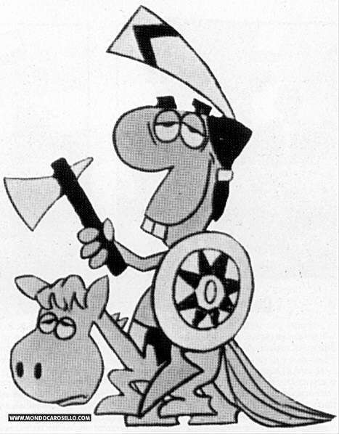
Animation in Europe 2
Italy 1

Slide 47
Animation in Europe 2
Italy 1
West and Soda (1965)

Slide 48
Animation in Europe 2
Italy 1
West and Soda (1965)

Slide 49
Animation in Europe 2
Italy 1
Vip, mio fratello superuomo (1968)

Slide 50
Animation in Europe 2
Italy 1
Vip, mio fratello superuomo (1968)

Slide 51
Animation in Europe 2
Italy 1
Allegro non troppo (1976)

Slide 52
Animation in Europe 2
Italy 1
Allegro non troppo (1976)

Slide 53
Animation in Europe 2
Italy 1
Allegro non troppo (1976)

Slide 54
Suggested readings
Giannalberto Bendazzi, Animation. A World History. 3 voll., Waltham, Massachusetts: Focal Press, 2015. Vol. I, pp. 167-169 (only the section “Italy”). Vol. II, pp. 215-216 (only the section “Italy: Allegro non troppo”).
Vol. II, pp. 216-223 (from –and including- the section “Bruno Bozzetto” up to –and including- the section “Cioni Carpi”).

