Slide 1
History of Animation
Second Cycle Degree in Theatre, Film, Television and Media Studies
Academic Year 2019-2020
Lesson 16

Slide 2
Animation in Asia 1
Animation in Asia:
China

Slide 3
Animation in Asia 1
China
China
For a long time (at least until the 1970s) animation in China was synonym with the Wan Brothers.
They were four brothers: Wan Laiming (1900-1997), Wan Guchan (1900-1995), Wan Chaochen (1906-1992) and Wan Dihuan (1907?-unknown).
They were set-designer for live-action cinema; they approached animation in an amateurish way, inspired by the productions of the Fleischer Brothers.
Their first film was Uproar in the Studio (1926); it is now lost.

Slide 4
Animation in Asia 1
China
Wan Dihuan left the Brothers in 1933, to devote himself to photography. The remaining three brothers kept working as animators: they studied foreign animated films and divulged their ideas on art.
After the Japanese invasion of Shanghai (1937), and a temporary escape to Wuhan, the Brothers settled in the “French Concession” in Shanghai. There, they organized a studio and started the production of Princess Iron Fan (1941): the first full-length feature film of Asia.
It was inspired by one of the most important works of Chinese literature: Journey to the West, a 16th century novel.

Slide 5
Animation in Asia 1
China
Princess Iron Fan (Wan Brothers, 1941)

Slide 6
Animation in Asia 1
China
The Shanghai Studio grew bigger at the end of the 40s.
The Wan Brothers reunited after a momentary separation (Wan Chaochen traveled to the USA to study American animation; Wan Laiming and Wan Guchan went to Hong Kong during the final years of the World War II). By the 1960s, the Shanghai Studio would count 380 workers.
Their production techniques were basically hand-drawn cel animation, puppet and paper cut-out animation.
Their most renowned post-war work was the two-part film Confusion in the Sky (1961 and 1964): another take on the Journey to the West.
The Studio closed from 1965 to 1972, because of the Cultural Revolution.

Slide 7
Animation in Asia 1
China
Zhu Baizhe Eats the Watermelon (Wan Guchan, 1958)

Slide 8
Animation in Asia 1
China
Confusion in the Sky (Wan Laiming, 1961 and 1964)

Slide 9
Animation in Asia 1
China
During the 70s, and after the fell of the political Gang of Four, the Shanghai Studio was revived.
The most important animator of the period was Xu Jingda, also known as A Da. His best work is the short film Three Monks (1980).
Chinese animation is today a multi-centered productive reality. Individual artistic research keeps going on; at the same time, however, directors and producers are trying to emulate the best-selling models of Japanese animation.

Slide 10
Animation in Asia 1
China
Three Monks (A Da, 1980)

Slide 11
Animation in Asia 1
China
Big Fish and Begonia (Liang Xuan, Zhang Chun, 2016)

Slide 12
Animation in Asia 2
Animation in Asia:
Japan

Slide 13
Animation in Asia 2
Japan
Japan
The first historical document of Japanese animation is the “Matsumoto fragment” (1907). It is a fragment of 35 mm clear film, with 50 hand-drawn frames. It shows a boys who writes katsudō shashin, that is to say: “moving pictures”.
The Matsumoto fragment was retrieved by dr. Natsuki Matumoto (University of Osaka), in 2005, in a private house in Kyoto.
It could prove that Japan developed animation on its own, without influences from the Western Countries.

Slide 14
Animation in Asia 2
Japan
The Matsumoto Fragment (1907?)

Slide 15
Animation in Asia 2
Japan
1917: three pioneers.
The comic artists Ōten Shimōkawa (1892-1973) and Jun’ichi Kōuchi (1886-1970) and the painter Seitarō Kitayama.
In 1917, they produced 18 short films; their work was called senga eiga (“line film”). Kitayama’s Momotarō (1918) was screened even in France.
Kitayama wrote the first Japanese manual of animation; he directed 30 films and founded the first animation studio of Japan, the Kitayama Eiga Seisakushō (“Kitayama Film Production Laboratory”)

Slide 16
Animation in Asia 2
Japan
Namakura Katana: Hanawa Hekonai Meitō no Maki (Jun’ichi Kōuchi, 1917; fragment)

Slide 17
Animation in Asia 2
Japan
During the 1920s, Yasuji Murata brought to Japan the transparent cel technique.
The most relevant animator of this age was Noburō Ōfuji (1900-1961). He considered animation a form of art, not just something to create advertisements or to entertain children. He founded the Chiyogami Eigasha studio in Tokyo in 1925.
His preferred technique was paper-cut outs (kirigami). In particular, he used a special semi-transparent paper, woodcut printed in colour. The name of that paper was chiyogami –hence the name of his studio.
With the short film Kujira (The Whale, 1927) Ōfuji introduced synchronized sound in Japanese animation. Kuro nyago (The Black Cat) was Ōfuji’s first attempt at synchronized dialogue.

Slide 18
Animation in Asia 2
Japan
Kokka Kimigayo (Noburō Ōfuji, 1931)

Slide 19
Animation in Asia 2
Japan
Kuro nyago (Noburō Ōfuji, 1929)

Slide 20
Animation in Asia 2
Japan
The World War II favored the production of many propaganda animated films.
Mitsuyo Seo, a former animator at Masaoka Eiga Seisakushō (helmed by Kenzō Masaoka) was entrusted with Momotarō no Umiwashi (Momotarō and the Sea Eagles, 1942), the longest animation made in Japan until that point (37 minutes).
The success of the film induced the Navy to fund a second Momotarō feature: Momotarō Umi no Shinpei (Momotarō, the Divine Warrior of the Sea, 1945).

Slide 21
Animation in Asia 2
Japan
Momotarō Umi no Shinpei (Mitsuyo Seo, 1945)

Slide 22
Animation in Asia 2
Japan
After the World War II, Japanese cinema slowly transitioned towards a rebirth.
Akira Kurosawa’s Rashōmon won the Golden Lion in Venice in 1951.
In 1955 the educational department of the Tōkyō Eigasha production company started to do animation (Ukare Violin, The Happy Violin, Taiji Yabushita, 1955). The department would become later (1956) known as Tōei.
In 1958, Tōei produced a new Japanese full-length film, the first one in full colour: Hakujaden (The White Serpent, Taiji Yabushita).
Yabushita (1903-1986) make the most of the contributions of the two main animators: Yasuji Mori (1925-1992) and Akira Daikubara. This successful production involved some future outstanding animators and directors, like Yasuo Ōtsuka and Rintarō).

Slide 23
Animation in Asia 2
Japan
Hakujaden (Taiji Yabushita, 1958)

Slide 24
Animation in Asia 2
Japan
Tōei was mostly concerned about imitating western models and producing full-length features for children (see the largely successful Nagautsu o Haita Neko, Puss in Boots, Kimio Yabuki, 1969).
However, the commercial and expressive potential of Japanese animation, and in particular of manga eiga (“comic films”, later identified as animeeshon and finally anime, for short), fully emerged thanks to Osamu Tezuka (1928-1989), the so-called “God of Manga” and “Godfather of Anime”.

Slide 25
Animation in Asia 2
Japan
Osamu Tezuka
1961: Mushi Productions
1963-1966: “Tetsuwan Atomu” (“Astroboy”): the first Japanese TV animated series. 193 episodes.
1968: Tezuka Productions

Slide 26
Animation in Asia 2
Japan
“Astroboy” (Osamu Tezuka, 1963)

Slide 27
Animation in Asia 2
Japan
Broken Down Film (Osamu Tezuka, 1985)

Slide 28
Animation in Asia 2
Japan
Daicon III Opening Animation (Hideaki Anno, Hiroyuki Tamaga, Takami Akai, 1981)

Slide 29
Animation in Asia 2
Japan
Some outstanding anime directors
Katsuhiro Ōtomo (1954)
Satoshi Kon (1963-2010)
Mamoru Oshii (1951)
Mamoru Hosoda (1967)

Slide 30
Animation in Asia 2
Japan
Akira (Katsuhiro Ōtomo, 1988)

Slide 31
Animation in Asia 2
Japan
Sennen Joyū (Millennium Actress, Satoshi Kon, 2001)

Slide 32
Animation in Asia 2
Japan
Kōkaku Kidōtai (Ghost in the Shell, Mamoru Oshii, 1995)

Slide 33
Animation in Asia 2
Japan
Toki o Kakeru Shōjo (The Girl Who Leapt Through Time, Mamoru Hosoda, 2006)

Slide 34
Animation in Asia 2
Japan
Summer Wars (Mamoru Hosoda, 2009)

Slide 35
Animation in Asia 3
Animation in Asia:
Studio Ghibli

Slide 36
Animation in Asia 3
Japan
Isao Takahata (1935-2018)
Hayao Miyazaki (1941)
Toshio Suzuki (1948)
Joe Hisaishi (1950)

Slide 37
Animation in Asia 3
Japan
Miyazaki’s early career
Born on January 5, 1941, in Akebono-cho, Bunkyo district of Tokyo.
His father worked in his brother’s aeronautic firm, Miyazaki Airplanes, producing the rudders for Zero fighters (theme: war and responsibility)
His mother was often hospitalized, from 1947 to 1955, because of spinal tuberculosis; however, she retained a central role in the family (theme: strong women, struggle to survive).

Slide 38
Animation in Asia 3
Japan
Miyazaki’s early career
In 1958, he “fell in love” with Pai Niang, heorine of Legend of the White Serpent (Hakujaden, Taiji Yabushita). Theme: metamorphosis, multifaceted heroine.
During his studies of political science and economics at Gakushuin University, he joined a group studying foreign literature for children. Theme: fantasy, storytelling for children, fascination with Europe.
In 1963, he joined Toei Animation studio working as an in-betweener (creating the movements of characters between an animator’s key poses). He took an active role in the Toei labor union. Theme: cooperation, solidarity.

Slide 39
Animation in Asia 3
Japan
Miyazaki’s early career
1968: The Great Adventure of Hols, Prince of the Sun (Taiyo no Ouji Horusu no Daibouken, Isao Takahata).
From 1971: left Toei, experiences at A-Pro, Zuiyo Eizo and Nippon Animation (“Lupin III”, 1971, “Heidi, girl of the Alps”, 1974, “3000 Leagues in Search of Mother”, 1976, “Anne of Green Gables”, 1979).
1979: first full-length feature, The Castle of Cagliostro (Rupan Sansei: Kariosutoro no Shiro).

Slide 40
Animation in Asia 3
Japan
Miyazaki’s early career
1982: Nausicaä of the Valley of the Wind starts as a manga on “Animage” (would end in 1994).
1983: green light to the Nausicaä film, from Tokuma Shoten and Topcraft, led by Toru Hara. The film production committee included Toshio Suzuki, an editor at “Animage” who would have produced all of Miyazaki’s films from the late 1980s onwards.
1984: overwhelming success of Nausicaä of the Valley of the Wind
1985: Takahata, Hara, Suzuki and Miyazaki create Studio Ghibli.

Slide 41
Animation in Asia 3
Japan

Slide 42
Animation in Asia 3
Japan
The Great Adventure of Hols, Prince of the Sun (Taiyo no Ouji Horusu no Daibouken, Isao Takahata, 1968).

Slide 43
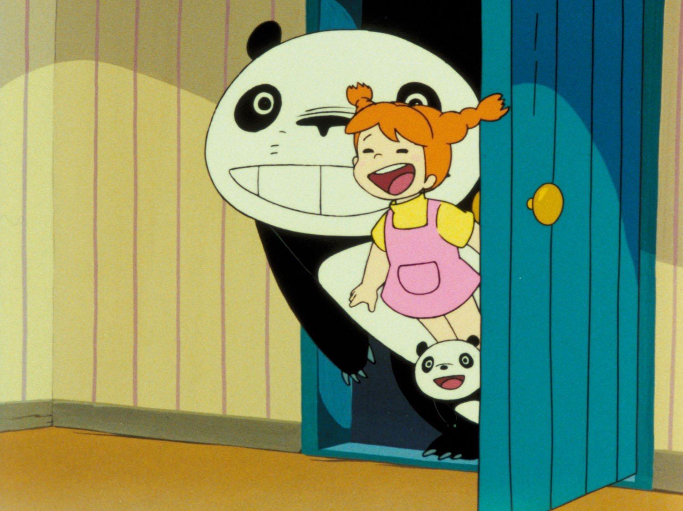
Animation in Asia 2
Japan

Slide 44
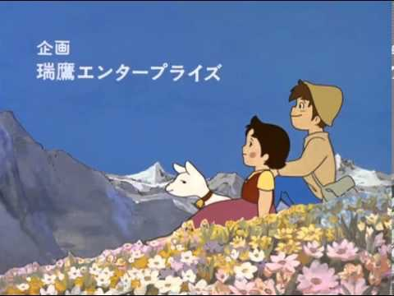
Animation in Asia 3
Japan

Slide 45
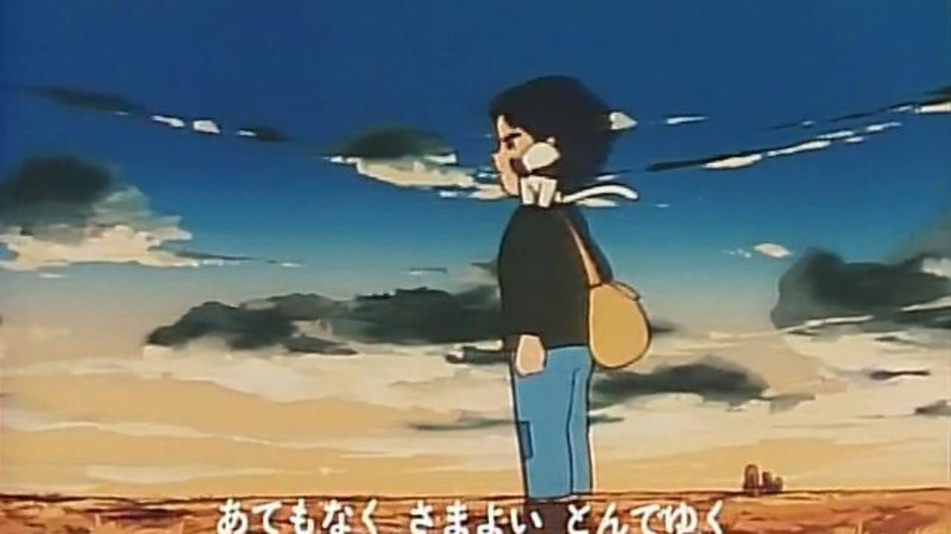
Animation in Asia 3
Japan

Slide 46
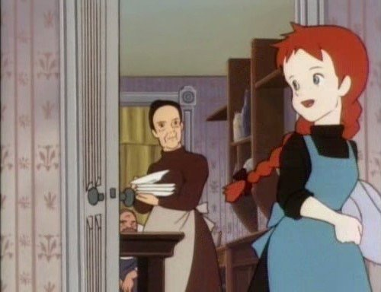
Animation in Asia 3
Japan

Slide 47
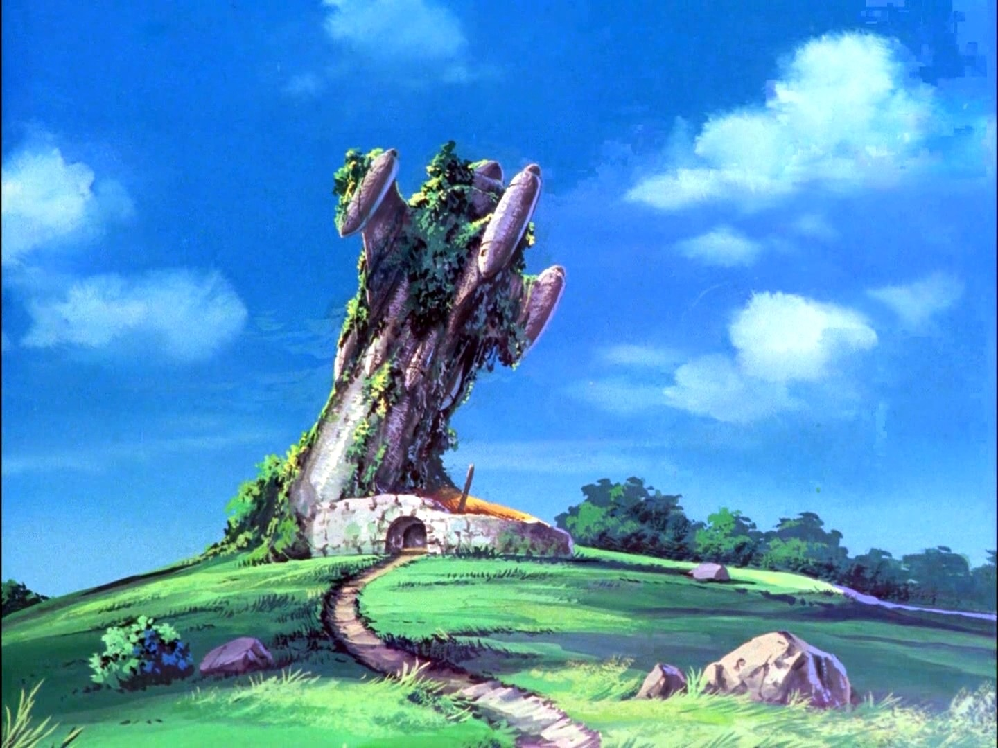
Animation in Asia 2
Japan

Slide 48
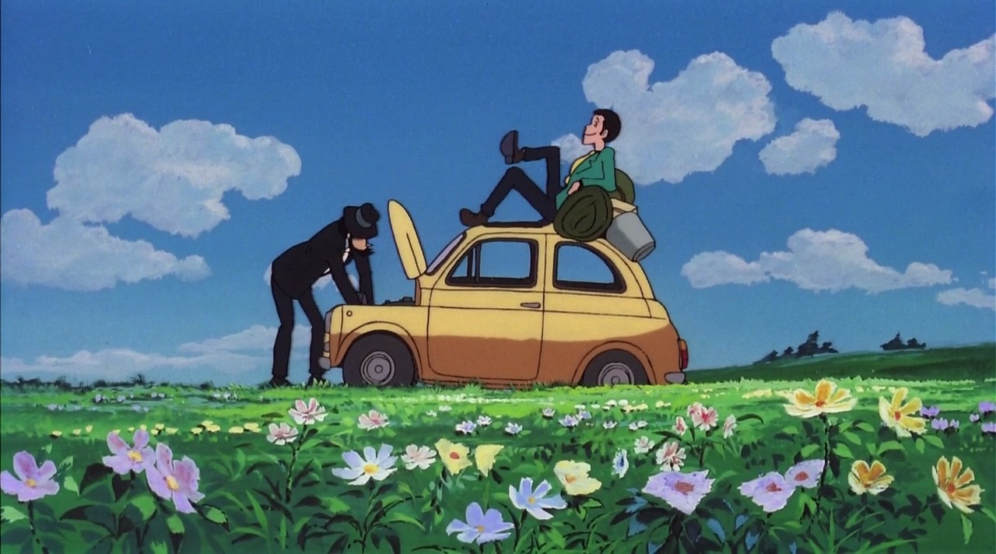
Animation in Asia 3
Japan

Slide 49
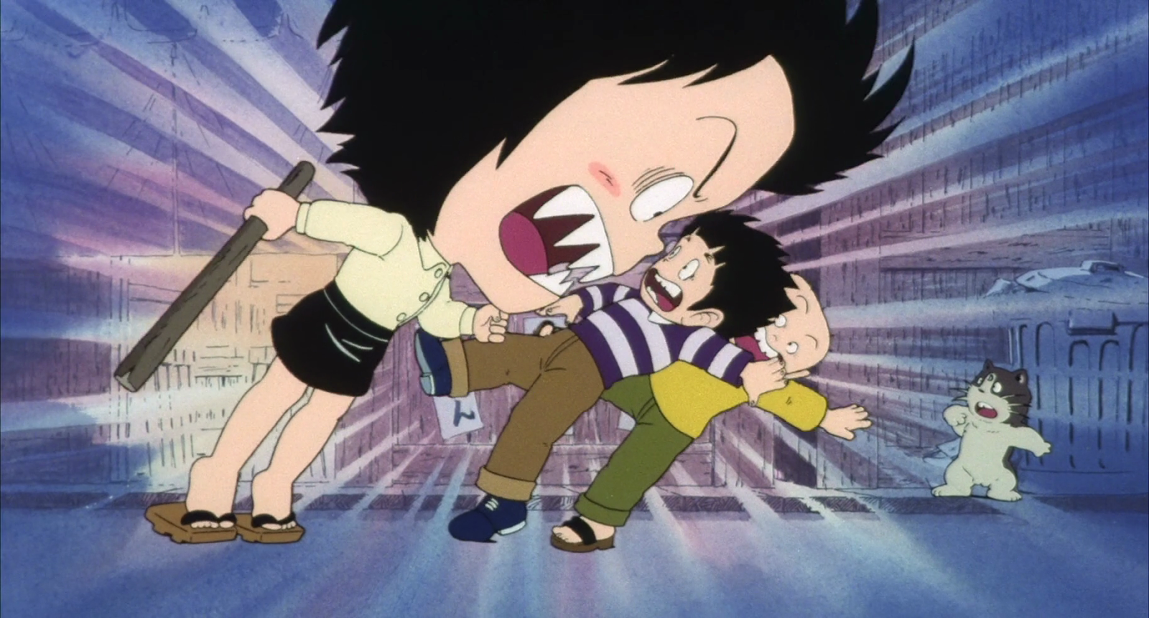
Animation in Asia 3
Japan

Slide 50
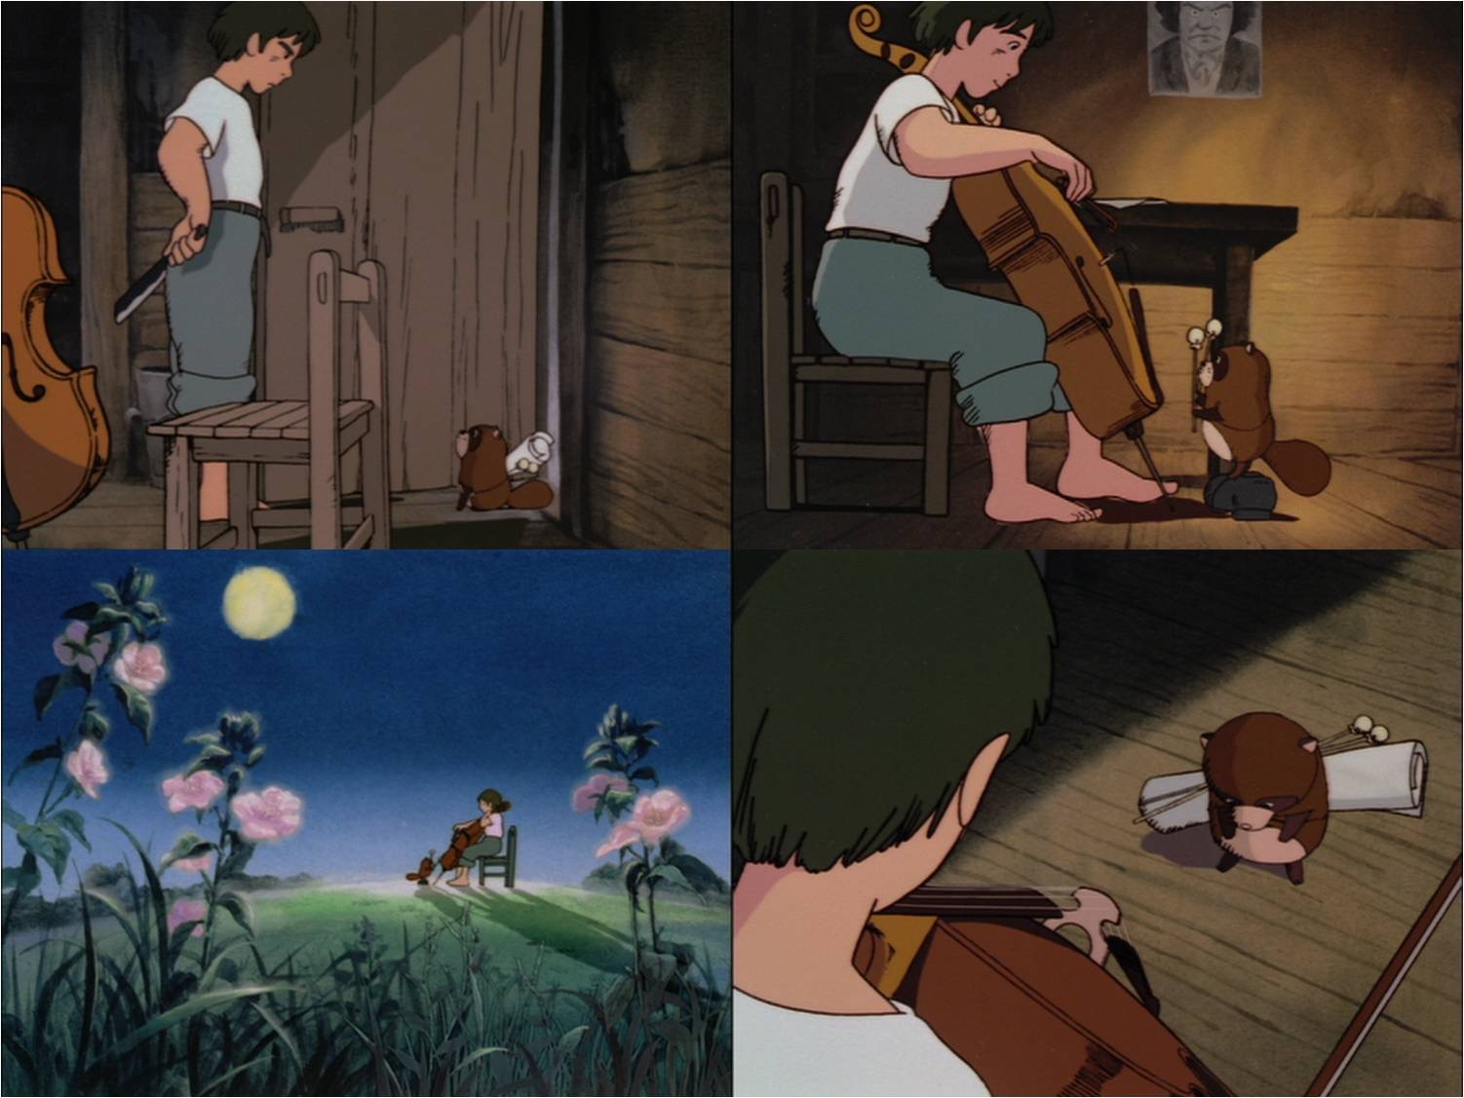
Animation in Asia 2
Japan

Slide 51
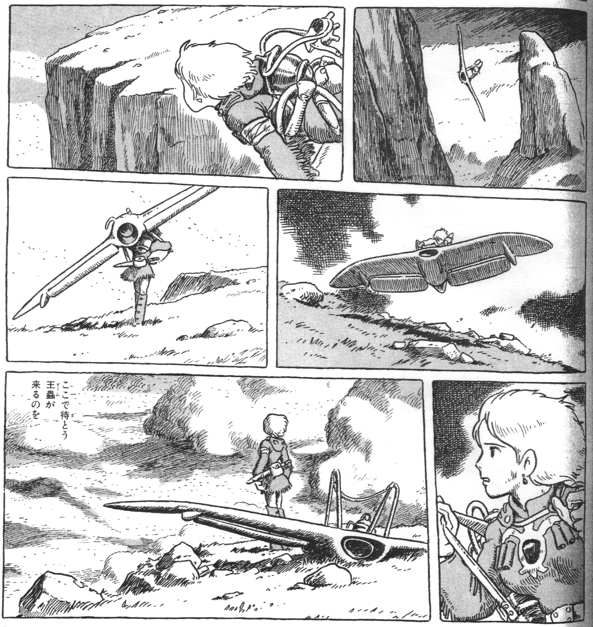
Animation in Asia 3
Japan

Slide 52
Animation in Asia 3
Japan
Kaze no Tani no Naushika (Nausicaä of the Valley of the Wind, Hayao Miyazaki, 1984).

Slide 53
Animation in Asia 3
Japan
Tenkū no Shiro Rapyuta (Castle in the Sky, Hayao Miyazaki, 1986).

Slide 54
Animation in Asia 3
Japan
«With the exception of Doraemon, most current animation is based on more serious, dramatic gekiga comics; Pazu will instead aim to help resurrect traditionally entertaining manga- or cartoon-style films. By focusing mainly on an audience of fourth graders […], it will reach an audience of even younger children, and expand even further in its age appeal. I am certain that hundreds of thousands of older anime fans will come to see this film no matter what, so there is no need to overtly cater to their tastes».
Hayao Miyazaki, “Original Proposal for Castle in The Sky”, 1984, now in in Jocelyne Allen (ed.), The Art of Castle in the Sky, San Francisco, 2016, p. 5.

Slide 55
Animation in Asia 3
Japan
Tonari no Totoro (My Neighbour Totoro, Hayao Miyazaki, 1988).

Slide 56
Animation in Asia 3
Japan
Hotaru no Haka (Grave of the Fireflies, Isao Takahata, 1988).

Slide 57
Animation in Asia 3
Japan
Majo no Takkyūbin (Kiki’s Delivery Service, Hayao Miyazaki, 1989).

Slide 58
Animation in Asia 3
Japan
Omohide Poro Poro (Only Yesterday, Isao Takahata, 1991).

Slide 59
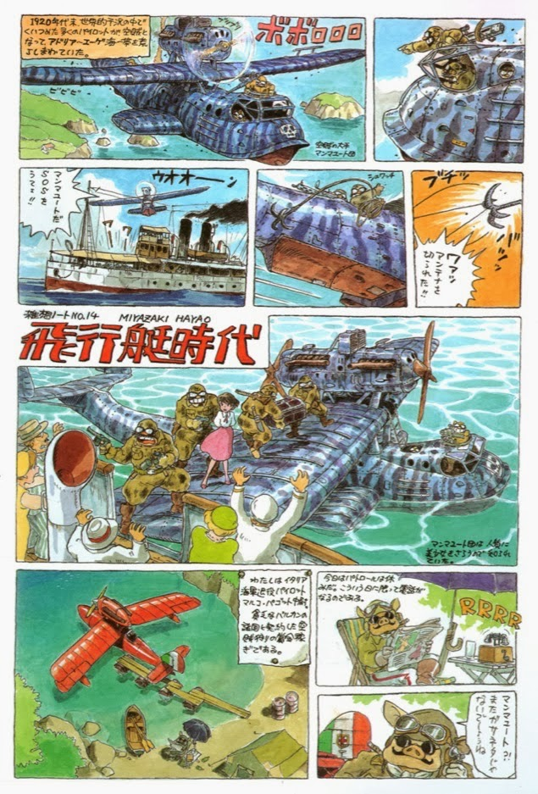
Animation in Asia 3
Japan

Slide 60
Animation in Asia 3
Japan
Kurenai no Buta (Porco Rosso,Hayao Miyazaki, 1992).

Slide 61
Animation in Asia 3
Japan
Mimi wo Sumaseba (Whisper of the Heart ,Yoshifumi Kondō, 1995).

Slide 62
Animation in Asia 3
Japan
Mononoke Hime (Princess Mononoke,Hayao Miyazaki, 1997).

Slide 63
Animation in Asia 3
Japan
Hōhokekyo tonari no Yamada-kun (My Neighbours the Yamadas, Isao Takahata, 1999).

Slide 64
Animation in Asia 3
Japan
Sen to Chihiro no Kamikakushi (Spirited Away, Hayao Miyazaki, 2001).

Slide 65
Animation in Asia 3
Japan
Hauru no Ugoku Shiro (Howl’s Moving Castle, Hayao Miyazaki, 2004).

Slide 66
Animation in Asia 3
Japan
Gedo Senki (Tales from Earthsea, Gorō Miyazaki, 2006).

Slide 67
Animation in Asia 3
Japan
Gake no Ue no Ponyo (Ponyo, Hayao Miyazaki, 2008).

Slide 68
Animation in Asia 3
Japan

Slide 69
Animation in Asia 3
Japan
Karigurashi no Arrietty (The Secret World of Arrietty, Hiromasa Yonebayashi, 2010).

Slide 70
Animation in Asia 3
Japan
Kokuriko Zaka-Kara (From Up on Poppy Hill, Gorō Miyazaki, 2011).

Slide 71
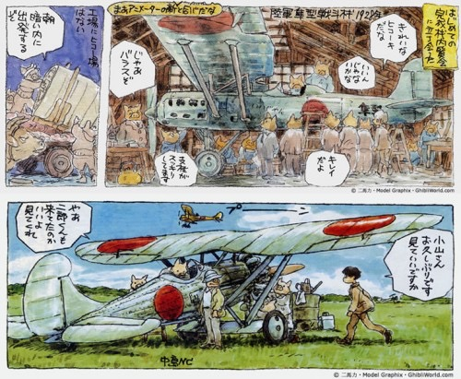
Animation in Asia 3
Japan

Slide 72
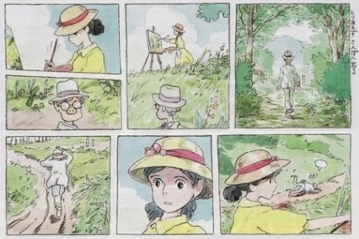
Animation in Asia 3
Japan

Slide 73
Animation in Asia 3
Japan
Kaze Tachinu (The Wind Rises, Hayao Miyazaki, 2013).

Slide 74
Animation in Asia 3
Japan
Kaguya-hime no Monogatari (The Tale of the Princess Kaguya, Isao Takahata, 2013).

Slide 75
Animation in Asia 3
Japan
Omoide no Marnie (When Marnie Was There, Hiromasa Yonebayashi, 2014).

Slide 76
Animation in Asia 3
Japan
“Sanzoku no Musume Rōnja” (“Ronja the Robber’s Daughter”, Gorō Miyazaki, 2014).

Slide 77
Animation in Asia 3
Japan
The Red Turtle (Michaël Dudok De Wit, Pascal Ferran, 2016).

Slide 78
Suggested readings
Giannalberto Bendazzi, Animation. A World History. 3 voll., Waltham, Massachusetts: Focal Press, 2015. Vol. I, pp. 187-188 (section “China”); Vol. II, pp. 89-90 (section “China”); Vol. III, pp. 270-271 (section “China”).
Vol. I, pp. 82-84 (chapter “Silent Asia”); Vol. II, pp. 85-88: “Asia” (to study up to –and including- the section “Experiments”); Vol. II, pp. 335-347: “Asia” (to study up to –and including- the section “Toei’s Fortunes”).
Vol. II, pp. 360-374 (from –and including- the section “The Tokusatsu Factor” up to –and including- the section “Akira and the End of the Decade”).
Vol. III, pp. 214-243: “Asia” (to study up to –and including- the section “Yamamura Koji”); Vol. III, pp. 247-248 (from –and including- the section “Conclusions” up to –and including- the section “Challenges”).
Colin Odell & Michelle Le Blanc, Studio Ghibli. The Films of Hayao Miyazaki and Isao Takahata, Kamera Books, Harpenden, 2009, pp. 35-151.
Hayao Miyazaki, “Hayao Miyazaki on His Own Works”, in Hayao Miyazaki, Starting Point, Viz Media, San Francisco, 2009, pp. 311-332.
Isao Takahata, “The Fireworks of Eros”, in Miyazaki, op. cit., pp. 451-461.
Miyazaki, “Animation Directing Class”, in Hayao Miyazaki, Turning Point, Viz Media, San Francisco, 2014, pp. 128-133.
Miyazaki, “Snezhnaya Koroleva (The Snow Queen): A Film That Made Me Think Animation Was Worthy Work”, in Miyazaki, op. cit., pp. 410-415.

