Slide 1
History of Animation
Second Cycle Degree in Theatre, Film, Television and Media Studies
Academic Year 2019-2020
Lesson 2

Slide 2
What is Animation?
«[…] It is nearly impossible to see an instantaneous photograph of motion without continuing the frozen motion in our imagination. These instant images practically demand animation».
Tom Gunning, “Animating the Instant: The Secret Symmetry between Animation and Photography”, in Karen Beckman, Animating Film Theory, Duke University Press, Durham and London, 2014, p. 48 (pp. 37-53).

Slide 3
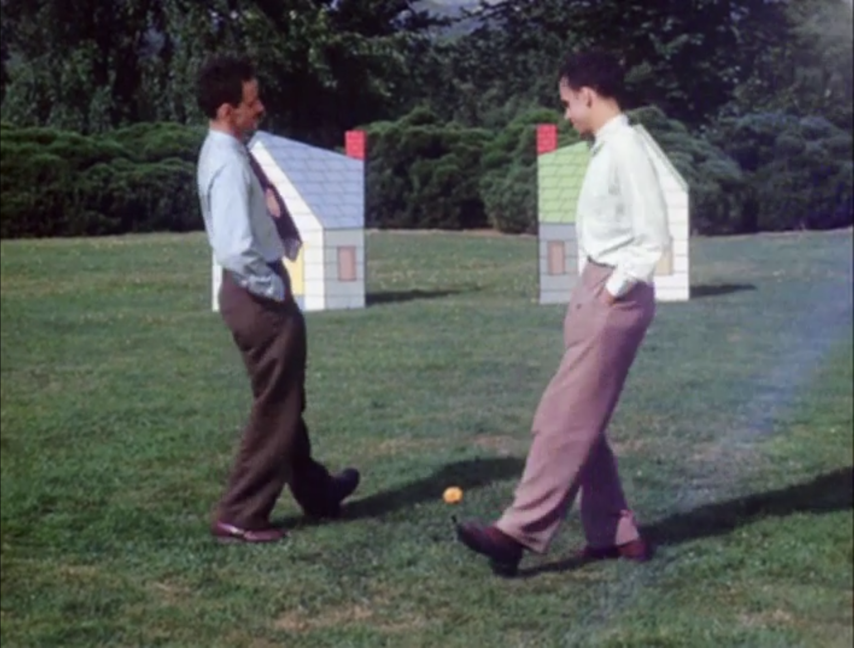
What is Animation?
Norman McLaren, Neighbours (1952)

Slide 4
What is Animation?
Norman McLaren, Neighbours (1952)

Slide 5
What is Animation?
Animation is often misunderstood as a film genre.
«Animation is not a genre; it is a technological process that creates a particular (highly idiosincratic) means of visual representation».
Daniel Goldmark, Tunes for 'Toons. Music and the Hollywood Cartoon, University of California Press, Berkeley, 2005, p. 3.
Any film genre can be associated with animation.

Slide 6
What is Animation?
«It might be useful to bisect our term animation into two related but separable meanings. The first I call animation¹; it refers to the technical production of motion from the rapid succession of discontinuous frames, shared by all cinematic moving images. I define animation² more narrowly, referring to the genre of animation as commonly understood: moving images that have been artificially made to move, rather than movement automatically captured through continuous-motion picture photography».
Tom Gunning, op. cit, p. 40.

Slide 7
What is Animation?
«[…] Not only is animation a form of film but all film, film “as such”, is a form of animation. Given all film by definition includes live action, live action is a form of animation».
Alan Cholodenko, “’First Principles’ of Animation”, in Beckman, op. cit., p. 98 (pp. 98-110).
«Born from animation, cinema pushed animation to its periphery, only in the end to become one particular case of animation».
Lev Manovich, The Language of New media, MIT Press, Cambridge, 2001, p. 302.

Slide 8
What is Animation?
«I say animated films to designate that genre or mode of films traditionally defined as “animation” and treated as the least significant form of film or even not a form of film at all, rather a form of graphic art, by film studies, film history, and film theory».
Alan Cholodenko, op. cit., p. 99.

Slide 9
What is Animation?
«The earlier introduction to the ASIFA [International Association of Animation Film Artists] statute stated that live action cinema was produced by mechanical analysis, through pictures of events similar to the ones which appeared on screen; whereas animation cinema created events through different instruments which differed from actual reproduction. In an animation film, events took place for the first time on the screen. Later on, the development of new techniques […] suggested a ‘negative’ definition, so that the 1980 statute of ASIFA defined animation as everything which is not a simple representation of live action shot at 24 frames per second».
Giannalberto Bendazzi, Cartoons. One Hundred Years of Cinema Animation, John Libbey, London, 1994, p. xvi.

Slide 10
What is Animation?
Jean Epstein and «animistic» cinema.
«Those lives it creates, by summoning objects out of the shadows of indifference into the light of dramatic concern, have little in common with human life… If we wish to understand how an animal, a plant, or a stone can inspire respect, fear, or horror, those three most sacred sentiments, I think we must watch them on the screen, living their mysterious, silent lives, alien to the human sensibility».
Jean Epstein, “On Certain Characteristics of Photogénie” (1924), in Richard Abel (ed.), French Film Theory and Criticism: A History/Anthology, 1907-1929, vol. 1, Princeton University Press, Princeton, 1988, pp. 316-317 (pp. 314-318).
Cinema (animation) creates a view of something previously invisible?

Slide 11
What is Animation?
«Cinema is not movement. This is the first thing. Cinema is not movement. Cinema is a projection of stills – which means images which do not move – in a very quick rhythm. And you can give the illusion of movement, of course, but this is a special case».
Peter Kubelka, “The Theory of Metrical Film” in P. Adams Sitney (ed.), The Avant-Garde Film: A Reader of Theory and Criticism, vol. 3 of the Anthology Film Archives Series, New York University Press, New York, 1978, p. 140 (pp. 139-159).

Slide 12
What is Animation?
Norman McLaren, Blinkity Blank (1955)

Slide 13
What is Animation?
«It’s between frames where cinema speaks. And then, when you have a roll of very weak collisions between frames – this is what I would call a shot, when one frame is very similar to the next frame, and the next frame, and the next frame, and the next frame, and the next frame – the result that you get when you have just a natural scene and you film it… This would be a shot. But, in reality, you can work with every frame».
Peter Kubelka, op. cit., p. 141.

Slide 14
What is Animation?
«Animation is not the art of drawings that move but the art of movements that are drawn; What happens between each frame is much more important than that exists on each frame; Animation is therefore the art of manipulating the invisible interstices that lie between the frames».
Norman McLaren in Georges Sifianos, “The Definition of Animation: A Letter from Norman McLaren”, Animation Journal Vol. 3 No. 2, Spring 1995: pp. 62-66.

Slide 15
What is Animation?
«Contrary to live action cinema, Animation draws the elements of its future works from a raw material made exclusively of human ideas, those ideas that different animators have about things, living beings and their forms, movements and meanings. They represent these ideas through images they make with their own hands. In the causal concatenation of their images – a concatenation they conceive themselves – nothing can be left to chance».
Alexandre Alexeïeff, “Preface”, in Bendazzi, op. cit., p. xxii.

Slide 16
What is Animation?
An alternative definition of animation: a kind of film production where the author is potentially in control of every single frame (and not just of every single image), and of the relations between a frame and the others.
Animation and composition?
A musical composer is in control of the features of every single note, and of the relations between a note and the other ones that preceded it or that will follow it.
An animator is in control of the features of every single frame, and of the relations between a frame and the other ones that preceded it or that will follow it.

Slide 17
Suggested readings
Andrew Selby, ”Introduction”, in Id., Animation, Laurence King, London, 2013, pp. 6-10.

