Slide 1
History of Animation
Second Cycle Degree in Theatre, Film, Television and Media Studies
Academic Year 2019-2020
Lesson 5

Slide 2
Animation Styles and Techniques
Basic Techniques of Animation
Animators have a wide range of possibilities in terms of choice of materials, dimensions and methods of capturing images.
Those possibilities can be combined within the same production.

Slide 3
Animation Styles and Techniques
Basic Techniques of Animation
Cel animation and traditional 2D processes
Drawn cel animation
Rotoscoping
2D computer-generated images

Slide 4
Cel animation and traditional 2D processes
Drawn Cel Animation
Patented by Earl Hurd in 1915.
Cel animation consisted of rough drawings which were drawn over in pencil or ink to finalize the design.
The individually inked line drawings were crafted onto single pre-punched acetate cels (or animation paper) by the animator at the animation table.
The table was tilted at an angle towards the animator, lit from underneath, with the cel fixed to a peg-bar directly over the light source, which illuminated a movable frosted glass or plastic disc in the centre of the table.
The illuminated disc allowed the animator to draw the new image onto a cel using the previous cel as a guide underneath, ensuring that moves previously drawn were incremental and consistent in keeping with the intended action.
The inked cels were turned over and painted on the back using acrylic paint on a factory line and, once dry, were turned right side up for filming.

Slide 5
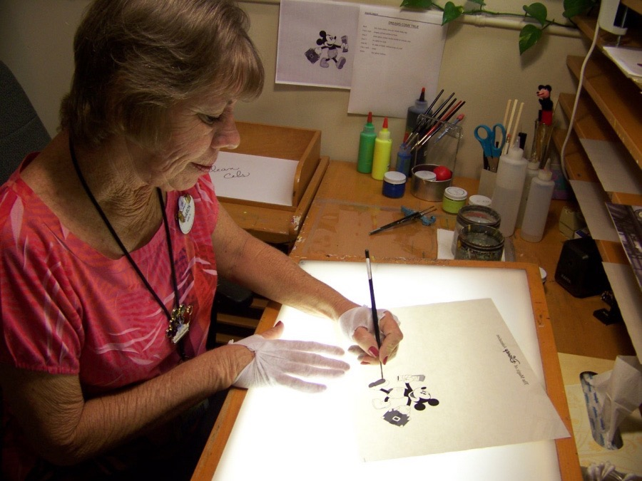
Cel animation and traditional 2D processes
Drawn Cel Animation

Slide 6
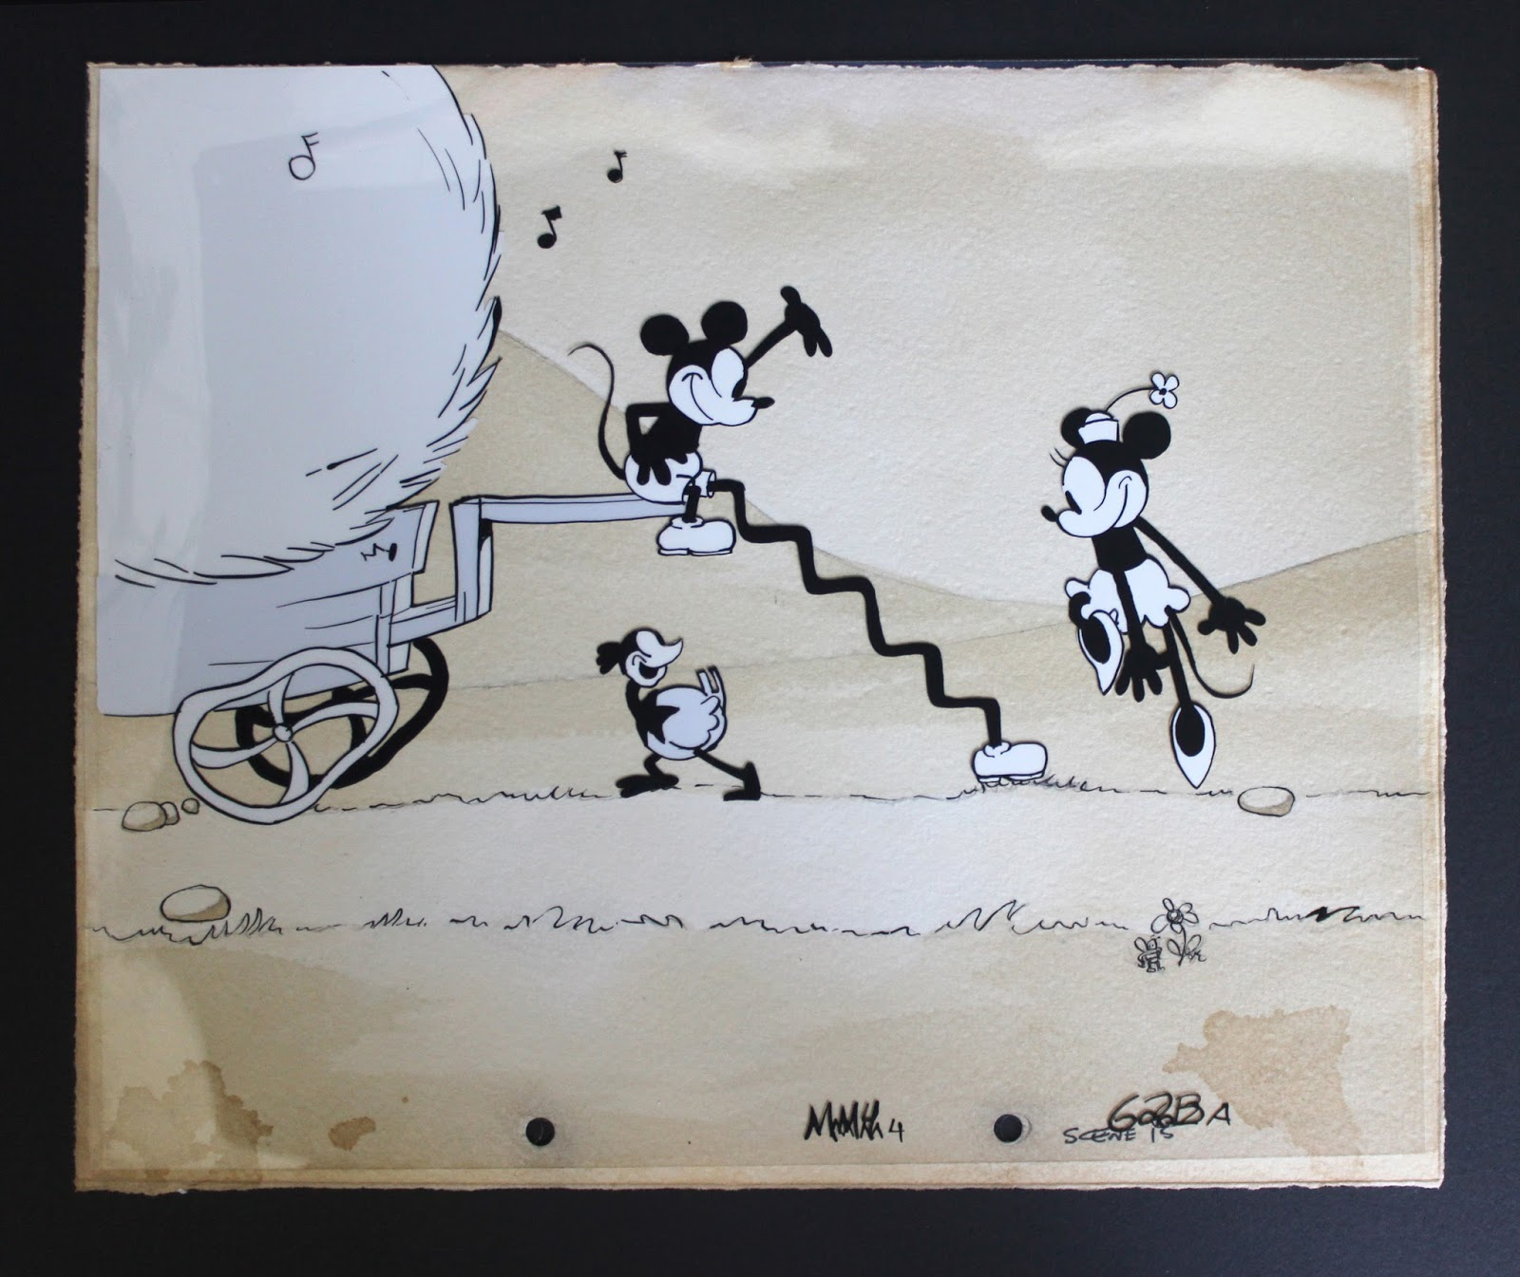
Cel animation and traditional 2D processes
Drawn Cel Animation

Slide 7
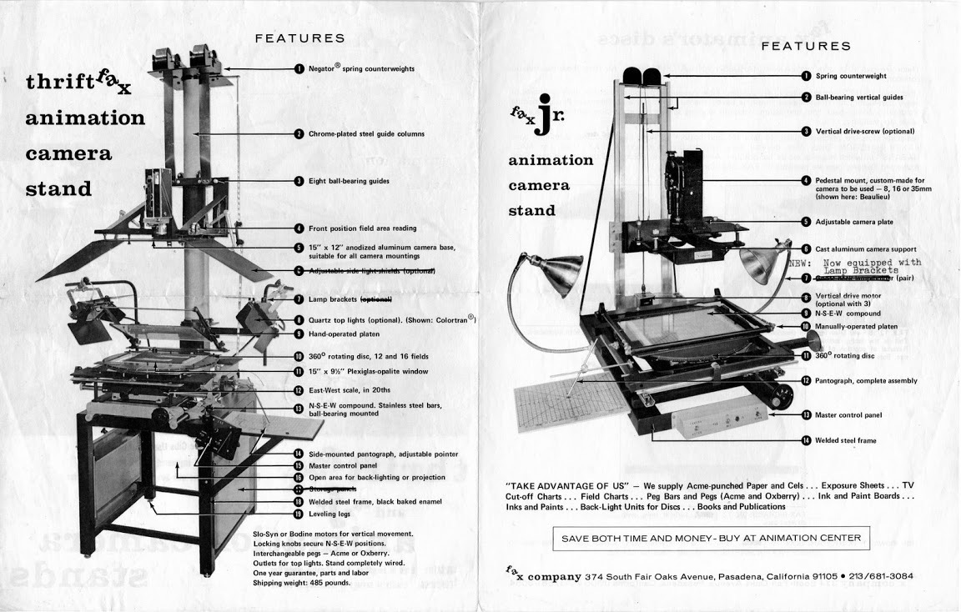
Cel animation and traditional 2D processes
Drawn Cel Animation

Slide 8
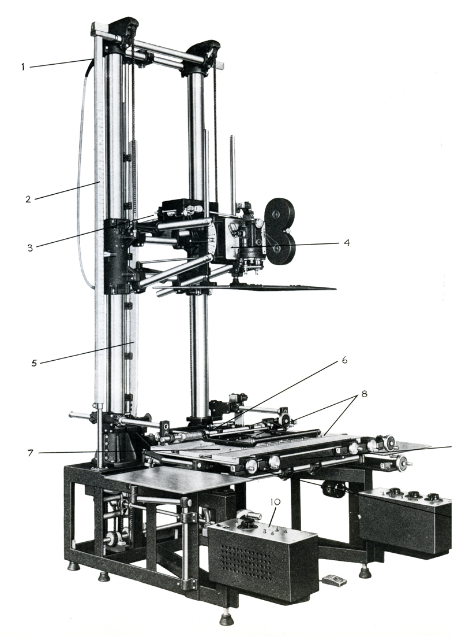
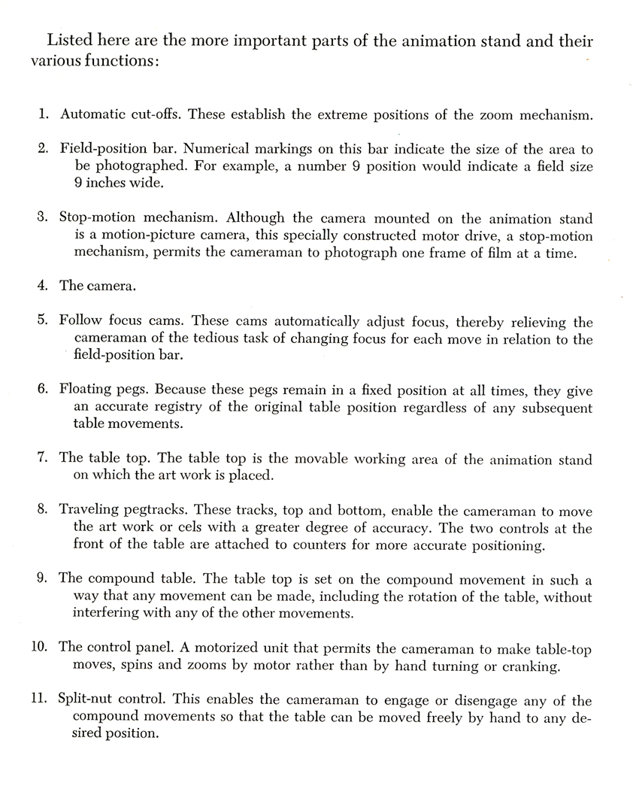
Cel animation and traditional 2D processes
Drawn Cel Animation

Slide 9
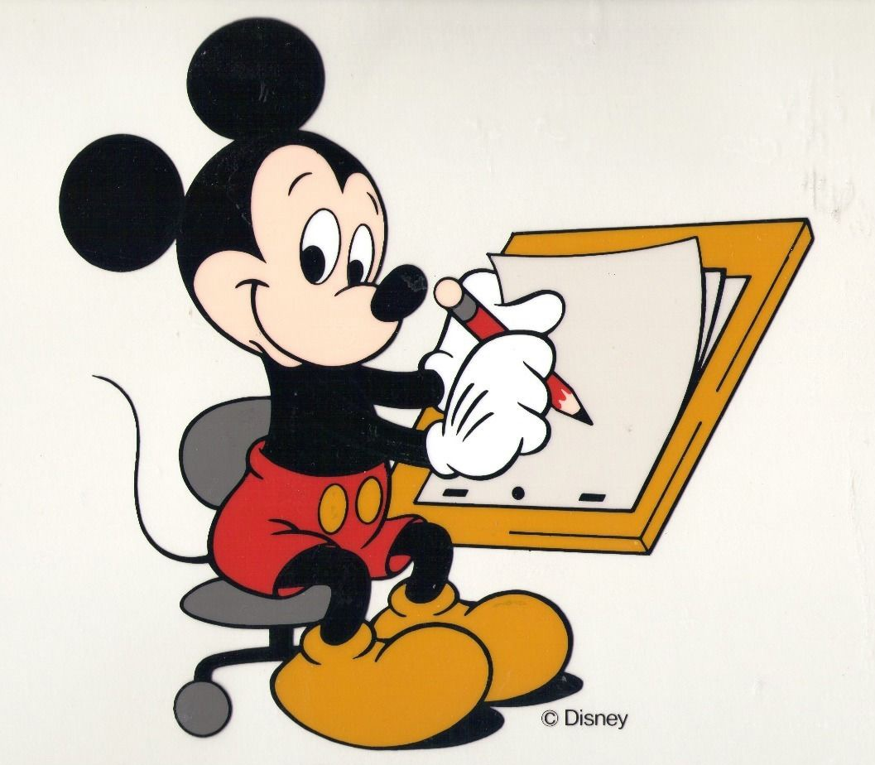
Cel animation and traditional 2D processes
Drawn Cel Animation

Slide 10
Cel animation and traditional 2D processes
Drawn Cel Animation
The Kingdom of Dreams and Madness (Yume to kyōki no Ohkoku, Mami Sunada, 2013)

Slide 11
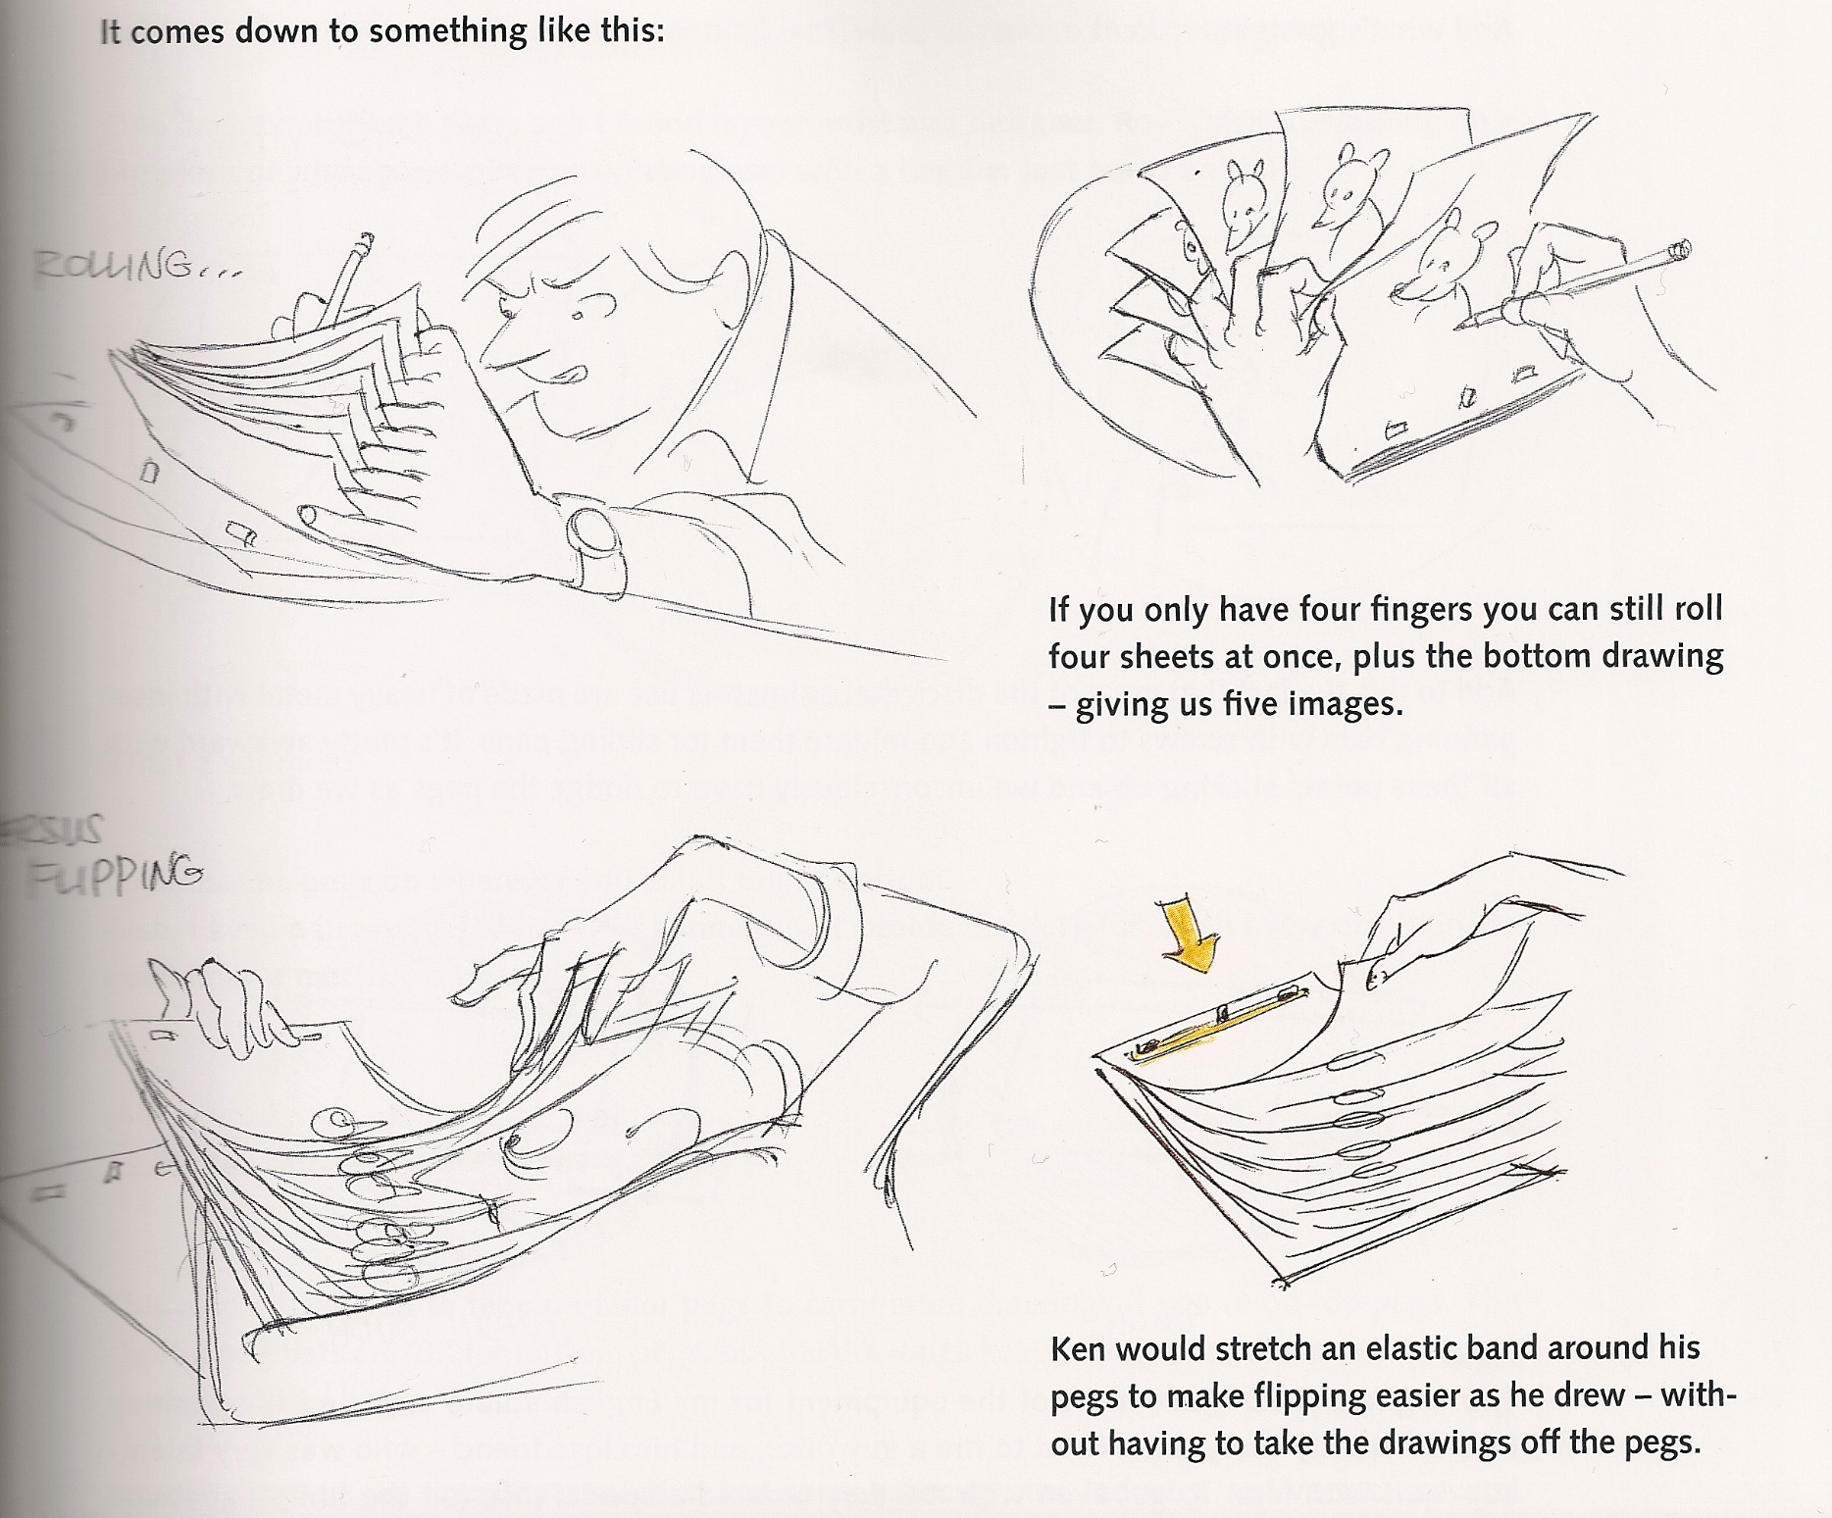
Cel animation and traditional 2D processes
Drawn Cel Animation

Slide 12
Cel animation and traditional 2D processes
Rotoscoping
Patented by the Fleischer Brothers in 1917.
A device that allowed the rear projection of a live-action film frame-by-frame on to a translucent surface set into a drawing board. An animator could simply trace each live-action image on to a piece of paper, advance the film by another frame and repeat the process. By these means, the live-action images became a guide to detailed and lifelike animation.
The instrument has been superseded by more efficient digital technology.

Slide 13
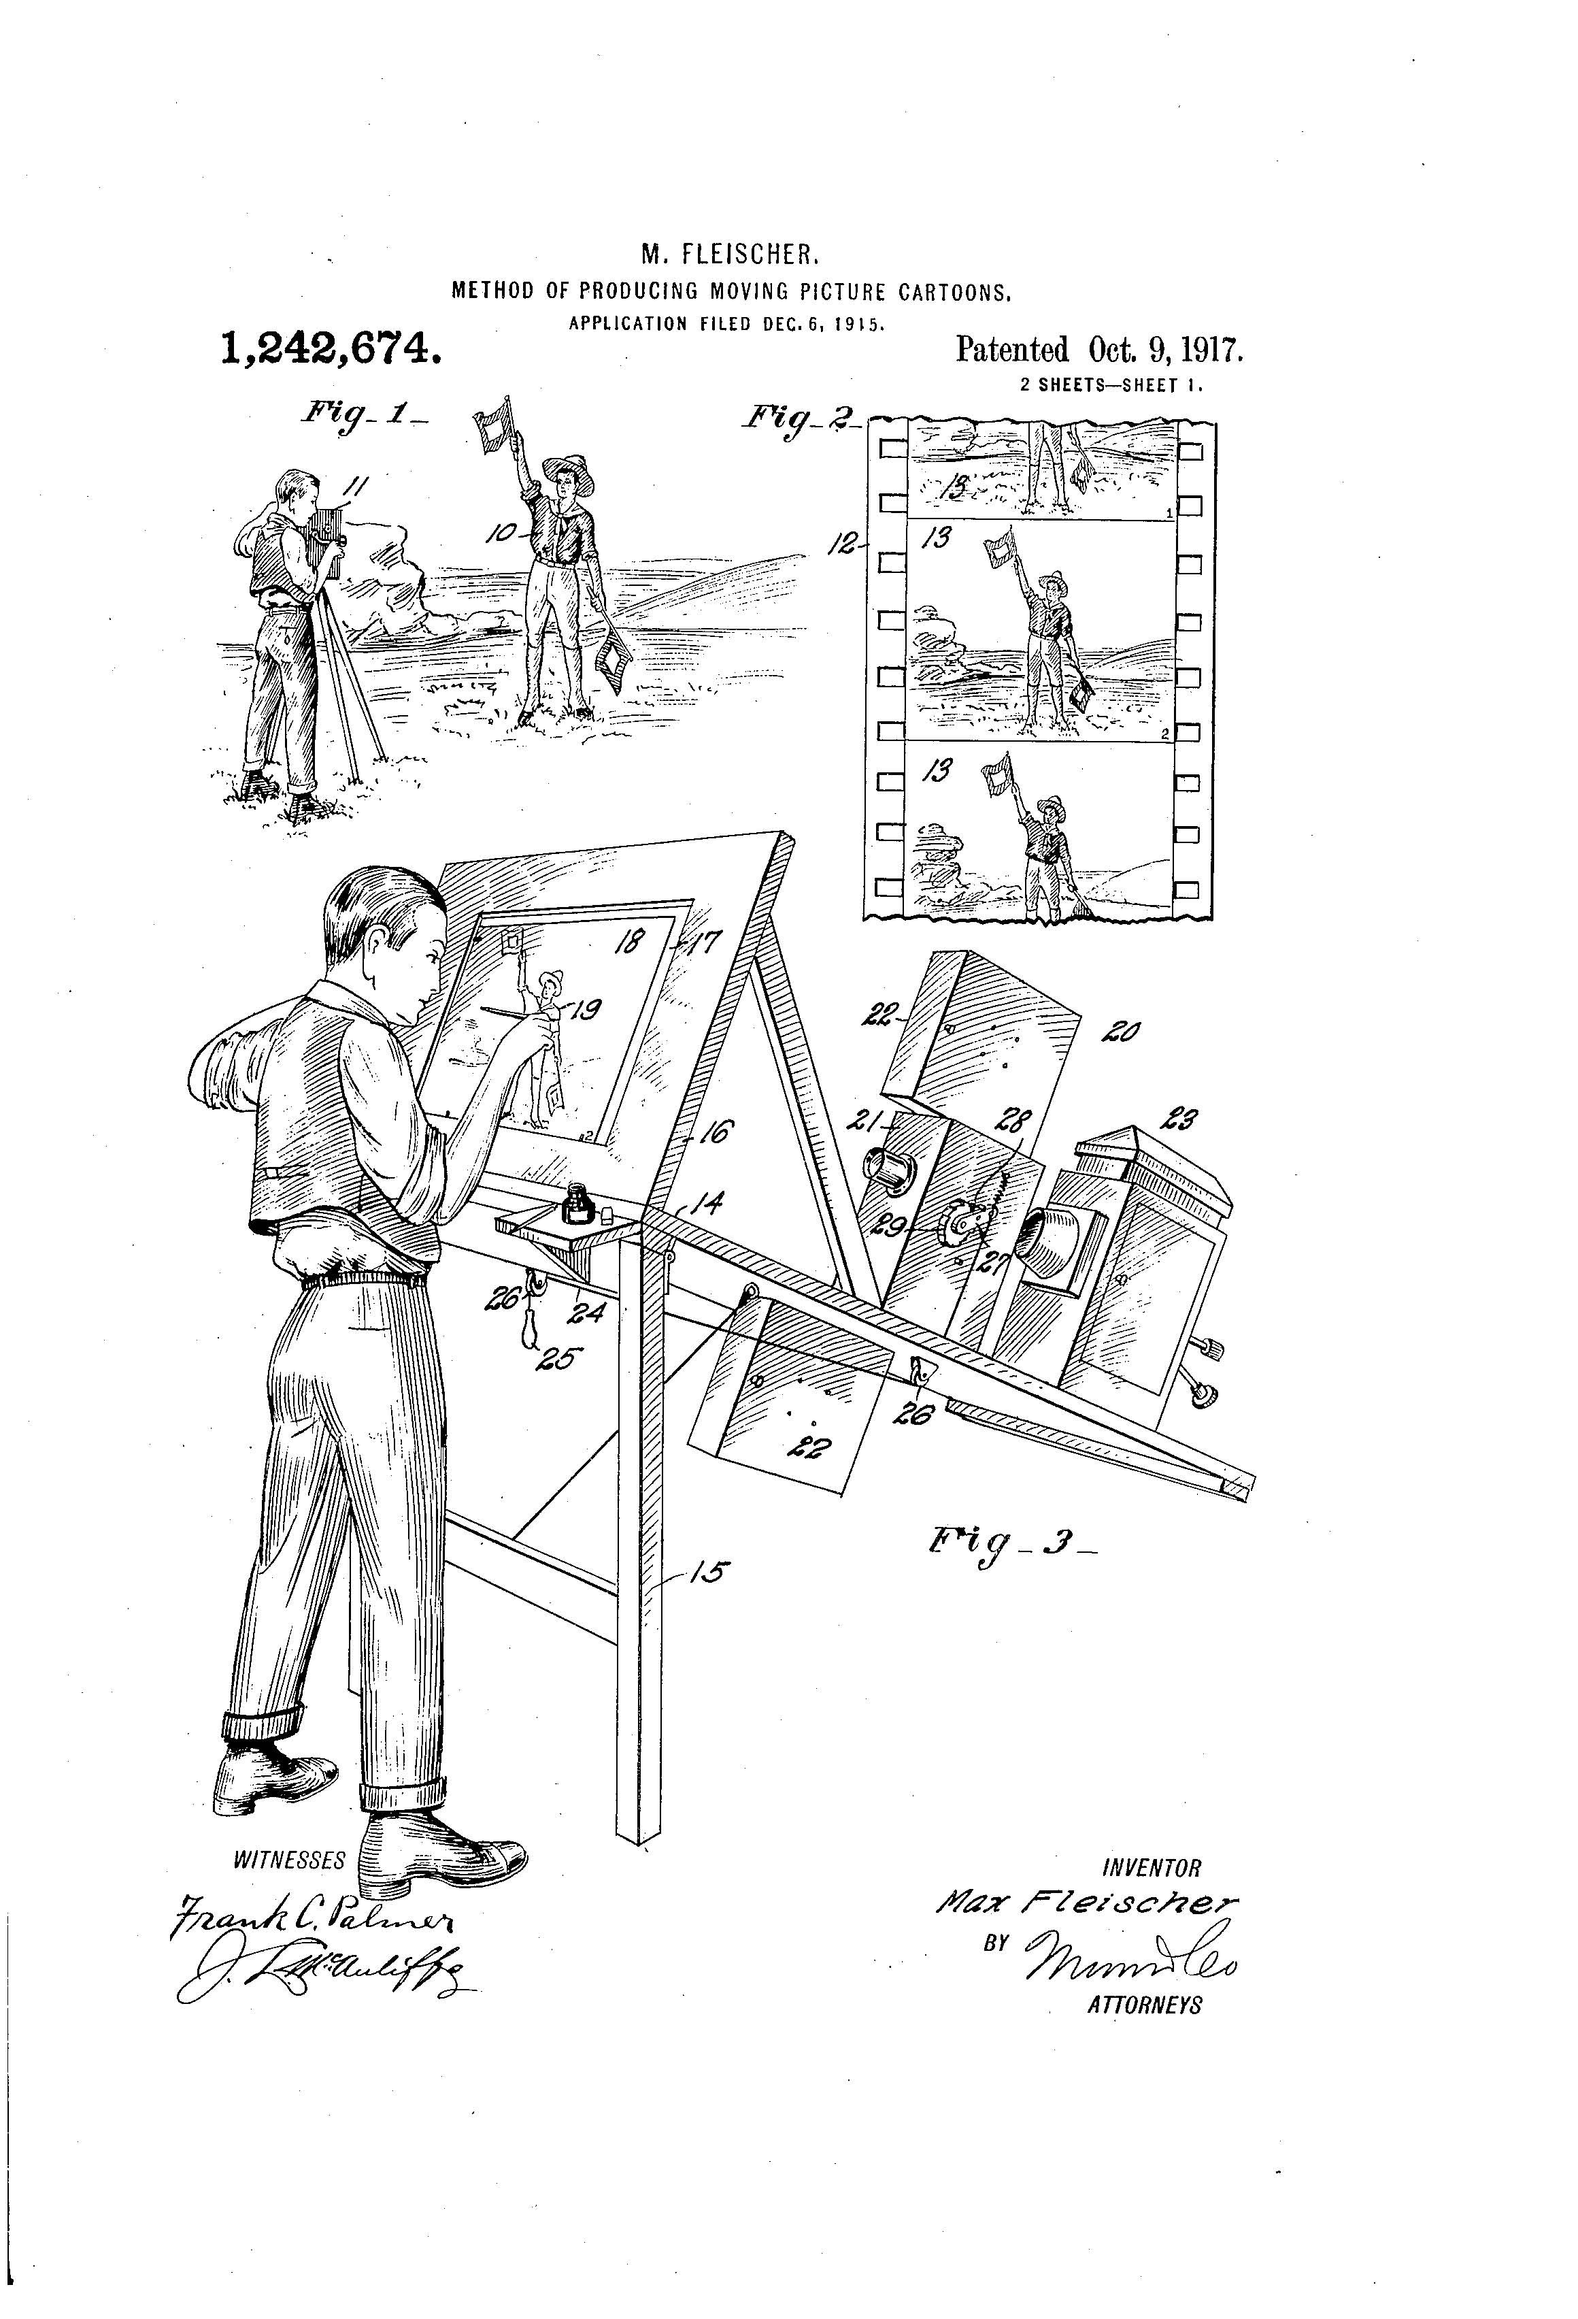
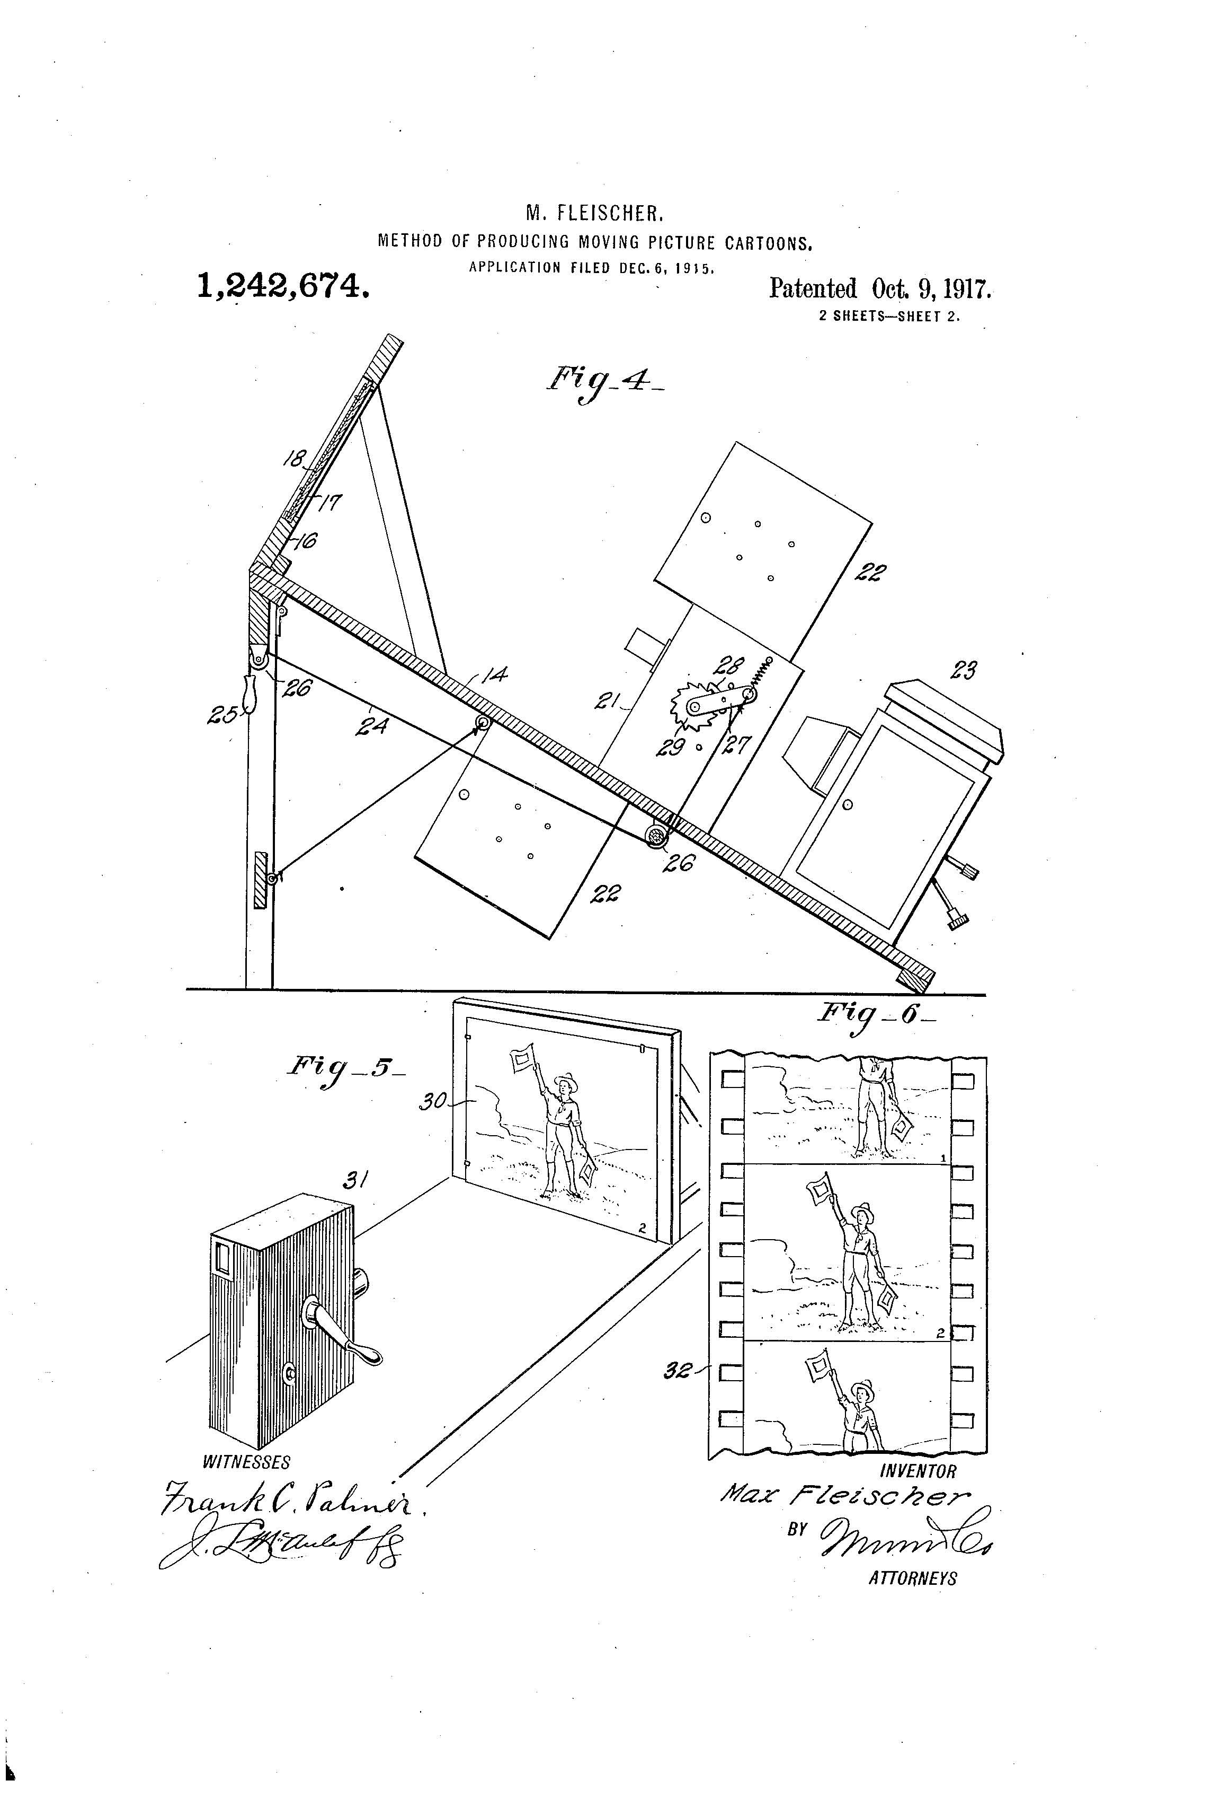
Cel animation and traditional 2D processes
Rotoscoping

Slide 14
Cel animation and traditional 2D processes
Rotoscoping
Snow-White (Dave Fleischer, 1933)

Slide 15
Cel animation and traditional 2D processes
Rotoscoping
Gulliver’s Travels (Max and Dave Fleischer, 1939)

Slide 16
Cel animation and traditional 2D processes
Rotoscoping
The Goddess of Spring (Wilfred Jackson, 1934)

Slide 17
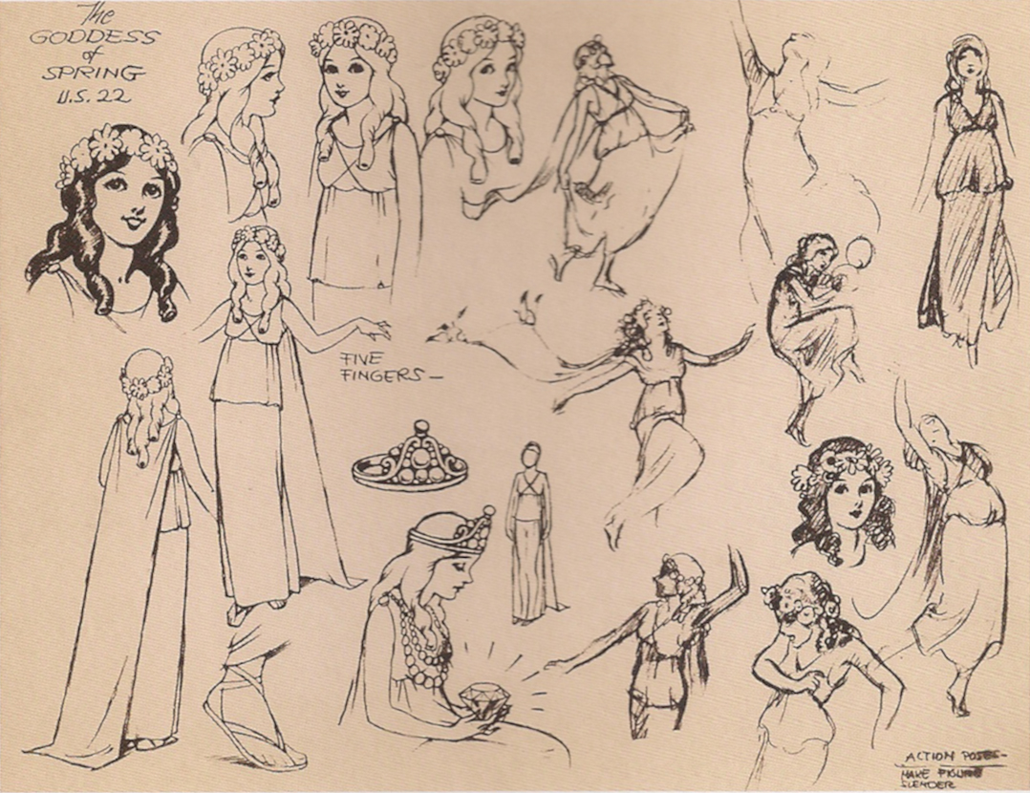
Cel animation and traditional 2D processes
Rotoscoping
The Goddess of Spring (Wilfred Jackson, 1934)

Slide 18
Cel animation and traditional 2D processes
Rotoscoping

Slide 19
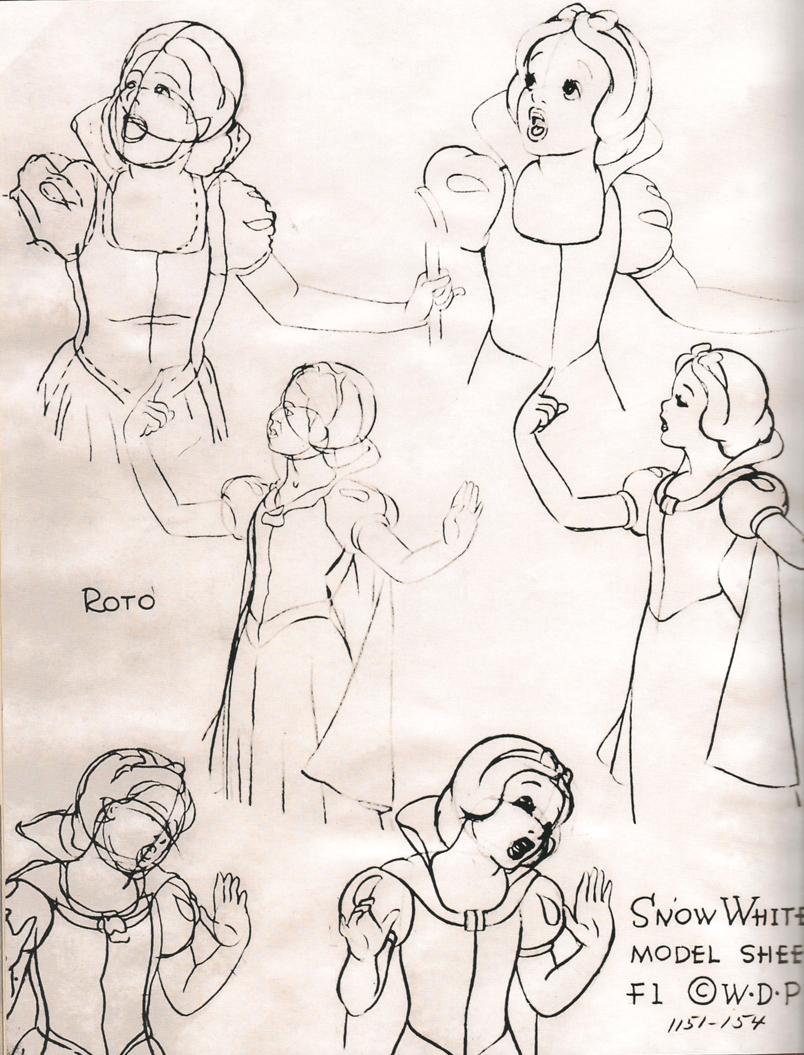
Cel animation and traditional 2D processes
Rotoscoping

Slide 20
Cel animation and traditional 2D processes
Rotoscoping
Snow White and the Seven Dwarfs (David Hand, 1937)

Slide 21
Cel animation and traditional 2D processes
2D computer-generated images
Two-dimensional computer-generated animation is created, produced and edited exclusively using digital technology.
Not to be confused with digitalized drawn animation.
Example: Adobe Flash

Slide 22
Cel animation and traditional 2D processes
2D computer-generated images
“The World of Stainboy” (Tim Burton, 2000)

Slide 23
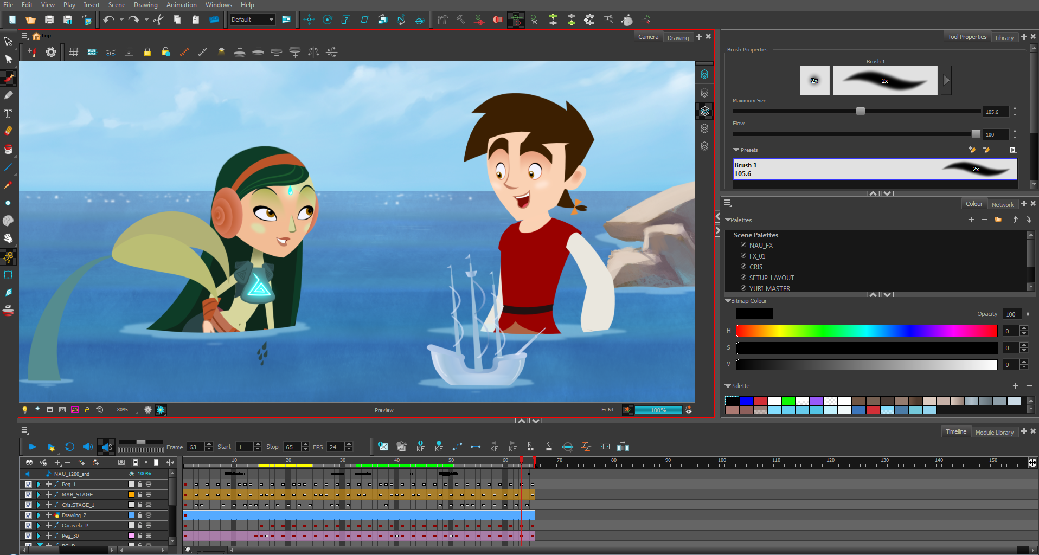
Cel animation and traditional 2D processes
2D computer-generated images

Slide 24
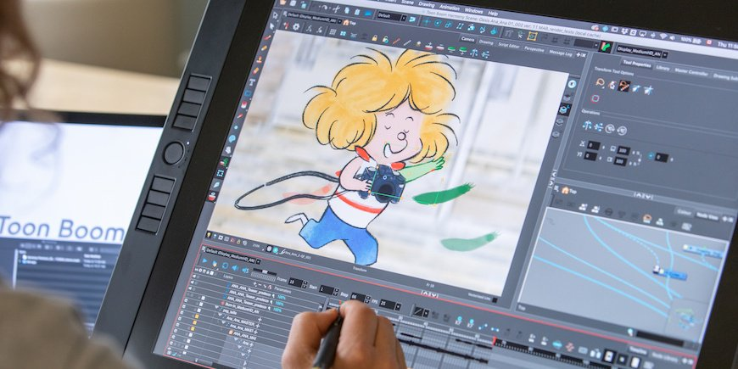
Cel animation and traditional 2D processes
2D computer-generated images

Slide 25
Animation Styles and Techniques
Basic Techniques of Animation
Stop-motion animation
2D stop-motion (sand, oil-paint, paper cut-outs)
3D stop-motion (puppets, claymation, object animation)

Slide 26
Stop-Motion Animation
2D Stop-Motion
There are several ways of working two-dimensionally in stop motion, each essentially applying the principle of incremental movement effected and recorded by the animator, creating a frame of film.
Some media which have been extensively used by animators: sand, oil-paint, paper cut-outs.

Slide 27
Stop-Motion Animation
2D Stop-Motion
Sand and oil-paint are useful to animate with: dry sand can be worked endlessly and oil paint remains wet under lights that become increasingly hot, allowing the animator to draw or paint.
Shooting each movement from above using a suspended camera attached to a secured metal framework –known as “rig”- makes for a rewarding working method.
Those materials are particularly apt to create animations of metamorphosis.

Slide 28
Stop-Motion Animation
2D Stop-Motion
Carmen Habanera (Aleksandra Korejwo, 1995)

Slide 29
Stop-Motion Animation
2D Stop-Motion
Aleksandr Petrov

Slide 30
Stop-Motion Animation
2D Stop-Motion
Aleksandr Petrov

Slide 31
Stop-Motion Animation
2D Stop-Motion
The Old Man and the Sea (Aleksandr Petrov, 1999)

Slide 32
Suggested readings
Marco Bellano, “La mappa della realtà. Il rotoscopio e l’estetica del realismo nel cinema d’animazione”.
Andrew Selby, ”Production”, in Id., Animation, Laurence King, London, 2013, pp. 128-158.

