Slide 1
History of Animation
Second Cycle Degree in Theatre, Film, Television and Media Studies
Academic Year 2019-2020
Lesson 6

Slide 2
Stop-Motion Animation
2D Stop-Motion
The process of paper cut-out animation is a technique best employed where only simple or limited incremental movements are required.
To create a character using such a technique the animator must create a series of heads, torsos and limbs that can be placed, removed and replaced by others incrementally to create a desired move. The greater the number of interchangeable parts, the more sophisticated the movements can become.

Slide 3
Stop-Motion Animation
2D Stop-Motion
Pulcinella (Giulio Gianini, Emanuele Luzzati, 1973)

Slide 4
Stop-Motion Animation
3D Stop-Motion
3D stop-motion enables three-dimensional forms to be created, manipulated and captured.
Sets, props and characters are imaginatively constructed from a variety of materials to make full use of the spatial possibilities of this kind of format.
Stop motion as a technique encompasses areas such as puppet animation, clay animation (also known as “claymation”), model or object animation.

Slide 5
Stop-Motion Animation
3D Stop-Motion
A Midsummer Night’s Dream (Sen noci svatojánské, Jiří Trnka, 1959).

Slide 6
Stop-Motion Animation
3D Stop-Motion
Allegro non troppo (Bruno Bozzetto, 1977).

Slide 7
Stop-Motion Animation
3D Stop-Motion
Interstellar Movie Trailer (CBL Animation, 2014).

Slide 8
Animation Styles and Techniques
Basic Techniques of Animation
3D computer-generated images

Slide 9
3D Computer-Generated Images
3D computer-generated animation merges stop-motion animation and frame-by-frame animation by allowing animators to create and manipulate worlds in which characters and environments are constructed as mathematically-rendered data.

Slide 10
3D Computer-Generated Images
Like stop-motion animation, three-dimensional computer-generated imagery is predominantly created in an artificial state, and every aspect of what is seen on screen needs to be constructed. This primarily includes characters, props and sets, but also involves how these elements are painted, lit and positioned, and indeed, how they move.

Slide 11
3D Computer-Generated Images
Animators working in this field, therefore, need to have not only complete knowledge of the programs they are using to create the production but also a significant awareness of cinematography, movement and narrative techniques to bring ideas to life.

Slide 12
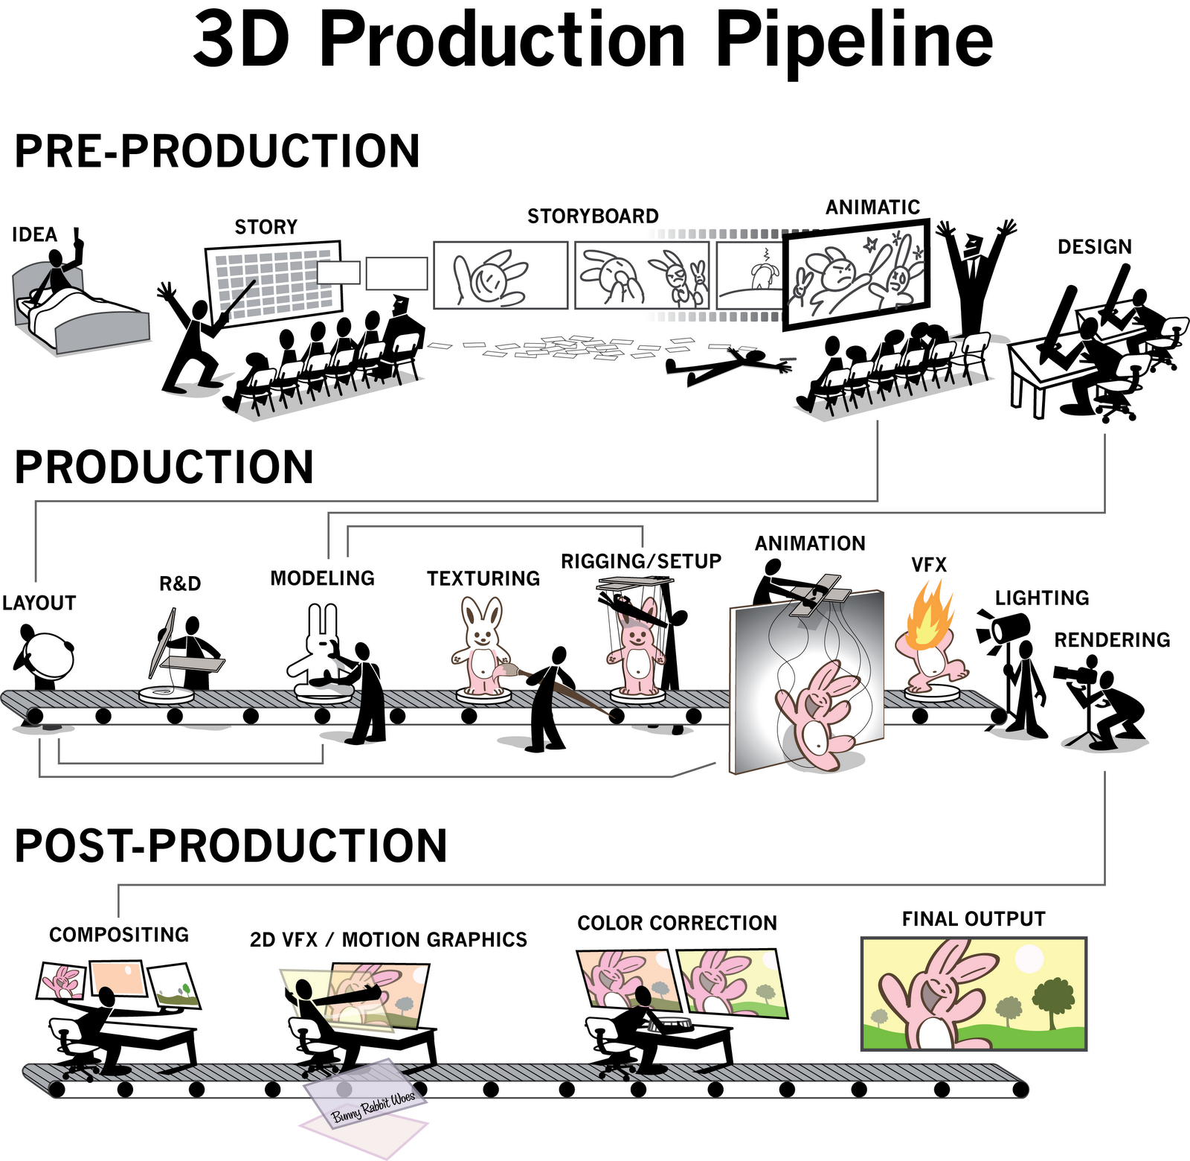
3D Computer-Generated Images

Slide 13
3D Computer-Generated Images
The Black Hole (Gary Nelson, 1979)

Slide 14
3D Computer-Generated Images
Young Sherlock Holmes (Barry Levinson, 1985)

Slide 15
Animation Styles and Techniques
Basic Techniques of Animation
Unorthodox animation
Pixilation
Auteur or artistic processes
Machinema
Augmented reality

Slide 16
Unorthodox Animation
Pixilation
Food (Jídlo, Jan Švankmajer, 1993)

Slide 17
Unorthodox Animation
Auteur or Artistic Processes
Night on Bald Mountain (Une nuit sur le Mont Chauve, Alexander Alexeïeff, Claire Parker, 1933).

Slide 18
Unorthodox Animation
Auteur or Artistic Processes
Here and the Great Elsewhere - Michèle Lemieux and the Secret of Pinscreen (Making of)

Slide 19
Unorthodox Animation
Machinema

Slide 20
Unorthodox Animation
Augmented Reality

Slide 21
Suggested readings
Andrew Selby, ”Production”, in Id., Animation, Laurence King, London, 2013, pp. 128-158.

