Slide 1
History of Animation
Second Cycle Degree in Theatre, Film, Television and Media Studies
Academic Year 2019-2020
Lesson 8

Slide 2
The Beginning of Animated Cinema
«Animation has bred a myth about its own origins that goes, according to the film historian’s lore, like this: Animation was virtually unknown until 1907. It was then that L’Hôtel hanté opened in Paris. The public response to this first animated film was so strong that all the French producers racked their brains trying to figure out the tricks that made objects move by themselves. After considerable difficulty, the secret was discovered and the history of cartoons could begin».
Donal Crafton, Before Mickey. The Animated Film 1898-1928, The University of Chicago Press, Chicago, 1993, p. 13.

Slide 3
The Beginning of Animated Cinema
The Haunted Hotel; or, The Strange Adventures of a Traveler
(Vitagraph of America, James Stuart Blackton, 1907)

Slide 4
The Beginning of Animated Cinema
Why was The Haunted Hotel a success?
The theme was not new. It was quite a common plot for stage acts and early films.
Donald Crafton lists at least seven films with a similar story among 1896 and 1900.
Some of them were by Georges Méliès, pioneer and master of “trick” films.

Slide 5
The Beginning of Animated Cinema
L’Auberge ensorcelée (Georges Méliès, 1897)

Slide 6
The Beginning of Animated Cinema
L’Auberge du bon repos (Georges Méliès, 1903)

Slide 7
The Beginning of Animated Cinema
… After Blackton’s film, the theme was even revived.
Its most relevant iteration was created by Spaniard Segundo de Chomón (1871-1929).
Later a director and a professional of special effects for Pathé trickfilms and for Itala Film in Turin (since 1912: he authored the special effects of Giovanni Pastrone’s Cabiria, 1914), Chomón tried to improve Blackton’s idea with El hotel eléctrico (1908).

Slide 8
The Beginning of Animated Cinema
El hotel eléctrico (Segundo de Chomón, 1908)

Slide 9
The Beginning of Animated Cinema
James Stuart Blackton
The Haunted Hotel was not even Blackton’s first animation.
Born in Sheffield (UK) in 1875, Blackton moved to the USA at the age of ten. He interviewed Thomas Alva Edison as a teenage journalist; as he confessed to an aptitude for drawing, he was asked to draw Edison’s portrait while a camera filmed the scene. The episode started Blackton’s career in cinema.
Blackton had direct experience with “chalk talks” or “lightning sketches”, a quite common kind of vaudeville act. He translated it into film, maybe realizing that drawings could be animated by single-framing techniques, just like objects.

Slide 10
The Beginning of Animated Cinema
James Stuart Blackton
The enchanted drawing (James Stuart Blackton, 1900)

Slide 11
The Beginning of Animated Cinema
James Stuart Blackton
Humorous Phases of Funny Faces (James Stuart Blackton, 1906)

Slide 12
The Beginning of Animated Cinema
James Stuart Blackton
Lighting Sketch (James Stuart Blackton, 1907)

Slide 13
The Beginning of Animated Cinema
James Stuart Blackton
The Haunted Hotel was such a sensational film partly because of some clever and hyperbolic advertising, but more importantly because some of its scenes displayed stand-alone object animation. Sometimes, animation stopped being a mere “trick” and became an independent expressive device: it was no more just a funny “disturbance” to live-action, but something of equal importance.
«The Vitagraph film The Haunted Hotel was a sensation and rightly so. Abandoning all the tricks of the movies, they had contrived entirely new and totally unexpected combinations of techniques. As we watched, the sharpest, most attentive eye was unable to detect any wires. One had to be informed of the process».
Victorin Jasset, 1911, quoted in Crafton, op. cit., p. 16.

Slide 14
The Beginning of Animated Cinema
As argued by Giannalberto Bendazzi (who follows C. W. Ceram [Kurt Wilhelm Marek]), a history of cinema animation should start when the animation process is no more a mere series of techniques, but it becomes a foundation for creativity and it gives rise to a new productive stage.
The first requirement was surely met by The Haunted Hotel, and even earlier films complied with it (Matches: An Appeal, by Arthur Melbourne Cooper, 1899).

Slide 15
The Beginning of Animated Cinema
Matches: An Appeal (Arthur Melbourne Cooper, 1899)

Slide 16
The Beginning of Animated Cinema
As to find evidence of the second requirement (rise of a new productive stage), however, it is necessary to wait until 1908: the year when, according to legend, a filmmaker finally discovered the trick behind Blackton’s The Haunted Hotel.
That man was the eclectic artist Émile Courtet, also known as Émile Cohl (1857-1938), who in 1907, at 50, joined Gaumont to begin his career in cinema.

Slide 17
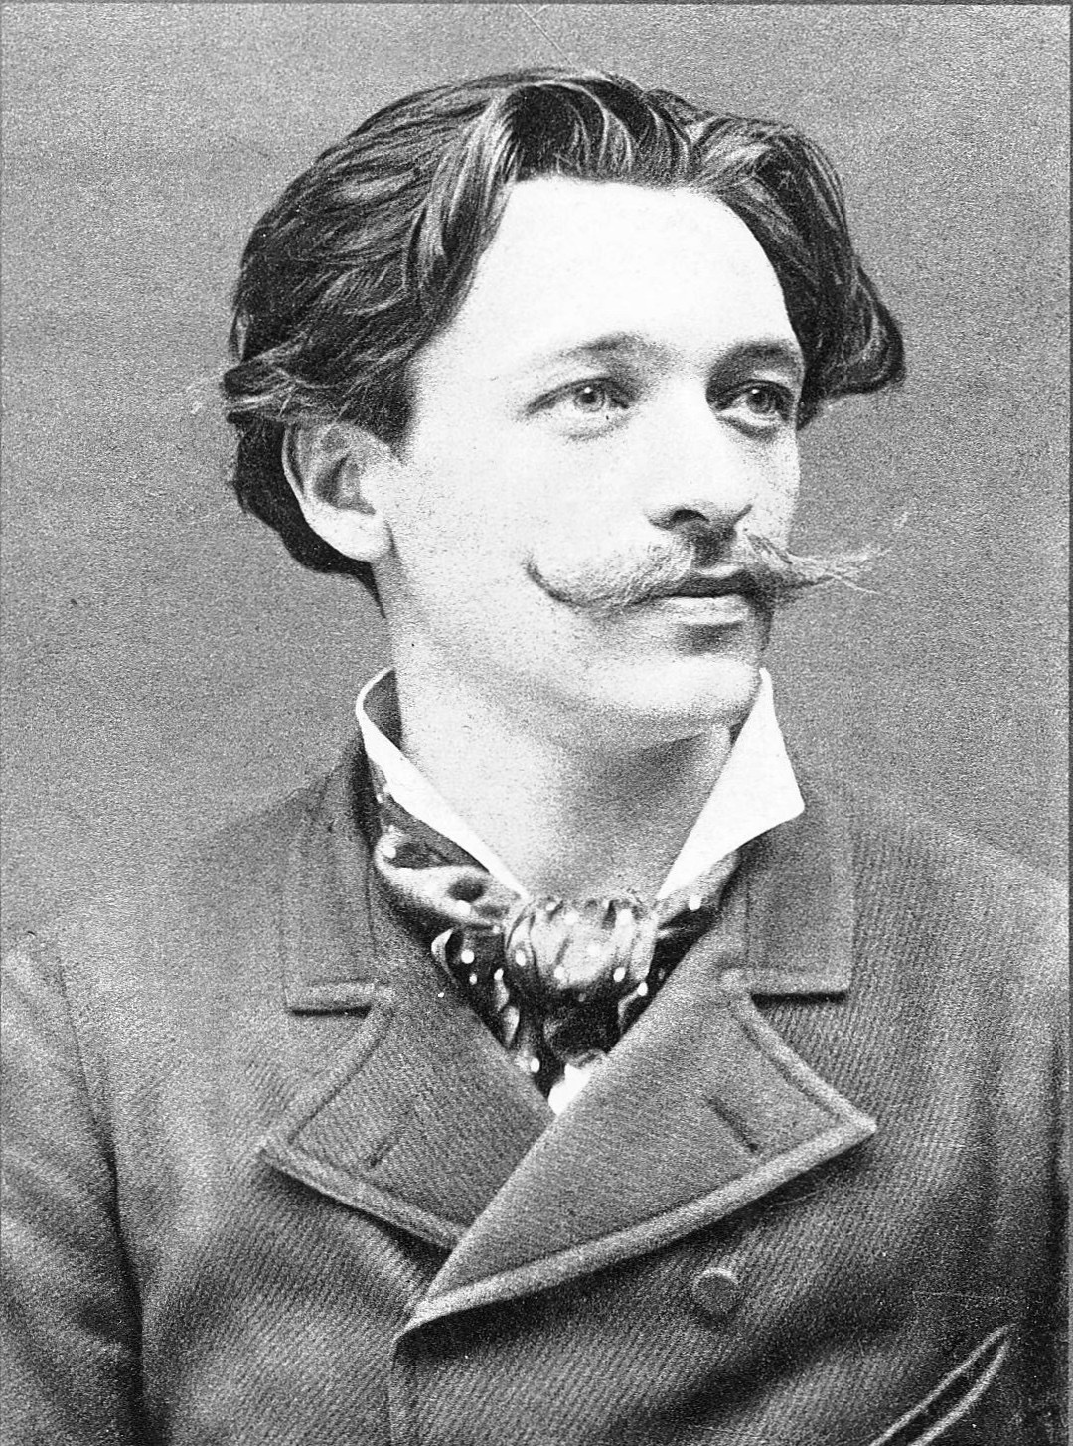
The Beginning of Animated Cinema
Émile Cohl

Slide 18
The Beginning of Animated Cinema
Émile Cohl
Èmile Cohl
Born in 1857 from a rubber salesman and a linen seamstress.
1867: Cohl discovers the works of André Gill, the best-known caricaturist of the day.
1878: he changes his surname from Courtet to Cohl and becomes assistant to André Gill. He learns a style of caricature whose trademark was a large head atop a small puppet-like body.
1879: editor of L’Hydropathe, satiric journal of the artistic circle Les Hydropathes, created in 1878 by Èmile Goudeau.
1882: the Hydropathes are disbanded, Cohl joins the Incoherents, founded by Jules Lévy.
1883: editor in chief at La Nouvelle Lune.
1885: death of André Gill.
1888: end of the Incoherents.

Slide 19
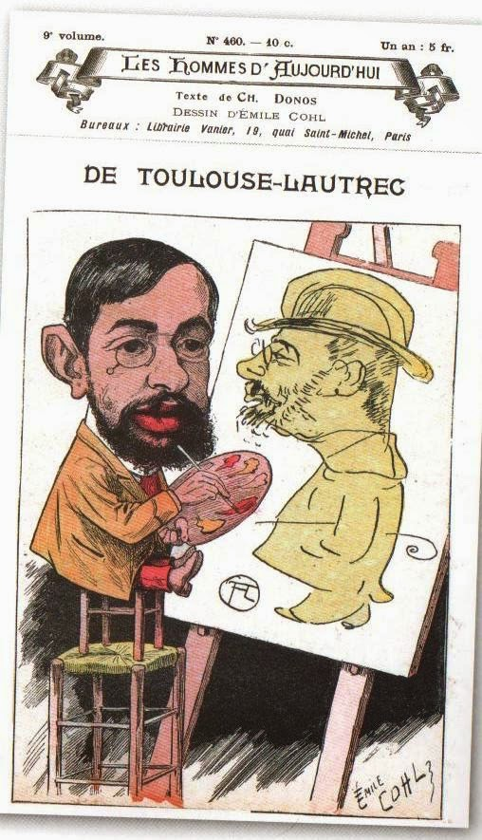
The Beginning of Animated Cinema
Émile Cohl
Les hommes d’aujourd’hui,
no. 460, 1897

Slide 20
The Beginning of Animated Cinema
Émile Cohl
«Cohl was like a chameleon of many colours. He worked as a caricaturist for several magazines, such as Les hommes d’aujourd’hui, to which he supplied caricatures of Verlaine and Toulouse-Lautrec. (In 1894, that same magazine confirmed Cohl’s vast notoriety by dedicating to him a cover caricature signed by Uzès). In the 1880s, Cohl turned successfully to photography. His light comedies were performed in the theatres of the boulevards and, last but not least of his numerous hobbies, he was interested in puzzles and magic tricks».
Giannalberto Bendazzi, Cartoons. One Hundred Years of Cinema Animation, John Libbey, London, 194, p. 9.

Slide 21
The Beginning of Animated Cinema
Émile Cohl
«During the winter [of 1908], Cohl had been walking in Monmartre when he noticed a poster for a film that apparently stole an idea from one of his comic strips. That this was a common practice at the time did little to assuage his temper, and he stalked over to the Gaumont studios to demand compensation. There he was met by Louis Feuillade, the “artistic director” of the company and the future director of Fantomas. Feuillade, no doubt secretly amused by the old man’s wrath, offered him a job writing scenarios. […] Cohl took the offer seriously and wrote several féeries. […] While he was writing scenarios, Cohl was also working on the Fantasmagorie drawings. The cartoon was completed in July and released in August, and was an international success. Cohl’s subsequent work pleased Léon Gaumont, and in January 1909 […] he was made a full-time salaried director. By the time he left the studio in 1910, Cohl would complete 77 films».
Donald Crafton, Before Mickey. The Animated Film 1898-1928, The Chicago University Press, Chicago, 1993, pp. 65-66.

Slide 22
The Beginning of Animated Cinema
Émile Cohl
Fantasmagorie (Émile Cohl, 1908)

Slide 23
The Beginning of Animated Cinema
Émile Cohl
Does Fantasmagorie reference any “genre” of early cinema? Is it just a féerie?
At the beginning it foregrounds the author, just like in Blackton’s lighting sketches.
But then, the author “disappears”.
The attraction is no more the display of a magician’s “trick”. Animation is no more a matter of making things appear or disappear, or of moving objects around. The motion itself, instead, takes center stage, by causing seamless metamorphoses. The lines are simple, the characters are abstract and naive; but that does not matter, as Cohl is more interested in motion than in what is moving.
Moreover: with Cohl, animation starts to define its own visual grammar.

Slide 24
The Beginning of Animated Cinema
Émile Cohl
Clair de lune espagnol (Émile Cohl, 1909)

Slide 25
The Beginning of Animated Cinema
Émile Cohl
Le retapeur de cervelles (Émile Cohl, 1910)

Slide 26
The Beginning of Animated Cinema
Émile Cohl
Le cheveu délateur (Émile Cohl, 1911)

Slide 27
The Beginning of Animated Cinema
Émile Cohl
In 1910, after an unsuccessful request for a raise, Cohl left Gaumont for Pathé. But he was pressured to do live-action and trick films. Only one of his eigth Pathé films survives – Le Retapeur de cervelles.
Through his friend and technical mentor Étienne Arnaud, Cohl was able to find a new job at the Eclair Company Studio in Fort Lee, New Jersey, USA.
From 1912 to 1914 Cohl worked on the series “The Newlyweds”, based on a newspaper comic strip by George McManus.
It was in an advertisement for “The Newlyweds” that the phrase “animated cartoons” was first used to describe this new genre.
A fire destroyed all of Cohl’s American works in 1914. A fire, indirectly, marked also the end of Cohl’s existence: in 1937, poor and forgotten, he knocked over an oil lamp. He died of pneumonia in a charity hospital, on January 20, 1938.

Slide 28
The Beginning of Animated Cinema
Émile Cohl
Cohl “created” animation also because with his work, for the first time, he defined what is an animator.
«He became the first of many similar individuals who would eventually populate animation studios everywhere. Among the distinctive features of this personality profile are a background in journalism, a compulsion to sketch, “workaholic” tendencies, and a well-developed but idiosyncratic sense of humor. Cohl was the first to bring to the cinema the necessary qualities of intellect, imagination, patience, and the obsessive love of drawing that would mark other great animators».
Crafton, op. cit., p. 60.

Slide 29
The Beginning of Animated Cinema
Émile Cohl

Slide 30
Animation in the USA 1
Cohl’s presence in the USA was probably highly influential for local animators.
Cohl could have been visited by Canadian Raoul Barré during his 1912-13 stay in Fort Lee.
Writing in 1927, Winsor McCay recalled that his first inspiration for “modern cartoon movies” came to him in 1909. Although he did not acknowledge Cohl, the date corresponds to the height of the French filmmaker’s American vogue.

Slide 31
Animation in the USA 1
Winsor McCay
Winsor McCay (1869 or 1871- 1934) was a self-taught artist from Spring Lake, Michigan. He studied only for a few days in a commercial art school when his family moved to Chicago.
He perfectioned his skills by drawing billboard signs in Cincinnati. But his career as a comic artist and illustrator started when he became an artist-reporter for the Cincinnati Commercial Tribune.
Starting from 1903, he worked on multiple comic series for the Evening Telegram and the Herald, in New York.

Slide 32
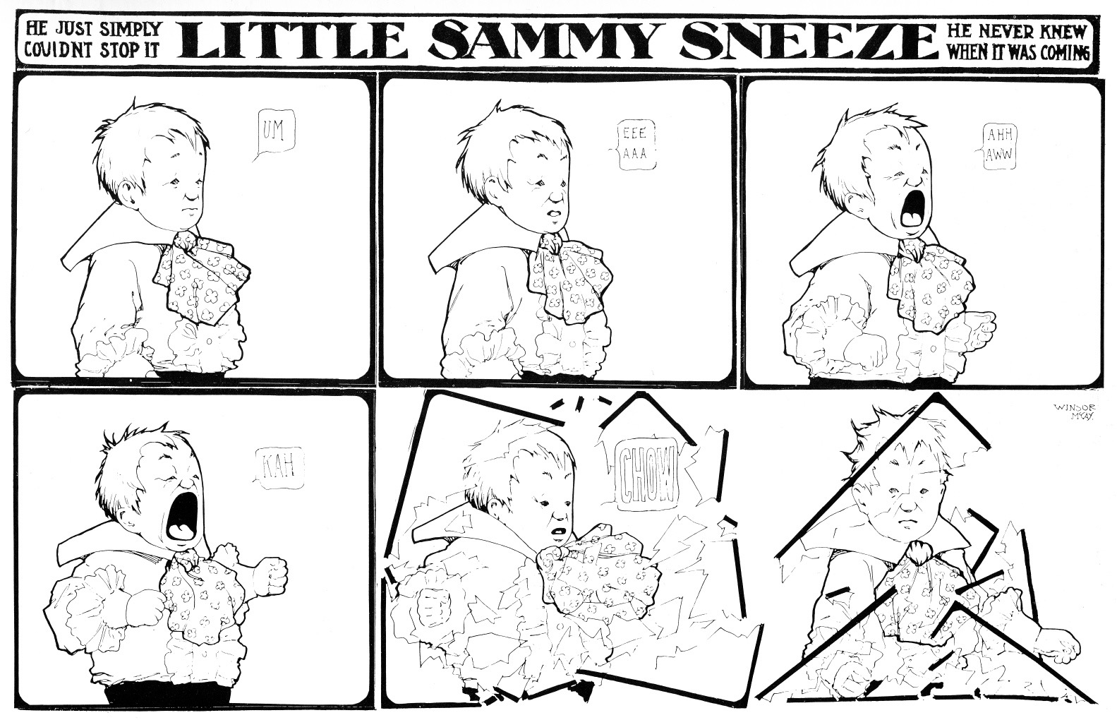
Animation in the USA 1
Winsor McCay

Slide 33
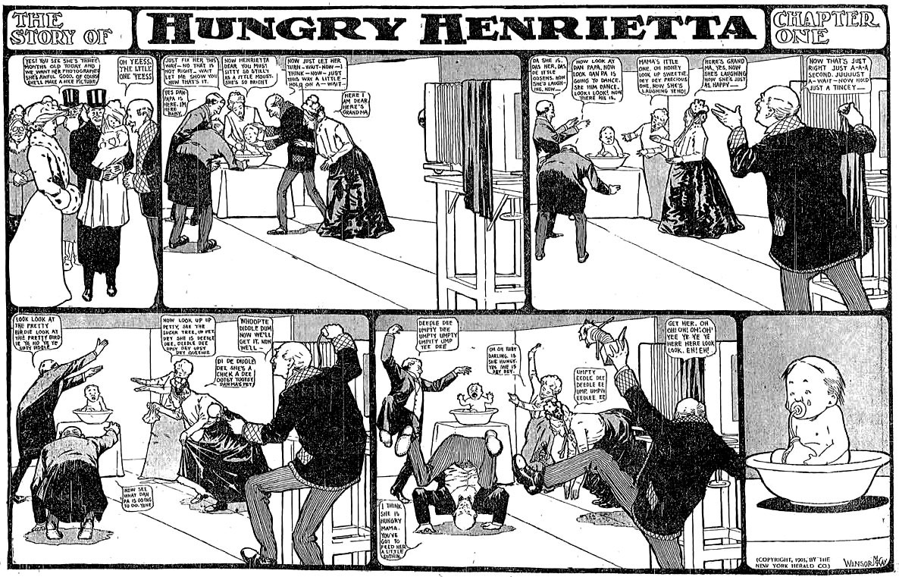
Animation in the USA 1
Winsor McCay

Slide 34
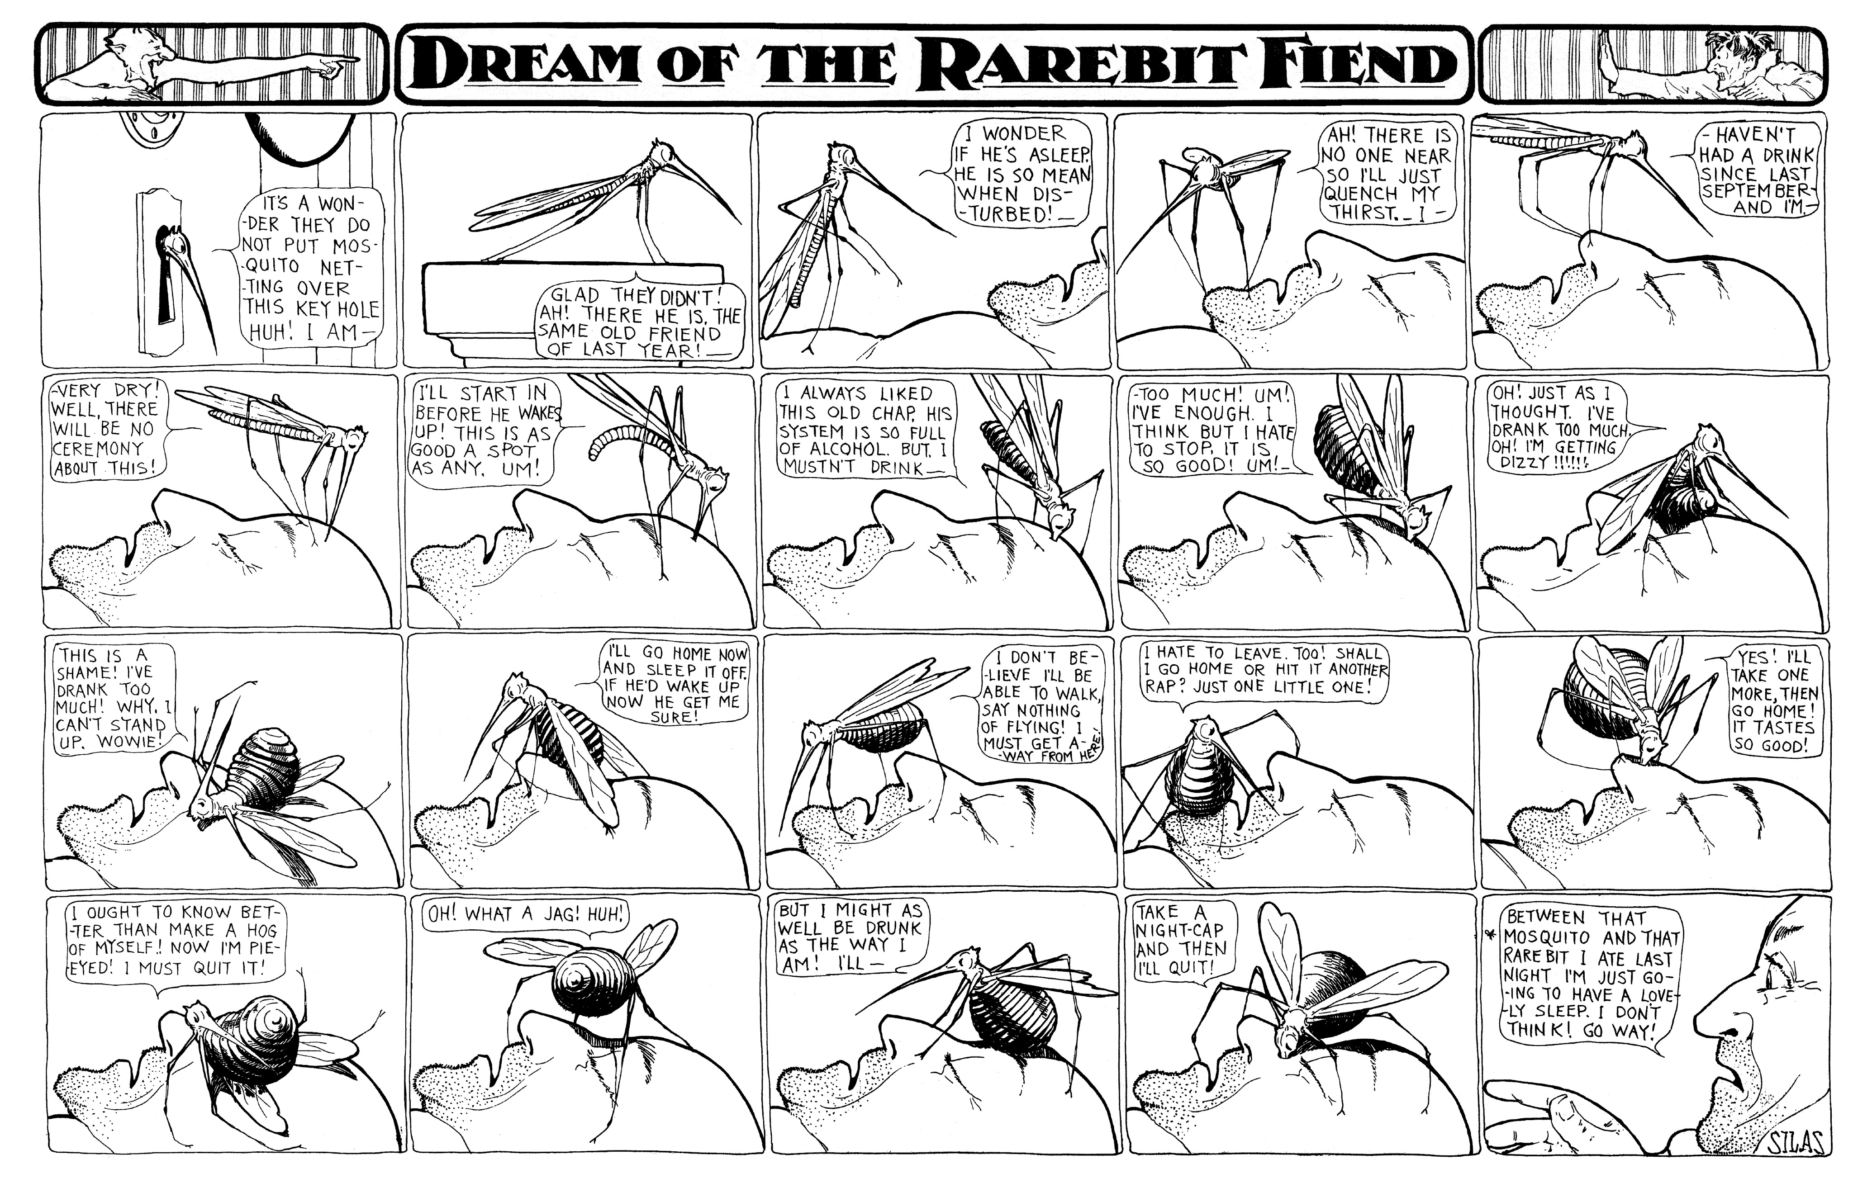
Animation in the USA 1
Winsor McCay

Slide 35
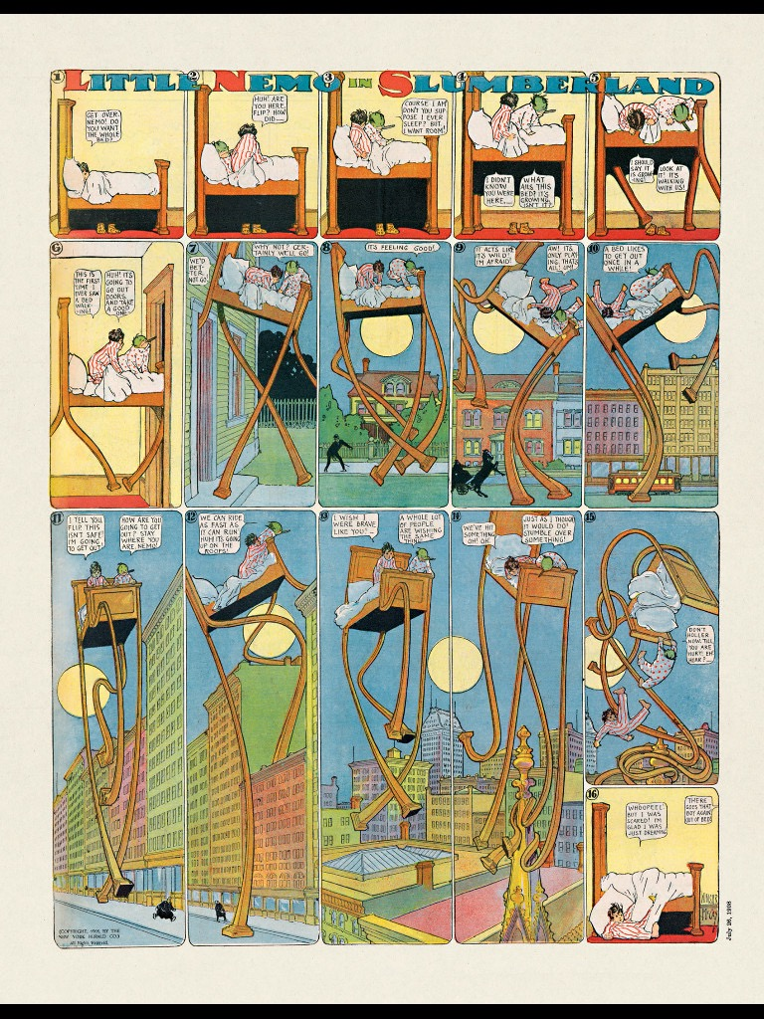
Animation in the USA 1
Winsor McCay

Slide 36
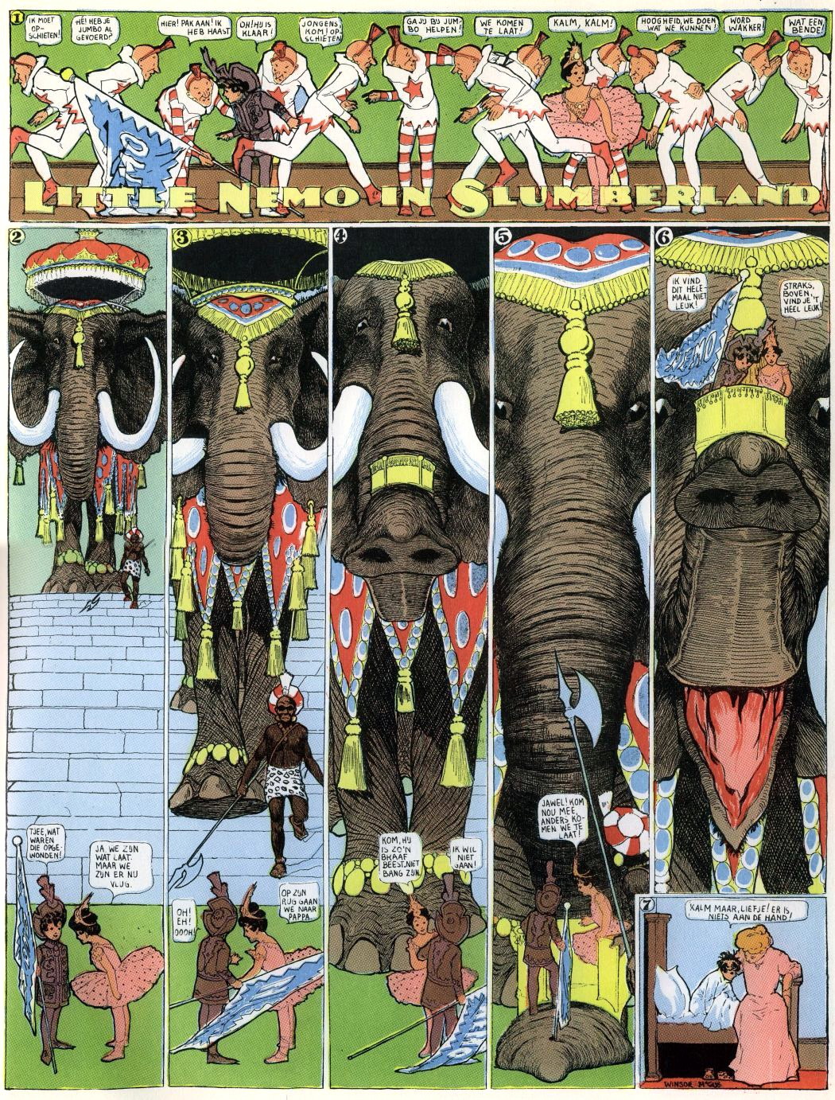
Animation in the USA 1
Winsor McCay

Slide 37
Animation in the USA 1
Winsor McCay
From 1906, McCay started also acting as the main performer of his “Seven Ages” vaudeville act. He also collaborated on a Broadway staging of his Little Nemo in Slumberland (written by Harry B. Smith and scored by Victor Herbert).
In 1906, Edwin S. Porter filmed an adaptation of McCay’s Dream of a Rarebit Fiend.
In 1911, McCay signed with the newspaper company of William Randolph Hearst.
Little Nemo in Slumberland continued until 1914, with the new title In the Land of Wonderful Dreams. But the Herald obtained an injunction, and McCay had to stop drawing his comic.
He reprised it only when he returned to the Herald (1924-1926)

Slide 38
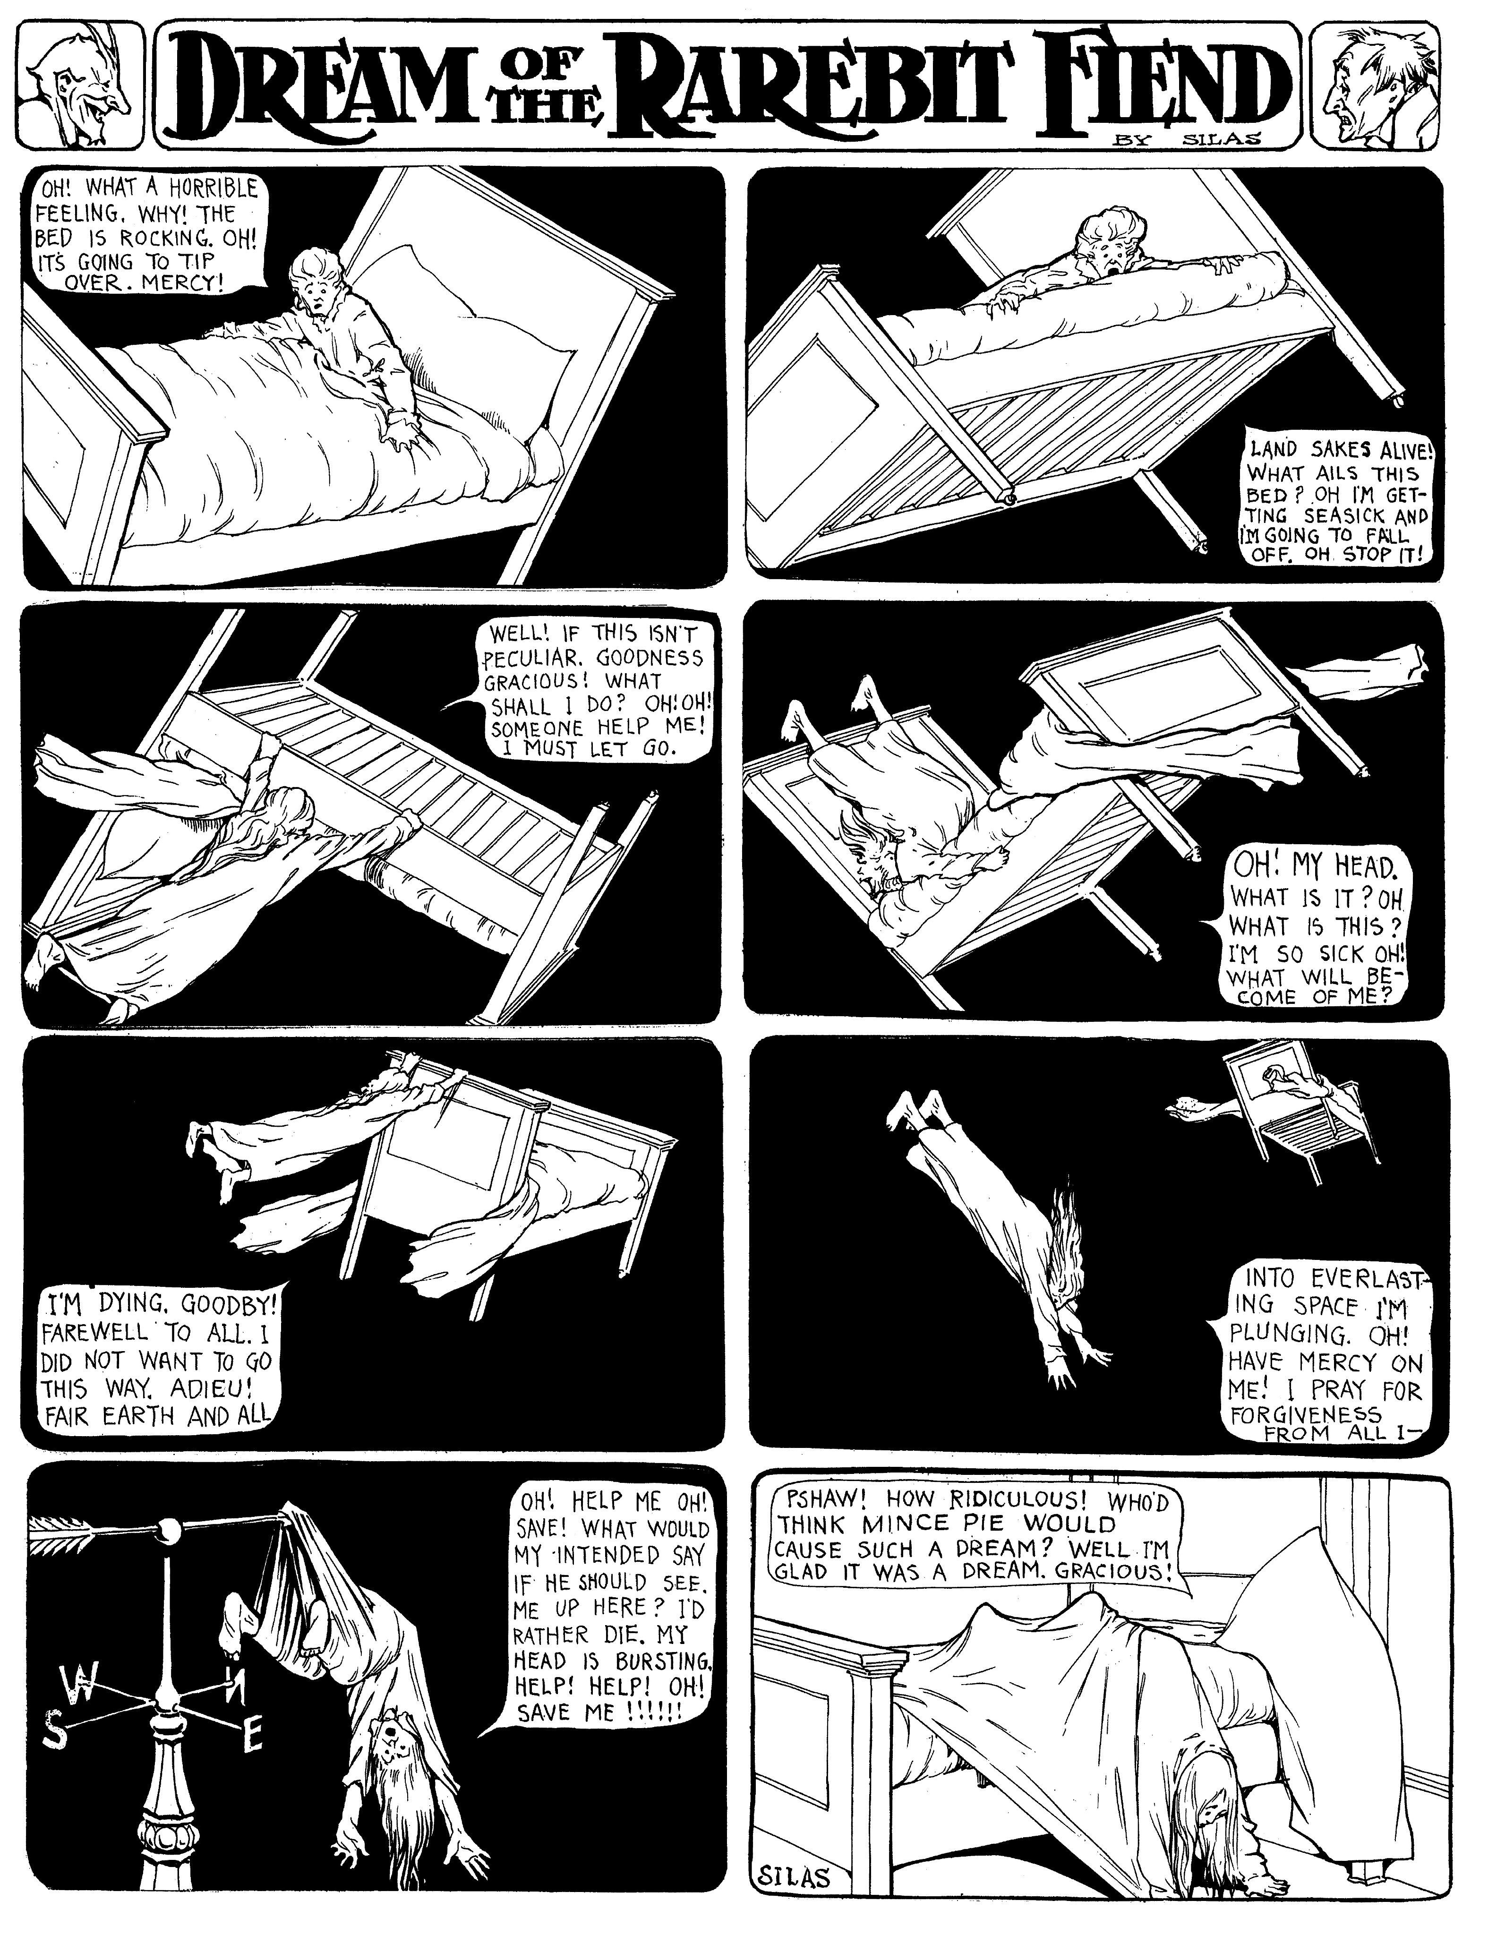
Animation in the USA 1
Winsor McCay

Slide 39
Animation in the USA 1
Winsor McCay
Dream of a Rarebit Fiend (Edwin S. Porter, 1906)

Slide 40
Animation in the USA 1
Winsor McCay
In 1911 McCay released his first film, Little Nemo (1911). The live action parts were shot by James Stuart Blackton.
It was followed by at least three outstanding works:
How a Mosquito Operates (1912); live prolog lost. It was produced and photographed by Vitagraph, but McCay did not allow the studio to distribute the film in the USA, where it would compete with his vaudeville act.
Gertie (1914), made especially for a vaudeville act. Because of the success of this film, Hearst invoked the exclusivity clause in his contract. McCay had to restrict his show to New York; his vaudeville career was finished. He later adapted Gertie for screening in theaters, by adding a live prolog and intertitles.
The Sinking of the Lusitania (1918): an animated propaganda documentary, and the first attempt of McCay at using cels.

Slide 41
Animation in the USA 1
Winsor McCay
Little Nemo (Winsor McCay, 1911)

Slide 42
Animation in the USA 1
Winsor McCay
How a Mosquito Operates (Winsor McCay, 1912)

Slide 43
Animation in the USA 1
Winsor McCay
Gertie (Winsor McCay, 1914)

Slide 44
Animation in the USA 1
Winsor McCay
The Sinking of the Lusitania (Winsor McCay, 1918)

Slide 45
Animation in the USA 1
Winsor McCay
McCay returned to animation during the 20s; however, he was no more competitive. Animation, in the USA, was undergoing a radical change in its production system: the painstaking and time-consuming efforts of single artists were giving place to studios were work was rationally parcellized among a team of professionals. This speeded up the production, reduced the costs and boosted the income.
McCay was not an industrial or a technician. His legacy consists of extraordinary artistic insights about naturalism in animation. He took Cohl’s aesthetics of metamorphic motion and joined it with a new interest in trompe l’oeil illusionism. This mix of free creativity and naturalism defined the aesthetic ground rules for all later American animation.
In McCay’s animation, even if the author is often part of the show, there is also a complementary and contrary tendency of the work to absorb and replace its creator. Little Nemo draws; McCay leaves as an animated drawing on top of Gertie; animation can become a “historical record”. This tendency would also leave a mark in the history of American animation.

Slide 46
Suggested readings
Donald Crafton, “The Secret of the Haunted Hotel”, in Before Mickey. The Animated Film 1898-1928, The University of Chicago Press, Chicago, 1993, pp. 13-33.
“Watch Me Move! The Films of Winsor McCay”, ivi, pp. 89-135.
“The First Animator: Emile Cohl”, ivi, pp. 58-88.
Giannalberto Bendazzi, Animation. A World History. 3 voll., Waltham, Massachusetts: Focal Press, 2015. Vol. I, pp. 35-43: “The Silent Pioneers (1908-1928)” (to study from –and including- the section “Winsor McCay”).

