Slide 1
History of Animation
Second Cycle Degree in Theatre, Film, Television and Media Studies
Academic Year 2019-2020
Lesson 9

Slide 2
Animation in the USA 2
The First Studios
The initiator of the American “studio system” of animation was John Randolph Bray (1879-1978). A journalist by training and a proficient draftsman by talent Bray started his career as a New York illustrator and graphic humorist (Little Johnny and the Teddy Bears, on Judge, since 1907).
In 1913 or 1914 Bray established Bray Productions, with his wife Margaret. It was one of the first studios completely devoted to animation, the other one being the Barré-Nolan Studio (founded by Raoul Barré, 1874-1932). Bray’s first production was The Artist’s Dream (usually dated 1910 or 1911; however, Bray probably backdated the short film to claim it was a forerunner to McCay’s Little Nemo).

Slide 3
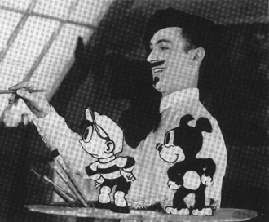
Animation in the USA 2
The First Studios

Slide 4
Animation in the USA 2
The First Studios
The Artist’s Dream (John Randolph Bray, 1913)

Slide 5
Animation in the USA 2
The First Studios
Diplodocus (John Randolph Bray, 1915)

Slide 6
Animation in the USA 2
The First Studios
Gertie on Tour (Winsor McCay, 1918-21)

Slide 7
Animation in the USA 2
The First Studios
«Since it had probably taken that long to produce The Artist’s Dream, Bray’s processes would have to be quickly perfected and streamlined. He was forced to make decisions affecting four crucial areas. First, conventional means of producing the animation units must be discarded or modified. He would implement a technique he had experimented with in The Artist’s Dream. Second, he would have to abandon individual control over production and mete out the work to assistants-in other words, establish division of labor. Third, the process should be protected by a patent. […] Fourth, improved means of distributing and marketing the product were devised».
Donald Crafton, Before Mickey. The Animated Film 1898-1928, The University of Chicago Press, Chicago, 1993, pp. 144-145.

Slide 8
Animation in the USA 2
The First Studios
Bray’s original patent used printed background, but it did not involve celluloid.
Confident in this new technique, Bray assembled his first staff of artists at 112th Street and Riverside. They ventured on the production of an animated series: “Colonel Heeza Liar” (1913-1917; 1922-1924).
Bray even produced the first animated cartoon printed in colour: The debut of Thomas Cat (1920), filmed with the Brewster two-colours process. (Actually, some stop-motion animation printed in colour was already featured in In Gollywoog Land, Walter R. Booth, F. Martin Thornton, 1912).
However, the true “cel” technique was patented by one of Bray’s artists: Earl Hurd (1880-1940), a young cartoonist from Kansas City

Slide 9
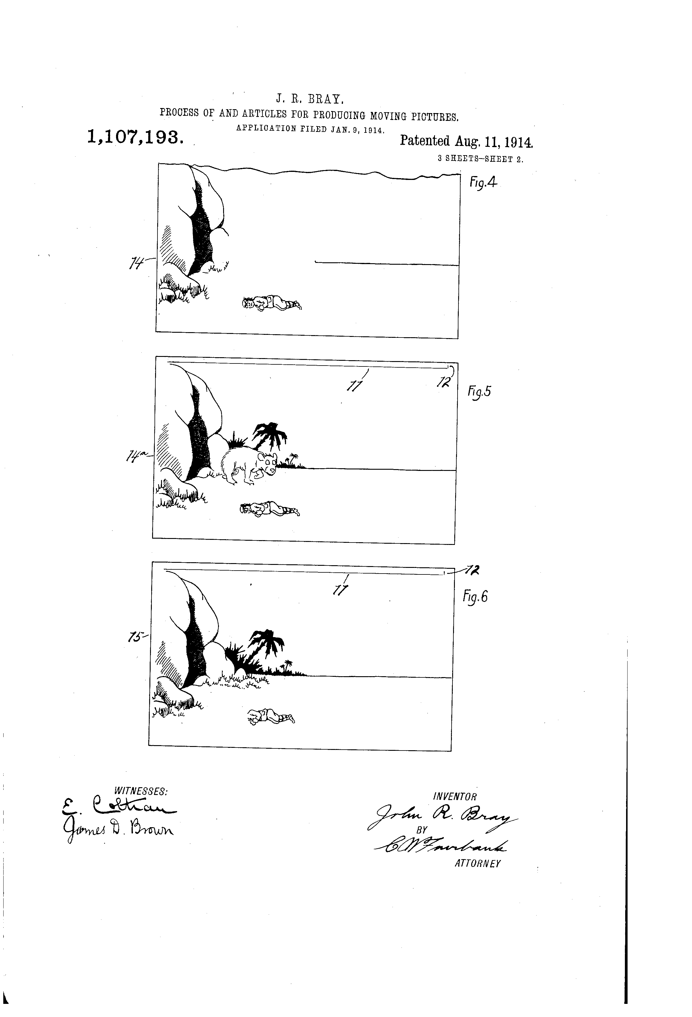
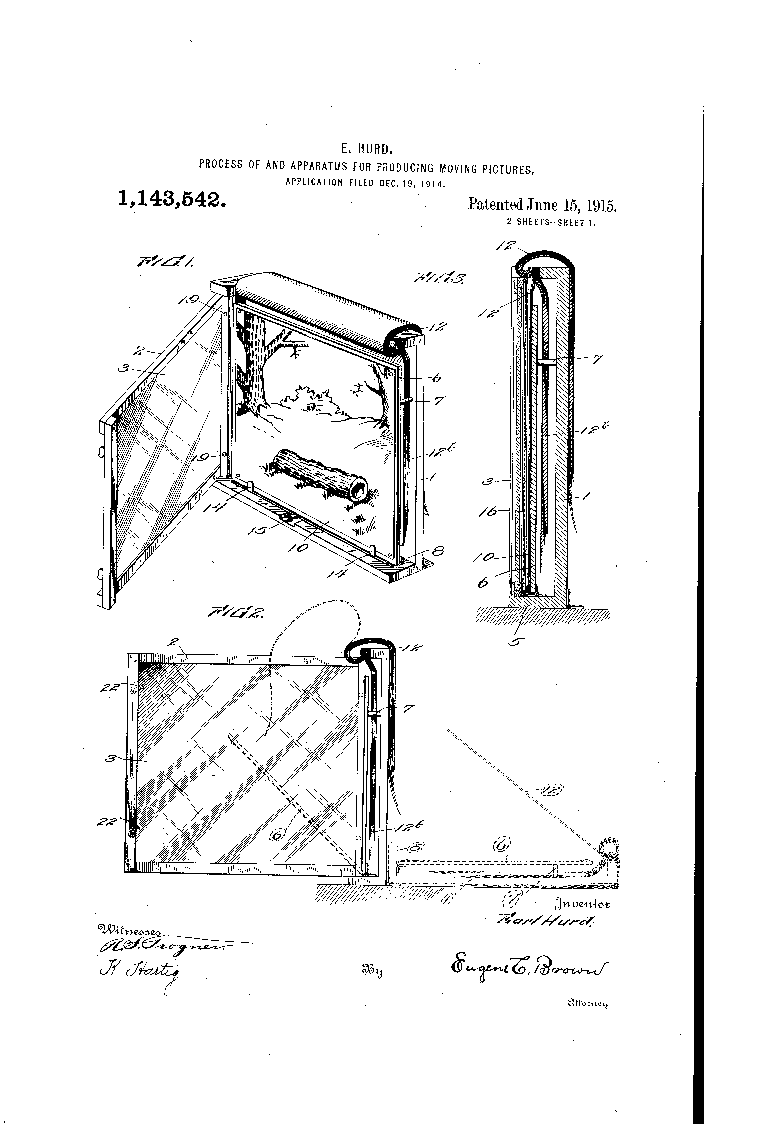
Animation in the USA 2
The First Studios

Slide 10
Animation in the USA 2
The First Studios
At their studio, Bill Nolan and Raoul Barré invented instead the “slash and tear” technique.
A part of this technique later integrated with Bray-Hurd’s patents: Barré used a punch to perforate the sheets so they could be stacked vertically in perfect alignment on fixed pins.

Slide 11
Animation in the USA 2
The First Studios
Bray and Barré’s studios were soon joined by many competitors: for example, the International Film Service (IFS, since 1915), founded by Hearst and supervised by Gregory La Cava. IFS produced animated series from the works by the whole lineup of Heart’s comic-strip cartoonists (except McCay): George McManus, George Herrimann, Tom Powers, Frederick Opper. Their most successful series was “The Katzenjammer Kids”, from the comic by Rudolph Dirks.

Slide 12
Animation in the USA 2
The First Studios
Policy and Pie (Gregory La Cava, 1918)

Slide 13
Animation in the USA 2
The First Studios
As André Martin wrote, «From 1913 on, American film animation can be compared to a boiling pot. All the movements are simultaneous, and the influences are countless. Directors and animators jump like fleas from one studio to another, from New York to Hollywood».
Some of those directors and animators would later open their own studio and become central figures of American animation.

Slide 14
Animation in the USA 2
The First Studios
Paul Terry (1887-1971): started his career at Bray studios, with eleven “Farmer Al Falfa” shorts. Champion of a proficient and profitable approach to animation, thanks to production shortcuts, he later founded a series of companies of his own (Paul Terry Productions, 1917; Fables Studios, 1920; Terrytoons, 1929). His “Aesop’s Fables” series highly influenced young Walt Disney. Later, Terry’s main cartoon “stars” became Mighty Mouse and Heckle & Jeckle.
Walter Lantz (1899-1994): he worked at IFS and then at Bray Productions. In 1927 he moved to Hollywood; one year later was hired by producer Charles B. Mintz to direct a series based on a character invented by Disney, Oswald the Lucky Rabbit. He founded the Lantz Studio in 1935. Lantz became a specialist of “funny animals” films: he created first the “Andy Panda” series (1939) and then his most famous character: Woody Woodpecker (1940).

Slide 15
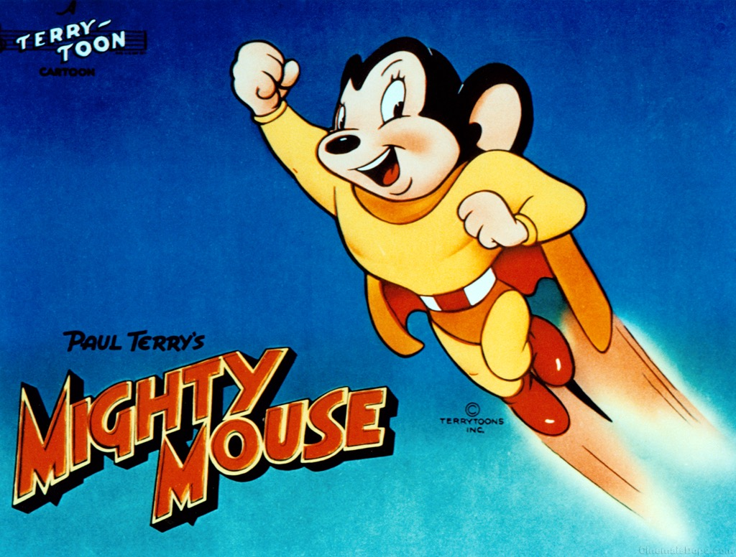
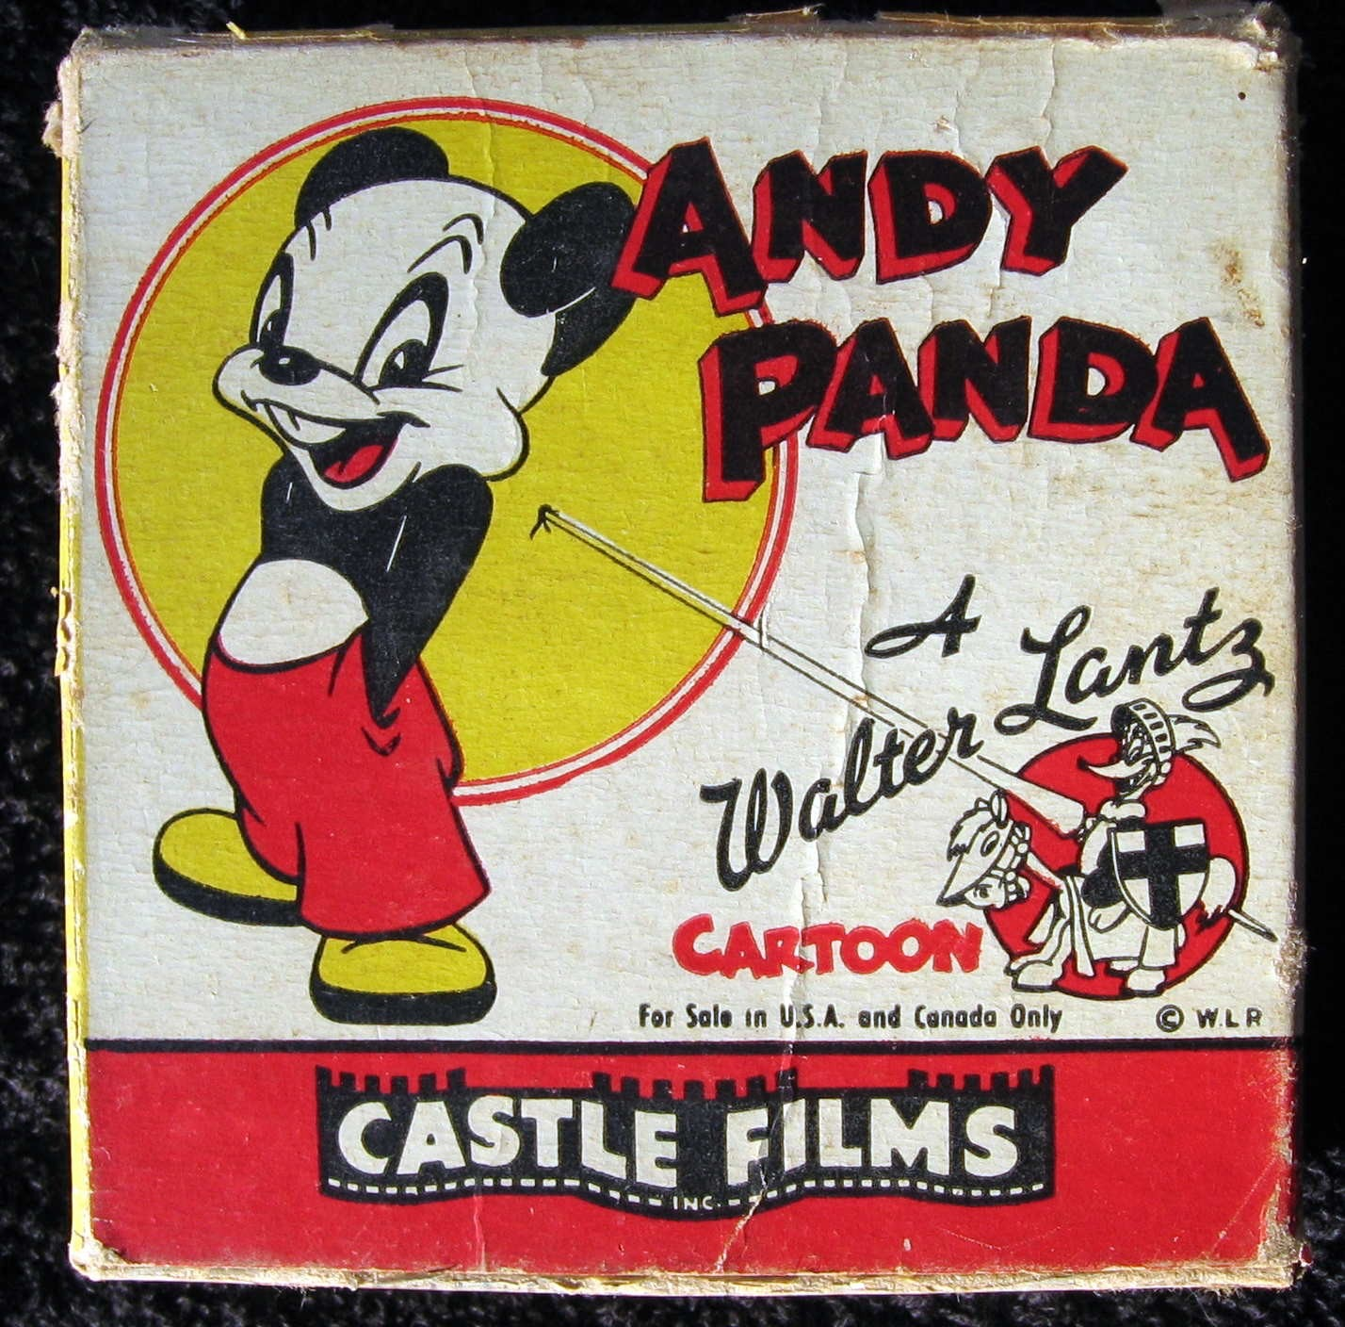
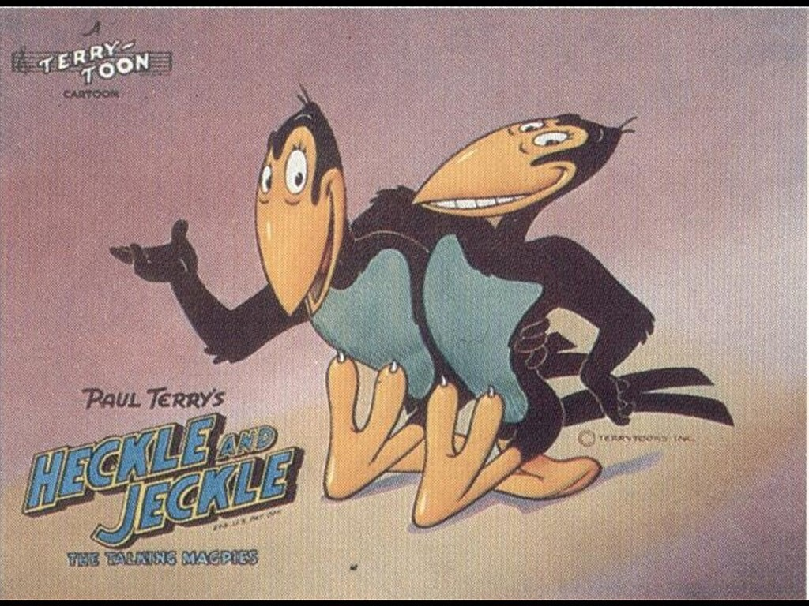
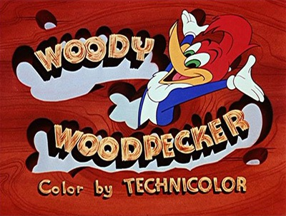
Animation in the USA 1
The First Studios

Slide 16
Animation in the USA 2
The First Studios
The quintessential cartoon of the 1920s was Felix the Cat.
A creation of Otto Messmer (1892-1983), it was cleverly produced and marketed by the Australian Pat Sullivan (1887-1933).
Messmer started his career as a part-time scene painter’s assistant at Universal. He started experimenting animation on his own. In 1915 Sullivan was at the studio to film a few of his own drawings; he soon noticed Messmer’s skills. Their combined efforts produced a quantity of successful cartoons, including the “Charlie” ones: a series based on Charlie Chaplin’s screen character.
Felix would have shared a lot with the early Chaplin: his sharp, sometimes malicious personality, and his fame: by about 1926, he was perhaps the most popular screen character, living or animated, except Chaplin himself.
Felix debuted at Paramount, in the short Feline Follies (1919). In 1922 Sullivan signed a production deal with Margaret Winkler. The advent of sound and the death of Sullivan marked the end of Felix’s success. The character was revived in the 1950s by Joe Oriolo.

Slide 17
Animation in the USA 2
The First Studios
Felix Dines and Pines (Otto Messmer, 1927)

Slide 18
Animation in the USA 3
Fleischer Brothers
Max (1883-1972) and Dave (1894-1979) Fleischer were among the artists who worked at Bray Productions. They were hired after a successful test of a new animation device which would have later been patented as the rotoscope, in 1917. The test featured Dave wearing a clown suit.
That traced character would later became Ko-ko the clown, protagonist of the successful series “Out of the Inkwell” (1919).
Bray produced the series until 1921, when the Fleischer Brothers set up their own studio in New York –Out of the Inkwell, Incorporated.
Their efforts were remarkable: their success was heavily based on the “realistic” feeling of the rotoscoped animation.
The “Out of the Inkwell” series continued as “The Inkwell Imps” at Paramount (1928); later, it continued as “Talkartoons” after the conversion to sound and the advent of a new star: Betty Boop (1930-1939).

Slide 19
Animation in the USA 3
Fleischer Brothers
Comin’ Thro’ the Rye (Dick Huemer, 1926): the “Song Car-Tunes” were among the first ever animation with recorded and synchronized sound.

Slide 20
Animation in the USA 3
Fleischer Brothers
However, the Fleischer Brothers lacked the “industrial” and rational aptitude of Bray. The design of their characters tended to change from film to film, as they were assigned to different animators. Betty Boop (created with the participation of Grim Natwick, who would have later animated Snow White for Disney) was an exception.
The worst consequence of the Fleischers’ weak management of their studio (that was moved to Miami, Florida) was the big strike that hit the company during the production of their first full-length feature, Gulliver’s travels (1939). Their approach to rotoscoping looked too stiff, in comparison to Disney’s. Their invention triggered the beginning and the end of their success.
After a second full-length feature (Mr. Bug Goes to Town, 1941) and some moderately successful Superman and Popeye shorts, the studio shut down in 1942.

Slide 21
Animation in the USA 3
Fleischer Brothers
The Ouija Board (Dave Fleischer, 1920)

Slide 22
Animation in the USA 3
Fleischer Brothers
Ko-Ko Sees Spooks (Dave Fleischer, 1925)

Slide 23
Animation in the USA 3
Fleischer Brothers
Dizzy Dishes (Dave Fleischer, 1930)

Slide 24
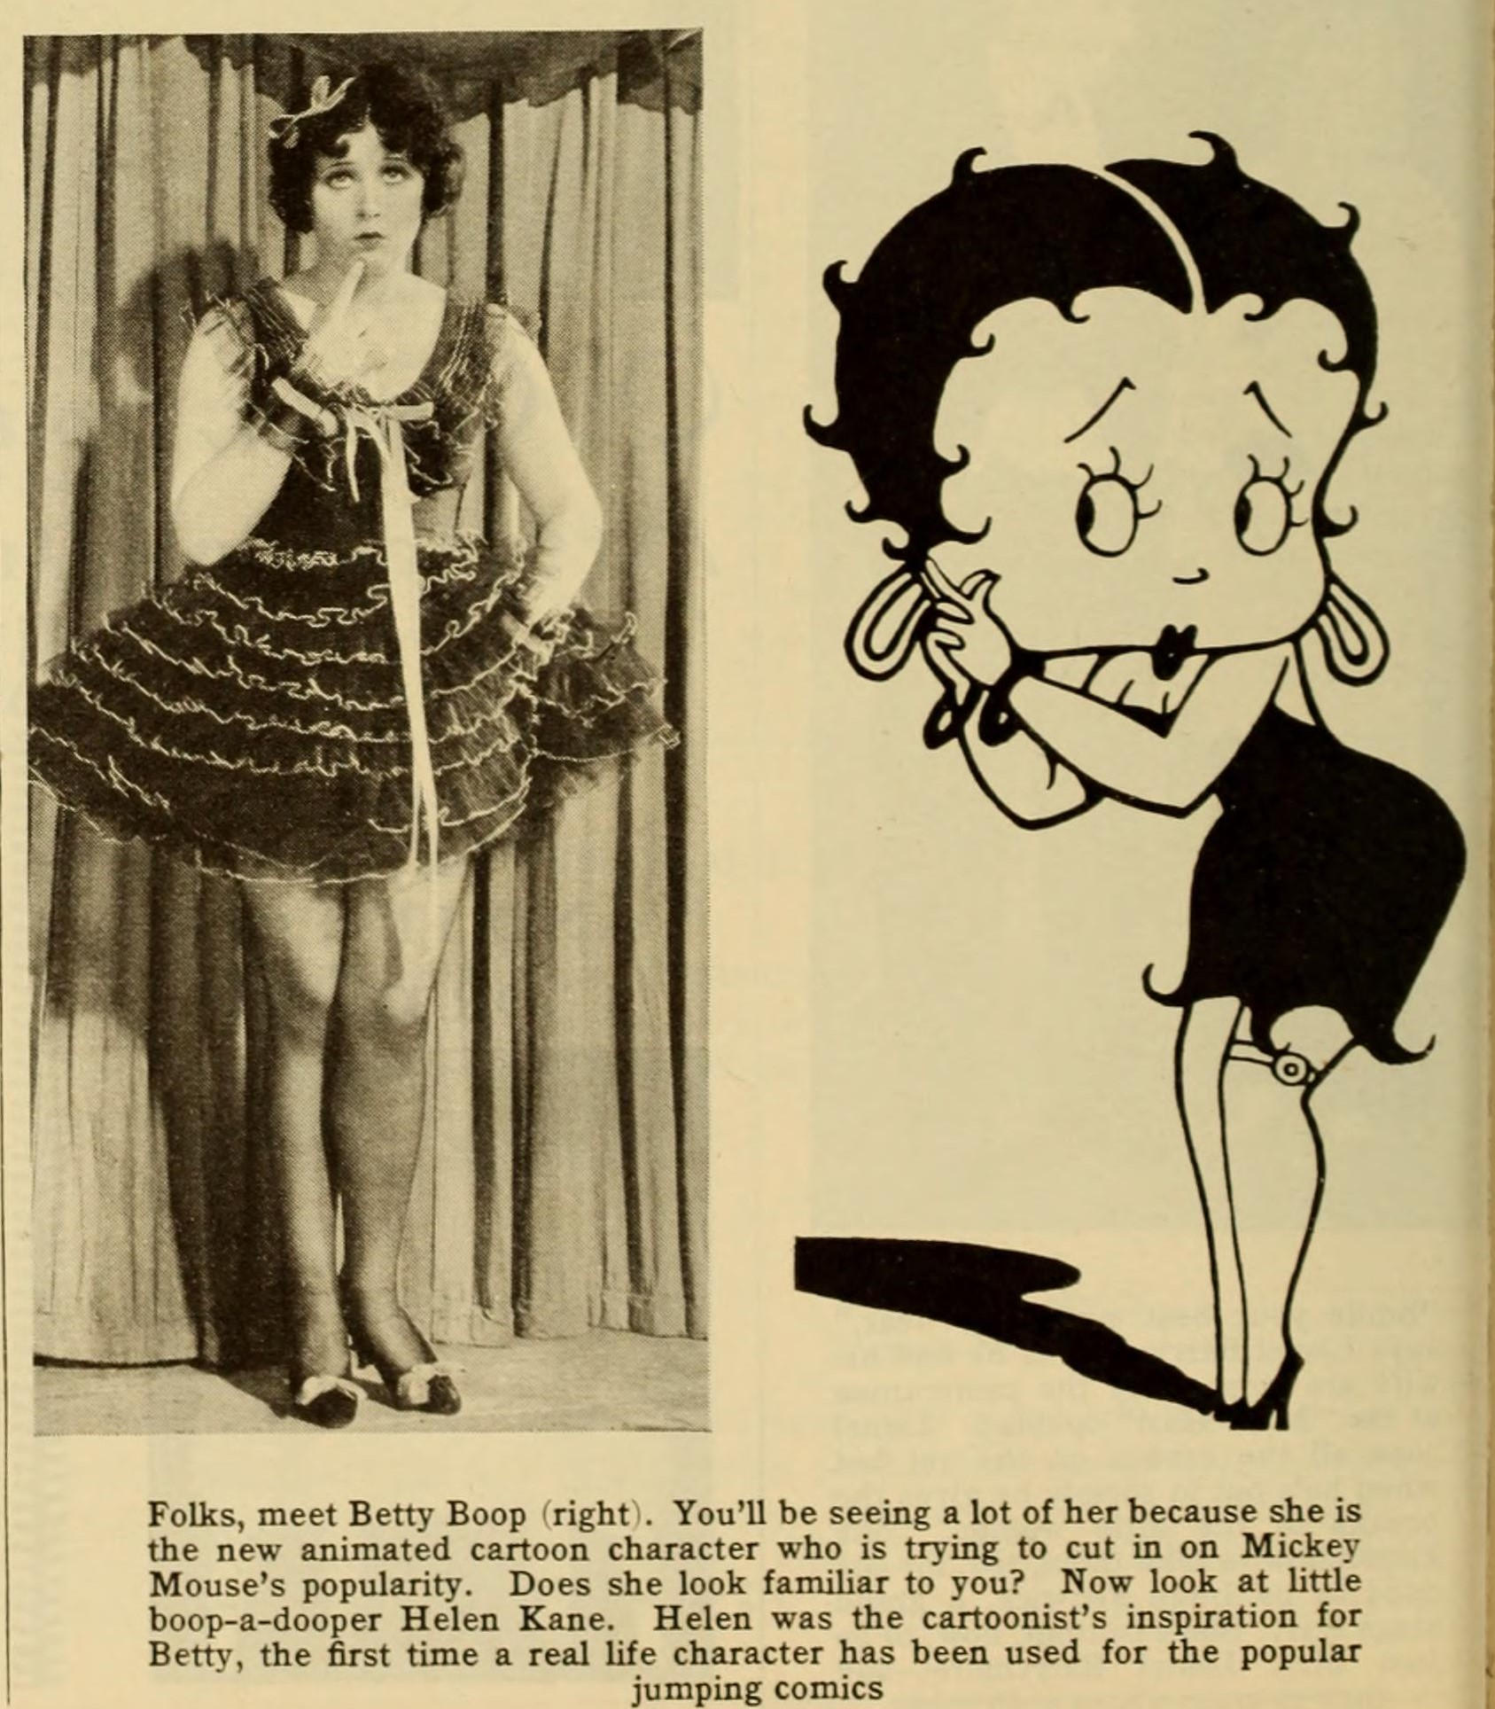
Animation in the USA 3
Fleischer Brothers

Slide 25
Animation in the USA 3
Fleischer Brothers
Boop-Oop-A-Doop (Dave Fleischer, 1932)

Slide 26
Animation in the USA 3
Fleischer Brothers
Popeye the Sailor Meets Sindbad the Sailor (Dave Fleischer, 1936)

Slide 27
Animation in the USA 3
Fleischer Brothers
The “Stereoptical” process

Slide 28
Animation in the USA 3
Fleischer Brothers
The Mechanical Monsters (Dave Fleischer, 1941)

Slide 29
Suggested readings
Donald Crafton, “Felix; or, Feline Felicity”, in Before Mickey. The Animated Film 1898-1928, The University of Chicago Press, Chicago, 1993, pp. 301-346.
Giannalberto Bendazzi, Animation. A World History. 3 voll., Waltham, Massachusetts: Focal Press, 2015. Vol. I, pp. 38-43: “Silent America I”.
Vol. I, pp. 111-118 (to study from –and including- the section “Lantz from the Rabbit to the Woodpecker”, up to –and including- the section “The Fleischers: Betty Boop, Popeye, and Two Feature Films”).

