Slide 1
Introducing Action Research to the Regina Paciso Center
Monica Fedeli
Edward Taylor

Slide 2
Action Research!
When you think of action research what comes to mind?
Examples?
Based on your experience what makes for a successful action research project?
Notes:
Ed - Slide

Slide 3
Action Research
Practitioner research
Interpreting a particular phenomenon/problem
Solving local, practical problems
Reflecting on the practices
Transforming and emancipating professionals
Examples
  A teacher exploring the impact of new education intervention
  An extension worker promoting a community development project (Merriam & Tisdell, 2015)
Notes:
Ed

Slide 4
Principles of Action Research
Focuses on a “problematic situation”
  Solve the problem
  Enhance the positive
  Improvement of practice
Action research is oriented toward some action or cycle of actions that organizational or community members …are taking… to address a particular problematic situation.” (Herr & Anderson, 2015,p. 4)
Notes:
Ed

Slide 5
Principles of Action Research
Action Research Process: Continuous spiral, emergent
  Plan – what the research/co-research (participants) are going to – first steps
  Act – implementing what is initially planned
  Observe – observe (collect data) what happened due to the action
  Reflect – think deeply about the results and what they will for the next plan of action (Kuhne & Quigley, 1997).
Notes:
Ed

Slide 6
Principles of Action Research
3. To some degree the researcher involves participants as co-investigators/researchers.
  Influencing factors
    Shared ownership
    Context
    Different phases of the study
“Active participation is the key to feelings of ownership that motivates people to invest their time and energy to help shape the nature and quality of the acts, activities and behaviors in which they engage” (Stringer, 2014, p. 31)
Notes:
Ed

Slide 7
Principles of Action Research
Researcher - Insider/Outsider
  Insider to an organization - (a teacher doing action research in her classroom)
  Collaborative researcher – (engaging a group of teachers within a school)
  Outsider – working as researcher within a community that is not your own
“Action research seeks to develop and maintain social and interpersonal interactions that are non-exploitive and enhance the social and emotional lives of all people who participate” (Stringer, 2014, p. 23).
Notes:
Ed

Slide 8
Principles of Action Research
Collect and analyze multiple forms of data
  Most use qualitative forms of data (interviews, field notes, focus groups, document analysis)
  Quantitative surveys (e.g., assessing the a community problem from the perspective of community members)
Notes:
Ed

Slide 9
Types of Action Research Designs
1. Technical action research guided by an interest to improving control over outcomes;
2. Practical action research guided by interest in education or enlightening practitioners so they can act more wisely and prudently;
3. Critical or participatory action research guided by an interest in emancipating people/groups from irrationality, unsustainability and injustice (Kemmis, McTagger, & Nixon, 2014, p. 14).
Notes:
Ed

Slide 10
Participatory action research PAR
Has a social and community orientation
Contributes to emancipation and change
Includes qualitative data collection (often)
Improves the quality of organizations, communities, and people. (Stringer, 1999)
(Creswell, 2008,p.603)
Notes:
Monica

Slide 11
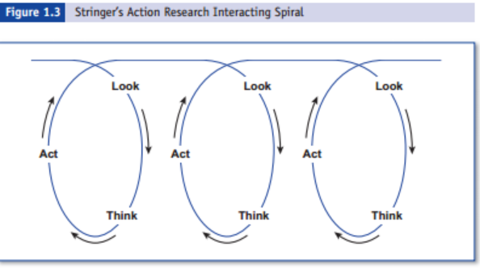
Stringer’s Action Research Plan
Notes:
Monica

Slide 12
Limitations of action research
Generalizability
Unique settings
On the margins of the academy as a research method
Tension between ownership of the group and needs of the researcher
?
?
Notes:
Ed

Slide 13
Regina Paciso Center:
Background of our Project
The educational center Regina Paciso is located in Quarto a very degraded area in Napoli
The center addressed its activities to: young people with experience in jail, or alternative penalty, children and parents living in a very poverty or disadvantaged context, people with great economic problem that need pedagogical or psychological support.
Notes:
Monica

Slide 14
Target group
Educators, Phycologists
Coordinators
Students, Childrens
Collaborative team
Parents
Administrators
Comminity stakeholdes
Notes:
Monica

Slide 15
Needs
Empower individuals through collaboration in groups
Encourage educators and advisors to reflect on their practices
Promote a process of continuing sharing and improving of practice.
Notes:
Monica

Slide 16
P.A.P.E.R - Help!
Plan an activity that introduces the idea of action research to the educators in Naples!
Goals:
  Beginning understanding action research
  Start an action research project that addresses a problem at the Regina Paciso Center
Context
    Researchers - 2 hours to observe educators work
    Researchers – 2 hour workshop
    Educators have limited English skills
    12-15 (people) Educators, Supervisors, Coordinators
Notes:
Monica

Slide 17
Each Group’s Task:
Develop an outline of a plan and schedule for the 2 hour workshop
Brief explanation of activities
Identify major challenges

Slide 18
Useful information for producers of research
Design and recognize the phases
Remember that the researcher will be the participant in his/her research project
Collect data and analyze it
Consider a full array of data-collection types (quantitative-qualitative)
Decide on the point of entry
Construct a realistic plan of action for this educational setting
(Reviewed from: Creswell, 2008, p.616)
Notes:
Monica

