Slide 1
How I used survey research design at University of Padua.
Personalizing higher education

Slide 2
Personalized learning
Personalization is a perspective, is the point of view from which we see and use the world.
Personalization is nowaday a trend in different field where bussiness is central.
We can personalize goods and services.
Governments as public providers of services could be interested in personalization to promote an education that answers needs of a society of people no more satisfied by a mass-production scheme.
Notes:
To explain what personalised learning is could require a lot of time so I’m trying just to focalize the general problem of research from which I started my work.
Personalization can be defined as a perspective or a trend because is a direction followed by people in the production and in the consume of good and services. Thanks to the use of technology the production and the distribution chains of every good and service can be flexibilized to fit the requests of customers. We can think to mobile phone where we can choose which app to install, we can think to Nike ID a web service where you can create your NIKE shoes deciding everything from the shape of the sole to the color of the stitching, or we can think to services, especially when the person establish a relationship with the provider like the Personal shopper that advise you on the latest fashion, helping you to by clothes or the health national service in which professionals, in a continue dialog with the patient, prevent him from disease.
Personalized learning could be used where normal sequences in teaching-learning dynamics are not more satisfying. for example (teacher explains/ students take notes) (students memorize/teacher ask) where the «one size fit all» education could be unefficent especially in higher education. Education as a public service could be personalized giving students resources and instruments to create the situations that help them to learn in the university, at work in the community where students live.

Slide 3
The research agenda of personalized learning
Developing a valid and reliable measure of teacher strategies for delivering effective personalized education both in and outside the classroom (Waldeck, 2006 p.350)

Slide 4
The Waldeck’s Questionnaire (2007)
Litterature revision
To know the students ( Sizer, 1989; Keefe & Jenkins 2002; Immediacy litterature)
Small class sizes (Black, 2003; Meyer, 2002)
Personalized education plans (Keefe & Jenkins 2002 Tschirhart & Wise 2002)
Collaborative classroom experience (Keefe & Jenkins 2002; Allen & Plax, 2002)
General question to a target group of student
Analysis of students’ responses to develop items
Testing the items with students

Slide 5
Group assessment
Which are your experiences in survey research?
What have you found problematic in conducting survey research?
About which steps of my Survey research design do you want to know more?
Identify the research questions or hypotheses
Identify the population, the sempling frame and the sample
Administer the Instrument
Analyze the data to address the research questions or hypotheses

Slide 6
Identify the research questions or hypotheses
Are the 3 factors of the original questionnaire (Waldeck, 2007), administered to Americans students, different from those in the Italian version of the questionnaire administered to students at University of Padua?
What is the frequency of personalized learning strategy, implemented by teachers, in the context of the University of Padua according to the perceptions of the students?
Notes:
The questions I formulated to conduct my study obviously are related to find similarity between the two questionnaire
I tried to understand if the factors discovered by waldeck could be transferred to the italian context, the frequency of the strategies realized by teachers,

Slide 7
Identify the research questions or hypotheses
Does the type of attended program (undergraduate/graduate) affect the perception of the level of Personalization for students of the University of Padua?
Does the perceived class size affect the perception of personalization for students of the University of Padua?
Does a program consistent job affect the perception of personalization in students of the University of Padua?

Slide 8
Identify the population, the sempling frame and the sample
Convenient sample
121 mail sent to program degree president
28 Courses
18 Program degree [9 Bechelor, 9 Masters (1 Ciclo Unico)]
N = 1242 students (range from 19 to 59)
M = 480 F= 748

Slide 9
Administer the Instrument
Linguistic traslation and adaptation to italian context
Pilot group
1° Pre Test
2° Pre Test
Administration
28 Courses
18 Program degree [9 Bechelor, 9 Masters (1 Ciclo Unico)]
N = 1242 students (range from 19 to 59)
M = 480 F= 748

Slide 10
Analyze the data to address the research questions or hypotheses

Slide 11
Cronbach's α to calculate item reliability of the Waldeck ‘s questionnaire in the Italian context.
1° fattore: Istructor accessibility (11 item) α di Cronbach = .91 (M=44; SD=11.7)
2° fattore: Interpersonal competence (7 item) α di Cronbach = .86 (M=24.5; SD = 4.82)
3° fattore: Course-related practice (9 item) α di Cronbach = .89 (M= 20.3; SD = 2.94)
1° fattore: Istructor accessibility (7 item) α di Cronbach = .72 (M=28.08; SD=10.4)
2° fattore: Interpersonal competence (5 item) α di Cronbach = .77 (M = 23.8; SD = 6.98)
3° fattore: Course-related practice (8 item) α di Cronbach = .79 (M = 30.3; SD = 11.46)

Slide 12
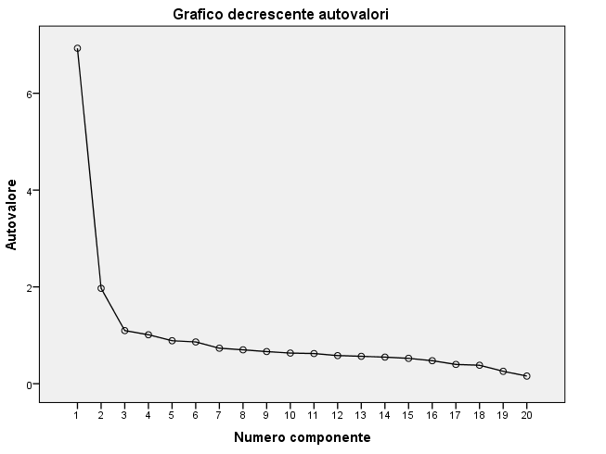
Factor analysis to calculate the presence of different factors from those of Waldeck.
Two factor solution that account for 49% of the variance
1° fattore: Interpersonal competence (7 item) α di Cronbach = .88 (M=36.4; SD=10.4)
2° fattore: Course-related practice (9 item) α di Cronbach = .78 (M= 32.9; SD = 12.27)

Slide 13
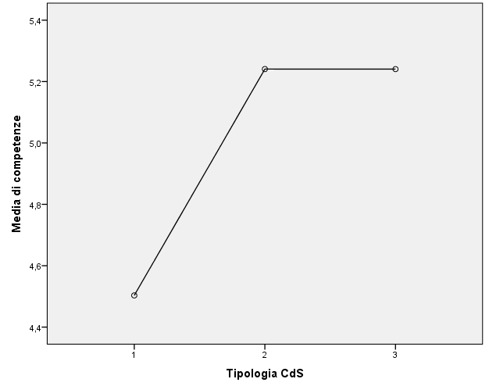
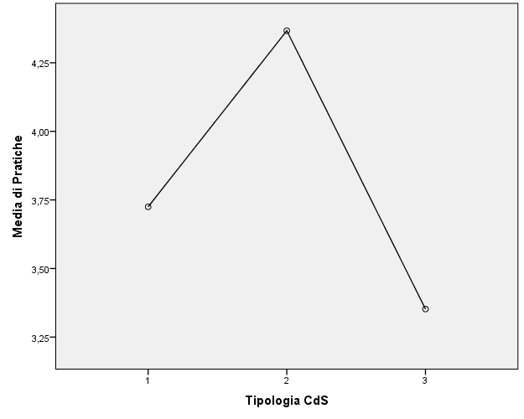
One Way Anova between groups to calculate a statistical significant difference in the mean of score for each factors among distinct groups by type of Program degree.

Slide 14
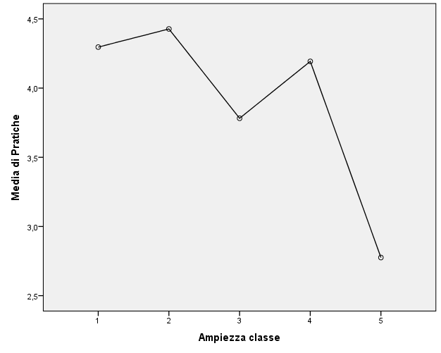
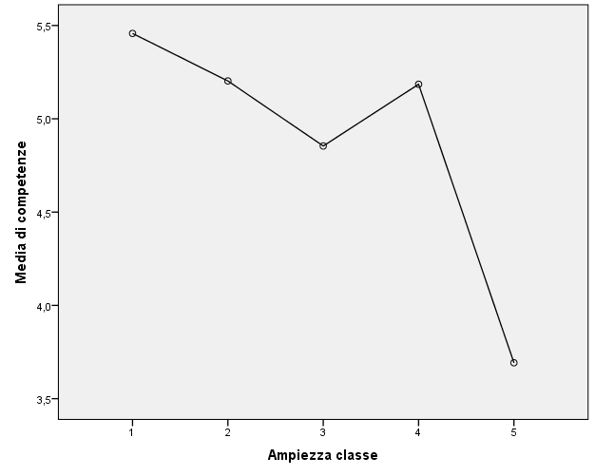
One Way Anova between groups to calculate statistical significant difference in the mean of score for each factors among distinct groups for perceived class size.

Slide 15
T-test for independent samples to calculate statistical significant difference in the mean of score for each factors among distinct groups for working/not working students
 | Work | N | Mean | Deviazione std.
Course related practice | Yes | 110 | 4,8 | 1,368
 | No | 794 | 3,65 | 1,386
Interpersonal competence | Yes | 110 | 5,11 | 1,094
 | No | 794 | 4,71 | 1,428

Slide 16
Group assessment
Ask for clarification, in depth analysis, concerns, rebuttal points etc…
What I need to study now…

