Slide 1
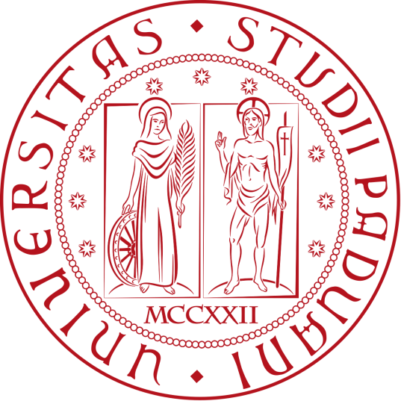
Marvels and Monstrosity
Representations of the Eastern Body in Wonders of the East and Alexander’s Letter to Aristotle
Lucrezia Scarpa
1242319

Slide 2
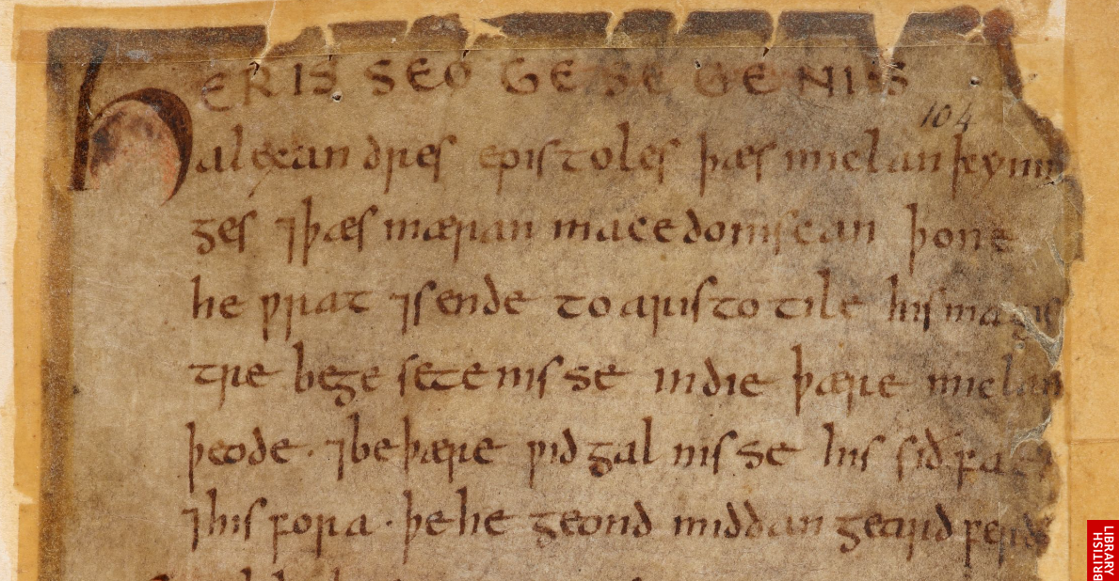
The Manuscript
London, British Library, MS Cotton Vitellius A.xv
Southwick Codex
Nowell Codex
Alexander’s Letter to Aristotle

Slide 3
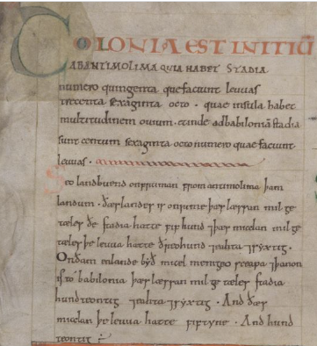
Sources
Both Wonders of the East and Alexander’s Letter to Aristotle are translations from Latin sources
London, British Library, MS Cotton Tiberius B.v, 78v

Slide 4
Geographical areas
India and Arabia
Britannia

Slide 5
Alexander the great and the east

Slide 6
Representation of the Eastern Body
Representation of the Other as a way to determine the Self through opposition
but
Two different kinds of representation:
alterity as monstrosity
alterity as marvel and almost deity

Slide 7
Monstrosity
Monstrosity as something that goes against Creation and against the divine order of the world
Two kinds of monstrosity:
Blurred boundaries between the animal reign and the human reign
Humans not shaped on God’s shape

Slide 8
Half human and half animal
§12. Ciconia in Gallia hatte þet land þær beoð men acenned þreosellices hiwes, þara heafda beoð gemona swa leona heafdo, and hi beoð twentiges fota lange and hig habbað micelne muð swa fann. […] Þas beoð menn gewenede.
- Wonders of the East
There is a land called Ciconia in Gallia, where people are born of three colours, whose heads have manes like lions’ heads, and they are twenty feet tall, and have mouths as big as fans. [...] They are thought to be men.
(translation by Andy Orchard)

Slide 9
Half human and half animal
§ 17. […] 7 þær beoð kende Homodubii þæt byð twylice. Hi beoþ oð ðene nafelan on menniscum gescape 7 syððan on eoseles gescape; hi habbað long sceancan swa fugelas 7 liðelice stefne. Gyf hi hwylcne mon on ðam landum ongitað oððe geseoð þonne feorriað hi 7 fleoð.
- Wonders of the East
There are born there Homodubii, that is ‘doubtful ones’. They have a human shape to the navel and below that the shape of a donkey, and they have long legs like birds, and a soft voice. If they see or perceive anyone in those lands, they run far off and flee.
(translation by Andy Orchard)

Slide 10
Half human and half animal
§ 27. Đonne sindon oðre wif ða habbað eoferes tucxas 7 feax oð helan side, 7 on lendenum oxan tægl. Þa wif syndon ðreotyne fota lange 7 heora lic bið on marmorstanes hwitnysse. 7 hi habbað olfenda fet 7 eoferes teð. For heora unclennesse hie gefelde wurdon fram ðam mycclan macedoniscan Alexandre. Þa he hi lifiende gefon ne mihte, þa acwealde he hi for ðam hi syndon æwisce on lichoman 7 unweorðe.
- Wonders of the East
Then there are other women who have boar’s tusks and hair down to their heels and ox-tails on their loins. Those women are thirteen feet tall and their bodies are of the whiteness of marble. And they have camel’s feet and boar’s teeth. Because of their uncleanness they were killed by Alexander the Great of Macedon. He killed them because he could not capture them alive, because they have offensive and disgusting bodies.
(translation by Andy Orchard)

Slide 11
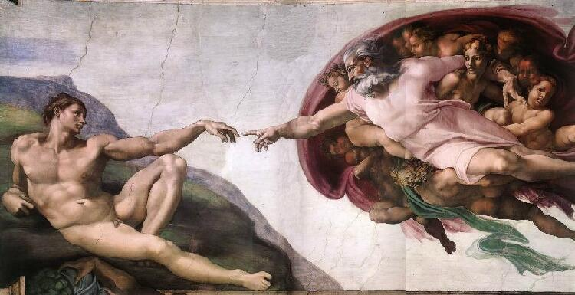
So God created mankind in his own image, in the image of God he created them; male and female he created them.
- Genesis, 1:27

Slide 12
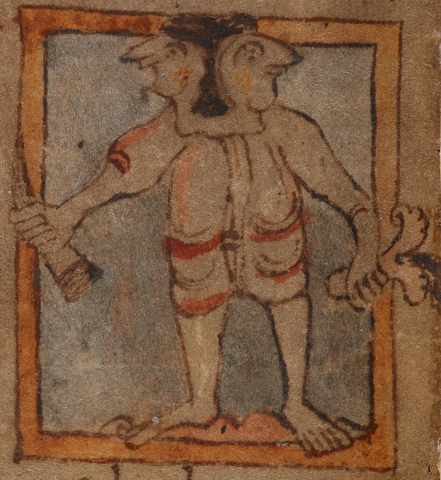
Not in His own image
§ 11. Đær beoð akende men, ða beoð fiftyne fota lange 7 hi habbað hwit lic 7 tu neb on anum heafde, fet 7 cneowu swiðe read, 7 lange nosu 7 sweart feax. [...]
- Wonders of the East
There are people born there, who are fifteen feet tall and have white bodies and two faces on a single head, feet and knees very red, and long noses and black hair.
(translation by Andy Orchard)

Slide 13
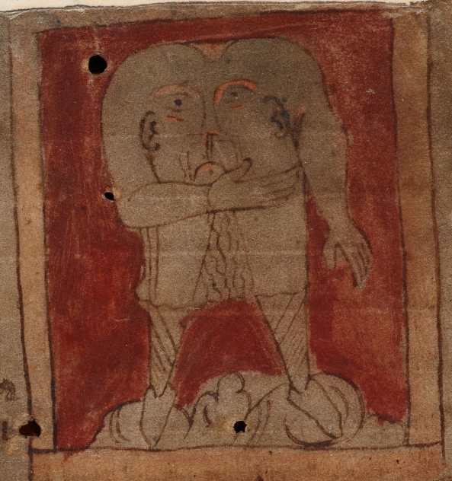
Not in His own image
§ 15. Đonne is oðer ealand suð fram Brixonte on þam beoð menn akende butan heafdum, þa habbaþ on heora breostum heora eagan 7 muð. Hi syndan eahta fota lange 7 eahta fota brade.
- Wonders of the East
Then there is another island, south of the Brixontes, on which there are born men without heads who have their eyes and mouth in their chests. They are eight feet tall and eight feet wide.
(translation by Andy Orchard)

Slide 14
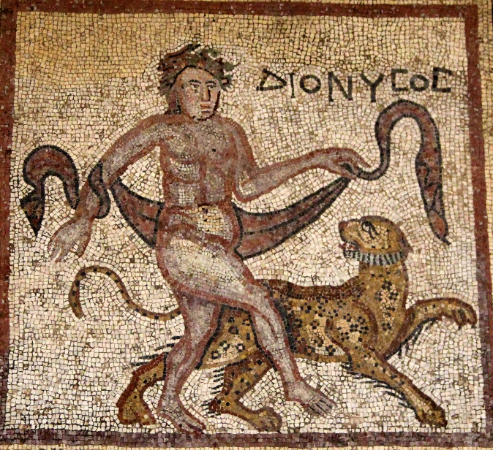
Marvels
East as the reign of the sacred
= in Greek mythology, Dionysius is an Eastern god
= the Earthly Paradise is located in the East
+ East as a place of mystery and magic

Slide 15
The cave of the God
§ 31 . [...] Swelce eac þa miclan 7 þa mæron dune we gesawon þa mon hateð Enesios 7 þæt scræf Libri þæs godes. Đa het ic þær in bescufan forworhte men þæt ic wolde gewitan hweþer sio segen soð wære þe me mon ær be þon sægde, þæt þær nænig mon ingan mehte 7 eft gesund æfter þon beon nymþe he mid asegendnisseum ineode in þæt scræf. 7 þæt wæs eac æfter þon gecyðed in þara monna deaðe, for þon ðy þriddan dæge hie swulton ðæs þe hie in [117r] þæt scræf eodon. [...]
- Alexander’s Letter to Aristotle
And we also saw the high and famous mountain which is called Enesios, and the cave of the god Bacchus. Then I ordered condemned men to be pushed in because I wanted to know whether the tradition was true that I had been told, that no one could enter and emerge afterwards unscathed unless he entered the cave with offerings. And that was afterwards made clear by the men’s death, for they perished on the third day after they had entered the cave.
(translation by Andy Orchard)

Slide 16
The Trees of the Moon and the Sun
§36 [...] Đa sægde se bisceop þæt þær næfre in þæm londum regnes dropa ne cwome ne fugel ne wildeor, ne nænig ætern wyrm þæt her dorste gesecean ða halgan gemæro sunnan 7 monan. Eac þonne he sægde se bisceop þonne þæt eclypsis wære þæt is þonne ðas sunnan asprungnis oðþe þære monan, þæt ða halgan triow swiðe wepen 7 mid micle sare onstyred wæron, for þon hie ondredon þæt hie hiora godmægne sceoldon beon benumene. [...]
- Alexander’s Letter to Aristotle
Then the bishop said that no drop of rain ever came in that land, nor bird, nor wild beast, nor did any poisonous serpent dare to seek out the holy precincts of the Sun and the Moon. The bishop also said that during an eclipse, that is a waning of the Sun or Moon, the holy trees wept greatly, and were stirred with great sorrow, for they feared that their divine power would be taken.
(translation by Andy Orchard)

Slide 17
The bisceop
§ 35. [...] Wæs he se bisceop .X. fota upheah, 7 eall him wæs se lichoma sweart buton þæm toþum ða wæron hwite. 7 earan him þurh þyrelode, 7 earhringas onhongedon of mænigfealdan gimcynne geworhte, 7 he wæs mid wildeora fellum gegerwed. [...]
§ 39. [...] Hæfde se bisceop þreo hund wintra on yldo.
- Alexander’s Letter to Aristotle
The bishop was ten feet tall (more or less 3 metres) and his entire body was black, except his teeth were white. and his ears were pierced through, and ear-rings hung down made of many kinds of jewels, and he was dressed in the skins of wild animals.
The bishop was three hundred years old.
(translation by Andy Orchard)

Slide 18
A different magical force
§ 20. Đonne is sum ealand on ðære Readan Sæ, þær is moncynn þæt is mid us Donestre genemned, þa syndon geweaxene swa frihteras fram ðan heafde oð ðone nafelan, 7 se oðer dæl byð mannes lice gelic. 7 hi cunnon eall mennisc gereord. Þonne hi fremdes kynnes mann geseoð, ðonne næmnað hi hine 7 his magas cuðra manna naman, 7 mid leaslicum wordum hine beswicað, 7 him onfoð, 7 þænne æfter þan hi hine fretað ealne butan his heafde 7 þonne sittað 7 wepað ofer ðam heafde.
- Wonders of the East

Slide 20
Then there is an island in the Red Sea where there is a race of people we call Donestre, who have grown like soothsayers from the head to the navel, and the other part is human. And they know all human speech. When they see someone from a foreign country, they name him and his kinsmen with the name of acquaintance, and with lying words they beguile him and capture him, and after that eat him all up except for the head, and then sit and weep over the head.
(translation by Andy Orchard)

Slide 21
Conclusion
East as the place of the Other
= Other both as a monstrous entity and a divine force
BUT
Even if the East represents a sort of singularity, a place where magical forces can be expressed, still its wilderness has relative power and, in the end, can be tamed by the Western gaze
= first hints of later Orientalism

Slide 22
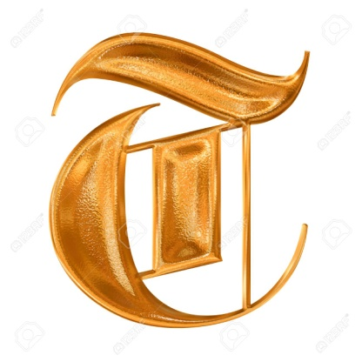
hank you for your attention

Slide 23
References
Campbell, Mary B., The Witness and the Other World: Exotic European Travel Writing, 400-1600, New York: Cornell University Press, 1988, pp. 47-86.
Godden, Malcom and Lapidge, Michael, The Cambridge Companion to Old English Literature, Cambridge: Cambridge University Press, 2013, pp. 74-80
Heide, Estes, “Wonders and Wisdom: Anglo-Saxons and the East”, English Studies, Vol. 91 No.4 (2010), pp. 360-373.
Mittman, Asa S., “Are the ‘monstrous races’ races?”, Postmedieval: a Journal of Medieval Cultural Studies, Vol. 6 No.1 (2015), pp. 36–51.
Orchard, Andy, Pride and Prodigies: Studies in the Monsters of the Beowulf-Manuscript, Cambridge: D.S. Brewer, 1995.
Pick, Lucy K., “Edward Said, Orientalism and the Middle Ages”, Medieval Encounters, Vol. 5 No. 3 (1999), pp. 265-271.
Rypins, Stanley, Three Old English Prose Texts in Ms. Cotton Vitellius A. Xv, London: Oxford University Press, 1924.
Said, Edward W., Orientalismo, Milano: Feltrinelli, 2019.
Wang, I-Chun, “Alexander the Great, Prester John, Strabo of Amasia, and Wonders of the East”, CLCWeb: Comparative Literature and Culture, Vol. 14 No. 5 (2012).

