Slide 1
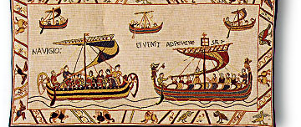
The Seafarer and the elegiac genre
by Matteo Zampiva

Slide 2
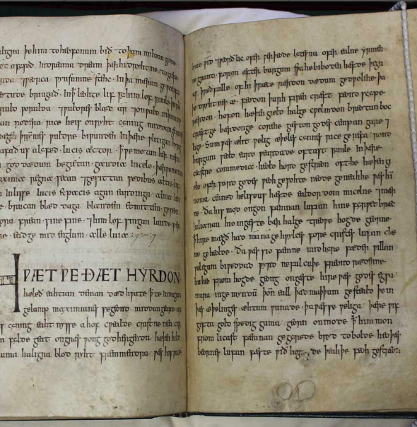
The Exeter Book or codex exoniensis (MS 3501)
One of the four fundamental codices of Old English poetry: MS Junius 11 (Oxford, Bodleian Library); Vercelli Book (Vercelli, Biblioteca Capitolare di Vercelli); Cotton Vitellius (London, British Library).
The codex was created in the second half of 10th century, probably by a single scriber.
However, it is unknown whether it was written in Exeter or elsewhere. Today it is held by the Library of the Dean and Chapter of Exeter Cathedral.

Slide 3
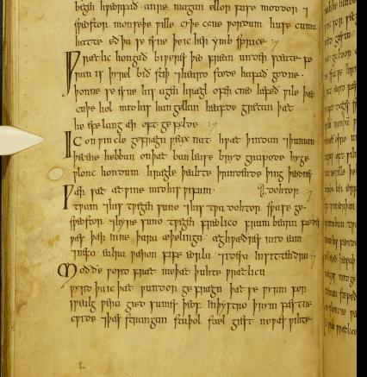
The EB has neither illuminations nor rubrics and the parchment is of low quality. There are only few capital letters with no decorations. The codex also contains some dry point images. It is anyway a fairly elegant manuscript written in square minuscule.

Slide 4
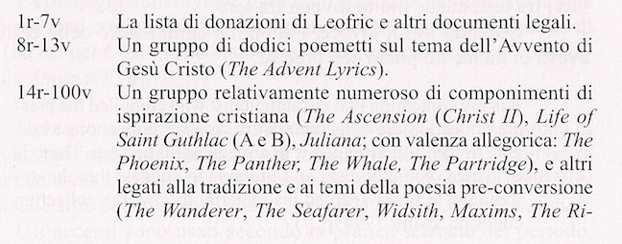
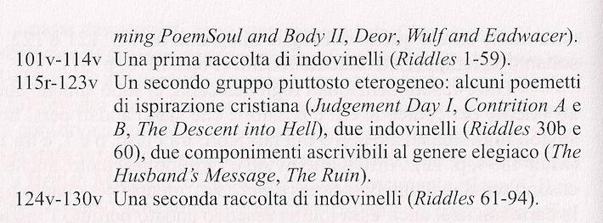
The EB contains a miscellany of different texts, of both Christian and pre-Christian traditions.

Slide 5
The Seafarer
The Seafarer is a lyrical poem in 124 verses.
The poem starts with the voice of a sailor who tells us his experiences out at sea and the sufferings he had to bear while on his journeys. The poet makes us aware of his physical sufferings, in fact he had to go through cold winters, and consequently the spiritual hardships he had to cope with.
Then he introduces a comparison between his wretched status and the comfortable and joyful status of the man on land. The man living on the land has in fact all the comforts he needs, he is together with his fellows and can enjoy the conviviality of the hall.

Slide 6
MÆG ic be mē sylfum sōđgien wrecan, I may tell a true story about myself,
sīÞan secgan, hū geswincdagum (I can tell) of my journeys, and how I suffered
earfođhwīle oft Þrōwade, in days of toil and in times of hardships.
bitre brēostceare gebiden hæbbe, I have endured bitter heart-care, (and I) have
5 Gecunnad in cēole cearselda fela, experienced in the keel [i.e. ship] many
atol ȳÞa gewealc. dwellings of sorrow (and) the terrible surging
of the waves.
(my translation)

Slide 7
Calde geÞrungen My feet were pinched by cold, fettered by
wæron mīne fēt, forste gebunden frost and climbed by cold; there the anxieties
10 caldum clommum, Þær Þā ceare seofedun sighed hot around my heart. Hunger rent the
hat ymb heortan. Hungor innan slāt sea-weary mind from within. This, the man
merewērges mōd. Þæt se mon ne wāt does not know, whom it happens most
Þe him on foldan fægrost limpeđ, pleasantly on earth; (he doesn’t know) how I,
hū ic earmcearig iscealdne sæ wretched, inhabited the ice-cold sea in winter,
15 winter wunade wræccan lāstum, in the paths of exile, bereft of my kinsfolk,
winemægum bidroren, hang about with icicles; hail in showers flew.
bihongen hrīmgicelum; hægl scūrum flæg.

Slide 8
19b Hwīlum ylfete song At times I took a swan’s song as my
dyde ic mē tō gomene, ganetes hleoÞor entertainment and the cry of the gannet
on huilpan swag fore hleahtor wera, and the sound of the curlew for the laughter
māw singende fore medodrince. of men; the singing seagull for my
mead-drinking.
27 ForÞon him gelyfeđ lyt, sē Þe āh līfes wyn Therefore, he little believes, he who
gebiden in burgum bealosiÞa hwōn, experienced life’s pleasures in the towns,
wlonc ond wīngal, hū ic wērig oft (he that had) few bitter experiences, (who is)
in brimlāde bīdan sceolde. Haughty and wanton with wine, how I had to
remain often weary in the ocean-path.

Slide 9
BUT… from line 34 the poem changes in its tone
34 ForÞon cnyssađ nū Therefore, my thoughts are now pressing
heortan geþohtas þæt ic hean streamas, in my heart for me to self-experience the
sealtyþa gelac sylf cunnige. deep currents, the tumult of the salty waves.
monað modes lust mæla gehwylce Within my mind the desire urges time and
ferð to feran, þæt ic feor heonan again to set out the spirit and seek out the land
elþeodigra eard gesece. of foreigners, far from here.

Slide 10
44 Ne biþ him to hearpan hyge ne to hringþege, His thought is not for harping, nor
ne to wife wyn ne to worulde hyht, for ring-receiving, nor for woman’s
ne ymbe owiht elles, nefne ymb yða gewealc; pleasure, not in hope of the world,
nor for anything else, except for the thrash of waves.

Slide 11
58 Forþon nu min hyge hweorfeð ofer hreþerlocan, Therefore, now my spirit turns out
min modsefa mid mereflode, of my breast, my mind soars wide
ofer hwæles eþel hweorfeð wide, over the whale’s home with the ocean
eorþan sceatas cymeð eft to me tide, over the regions of the earth, and
62 gifre ond grædig; gielleđ ānfloga, then it comes back to me avid and hweteđ on wælweg hreÞer unwearnum greedy; the solitary bird
ofer holma gelagu. irresistibly incites the heart to the whale’s path, over the sea’s expanses.
Scholars seem to agree on the fact that lines from 64b to 124 are not part of the original poem, but were added later, possibly by the scribe who wrote it in the Exeter Book. In this last part, in fact, the text is completely different in mood.

Slide 12
The interpolator tries to convince us that hātran sind Dryhtnes drēamas (the joys of God are more inspiring), and hence we should not go after earthly riches and fame, because they will be useless after we die.
The interpolator develops his discourse around the themes of man’s caducity and God’s perfection.
69 ær his tiddege to tweon weorþeð: One of the three things among sickness, old age or
adl oþþe yldo oþþe ecghete sword-violence always becomes a matter of doubt,
fægum fromweardum feorh oðþringeð. before his final day, for the man who is fated to die.

Slide 13
117 Uton we hycgan hwær we ham agen, Let us consider where we have a home,
ond þonne geþencan hu we þider cumen; and then think how we should come tither;
ond we þonne eac tilien þæt we to moten and then we should all strive that we might
in þa ecan eadignesse go to eternal blessedness.
Marsden (2014): at the basis of The Seafarer is St. Augustine of Hippo’s theology of the two cities (De Civitate Dei, V c.).
He interprets seafaring as a wretched business with the function of challenging the Christian man on earth, whereas the abrupt change of mood from line 34 introduces the blessed city of God. However, the desire of the lyrical I to reach the city of God is clearly stated in the interpolated part.
The Seafarer would be an exhortatory or didactic poem.

Slide 14
MAY THE SEAFARER BE DEPICTED AS AN ELEGY OR NOT?
The Anglo-Saxon elegy:
Ruggerini (2019): “Se invece il personaggio che lamenta una disgrazia contingente rivolgendo lo sguardo a tempi più felici è maschile, egli si descriverà come un esule, costretto a viaggiare in ambienti ostili e pericolosi, separato dalla comunità di appartenenza; oppure piangerà la morte traumatica di un caro congiunto, in specie di un proprio figlio, o di un maestro.”

Slide 15
Often alone, always at daybreak
I must lament my cares; not one remains alive
to whom I could utter the thoughts in my heart,
tell him my sorrows.
(The Wanderer, 8-11; translation: Alfred David)
I may tell a true story about myself,
(I can tell) of my journeys, and how I suffered
in days of toil and in times of hardships.
(The Seafarer, 1-3; my translation)

Slide 16
The protagonist of the poem describes himself with the words merewērge, earmcearig and he was in wræccan lāstum, winemægum bidroren.
FROM LINE 34: can an elegy change from a negative condition of tristitia to a positive mood?
Ruggerini (2019: 58): il lamento può non trovare sbocco, oppure – come si diceva – stemperarsi in una visione consolatoria e universale, tradotta negli stilemi della poesia gnomica e omiletica.

Slide 17
So said the wise man as he sat in meditation.
A good man holds his words back, tells his woes not too soon,
baring his inner heart before knowing the best way,
an eorl who acts with courage. All shall be well for him who seeks grace,
help from our Father in heaven where a fortress stands for us all.
(The Wanderer, 111-15; translation by Alfred David)

Slide 18
The earth was bound with frost, hail fell on earth,
The coldest of grains.
(The Seafarer, 32-33; my translation)
Therefore, the thoughts in my heart
Are now pressing me to self-experience the deep currents,
The tumult of the salty waves.
(The Seafarer, 34-36; my translation)

Slide 19
Boer (Lawrence 1902: 463) maintained that forÞon is essential in enlightening an interpolation, because in fact from now on the text contradicts with what comes before.
Lawrence (1902: 463), instead, tends to understand it as “so” in modern English: it connects two ideas notwithstanding their logical result.
Many critics in the past argued that the poem is a dialogue between an old sailor and a youth. This hypothesis is dismissed by modern critics, who tend to read the poem as a soliloquy.
His thought is not in harping, nor for ring-receiving,
Nor for woman’s pleasure, nor in hope of the world,
Nor for anything else, except for the thrash of waves.
(The Seafarer, 45-47; my translation)

Slide 20
Therefore, now my spirit journeys beyond my breast,
my mind with the ocean tide
over the whale’s home journeys wide,
over the regions of the earth, (then) comes again to me
avid and greedy; the solitary bird
irresistibly incites the heart to the whale’s path,
over the sea’s expanses.
(The Seafarer, 58-64b; my translation)

Slide 21
Lawrence (1902: 467): there are three main ideas in the poet’s mind
a. the hardships involving seafaring.
b. the fascination of the sea for those who have sailed upon it.
c. men on land cannot realize the hardships of seafaring.
Ideas a. and b. are antithetic but give greater power to the poem.
The poem ends with the seafarer attracted by the sea, but there is neither an unresolved lament nor a consolatory and universal ending like we have it in The Wanderer. The poem just ends with a contradiction.

Slide 22
CONCLUSIONS:
Scholars agree on the fact that the passage from line 64b to the end was added later by another poet. If considered entirely, the text can be depicted as a didactic poem (Marsden’s interpretation).
Even though from 1 to 64a there are typical elements of the elegiac mood - like the language, a lyrical I talking about a personal sorrowful experience, the exile, the wandering in dangerous places – the seafarer is telling us of his past journeys and we cannot infer his current condition.
Notwithstanding the vivid description of the wretchedness of seafaring, from line 34 the man desires to experience it again: the paradox between the two parts of the poem is difficult to explain.
The end of the poem does not resolve the contradiction created before.
Considering Ruggerini’s definition of elegy, The Seafarer does not seem to comply with the genre.

Slide 23
THANK YOU
FOR YOUR
ATTENTION!

Slide 24
BIBLIOGRAPHY:
Alexander M., The Earliest English Poems, Middlesex, Penguin Boks,1986.
Ruggerini M. E., “Aspetti Lessicali Combinatori nelle Elegie Anglosassoni: il Dominio del Dolore” in La Lettura del Codex Exoniensis: le Elegie Anglosassoni, Alessandria, Edizioni dell’Orso, 2018.
Marsden R., The Cambridge Old English Reader, Cambridge, Cambridge University Press, 2014.
Rosselli Del Turco R., “Il Manoscritto e le Edizioni dell’Exeter Book” in La Lettura del Codex Exoniensis, Alessandria, Edizioni dell’Orso, 2018.
Lawrence W. W., “The Wanderer and The Seafarer” in The Journal of Germanic Philology vol. 4, Illinois, University of Illinois Press, 1902, pp. 460-480.
Greenblatt S., The Norton Anthology of English Literature (10th edition), vol. A “The Middle Ages” ed. by Simpson J., New York, Norton & Company, 2018.

Slide 25
SITOGRAPHY:
British Library https://www.bl.uk/collection-items/exeter-book# [accessed in November 2020]
Bosworth Toller’s Anglo-Saxon Dictionary https://bosworthtoller.com/ [accessed in November and December 2020]

