Slide 1
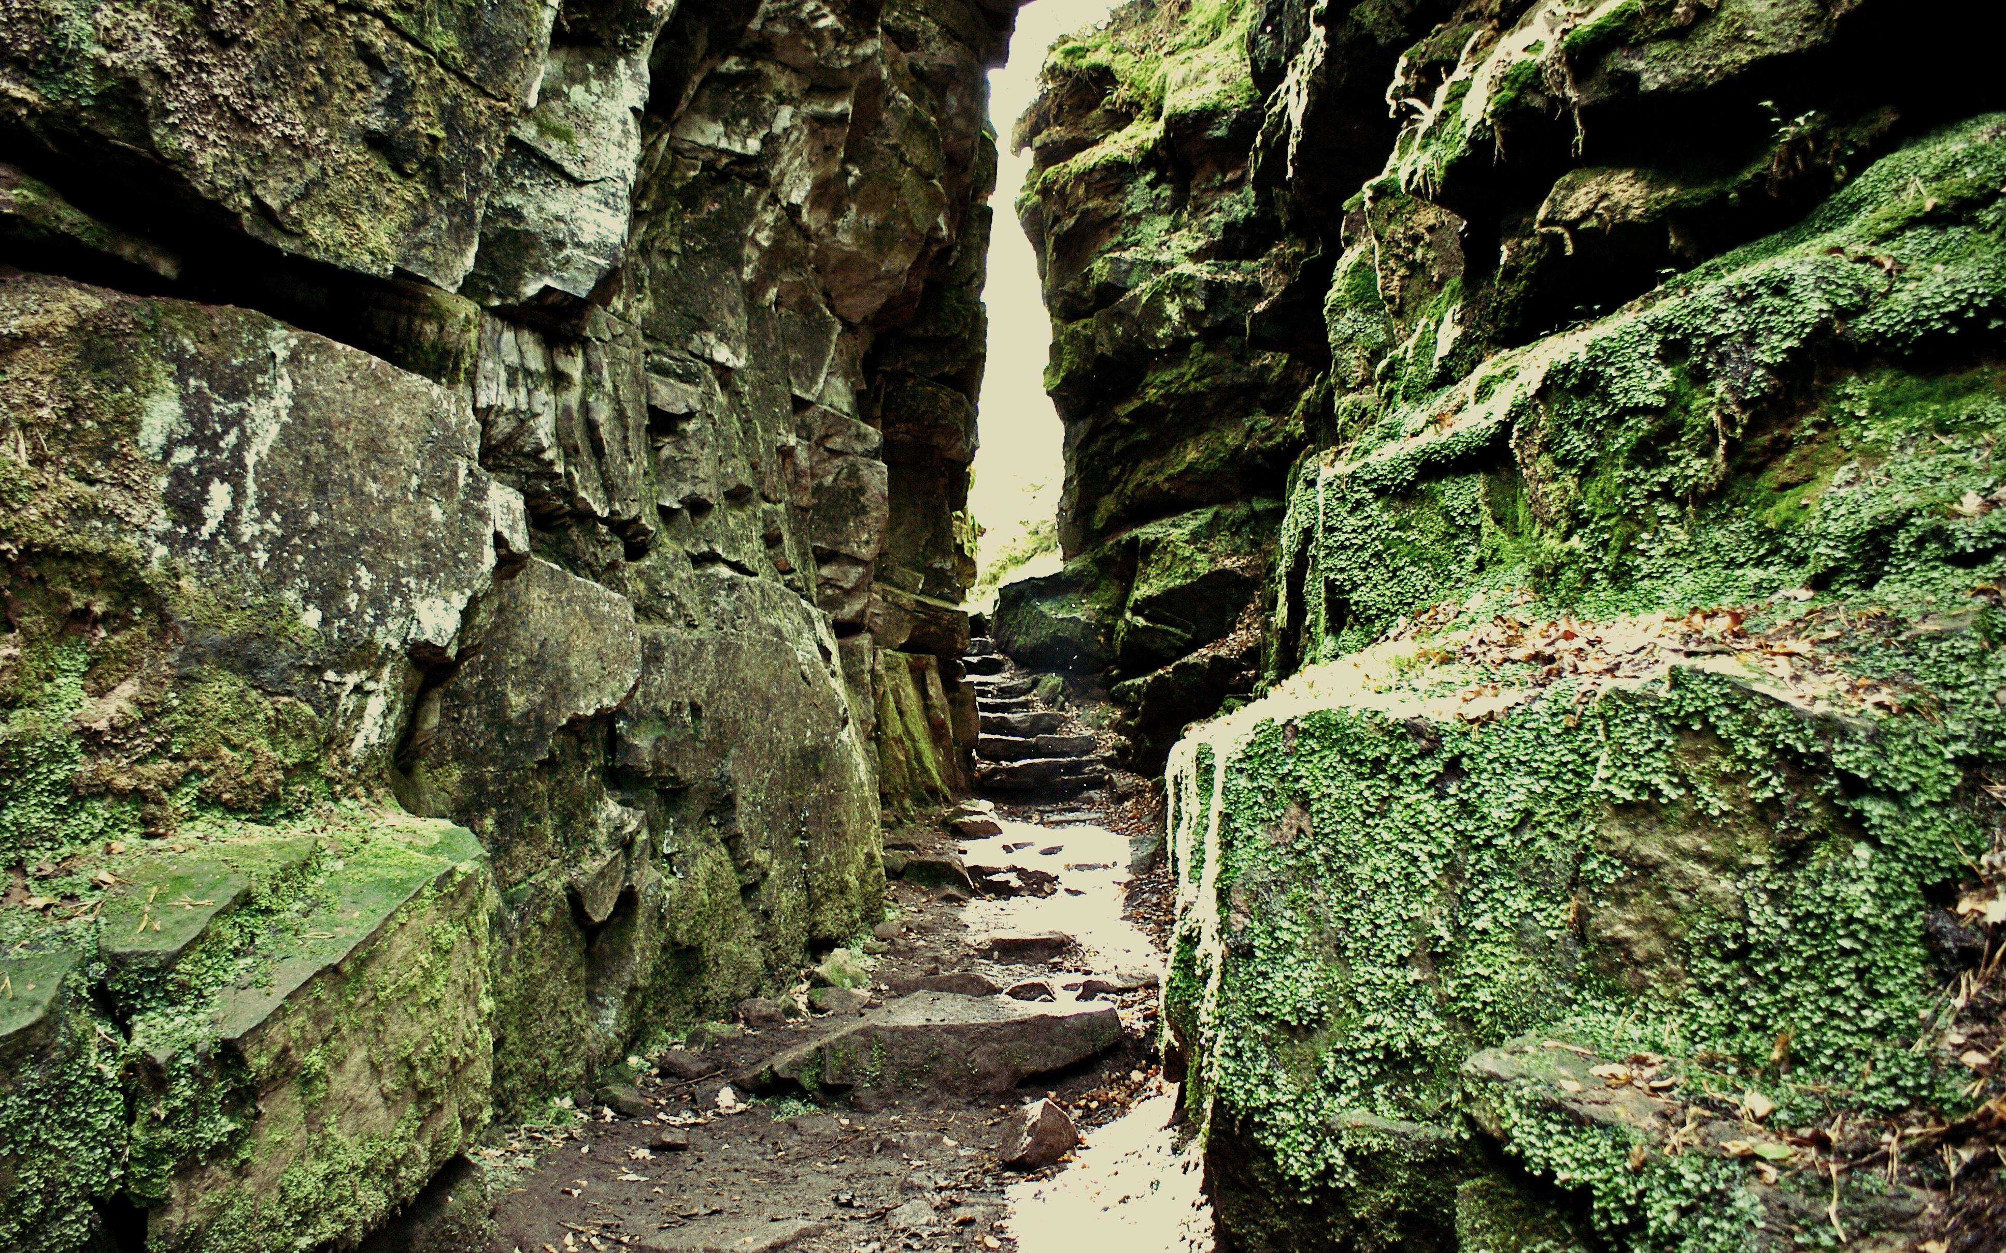
Sibilla Siano
Filologia del Testo Medievale Inglese
sibilla.siano@phd.unipd.it
Wandering the Wilderness: Echoes of the Old English Elegies in Sir Gawain and the Green Knight

Slide 2
COTTON MS NERO A X/2
Cotton MS Nero A X/2 – general information
The manuscript is composed of four texts presumably by the same author (whose identity remains unknown)
Pearl (dream vision), Patience and Cleanness (homiletic texts), and SGGK (Arthurian romance)
Codex unicus
Only surviving manuscript entirely consisting of alliterative poetry in ME

Slide 3
COTTON MS NERO A X/2
Cotton MS Nero A X/2 – general information
The dialect evidence allows the identification of the area of composition with Cheshire or Staffordshire
Script: textura rotunda with some features of anglicana
Date of creation: 1375 – 1425
Patron unknown

Slide 4
SIR GAWAIN AND
THE GREEN KNIGHT
Sir Gawain and the Green Knight
Text divided in stanzas of irregular length with additional bob-and-wheel lines rhyming ABABA at the end of each stanza
Synopsis:

Slide 5
SIR GAWAIN AND
THE GREEN KNIGHT
First stanza
SIÞEN þe sege and þe assaut watz sesed at Troye,
Þe borȝ brittened and brent to brondeȝ and askez,
Þe tulk þat þe trammes of tresoun þer wroȝt
Watz tried for his tricherie, þe trewest on erthe:
Hit watz Ennias þe athel, and his highe kynde,
Þat siþen depreced prouinces, and patrounes bicome
Welneȝe of al þe wele in þe west iles.
Fro riche Romulus to Rome ricchis hym swyþe,
With gret bobbaunce þat burȝe he biges vpon fyrst,
And neuenes hit his aune nome, as hit now hat;
Tirius to Tuskan and teldes bigynnes,
Langaberde in Lumbardie lyftes vp homes,
And fer ouer þe French flod Felix Brutus
On mony bonkkes ful brode Bretayn he settez
wyth wynne,
Where werre and wrake and wonder
Bi syþez hatz wont þerinne,
And oft boþe blysse and blunder
Ful skete hatz skyfted synne. (ll. 1-19)
Alliterating long lines
Bob-and-wheel

Slide 6
THE REPRESENTATION OF THE NATURAL WORLD
The meter of SGGK
The unrhymed alliterative long line in Middle English consists of two verses or half-lines divided by a caesura
Each verse may have two or three lifts (stresses) and one to four (dips)
X | / | X | X | / | X | X | / | X | X | /
Þe | tulk | þat | þe | tram | mes | of | tre | soun | þer | wroȝt

Slide 7
THE REPRESENTATION OF THE NATURAL WORLD
The representation of the natural world in Sir Gawain and the Green Knight

Slide 8
THE REPRESENTATION OF THE NATURAL WORLD
The natural world in traditional Arthurian romances
Functional to the story
Meeting the audience’s expectations
Never a threat
Crowded with stereotyped, conventional foes (giants, dragons, wodwoes)

Slide 9
THE REPRESENTATION OF THE NATURAL WORLD
E.g. Chrétien de Troyes, Yvain ou Le Chevalier au Lion
Mes sire Yvains ne sejorna
Puis qu'armes fu ne tant ne qant,
Einçois erra chascun jor tant,
Par montaignes et par valees
Et par forez longues et lees,
Par leus estranges et salvages,
Si passa mainz felons passages
Et maint peril et maint destroit,
Tant qu'il vint au santier estroit
Plain de ronces et d'oscurtez.
Et lors fu il asseürez
Qu'il ne pooit mes esgarer. (ll. 760-71)

Slide 10
THE REPRESENTATION OF THE NATURAL WORLD
At the beginning of Gawain’s quest, the author similarly describes his encounters in the wilderness.
So mony meruayl bi mount þer þe mon fyndez,
Hit were to tore for to telle of þe tenþe dole.
Sumwhyle wyth wormez he werrez, and with wolues als,
Sumwhyle wyth wodwos, þat woned in þe knarrez,
Boþe wyth bullez and berez, and borez oþerquyle,
And etaynez, þat hym anelede of þe heȝe felle;
Nade he ben duȝty and dryȝe, and Dryȝtyn had serued,
Douteles he hade ben ded and dreped ful ofte. (ll. 718-25)

Slide 11
THE REPRESENTATION OF THE NATURAL WORLD
However, the author dismisses this traditional material in only a few lines and paints with brushstrokes of realism a threatening wintry landscape.
‘For werre wrathed hym not so much þat wynter nas wors’ (l. 726)
This line marks the threshold between a natural landscape sketched by drawing on traditional Arthurian romances and a real natural world, seriously capable of endangering Gawain’s life.

Slide 12
THE REPRESENTATION OF THE NATURAL WORLD
As soon as the audience crosses this threshold alongside their hero, the natural world is depicted as increasingly threatening, though increasingly realistic at the same time.
The forest is presented as a self-standing character;
The natural landscape fails to fulfil the audience’s expectations;
The weather is presented as the real enemy.

Slide 13
THE REPRESENTATION OF THE NATURAL WORLD
…however,
the role of nature does not appear to be restricted to that of a mere foe, but rather ranges from proper enemy to an instrument to strengthen the hero’s faith.
→ constant ambiguity at the very heart of the poem.

Slide 14
THE REPRESENTATION OF THE NATURAL WORLD
Although the description of nature is somehow indebted to standard Arthurian romances, it also reveals a significant degree of unusualness by simultaneously drawing on multiple cultural traditions.
Old English Elegies;
Popular folklore;
Celtic and Norse legends.

Slide 15
THE INFLUENCE OF
OLD ENGLISH ELEGIES
The revival of the alliterative verse
In order to convey an almost realistic description of the wintry weather, the Gawain-poet makes use of the evocative power of alliteration, reminiscent of Old English poetry, and recreates before the audience’s eyes the sound of the wailing wind slashing the bare rocks.
When þe colde cler water fro þe cloudez schadde,
And fres er hit falle myȝt to þe fale erþe;
Ner slayn wyth þe slete he sleped in his yrnes
Mo nyȝtez þen innoghe in naked rokkez,
Þer as claterande fro þe crest þe colde borne rennez,
And henged heȝe ouer his hede in hard iisse-ikkles.
(ll. 727-32)

Slide 16
THE INFLUENCE OF
OLD ENGLISH ELEGIES
The description of the frozen landscape seems to be remarkably more inspired by the Old English alliterative tradition of The Wanderer or of The Seafarer, rather than by courtly romances.
The wind holds centre stage
The miserable condition of the anhaga
Ubi sunt theme

Slide 17
THE INFLUENCE OF
OLD ENGLISH ELEGIES
The description of the wind
ond þas stanhleoþu | stormas cnyssað,
hrið hreosende | hrusan bindeð,
wintres woma, | þonne won cymeð,
(The Wanderer, ll. 101-3)
NOW neȝez þe Nw Ȝere, and þe nyȝt passez,
Þe day dryuez to þe derk, as Dryȝtyn biddez;
Bot wylde wederez of þe worlde wakned þeroute,
Clowdes kesten kenly þe colde to þe erþe,
Wyth nyȝe innoghe of þe norþe, þe naked to tene;
Þe snawe snitered ful snart, þat snayped þe wylde;
Þe werbelande wynde wapped fro þe hyȝe,
And drof vche dale ful of dryftes ful grete.
Þe leude lystened ful wel þat leȝ in his bedde,
(ll. 1998-2006)

Slide 18
THE INFLUENCE OF
OLD ENGLISH ELEGIES
The wind has changed its symbolic value.
In Sir Gawain and the Green Knight, the image of the wind beating the castle walls echoes that of the wilderness trying to gain room to civilised castles, whereas in the OE elegies, it is a symbol of decay and transience of earthly things.
Þe wallez were wel arayed,
Hit dut no wyndez blaste.
(ll. 783-4)
swa nu missenlice | geond þisne middangeard
winde biwaune | weallas stondaþ,
hrime bihrorene, | hryðge þa ederas;
(The Wanderer, ll. 75-7)

Slide 19
THE INFLUENCE OF
POPULAR FOLKLORE
Although the chaotic wilderness is promptly transformed in the orderly creation of God by the power of Christian prayers, some elements related to popular folklore and Norse and Celtic legends are still evoked.
Bi a mounte on þe morne meryly he rydes
Into a forest ful dep, þat ferly watz wylde,
Hiȝe hillez on vche a halue, and holtwodez vnder
Of hore okez ful hoge a hundreth togeder;
Þe hasel and þe haȝþorne were harled al samen,
With roȝe raged mosse rayled aywhere,
With mony bryddez vnblyþe vpon bare twyges,
Þat pitosly þer piped for pyne of þe colde.
Þe gome vpon Gryngolet glydez hem vnder,
Þurȝ mony misy and myre, mon al hym one,
(ll. 740-9)

Slide 20
THE INFLUENCE OF
POPULAR FOLKLORE
Emergence of elements inherited from popular folklore:
Misy and myre → mires used to be surrounded by an aura of mystery and abhorrence,
berȝ → inherited from both Celtic and Norse mythology, according to which the tumuli were inhabited by hostile elfish creatures.
Further ambiguity:
the landscape appears to be still “ferly wylde” (l. 741)
Ferly = 1) exceedingly (referred to a real deep forest)
2) terribly (forest still related to the marvellous, and thus terribilis = uncanny, beyond human comprehension)

Slide 21
THE INFLUENCE OF
POPULAR FOLKLORE
The description of the natural landscape completely paralysed by ice is intertwined with elements reminiscent of popular folklore.
Þay boȝen bi bonkkez þer boȝez ar bare,
Þay clomben bi clyffez þer clengez þe colde.
Þe heuen watz vphalt, bot vgly þer-vnder;
Mist muged on þe mor, malt on þe mountez,
Vch hille hade a hatte, a myst-hakel huge.
Brokez byled and breke bi bonkkez aboute,
Schyre schaterande on schorez, þer þay doun schowued.
(ll. 2077- 83)

Slide 22
THE INFLUENCE OF
POPULAR FOLKLORE
The description of bubbling streams was almost a trope in OE literature; however, in only a few lines, the addition of a single vowel to the word byled transforms a real stream into a meruayl.
He seȝ non suche in no syde, & selly hym þoȝt, Saue a lyttel on a launde, a lawe as hit we[re], A balȝ berȝ bi a bonke þe brymme by-syde, Bi a forȝ of a flode þat ferked þare; Þe borne blubred þer-inne as hit boyled hade.
(ll. 2170-4)
De la fontaine pöez croire,
Qu'ele boloit com iaue chaude.
Li perrons ert d'une esmeraude
(Chrétien de Troyes, Yvain ou le Chevalier au Lion, ll. 422-4)

Slide 23
THE REPRESENTATION OF THE NATURAL WORLD
In conclusion, although the Gawain-poet partially draws on the romance tradition in order to depict the natural landscape, he significantly detaches himself from standard Arthurian romances, by representing it not as a mere background for his hero’s adventures, but rather as an additional character. Nature is no longer described as functional to the story, but rather as unpredictable and potentially deadly, thus capable of playing an ambiguous and particularly active role in the narrative.

Slide 24
THE REPRESENTATION OF THE NATURAL WORLD
Bibliography
Primary Sources
Sir Gawain and the Green Knight, edited by Helen Cooper, translated by Keith Harrison, New York: Oxford University Press, 2008.
The Earliest English Poems, translated and introduced by Michael Alexander, London: Penguin Books, 1991.
The Poems of the Pearl Manuscript, edited by Andrew Malcolm and Waldron Ronald, Exeter: Liverpool University Press, 2007.
The Works of the Gawain Poet, Pearl, Cleanness, Patience, Sir Gawain and the Green Knight, edited by Ad Putter and Myra Stokes, London: Penguin, 2014.
Chrétien de Troyes, The Knight with the Lion, or Yvain (Le Chevalier au Lion), edited and translated by William W. Kibler, New York: Garland Library of Middle English Literature, 1985.
Critical literature
Auerbach, Erich, Mimesis, The Representation of Reality in Western Literature (Mimesis: Dargestellte Wirklichkeit in der abendländischen Literatur), translated by Willard R. Trask, Princeton: Princeton University Press, 1953.

Slide 25
THE REPRESENTATION OF THE NATURAL WORLD
Bibliography
Barber, Richard, Edward III and the Triumph of England, London: Penguin, 2014.
Barron, W.R.J., ‘Arthurian Romance’ in Corinne Saunders ed., A Companion to Romance from Classical to Contemporary, Oxford: Blackwell, 2004, pp. 65-84.
Chiesa Isnardi, Gianna, I Miti Nordici, Milano: Longanesi, 1991.
Dean, Christopher, ‘“Weal Wundrum Heah, Wyrmlicum Fah” and the Narrative Background of “The Wanderer”’, Modern Philology, 63 (1965), pp. 141-3.
Hanscom, Elizabeth Deering, ‘The Feeling for Nature in Old English Poetry’, The Journal of English and Germanic Philology, 5 (1905), pp. 439-63.
Klinck, Anne L., The Old English Elegies, A Critical Edition and Genre Study, Montreal: McGill-Queen 's University Press, 1992.
Martinez, Ann M., ‘Bertilak’s Green Vision: Land Stewardship in Sir Gawain and the Green Knight’, Arthuriana, 26 (2016), pp. 114-29.
Putter, Ad, Sir Gawain and the Green Knight and the French Arthurian Romance, Oxford: Clarendon Press, 1995.

Slide 26
THE REPRESENTATION OF THE NATURAL WORLD
Bibliography
Rudd, Gillian, ‘“The Wilderness of Wirral” in Sir Gawain and the Green Knight’, Arthuriana, 23 (2013), pp. 52-65.
Saunders, Corinne, The Forest of Medieval Romance: Avernus, Broceliande, Arden, Cambridge: Boydell and Brewer, 1993.
Online sources
Middle English Dictionary https://quod.lib.umich.edu/m/middle-english-dictionary/dictionary [accessed on 08/10/2019]
Cheshire Wildforest Trust, https://www.wirralwildlife.org.uk/thornton-wood [accessed on 06/12/2019]

Slide 27
Sibilla Siano
Filologia del Testo Medievale Inglese
sibilla.siano@phd.unipd.it
Thank you!

